Slide 1
Why markers
Signoff power/IR emits markers for IR drop and EM hits
learn_power — 03 power markers
Notes:
Signoff power/IR emits markers for IR drop and EM hits.

Slide 2
The idea
GOLDEN: marker_count=4
learn_power — 03 power markers
Notes:
GOLDEN: marker_count=4.

Slide 3
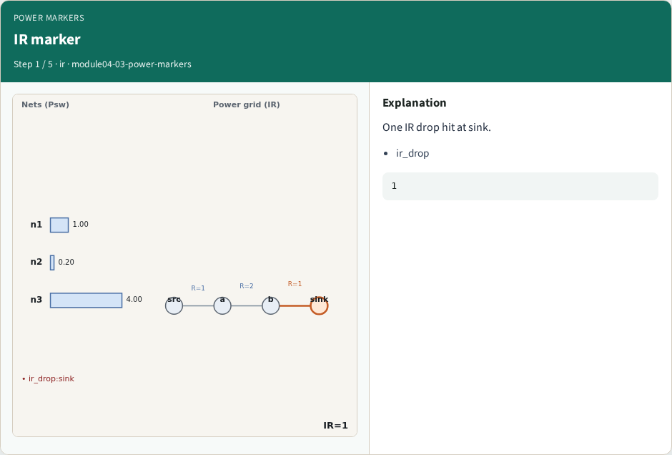
IR marker
IR marker
learn_power — 03 power markers
Notes:
One IR drop hit at sink.

Slide 4
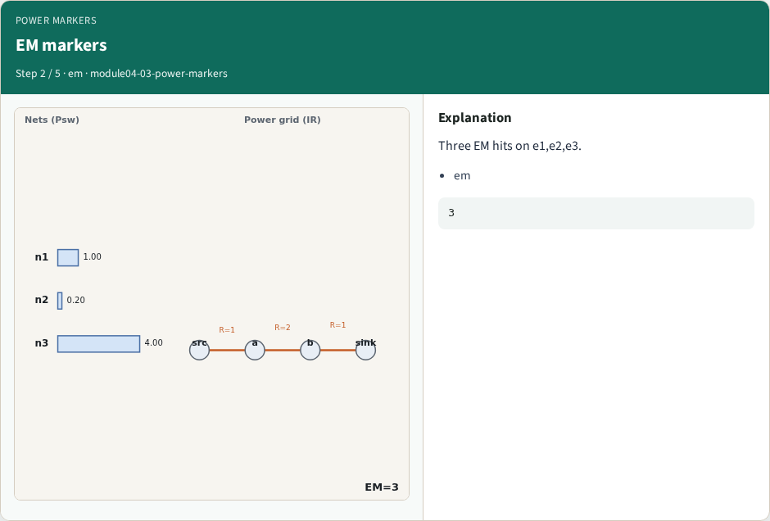
EM markers
EM markers
learn_power — 03 power markers
Notes:
Three EM hits on e1,e2,e3.

Slide 5
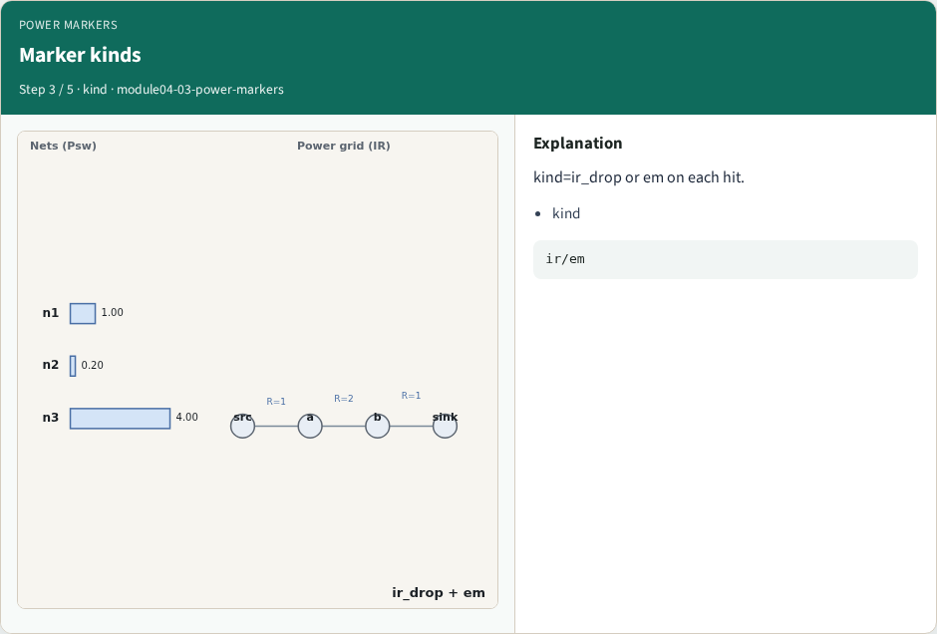
Marker kinds
Marker kinds
learn_power — 03 power markers
Notes:
kind=ir_drop or em on each hit.

Slide 6
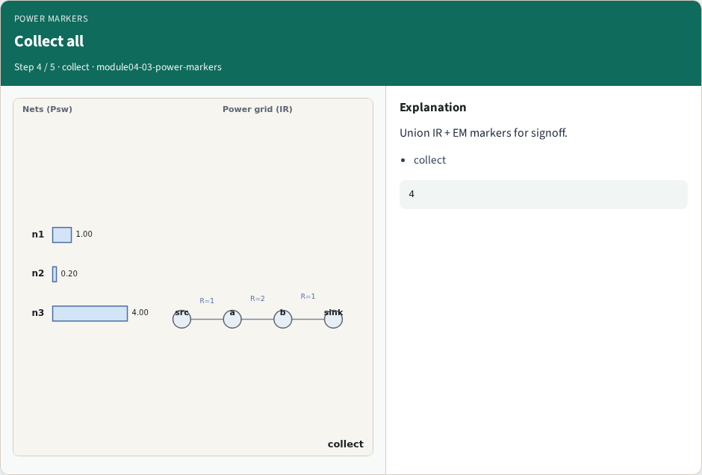
Collect all
Collect all
learn_power — 03 power markers
Notes:
Union IR + EM markers for signoff.

Slide 7
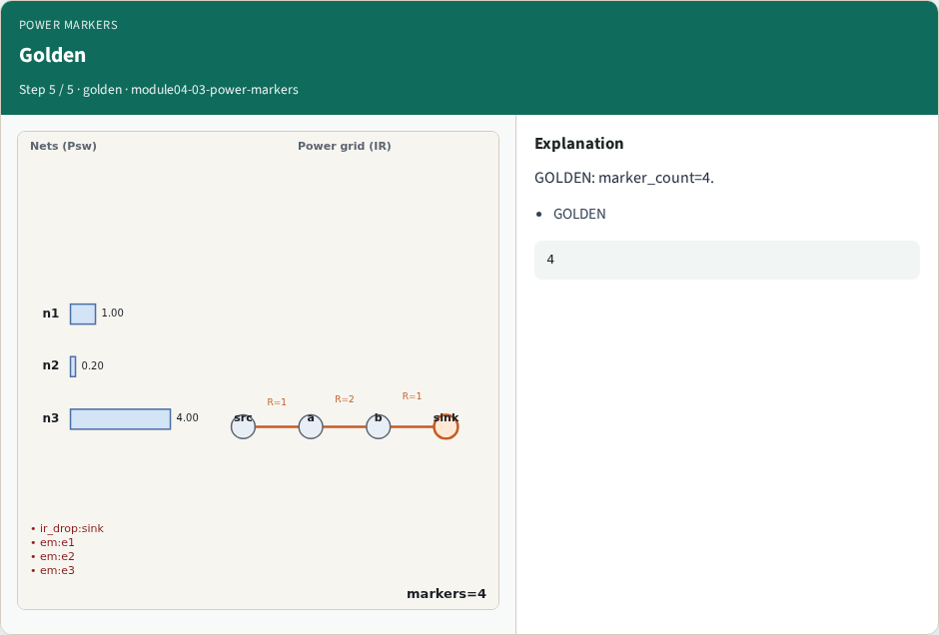
Golden
Golden
learn_power — 03 power markers
Notes:
GOLDEN: marker_count=4.

Slide 8

Browser lab track
Browser lab starter
learn_power — 03 power markers
Notes:
Open **power-markers**. Run collect; confirm 4 markers.

Slide 9
Implement track
Call collect_markers(); assert count==4
learn_power — 03 power markers
Notes:
Call collect_markers(); assert count==4.

Slide 10
Pitfalls
Counting only IR
Missing EM edges
learn_power — 03 power markers
Notes:
Counting only IR. Missing EM edges.

Slide 11
Your turn
Next: power engine
learn_power — 03 power markers
Notes:
Next: power engine.

