Slide 1
Engine
A tiny engine chains power, IR, EM, and markers
learn_power — 01 power engine
Notes:
A tiny engine chains power, IR, EM, and markers.

Slide 2
The idea
GOLDEN: chip Ptot=5.55, ir_drop=0.4, markers=4, ok=True
learn_power — 01 power engine
Notes:
GOLDEN: chip Ptot=5.55, ir_drop=0.4, markers=4, ok=True.

Slide 3
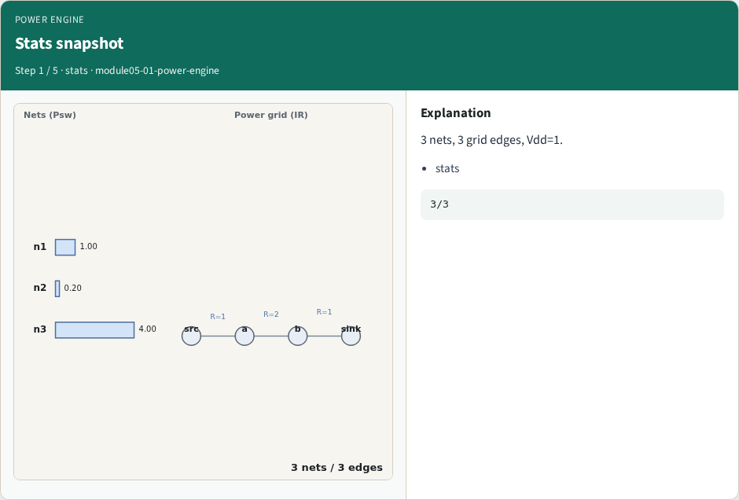
Stats snapshot
Stats snapshot
learn_power — 01 power engine
Notes:
3 nets, 3 grid edges, Vdd=1.

Slide 4
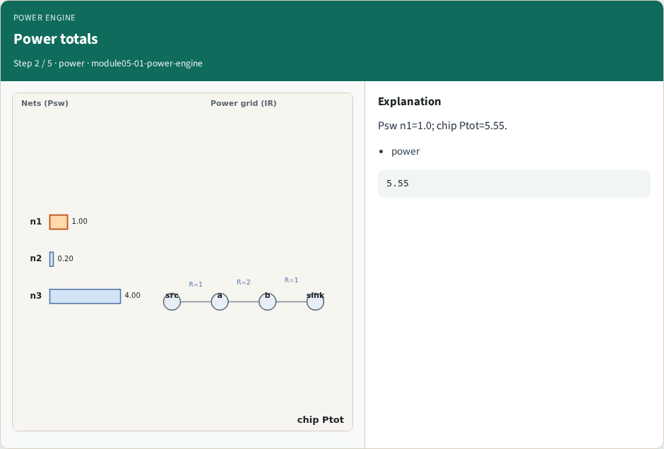
Power totals
Power totals
learn_power — 01 power engine
Notes:
Psw n1=1.0; chip Ptot=5.55.

Slide 5
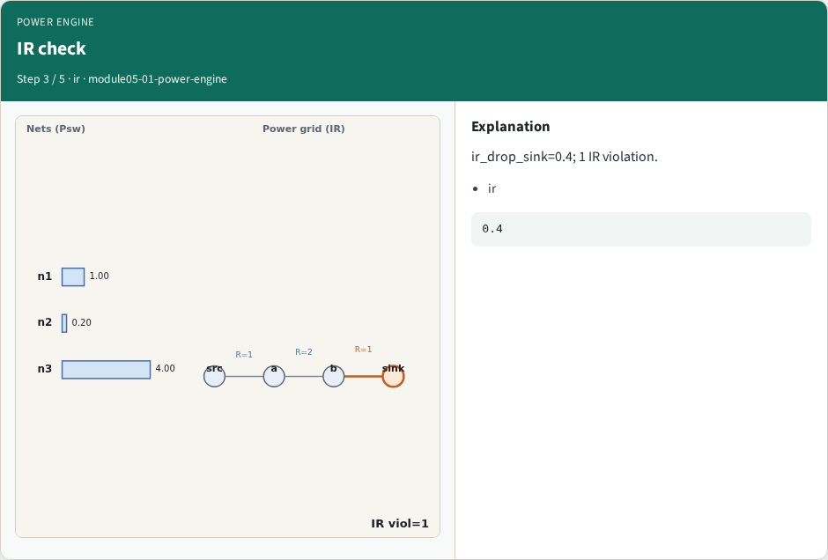
IR check
IR check
learn_power — 01 power engine
Notes:
ir_drop_sink=0.4; 1 IR violation.

Slide 6
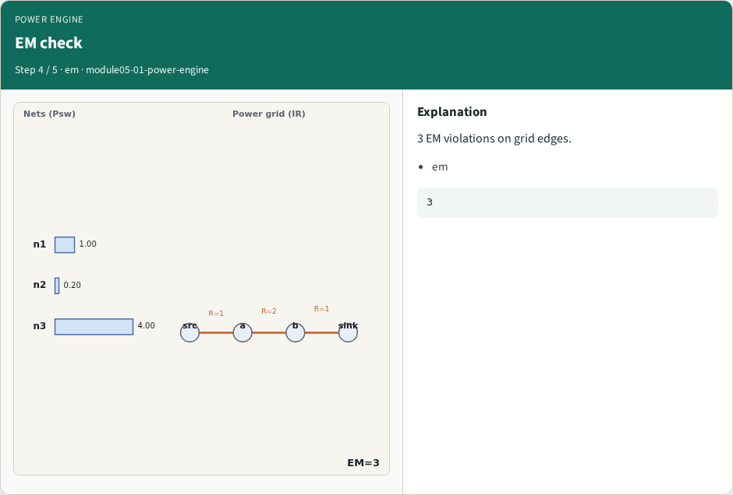
EM check
EM check
learn_power — 01 power engine
Notes:
3 EM violations on grid edges.

Slide 7
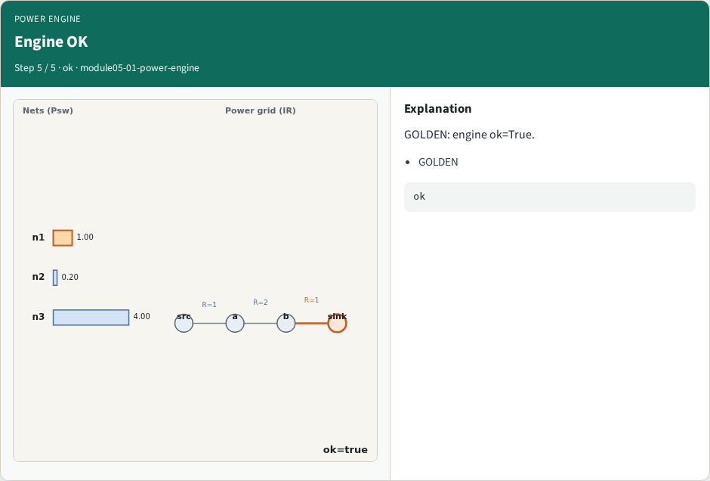
Engine OK
Engine OK
learn_power — 01 power engine
Notes:
GOLDEN: engine ok=True.

Slide 8

Browser lab track
Browser lab starter
learn_power — 01 power engine
Notes:
Open **power-engine**. Run engine; confirm ok.

Slide 9
Implement track
Call power_engine(); assert ok and markers.count==4
learn_power — 01 power engine
Notes:
Call power_engine(); assert ok and markers.count==4.

Slide 10
Pitfalls
Reporting partial checks
Changing toy without updating goldens
learn_power — 01 power engine
Notes:
Reporting partial checks. Changing toy without updating goldens.

Slide 11
Your turn
Next: offline compare, then wrap
learn_power — 01 power engine
Notes:
Next: offline compare, then wrap.

