Slide 1
Why corners
Signoff starts from a small set of process/voltage/temperature corners
learn_signoff — 01 corners
Notes:
Signoff starts from a small set of process/voltage/temperature corners.

Slide 2
The idea
GOLDEN: corner_count=3
learn_signoff — 01 corners
Notes:
GOLDEN: corner_count=3.

Slide 3
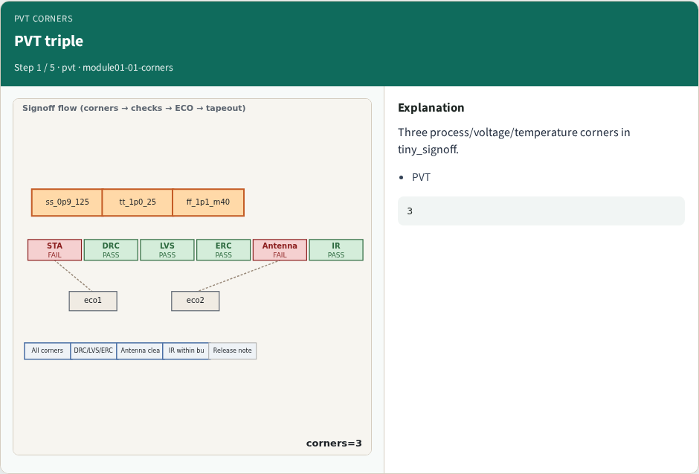
PVT triple
PVT triple
learn_signoff — 01 corners
Notes:
Three process/voltage/temperature corners in tiny_signoff.

Slide 4
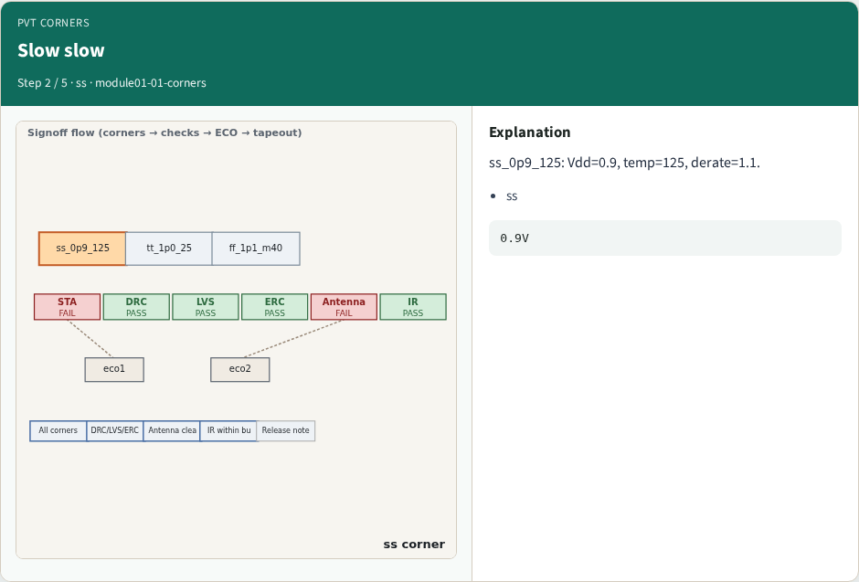
Slow slow
Slow slow
learn_signoff — 01 corners
Notes:
ss_0p9_125: Vdd=0.9, temp=125, derate=1.1.

Slide 5
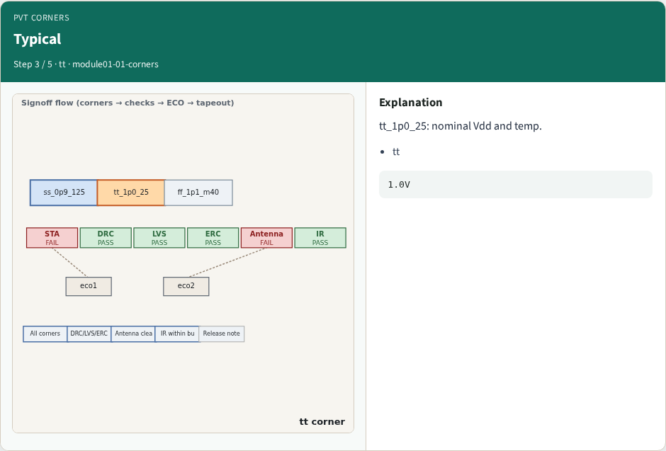
Typical
Typical
learn_signoff — 01 corners
Notes:
tt_1p0_25: nominal Vdd and temp.

Slide 6
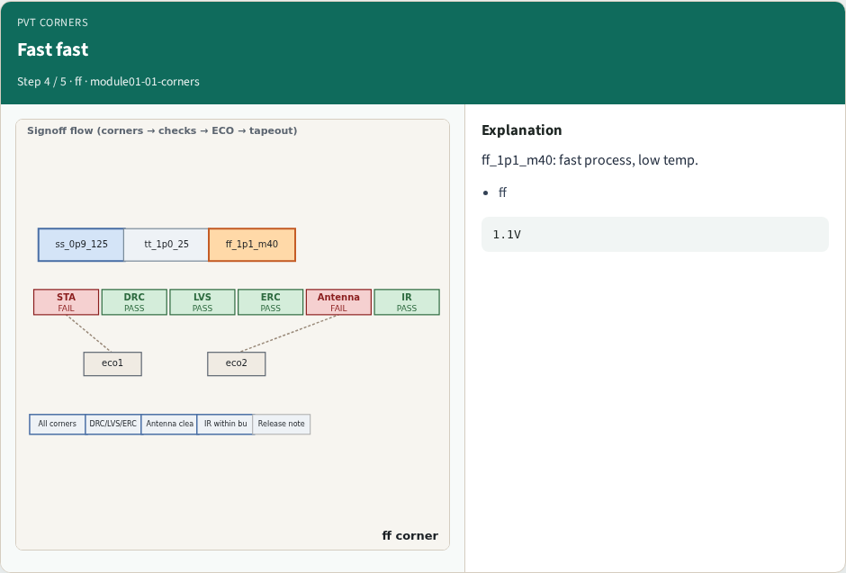
Fast fast
Fast fast
learn_signoff — 01 corners
Notes:
ff_1p1_m40: fast process, low temp.

Slide 7
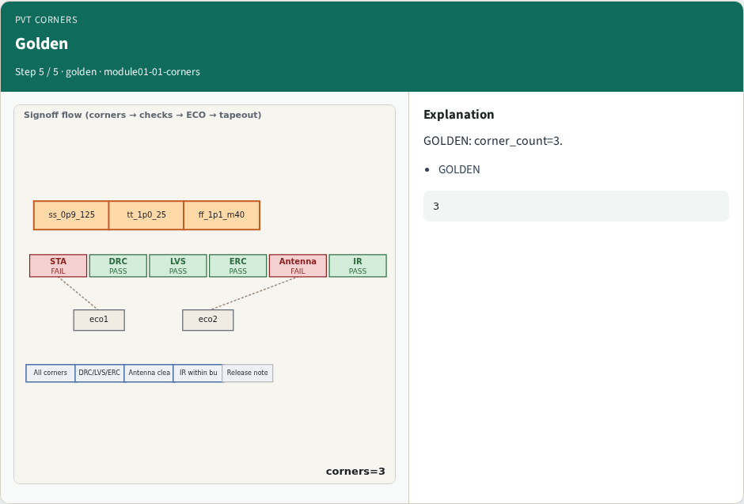
Golden
Golden
learn_signoff — 01 corners
Notes:
GOLDEN: corner_count=3.

Slide 8
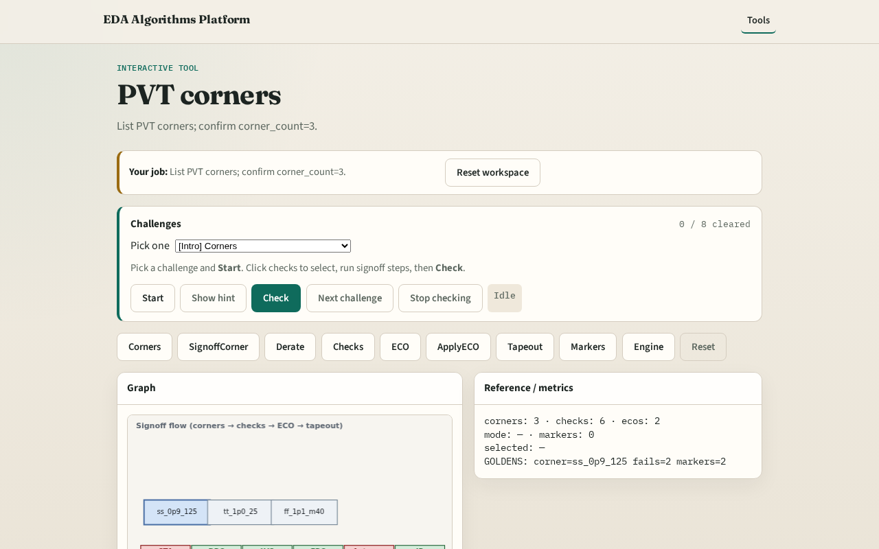
Browser lab track
Browser lab starter
learn_signoff — 01 corners
Notes:
Open **corners**. Inspect tiny_signoff; confirm 3 corners.

Slide 9
Implement track
Call list_corners(); assert count==3
learn_signoff — 01 corners
Notes:
Call list_corners(); assert count==3.

Slide 10
Pitfalls
Confusing signoff corner with full MCMM
Missing derate field
learn_signoff — 01 corners
Notes:
Confusing signoff corner with full MCMM. Missing derate field.

Slide 11
Your turn
Next: pick signoff corner
learn_signoff — 01 corners
Notes:
Next: pick signoff corner.

