Slide 1
Why signoff corner
The slow-slow hot corner is the pessimistic signoff PVT for delay
learn_signoff — 03 signoff corner
Notes:
The slow-slow hot corner is the pessimistic signoff PVT for delay.

Slide 2
The idea
GOLDEN: signoff_corner=ss_0p9_125, derate=1.1
learn_signoff — 03 signoff corner
Notes:
GOLDEN: signoff_corner=ss_0p9_125, derate=1.1.

Slide 3
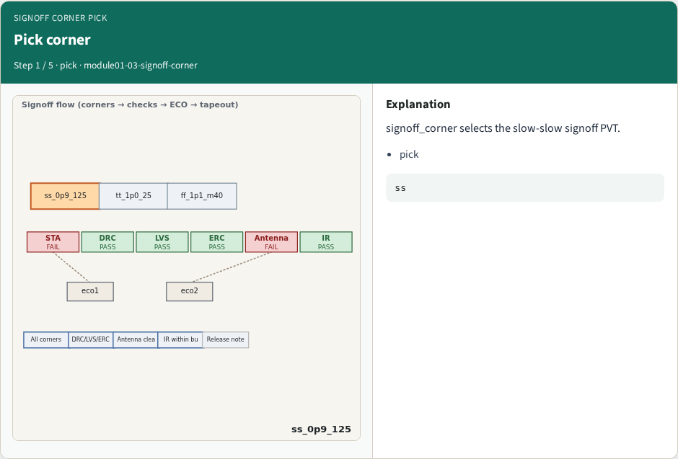
Pick corner
Pick corner
learn_signoff — 03 signoff corner
Notes:
signoff_corner selects the slow-slow signoff PVT.

Slide 4
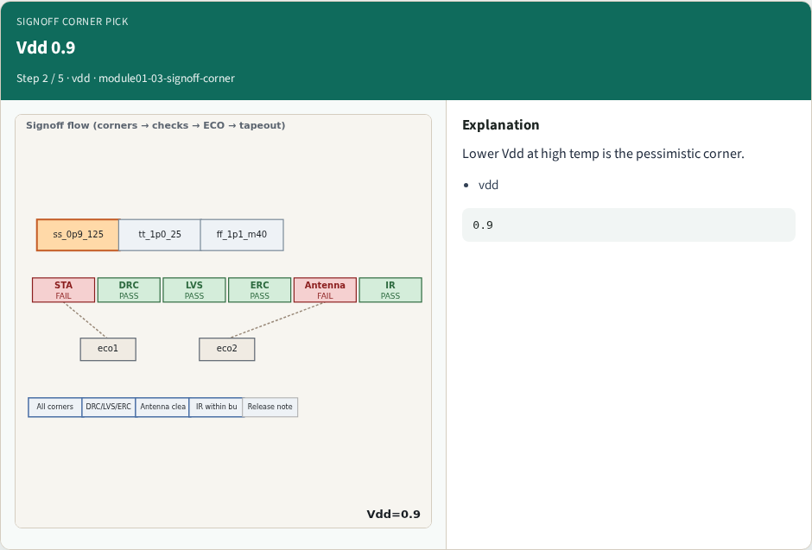
Vdd 0.9
Vdd 0.9
learn_signoff — 03 signoff corner
Notes:
Lower Vdd at high temp is the pessimistic corner.

Slide 5
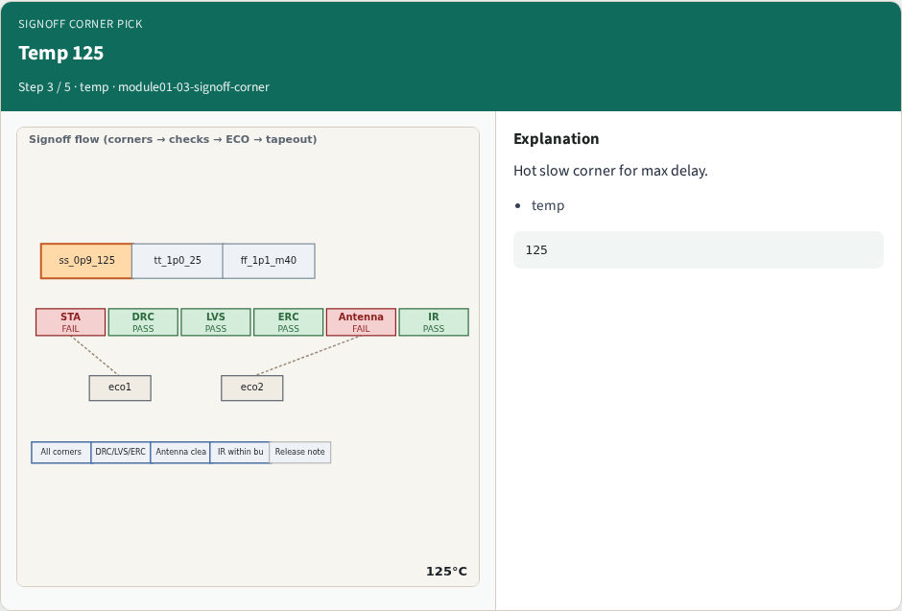
Temp 125
Temp 125
learn_signoff — 03 signoff corner
Notes:
Hot slow corner for max delay.

Slide 6
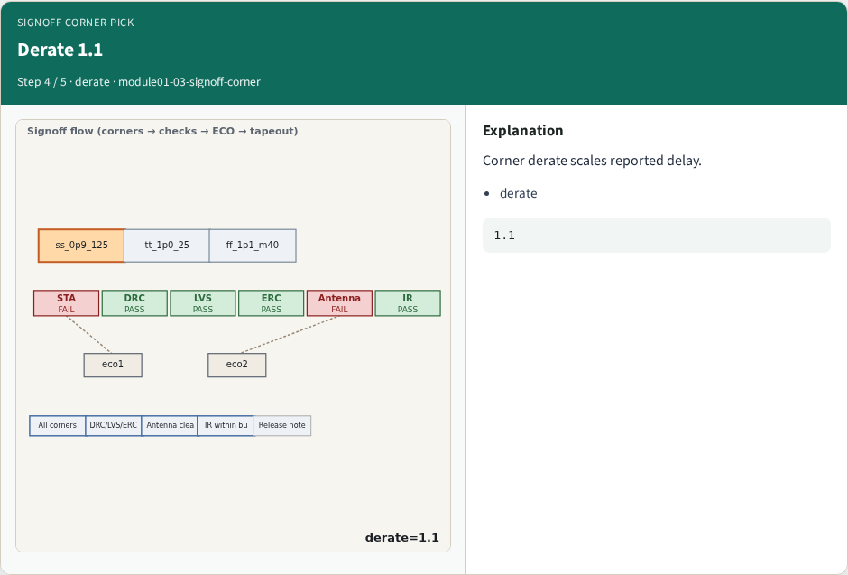
Derate 1.1
Derate 1.1
learn_signoff — 03 signoff corner
Notes:
Corner derate scales reported delay.

Slide 7

Golden
Golden
learn_signoff — 03 signoff corner
Notes:
GOLDEN: ss_0p9_125 derate=1.1.

Slide 8
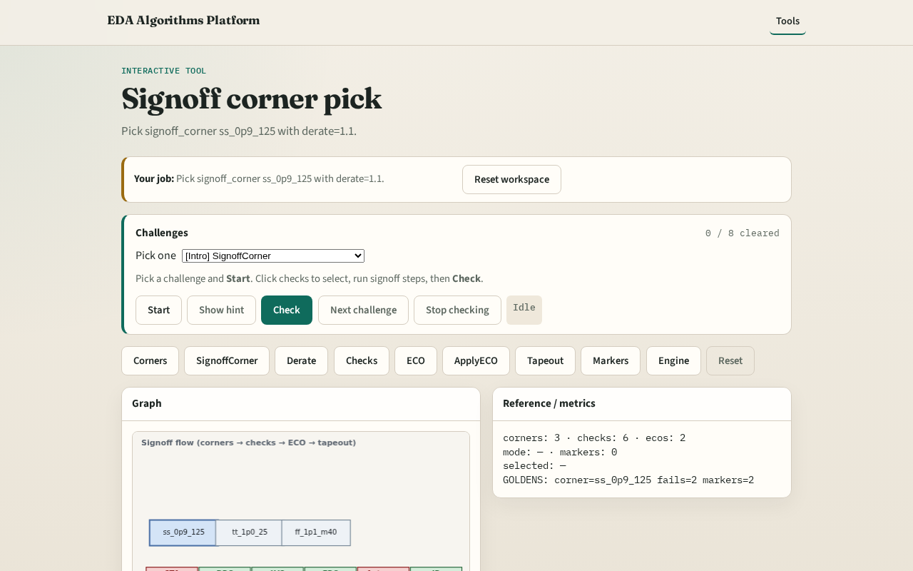
Browser lab track
Browser lab starter
learn_signoff — 03 signoff corner
Notes:
Open **signoff-corner**. Confirm ss_0p9_125 and derate 1.1.

Slide 9
Implement track
Call pick_signoff_corner(); assert id and derate match goldens
learn_signoff — 03 signoff corner
Notes:
Call pick_signoff_corner(); assert id and derate match goldens.

Slide 10
Pitfalls
Using tt for signoff
Ignoring derate on ss
learn_signoff — 03 signoff corner
Notes:
Using tt for signoff. Ignoring derate on ss.

Slide 11
Your turn
Next: apply derate
learn_signoff — 03 signoff corner
Notes:
Next: apply derate.

