Slide 1
Why derate
Reported path delay scales by the signoff corner derate
learn_signoff — 01 derate
Notes:
Reported path delay scales by the signoff corner derate.

Slide 2
The idea
GOLDEN: derated=1.1 for delay=1.0
learn_signoff — 01 derate
Notes:
GOLDEN: derated=1.1 for delay=1.0.

Slide 3
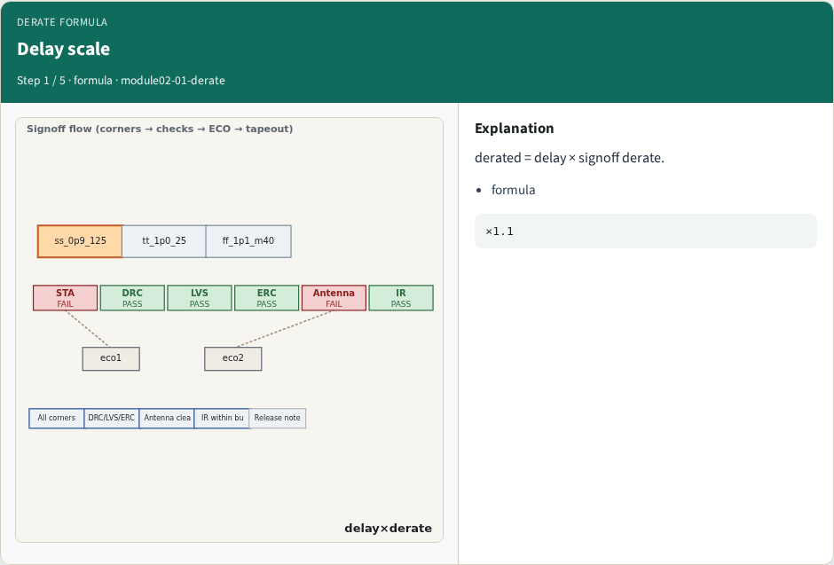
Delay scale
Delay scale
learn_signoff — 01 derate
Notes:
derated = delay × signoff derate.

Slide 4
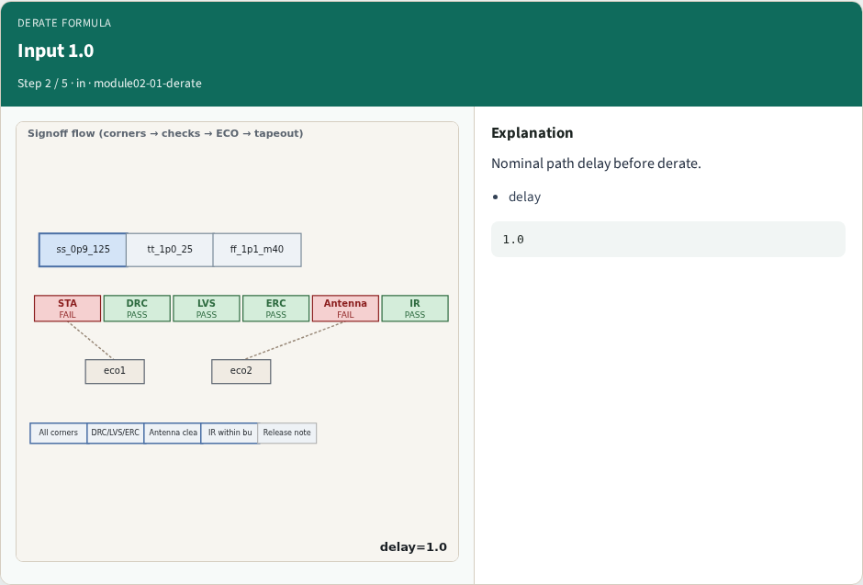
Input 1.0
Input 1.0
learn_signoff — 01 derate
Notes:
Nominal path delay before derate.

Slide 5
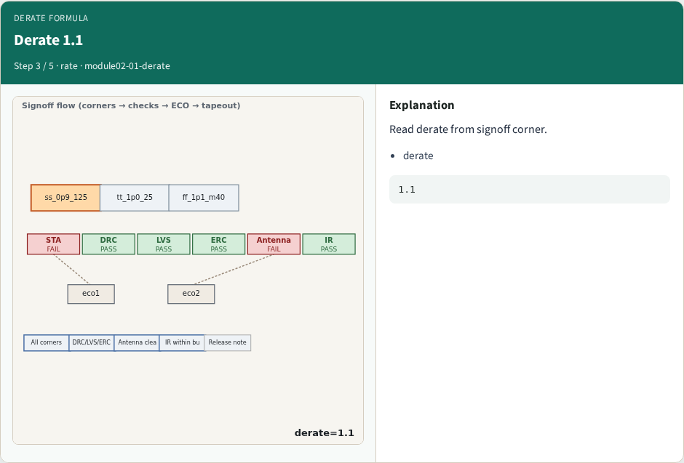
Derate 1.1
Derate 1.1
learn_signoff — 01 derate
Notes:
Read derate from signoff corner.

Slide 6

Result 1.1
Result 1.1
learn_signoff — 01 derate
Notes:
1.0 × 1.1 = 1.1 ns derated.

Slide 7

Golden
Golden
learn_signoff — 01 derate
Notes:
GOLDEN: derated=1.1 for delay=1.0.

Slide 8
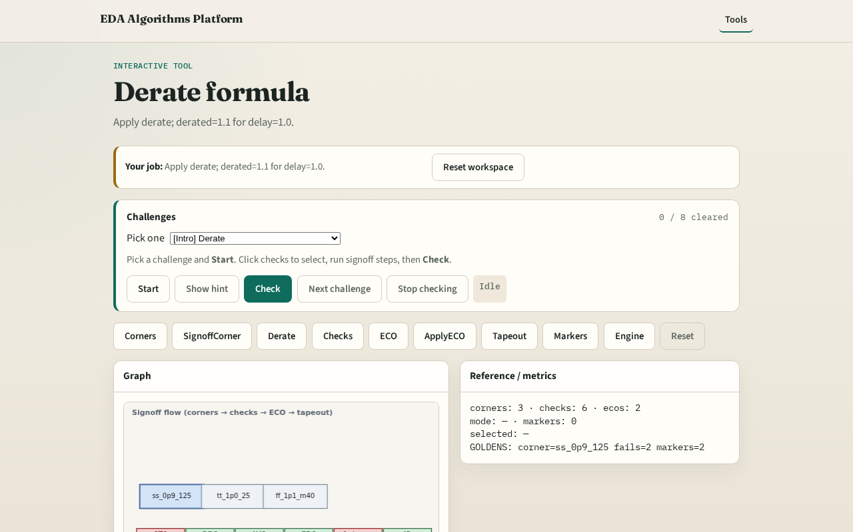
Browser lab track
Browser lab starter
learn_signoff — 01 derate
Notes:
Open **derate**. Run derate on delay=1.0; confirm 1.1.

Slide 9
Implement track
Call apply_derate(1.0); assert derated==1.1
learn_signoff — 01 derate
Notes:
Call apply_derate(1.0); assert derated==1.1.

Slide 10
Pitfalls
Using wrong corner derate
Forgetting multiply order
learn_signoff — 01 derate
Notes:
Using wrong corner derate. Forgetting multiply order.

Slide 11
Your turn
Next: check suite
learn_signoff — 01 derate
Notes:
Next: check suite.

