Slide 1
Why check suite
STA, DRC, LVS, ERC, antenna, and IR form the toy check suite
learn_signoff — 03 check suite
Notes:
STA, DRC, LVS, ERC, antenna, and IR form the toy check suite.

Slide 2
The idea
GOLDEN: fail_count=2, pass_count=4
learn_signoff — 03 check suite
Notes:
GOLDEN: fail_count=2, pass_count=4.

Slide 3
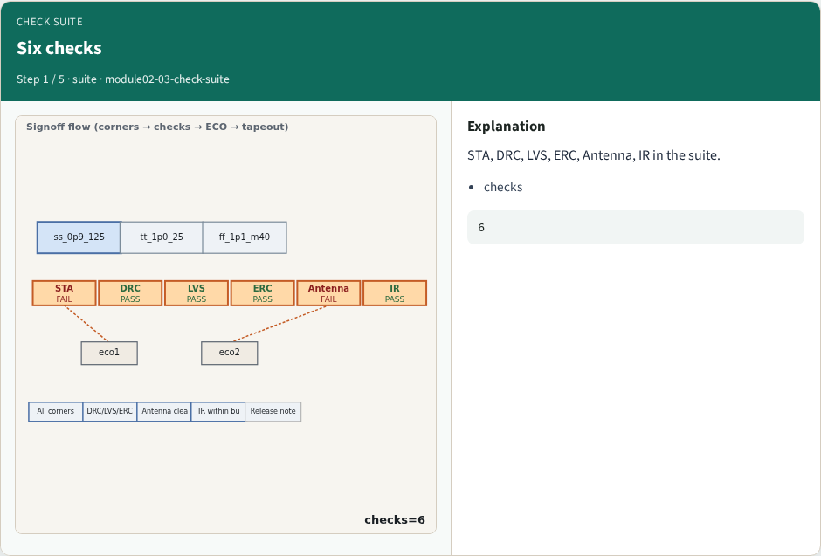
Six checks
Six checks
learn_signoff — 03 check suite
Notes:
STA, DRC, LVS, ERC, Antenna, IR in the suite.

Slide 4
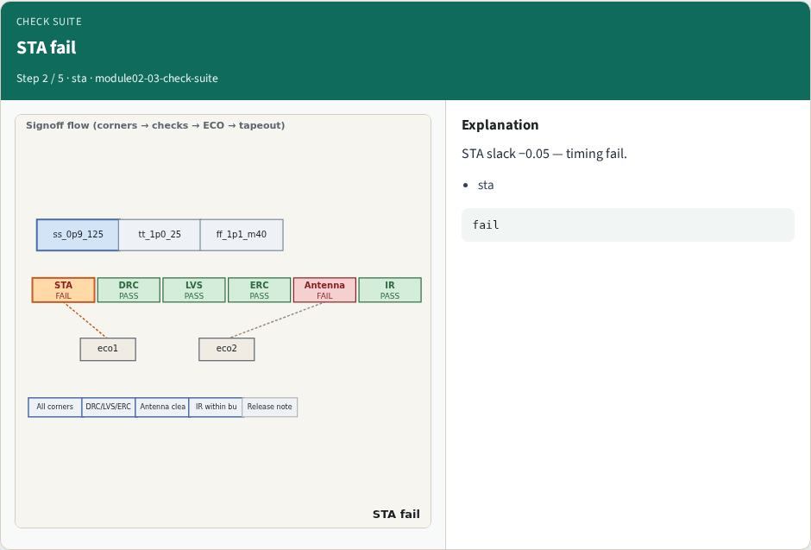
STA fail
STA fail
learn_signoff — 03 check suite
Notes:
STA slack −0.05 — timing fail.

Slide 5
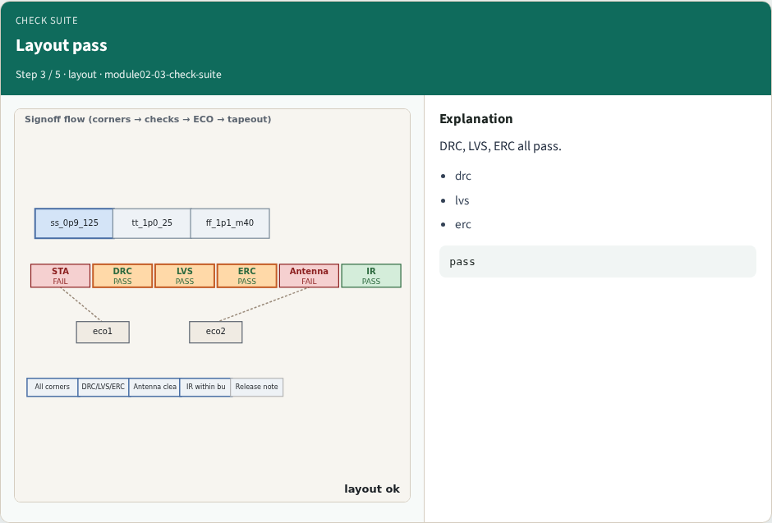
Layout pass
Layout pass
learn_signoff — 03 check suite
Notes:
DRC, LVS, ERC all pass.

Slide 6
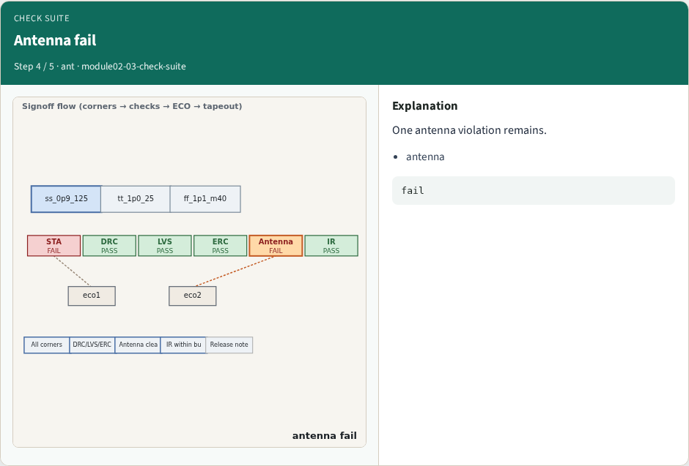
Antenna fail
Antenna fail
learn_signoff — 03 check suite
Notes:
One antenna violation remains.

Slide 7
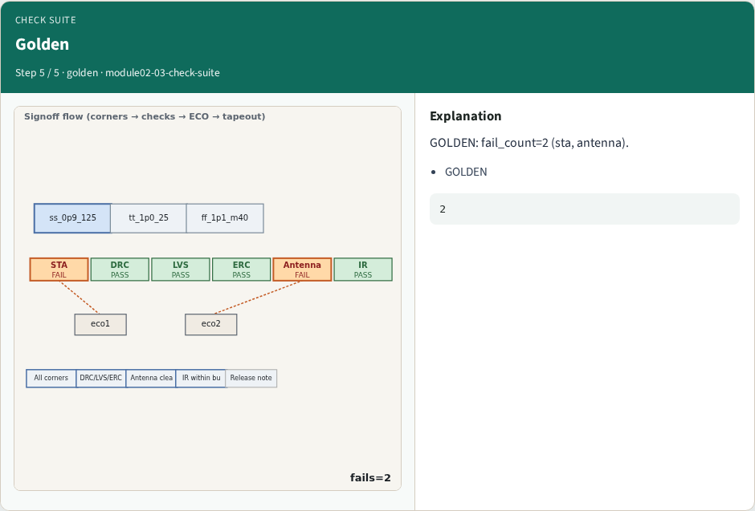
Golden
Golden
learn_signoff — 03 check suite
Notes:
GOLDEN: fail_count=2 (sta, antenna).

Slide 8
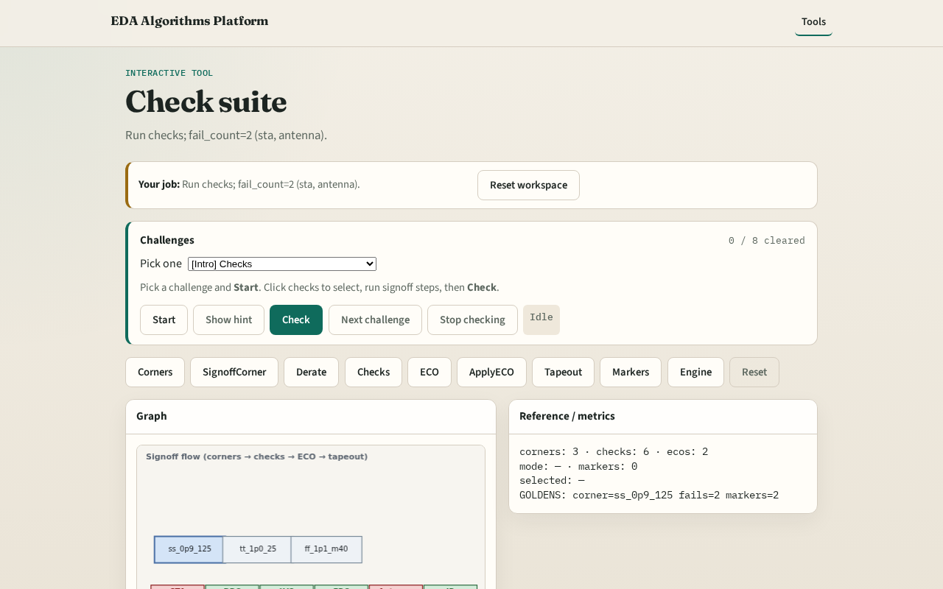
Browser lab track
Browser lab starter
learn_signoff — 03 check suite
Notes:
Open **check-suite**. Run checks; confirm 2 fails.

Slide 9
Implement track
Call run_checks(); assert fail_count==2 and pass_count==4
learn_signoff — 03 check suite
Notes:
Call run_checks(); assert fail_count==2 and pass_count==4.

Slide 10
Pitfalls
Counting IR as fail
Missing antenna in fail set
learn_signoff — 03 check suite
Notes:
Counting IR as fail. Missing antenna in fail set.

Slide 11
Your turn
Next: ECO loop
learn_signoff — 03 check suite
Notes:
Next: ECO loop.

