Slide 1
Why ECO loop
Engineering change orders map fixes to failing checks
learn_signoff — 01 eco loop
Notes:
Engineering change orders map fixes to failing checks.

Slide 2
The idea
GOLDEN: eco_count=2, fixes_all=true
learn_signoff — 01 eco loop
Notes:
GOLDEN: eco_count=2, fixes_all=true.

Slide 3
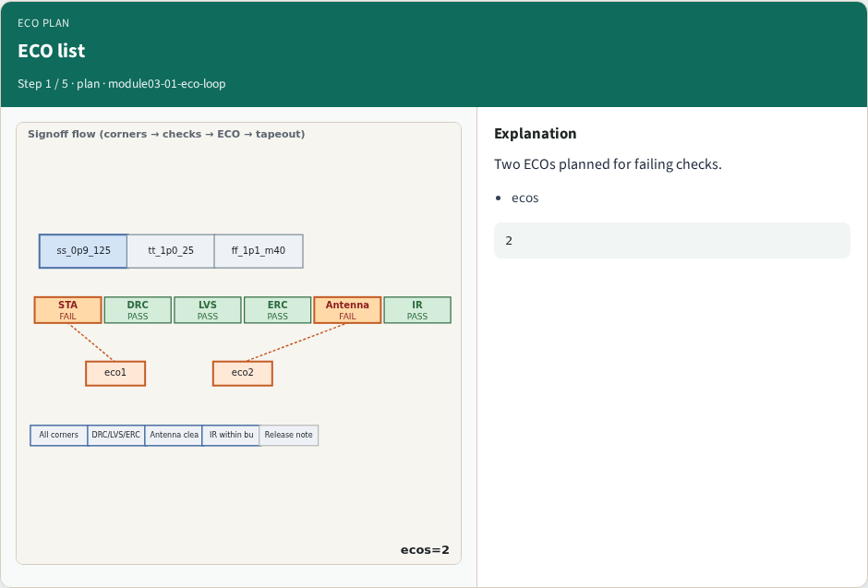
ECO list
ECO list
learn_signoff — 01 eco loop
Notes:
Two ECOs planned for failing checks.

Slide 4
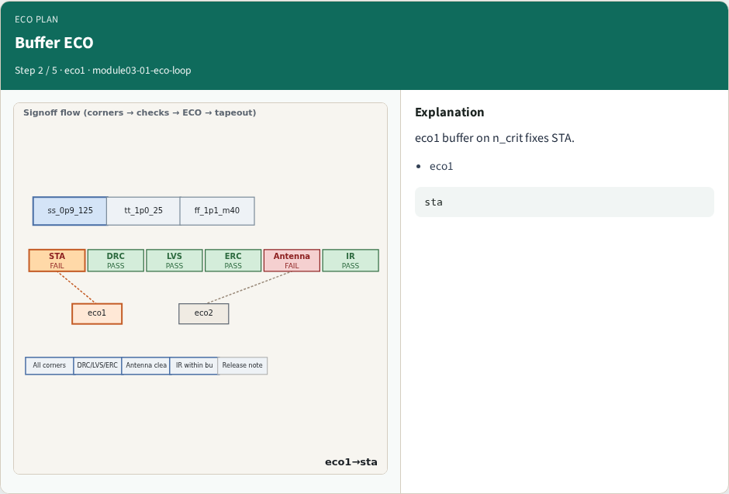
Buffer ECO
Buffer ECO
learn_signoff — 01 eco loop
Notes:
eco1 buffer on n_crit fixes STA.

Slide 5
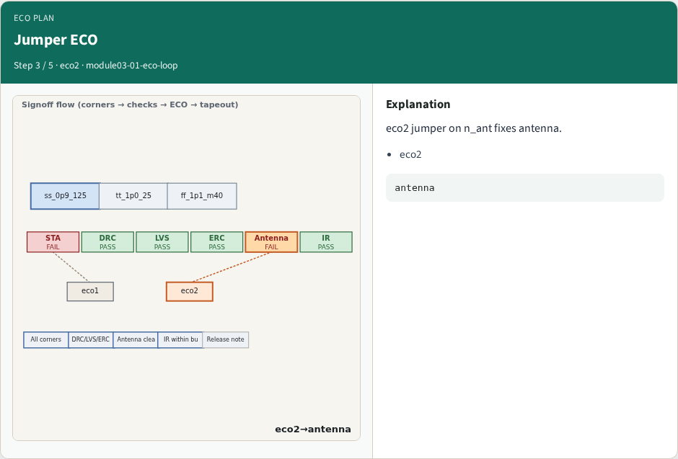
Jumper ECO
Jumper ECO
learn_signoff — 01 eco loop
Notes:
eco2 jumper on n_ant fixes antenna.

Slide 6
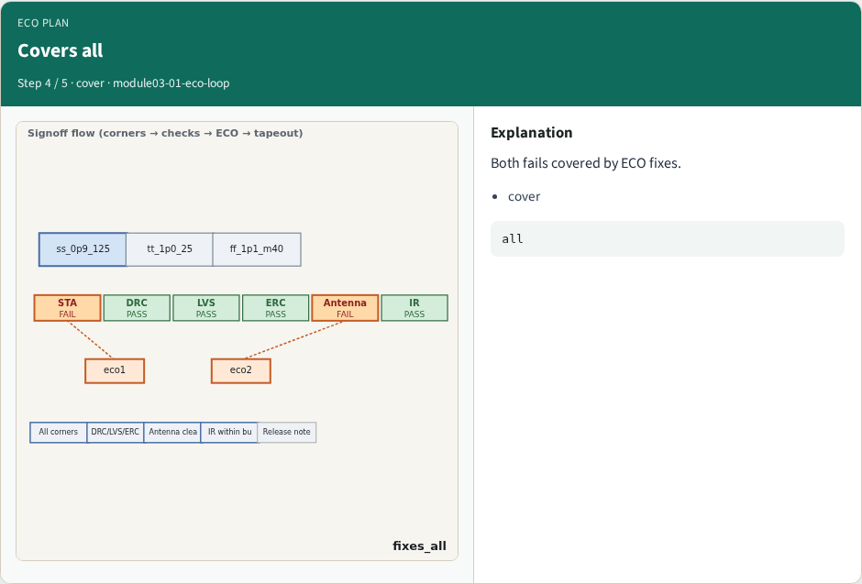
Covers all
Covers all
learn_signoff — 01 eco loop
Notes:
Both fails covered by ECO fixes.

Slide 7
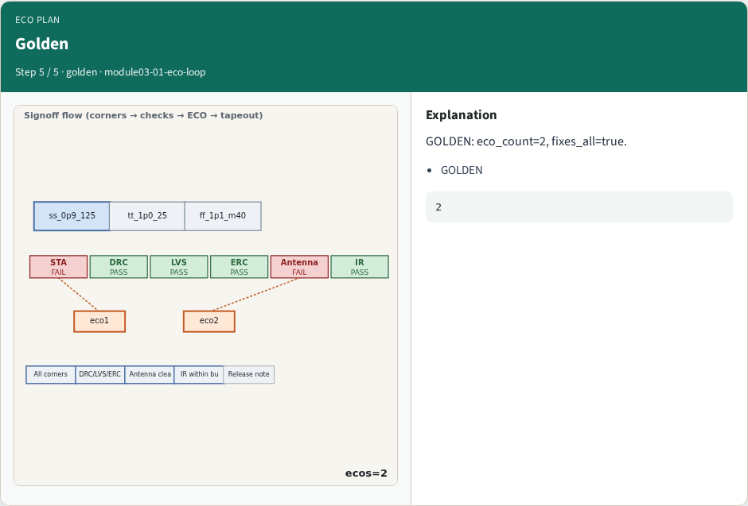
Golden
Golden
learn_signoff — 01 eco loop
Notes:
GOLDEN: eco_count=2, fixes_all=true.

Slide 8
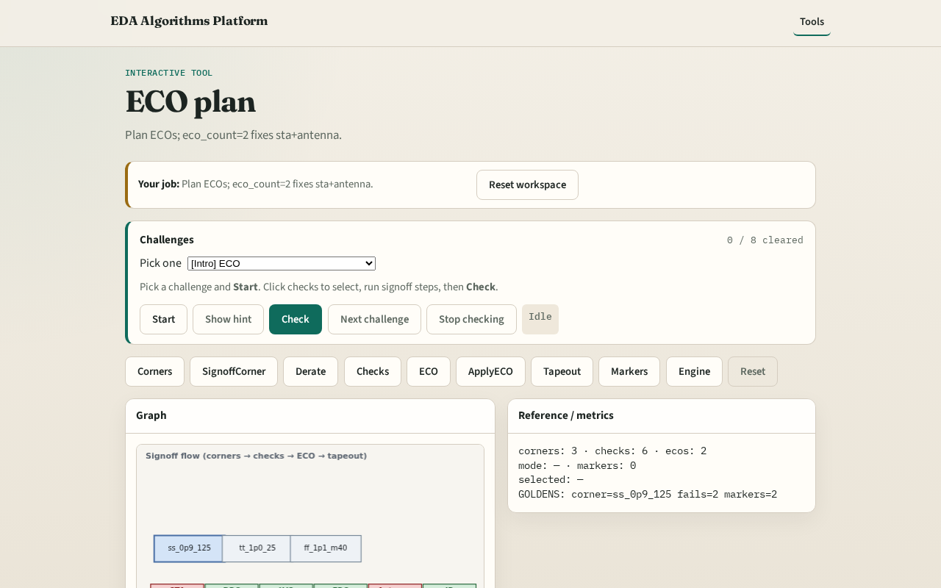
Browser lab track
Browser lab starter
learn_signoff — 01 eco loop
Notes:
Open **eco-loop**. Confirm 2 ECOs cover sta+antenna.

Slide 9
Implement track
Call eco_plan(); assert eco_count==2 and fixes_all
learn_signoff — 01 eco loop
Notes:
Call eco_plan(); assert eco_count==2 and fixes_all.

Slide 10
Pitfalls
ECO missing a fail
Double-counting ECOs
learn_signoff — 01 eco loop
Notes:
ECO missing a fail. Double-counting ECOs.

Slide 11
Your turn
Next: apply ECOs
learn_signoff — 01 eco loop
Notes:
Next: apply ECOs.

