Slide 1
Why apply ECOs
Applying ECOs flips fixed checks from fail to pass
learn_signoff — 03 apply ecos
Notes:
Applying ECOs flips fixed checks from fail to pass.

Slide 2
The idea
GOLDEN: fail_count→0 after apply_ecos
learn_signoff — 03 apply ecos
Notes:
GOLDEN: fail_count→0 after apply_ecos.

Slide 3
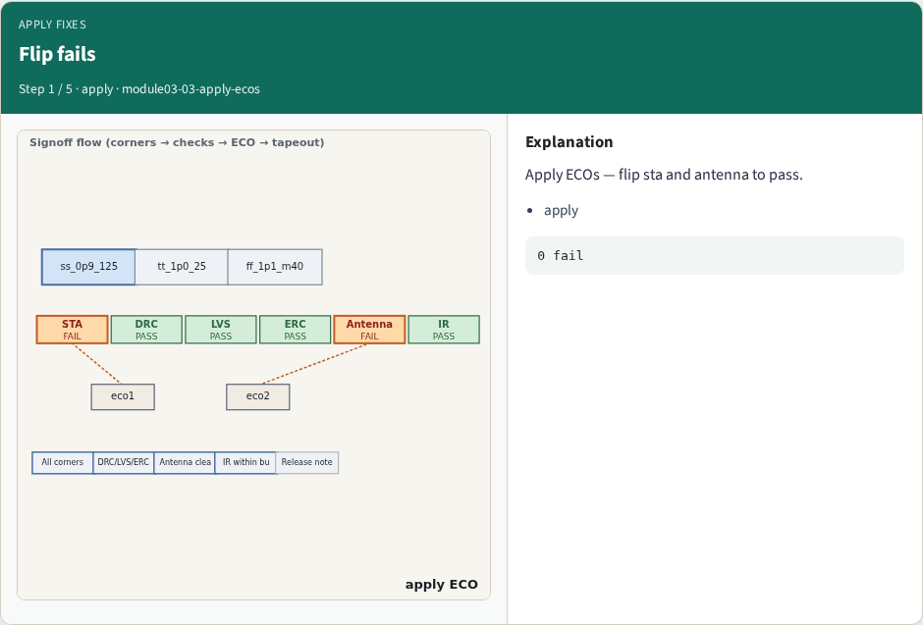
Flip fails
Flip fails
learn_signoff — 03 apply ecos
Notes:
Apply ECOs — flip sta and antenna to pass.

Slide 4
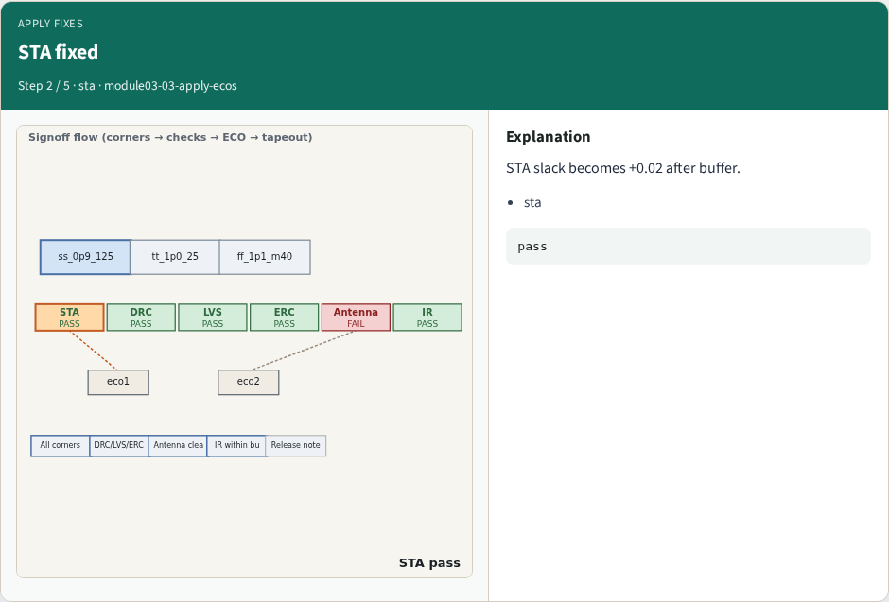
STA fixed
STA fixed
learn_signoff — 03 apply ecos
Notes:
STA slack becomes +0.02 after buffer.

Slide 5
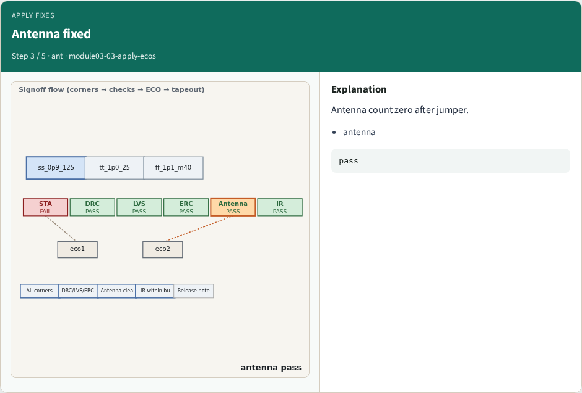
Antenna fixed
Antenna fixed
learn_signoff — 03 apply ecos
Notes:
Antenna count zero after jumper.

Slide 6
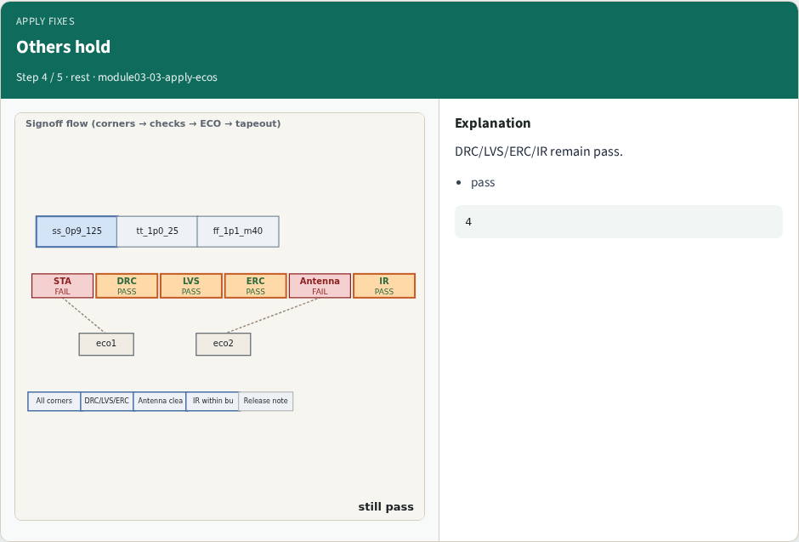
Others hold
Others hold
learn_signoff — 03 apply ecos
Notes:
DRC/LVS/ERC/IR remain pass.

Slide 7
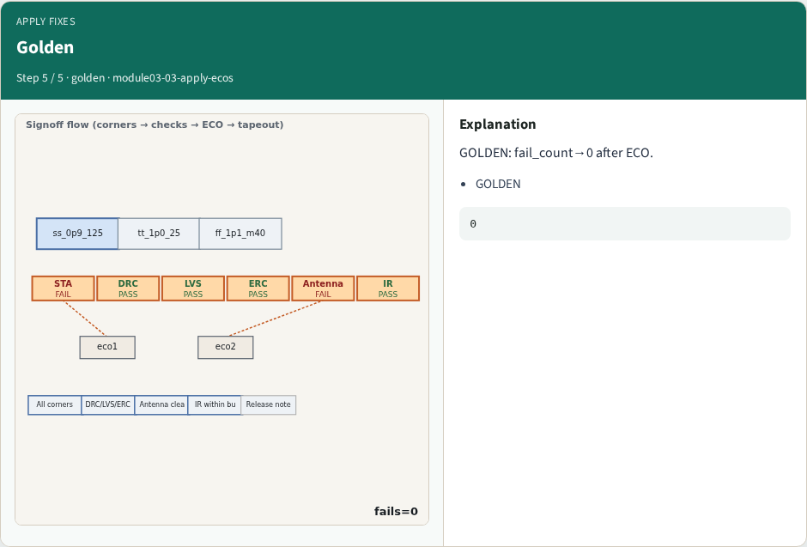
Golden
Golden
learn_signoff — 03 apply ecos
Notes:
GOLDEN: fail_count→0 after ECO.

Slide 8
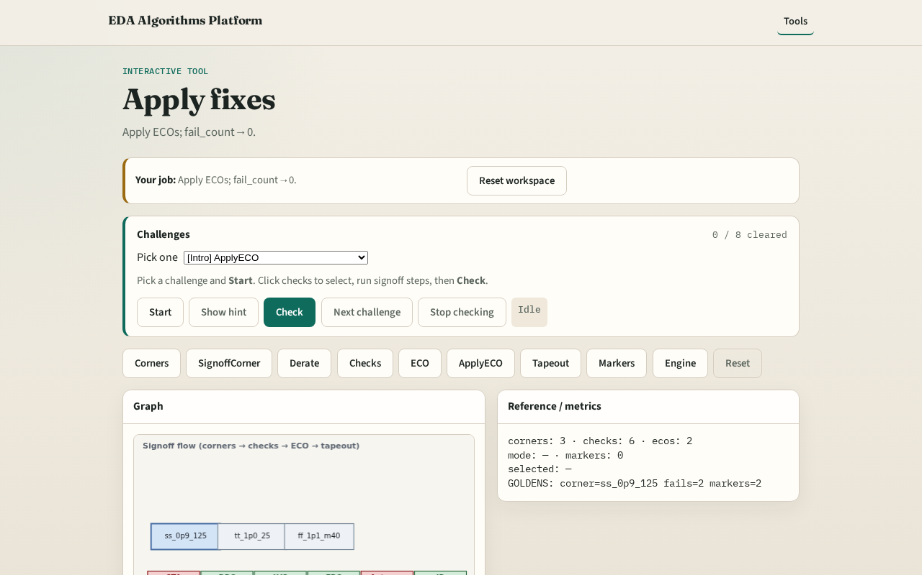
Browser lab track
Browser lab starter
learn_signoff — 03 apply ecos
Notes:
Open **apply-ecos**. Apply ECOs; confirm fail_count=0.

Slide 9
Implement track
Call apply_ecos(); assert fail_count==0
learn_signoff — 03 apply ecos
Notes:
Call apply_ecos(); assert fail_count==0.

Slide 10
Pitfalls
Applying ECO without updating check status
Partial apply
learn_signoff — 03 apply ecos
Notes:
Applying ECO without updating check status. Partial apply.

Slide 11
Your turn
Next: tapeout checklist
learn_signoff — 03 apply ecos
Notes:
Next: tapeout checklist.

