Slide 1
Why tapeout
Required tapeout gates block release until checks are clean
learn_signoff — 01 tapeout checklist
Notes:
Required tapeout gates block release until checks are clean.

Slide 2
The idea
GOLDEN: ready=false before ECO, ready=true after
learn_signoff — 01 tapeout checklist
Notes:
GOLDEN: ready=false before ECO, ready=true after.

Slide 3
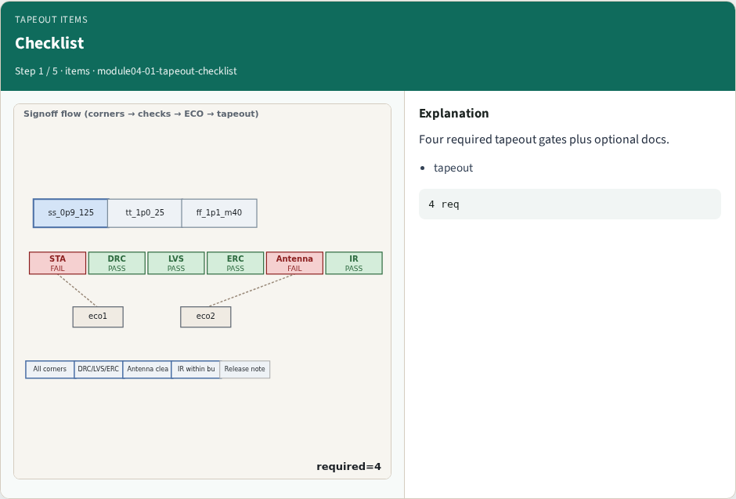
Checklist
Checklist
learn_signoff — 01 tapeout checklist
Notes:
Four required tapeout gates plus optional docs.

Slide 4
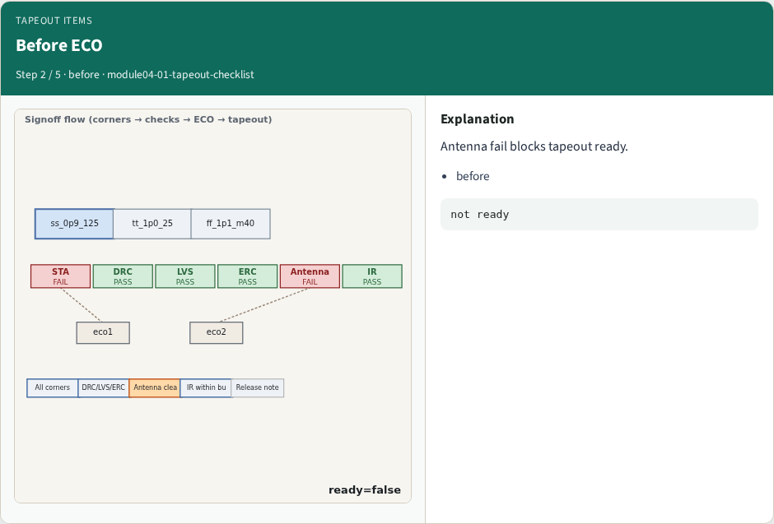
Before ECO
Before ECO
learn_signoff — 01 tapeout checklist
Notes:
Antenna fail blocks tapeout ready.

Slide 5
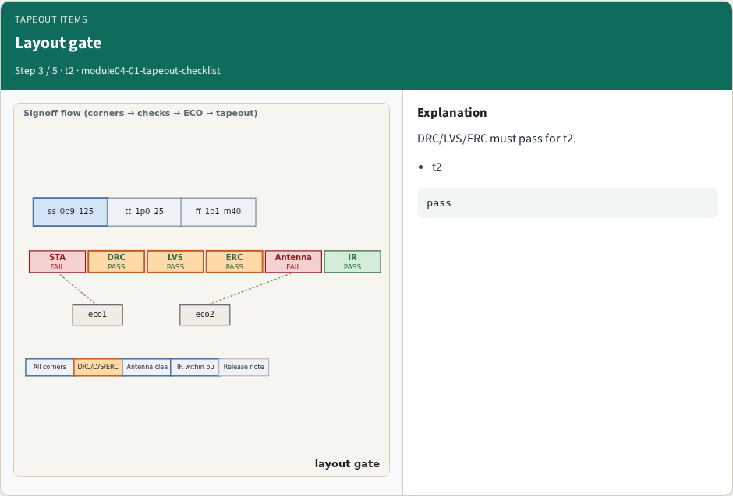
Layout gate
Layout gate
learn_signoff — 01 tapeout checklist
Notes:
DRC/LVS/ERC must pass for t2.

Slide 6
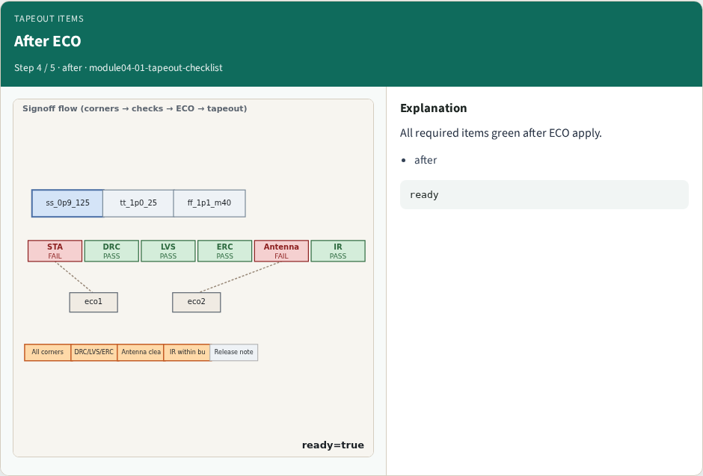
After ECO
After ECO
learn_signoff — 01 tapeout checklist
Notes:
All required items green after ECO apply.

Slide 7
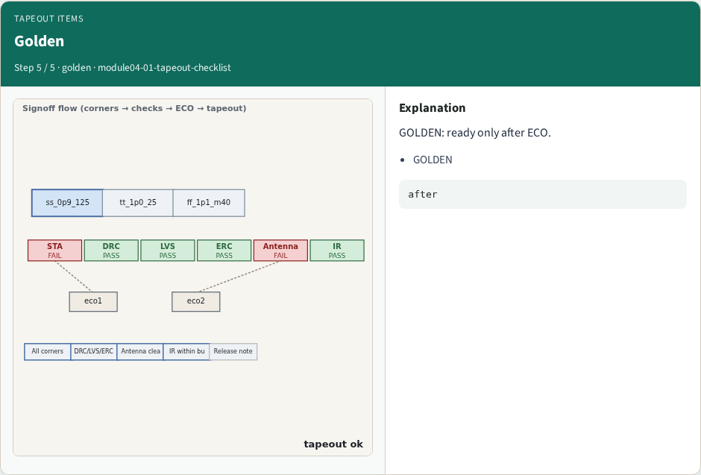
Golden
Golden
learn_signoff — 01 tapeout checklist
Notes:
GOLDEN: ready only after ECO.

Slide 8
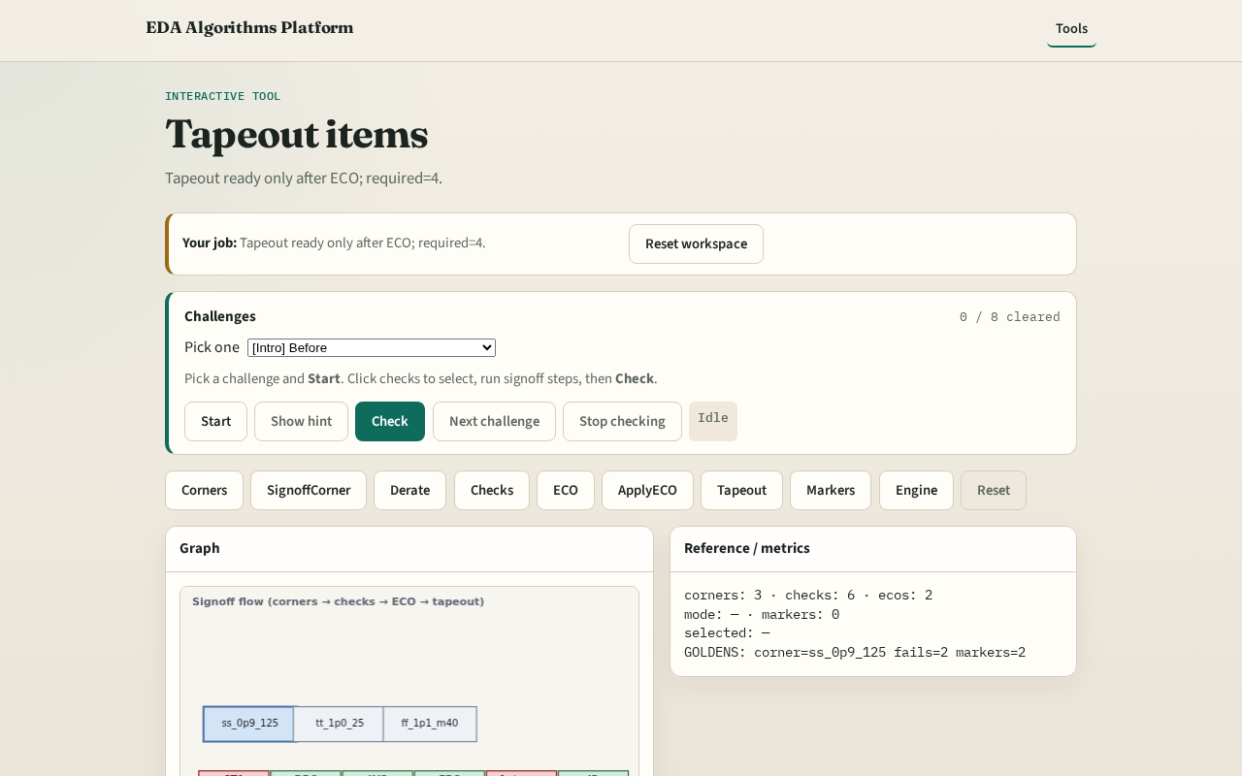
Browser lab track
Browser lab starter
learn_signoff — 01 tapeout checklist
Notes:
Open **tapeout-checklist**. Compare before/after ECO ready flags.

Slide 9
Implement track
Call tapeout_checklist(after_eco=False/True); assert ready flags
learn_signoff — 01 tapeout checklist
Notes:
Call tapeout_checklist(after_eco=False/True); assert ready flags.

Slide 10
Pitfalls
Ignoring optional vs required
Checking before ECO only
learn_signoff — 01 tapeout checklist
Notes:
Ignoring optional vs required. Checking before ECO only.

Slide 11
Your turn
Next: signoff markers
learn_signoff — 01 tapeout checklist
Notes:
Next: signoff markers.

