Slide 1
Why markers
Signoff emits markers for each failing check before ECO
learn_signoff — 03 signoff markers
Notes:
Signoff emits markers for each failing check before ECO.

Slide 2
The idea
GOLDEN: marker_count=2
learn_signoff — 03 signoff markers
Notes:
GOLDEN: marker_count=2.

Slide 3
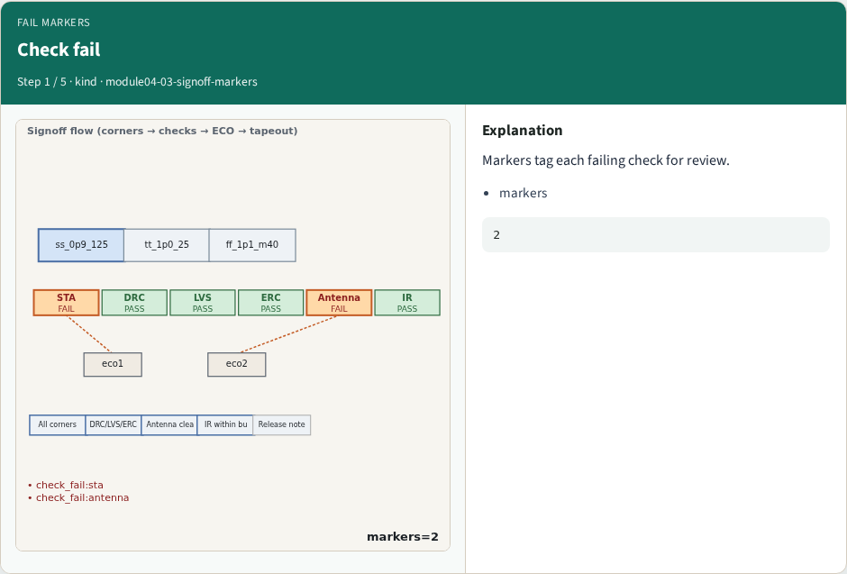
Check fail
Check fail
learn_signoff — 03 signoff markers
Notes:
Markers tag each failing check for review.

Slide 4
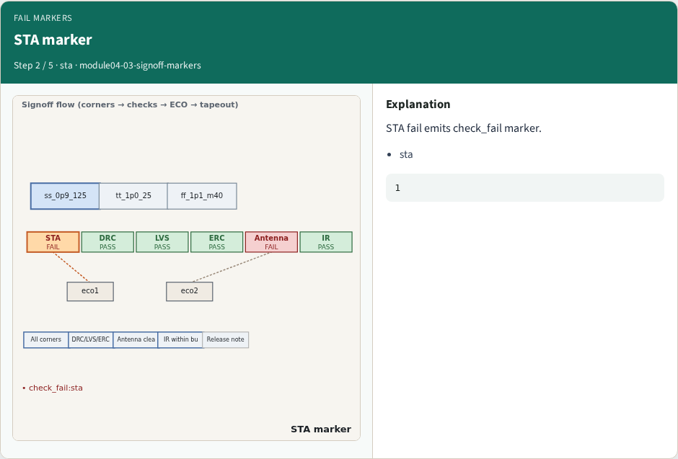
STA marker
STA marker
learn_signoff — 03 signoff markers
Notes:
STA fail emits check_fail marker.

Slide 5
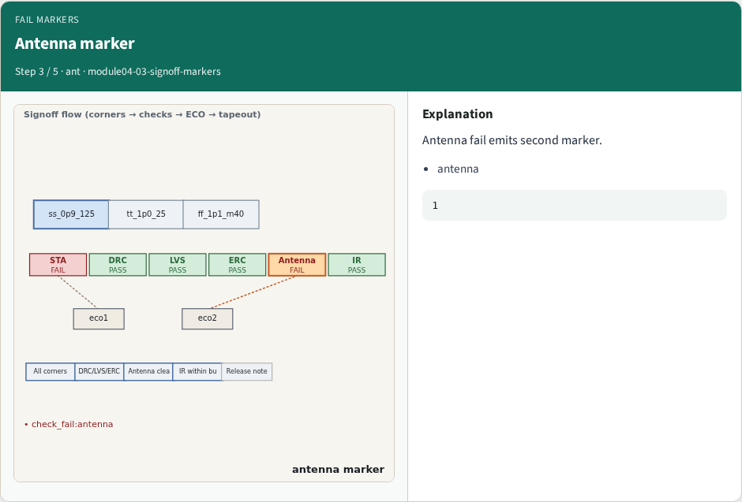
Antenna marker
Antenna marker
learn_signoff — 03 signoff markers
Notes:
Antenna fail emits second marker.

Slide 6
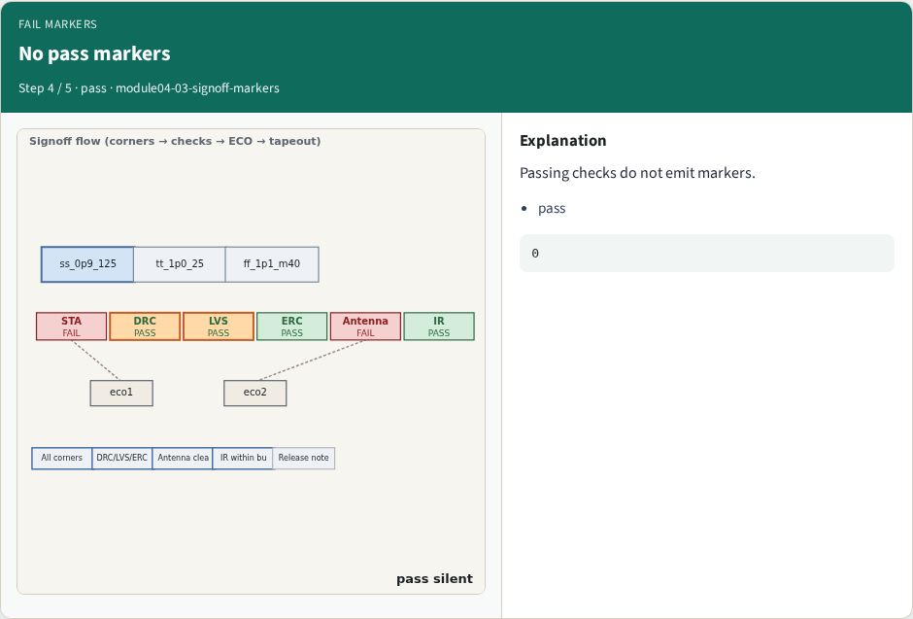
No pass markers
No pass markers
learn_signoff — 03 signoff markers
Notes:
Passing checks do not emit markers.

Slide 7
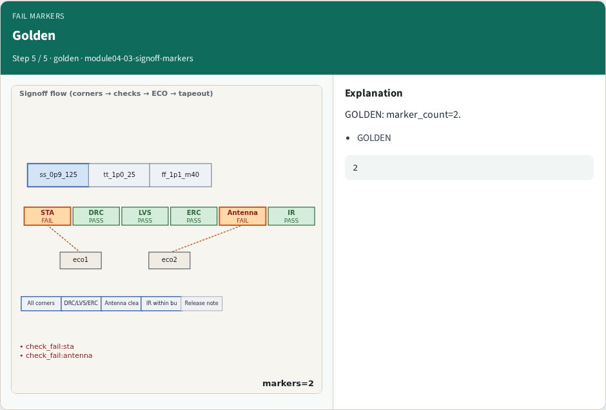
Golden
Golden
learn_signoff — 03 signoff markers
Notes:
GOLDEN: marker_count=2.

Slide 8
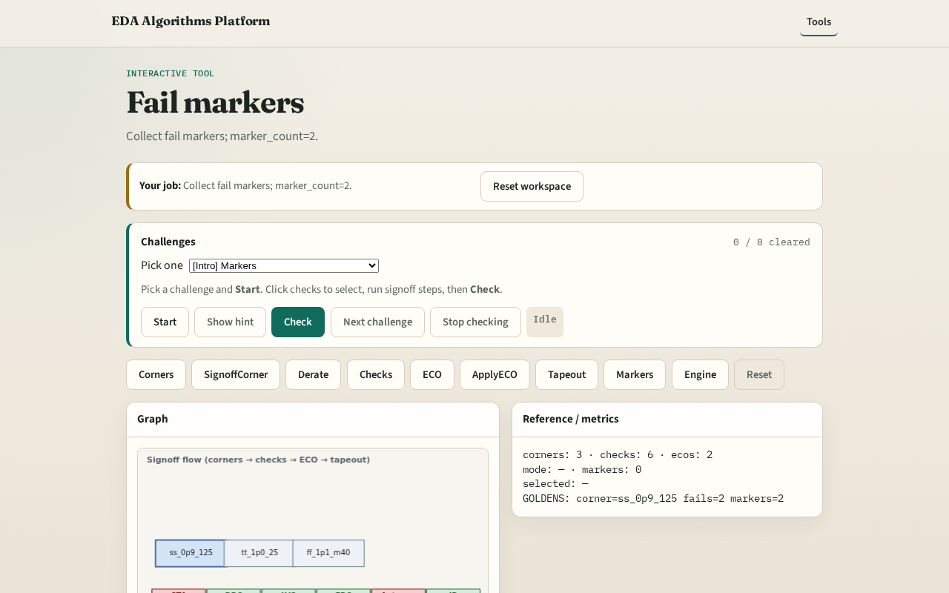
Browser lab track
Browser lab starter
learn_signoff — 03 signoff markers
Notes:
Open **signoff-markers**. Run collect; confirm 2 markers.

Slide 9
Implement track
Call collect_markers(); assert count==2
learn_signoff — 03 signoff markers
Notes:
Call collect_markers(); assert count==2.

Slide 10
Pitfalls
Counting pass checks
Markers after ECO without reset
learn_signoff — 03 signoff markers
Notes:
Counting pass checks. Markers after ECO without reset.

Slide 11
Your turn
Next: signoff engine
learn_signoff — 03 signoff markers
Notes:
Next: signoff engine.

