Slide 1
Engine
A tiny engine chains corners, checks, ECO, tapeout, and markers
learn_signoff — 01 signoff engine
Notes:
A tiny engine chains corners, checks, ECO, tapeout, and markers.

Slide 2
The idea
GOLDEN: corners=3, fails=2, ecos=2, markers=2, ok=True
learn_signoff — 01 signoff engine
Notes:
GOLDEN: corners=3, fails=2, ecos=2, markers=2, ok=True.

Slide 3
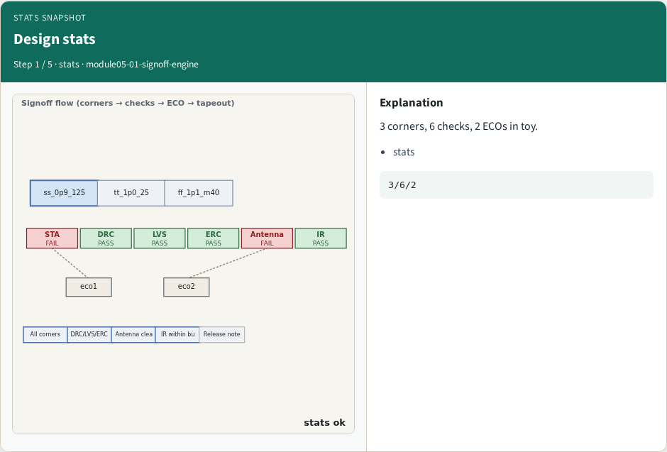
Design stats
Design stats
learn_signoff — 01 signoff engine
Notes:
3 corners, 6 checks, 2 ECOs in toy.

Slide 4
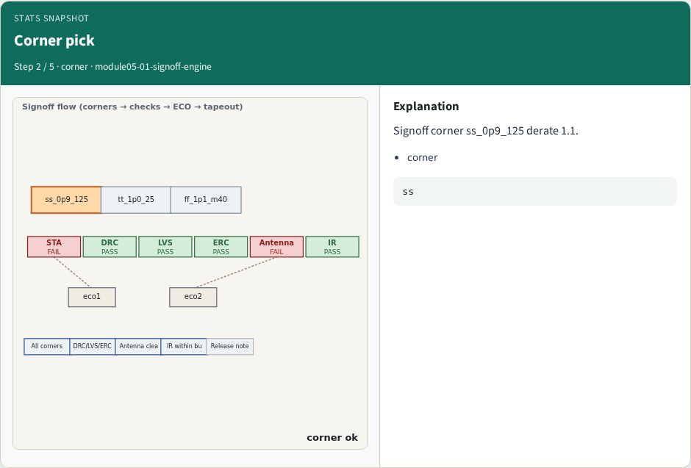
Corner pick
Corner pick
learn_signoff — 01 signoff engine
Notes:
Signoff corner ss_0p9_125 derate 1.1.

Slide 5
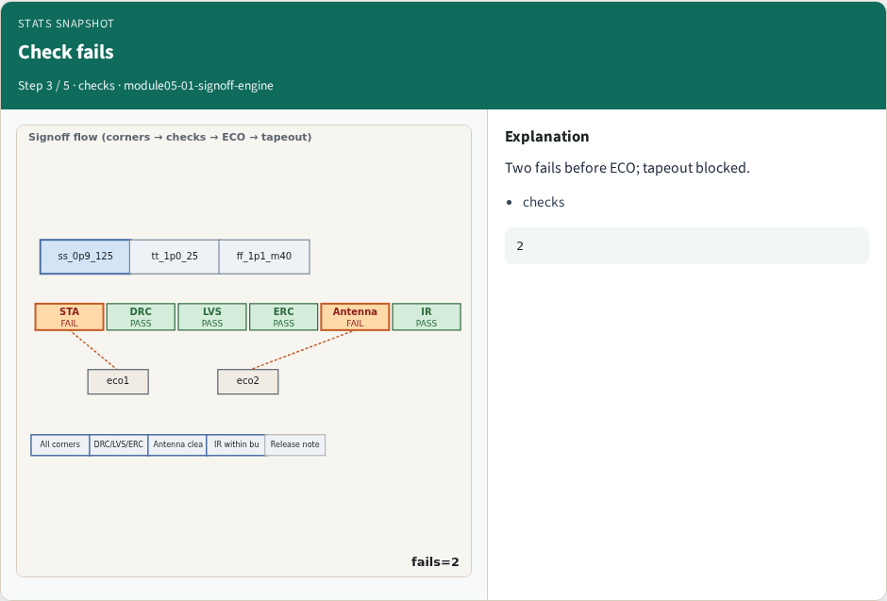
Check fails
Check fails
learn_signoff — 01 signoff engine
Notes:
Two fails before ECO; tapeout blocked.

Slide 6
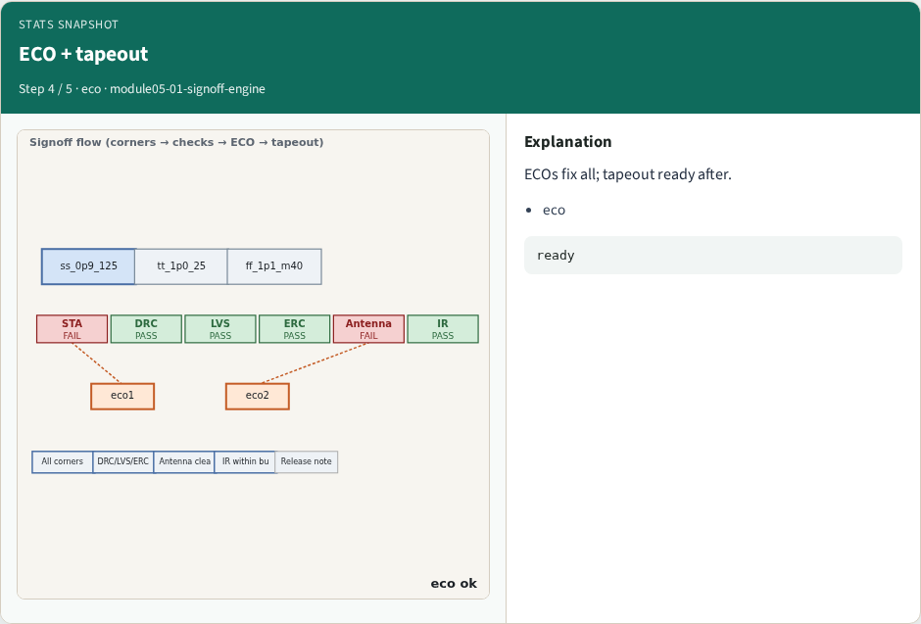
ECO + tapeout
ECO + tapeout
learn_signoff — 01 signoff engine
Notes:
ECOs fix all; tapeout ready after.

Slide 7
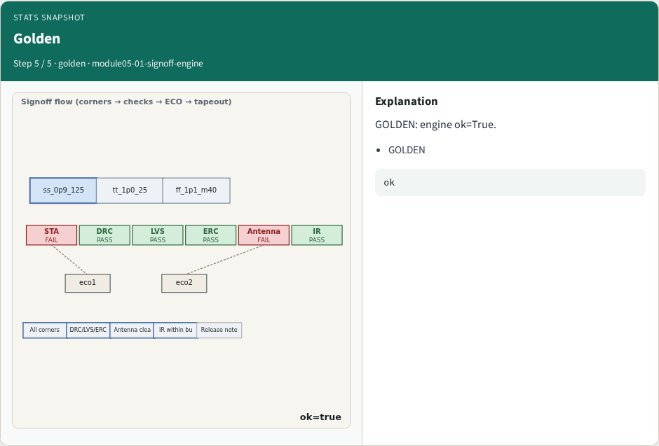
Golden
Golden
learn_signoff — 01 signoff engine
Notes:
GOLDEN: engine ok=True.

Slide 8
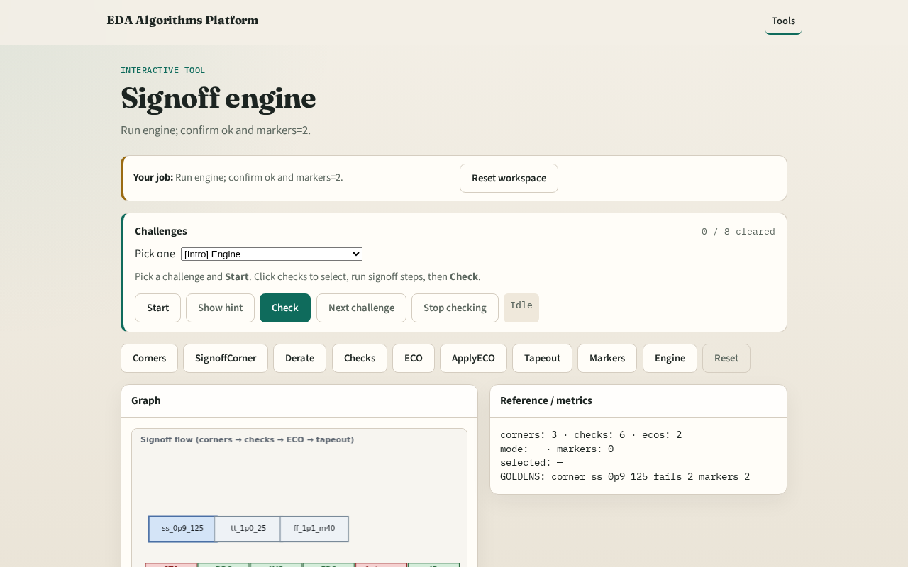
Browser lab track
Browser lab starter
learn_signoff — 01 signoff engine
Notes:
Open **signoff-engine**. Run engine; confirm ok.

Slide 9
Implement track
Call signoff_engine(); assert ok and markers.count==2
learn_signoff — 01 signoff engine
Notes:
Call signoff_engine(); assert ok and markers.count==2.

Slide 10
Pitfalls
Reporting partial checks
Changing toy without updating goldens
learn_signoff — 01 signoff engine
Notes:
Reporting partial checks. Changing toy without updating goldens.

Slide 11
Your turn
Next: offline compare, then wrap
learn_signoff — 01 signoff engine
Notes:
Next: offline compare, then wrap.

