Slide 1
Why proc
The proc pass lowers RTL to a gate-level netlist Yosys can optimize
learn_yosys — 01 proc elaborate
Notes:
The proc pass lowers RTL to a gate-level netlist Yosys can optimize.

Slide 2
The idea
GOLDEN: rtl_cell_count=6, module_count=2
learn_yosys — 01 proc elaborate
Notes:
GOLDEN: rtl_cell_count=6, module_count=2.

Slide 3
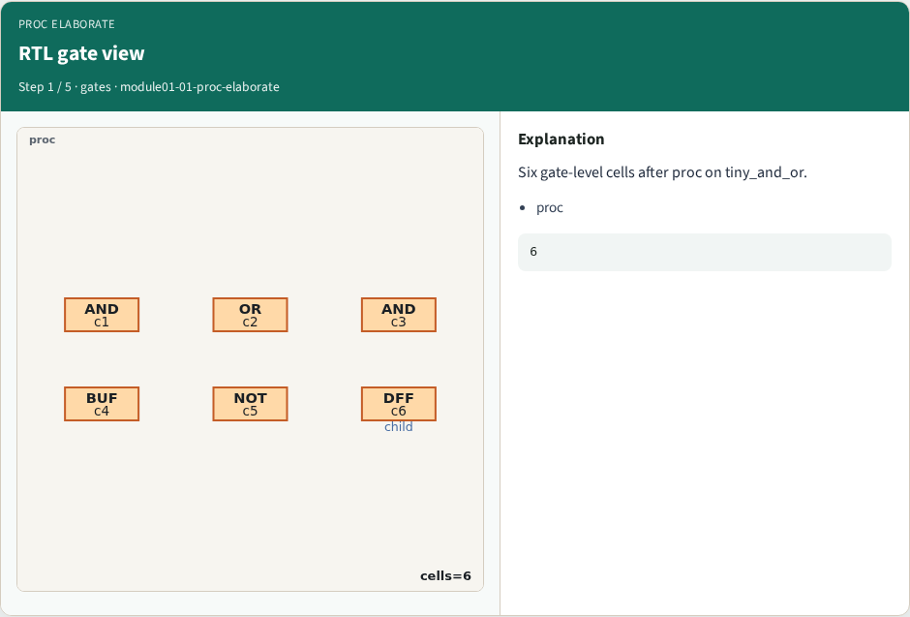
RTL gate view
RTL gate view
learn_yosys — 01 proc elaborate
Notes:
Six gate-level cells after proc on tiny_and_or.

Slide 4
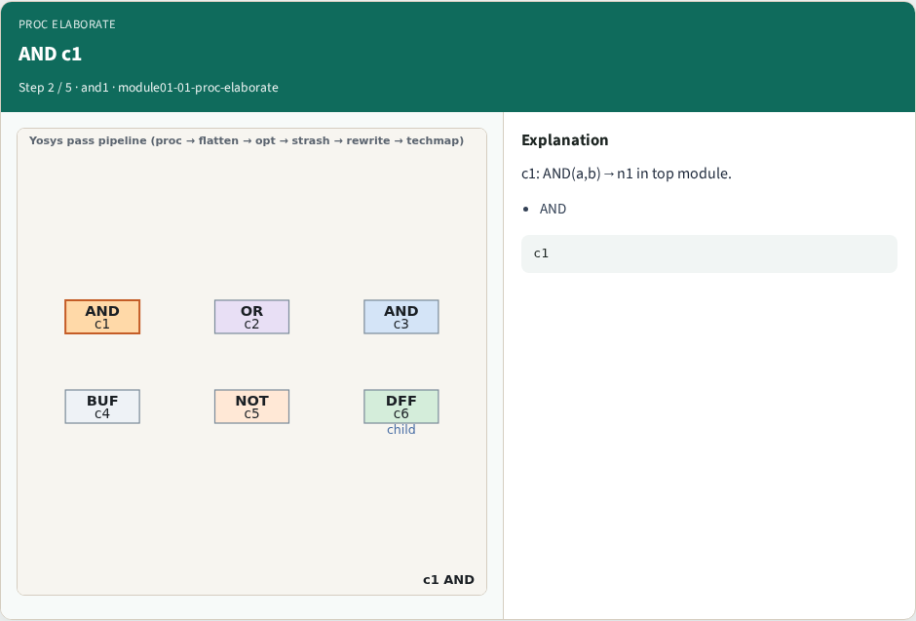
AND c1
AND c1
learn_yosys — 01 proc elaborate
Notes:
c1: AND(a,b)→n1 in top module.

Slide 5
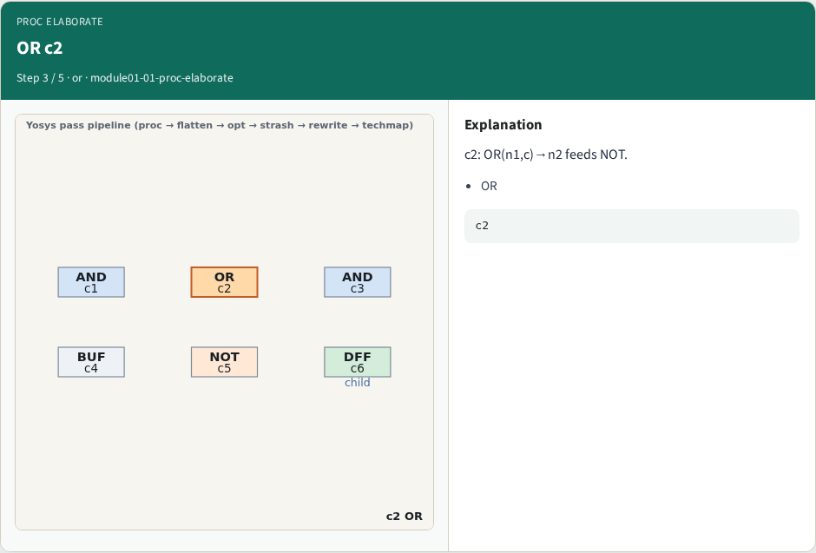
OR c2
OR c2
learn_yosys — 01 proc elaborate
Notes:
c2: OR(n1,c)→n2 feeds NOT.

Slide 6
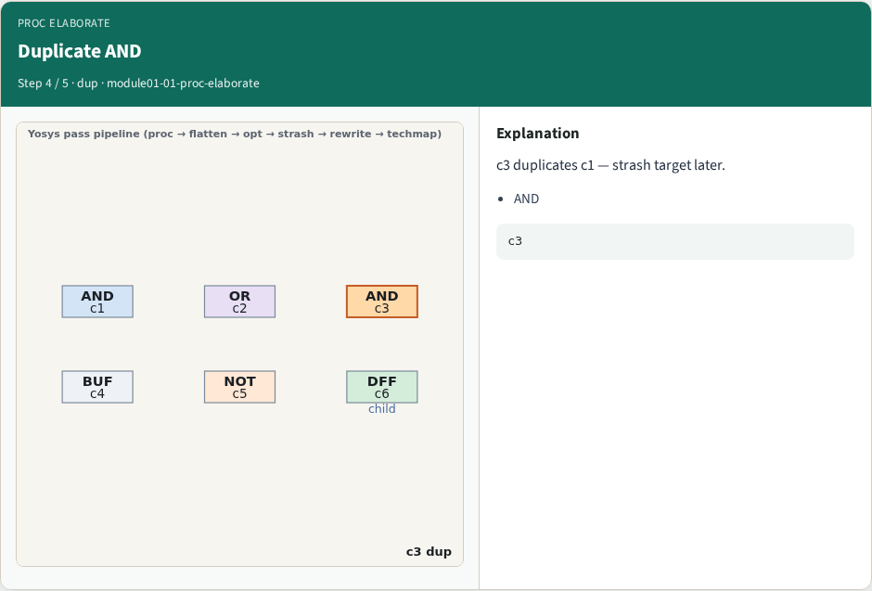
Duplicate AND
Duplicate AND
learn_yosys — 01 proc elaborate
Notes:
c3 duplicates c1 — strash target later.

Slide 7
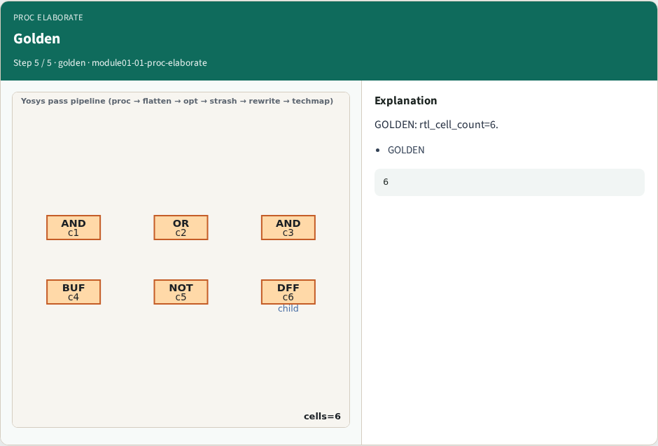
Golden
Golden
learn_yosys — 01 proc elaborate
Notes:
GOLDEN: rtl_cell_count=6.

Slide 8
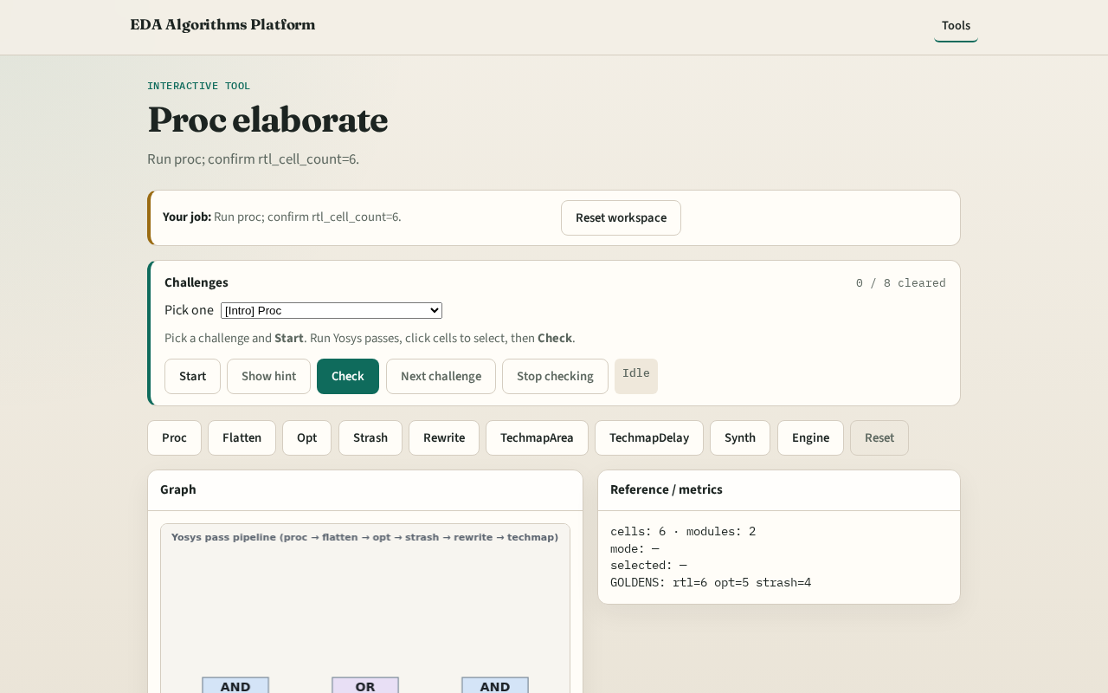
Browser lab track
Browser lab starter
learn_yosys — 01 proc elaborate
Notes:
Open **proc-elaborate**. Inspect tiny_yosys; confirm 6 cells.

Slide 9
Implement track
Call pass_proc(); assert cell_count==6
learn_yosys — 01 proc elaborate
Notes:
Call pass_proc(); assert cell_count==6.

Slide 10
Pitfalls
Confusing proc with synth
Expecting fewer cells before opt
learn_yosys — 01 proc elaborate
Notes:
Confusing proc with synth. Expecting fewer cells before opt.

Slide 11
Your turn
Next: hierarchy flatten
learn_yosys — 01 proc elaborate
Notes:
Next: hierarchy flatten.

