Slide 1
Why flatten
Flatten merges child hierarchy so later passes see one module
learn_yosys — 03 hierarchy flatten
Notes:
Flatten merges child hierarchy so later passes see one module.

Slide 2
The idea
GOLDEN: after_flatten_modules=1
learn_yosys — 03 hierarchy flatten
Notes:
GOLDEN: after_flatten_modules=1.

Slide 3
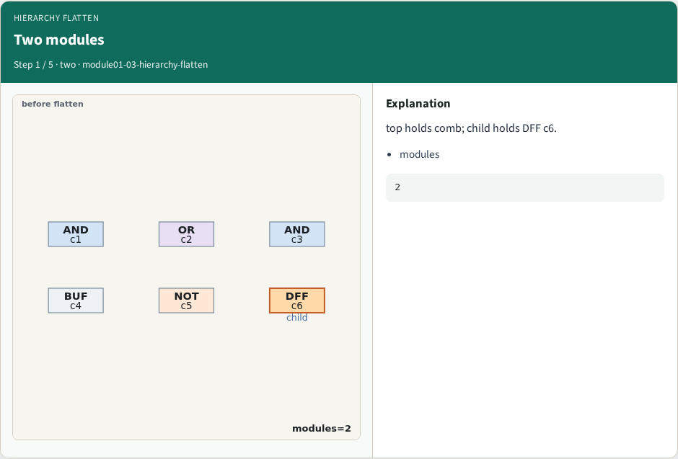
Two modules
Two modules
learn_yosys — 03 hierarchy flatten
Notes:
top holds comb; child holds DFF c6.

Slide 4
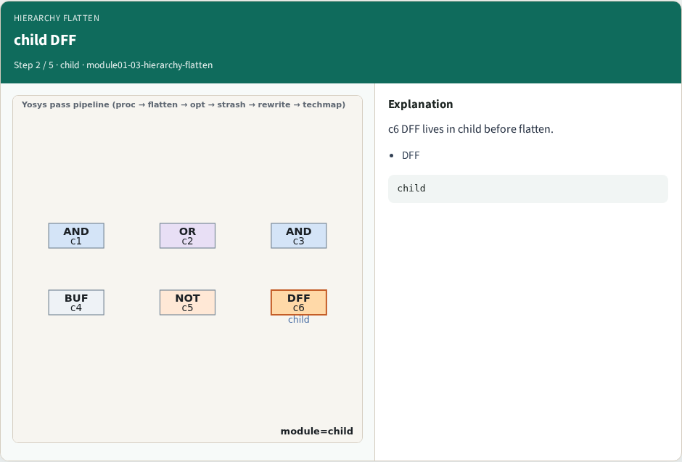
child DFF
child DFF
learn_yosys — 03 hierarchy flatten
Notes:
c6 DFF lives in child before flatten.

Slide 5
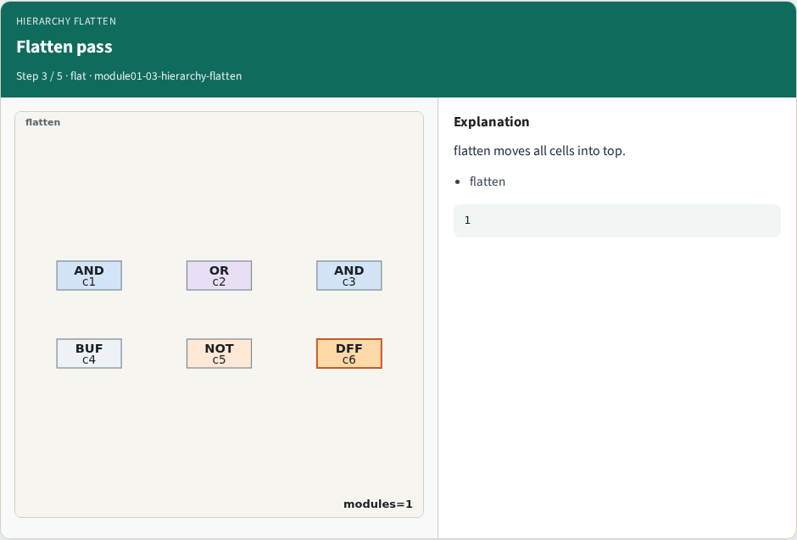
Flatten pass
Flatten pass
learn_yosys — 03 hierarchy flatten
Notes:
flatten moves all cells into top.

Slide 6
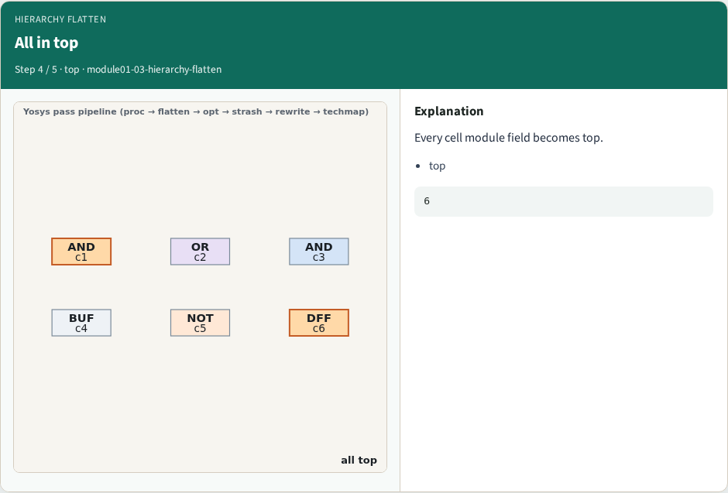
All in top
All in top
learn_yosys — 03 hierarchy flatten
Notes:
Every cell module field becomes top.

Slide 7
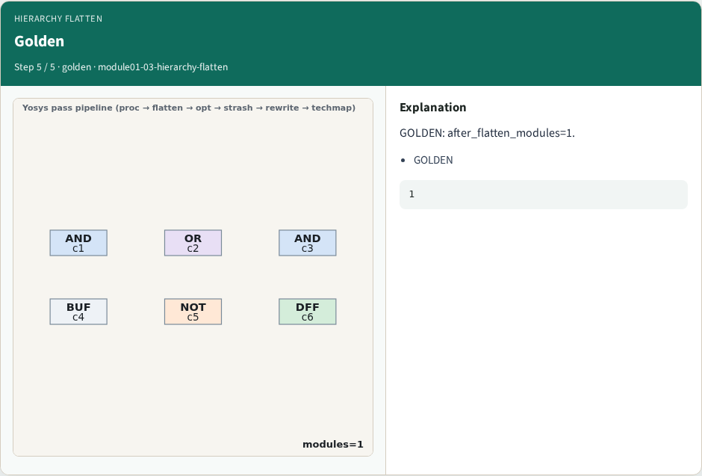
Golden
Golden
learn_yosys — 03 hierarchy flatten
Notes:
GOLDEN: after_flatten_modules=1.

Slide 8
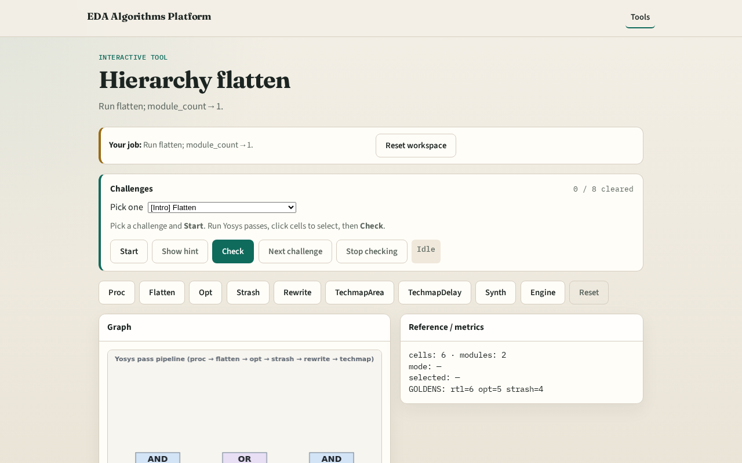
Browser lab track
Browser lab starter
learn_yosys — 03 hierarchy flatten
Notes:
Open **hierarchy-flatten**. Confirm module_count=1.

Slide 9
Implement track
Call pass_hierarchy_flatten(); assert module_count==1
learn_yosys — 03 hierarchy flatten
Notes:
Call pass_hierarchy_flatten(); assert module_count==1.

Slide 10
Pitfalls
Flattening before proc
Forgetting DFF in child
learn_yosys — 03 hierarchy flatten
Notes:
Flattening before proc. Forgetting DFF in child.

Slide 11
Your turn
Next: opt/DCE
learn_yosys — 03 hierarchy flatten
Notes:
Next: opt/DCE.

