Slide 1
Why opt
Opt removes unreachable logic such as BUF tied to const0
learn_yosys — 01 opt dce
Notes:
opt removes unreachable logic such as BUF tied to const0.

Slide 2
The idea
GOLDEN: after_opt_cells=5, removed c4
learn_yosys — 01 opt dce
Notes:
GOLDEN: after_opt_cells=5, removed c4.

Slide 3
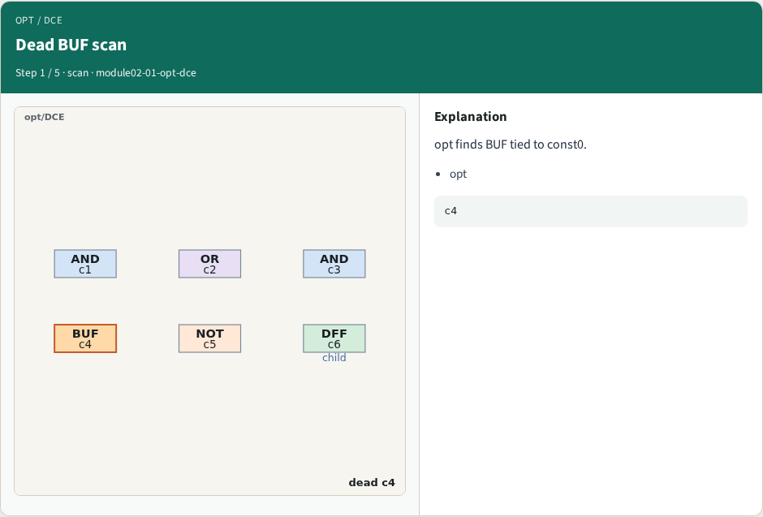
Dead BUF scan
Dead BUF scan
learn_yosys — 01 opt dce
Notes:
opt finds BUF tied to const0.

Slide 4
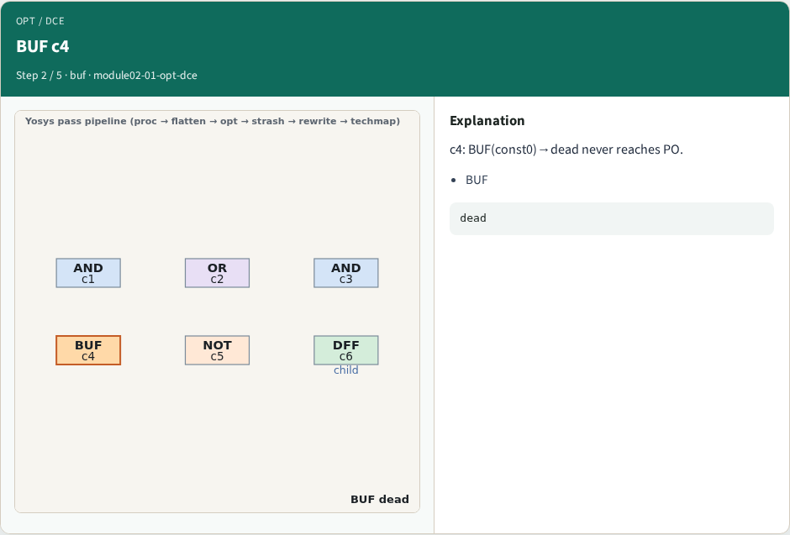
BUF c4
BUF c4
learn_yosys — 01 opt dce
Notes:
c4: BUF(const0)→dead never reaches PO.

Slide 5
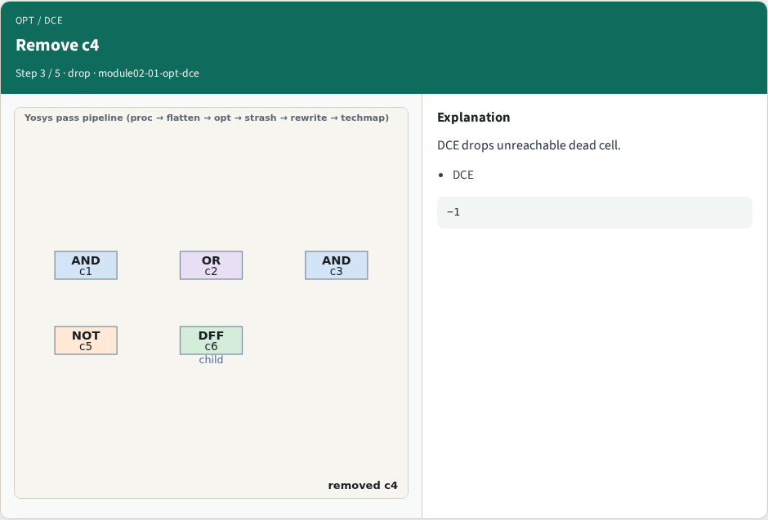
Remove c4
Remove c4
learn_yosys — 01 opt dce
Notes:
DCE drops unreachable dead cell.

Slide 6
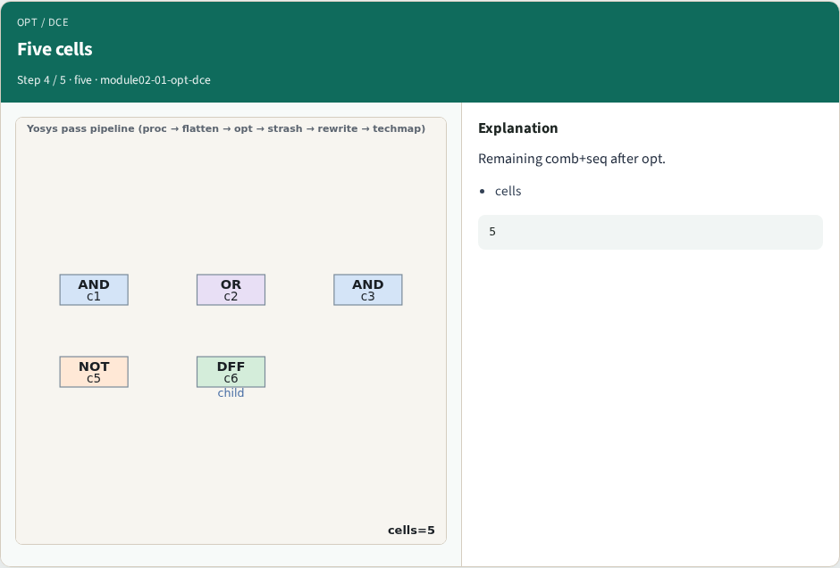
Five cells
Five cells
learn_yosys — 01 opt dce
Notes:
Remaining comb+seq after opt.

Slide 7
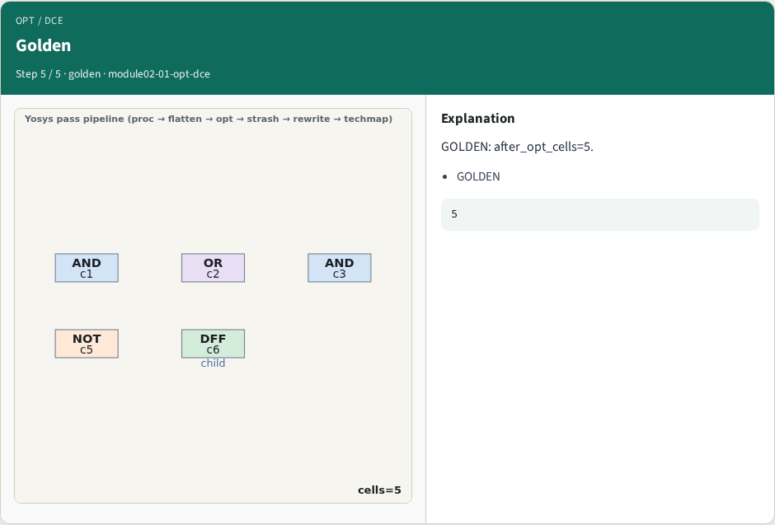
Golden
Golden
learn_yosys — 01 opt dce
Notes:
GOLDEN: after_opt_cells=5.

Slide 8
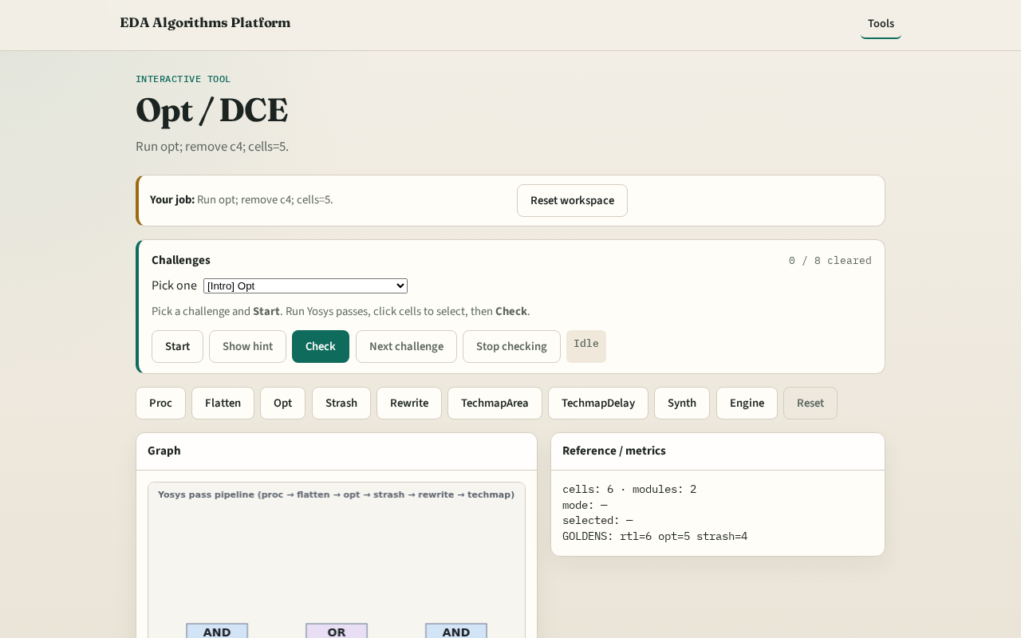
Browser lab track
Browser lab starter
learn_yosys — 01 opt dce
Notes:
Open **opt-dce**. Run opt; confirm cells=5 and c4 removed.

Slide 9
Implement track
Call pass_opt_dce(); assert cell_count==5 and c4 in removed
learn_yosys — 01 opt dce
Notes:
Call pass_opt_dce(); assert cell_count==5 and c4 in removed.

Slide 10
Pitfalls
Removing live cells
Skipping opt before strash
learn_yosys — 01 opt dce
Notes:
Removing live cells. Skipping opt before strash.

Slide 11
Your turn
Next: AIG strash
learn_yosys — 01 opt dce
Notes:
Next: AIG strash.

