Slide 1
Why strash
Strash merges structurally identical AND(a,b) and retargets fans
learn_yosys — 03 aig strash
Notes:
strash merges structurally identical AND(a,b) and retargets fans.

Slide 2
The idea
GOLDEN: after_strash_cells=4, merge n3→n1
learn_yosys — 03 aig strash
Notes:
GOLDEN: after_strash_cells=4, merge n3→n1.

Slide 3
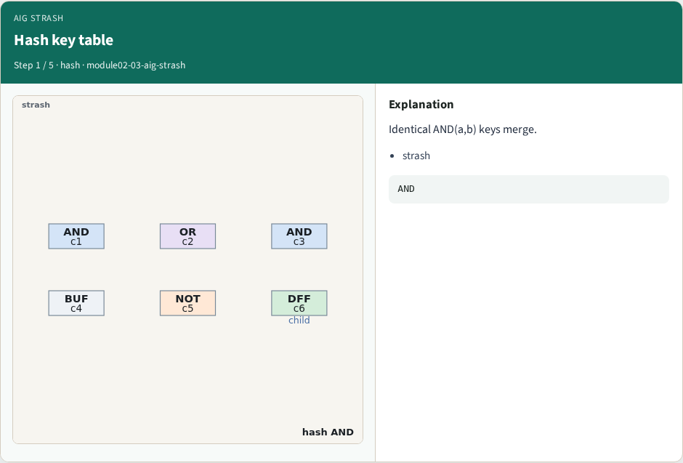
Hash key table
Hash key table
learn_yosys — 03 aig strash
Notes:
Identical AND(a,b) keys merge.

Slide 4
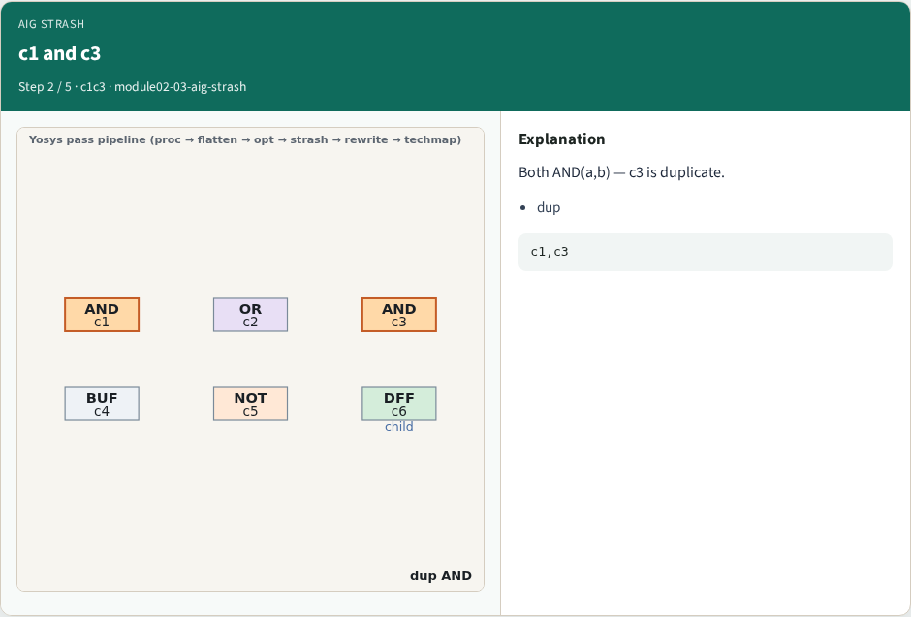
c1 and c3
c1 and c3
learn_yosys — 03 aig strash
Notes:
Both AND(a,b) — c3 is duplicate.

Slide 5
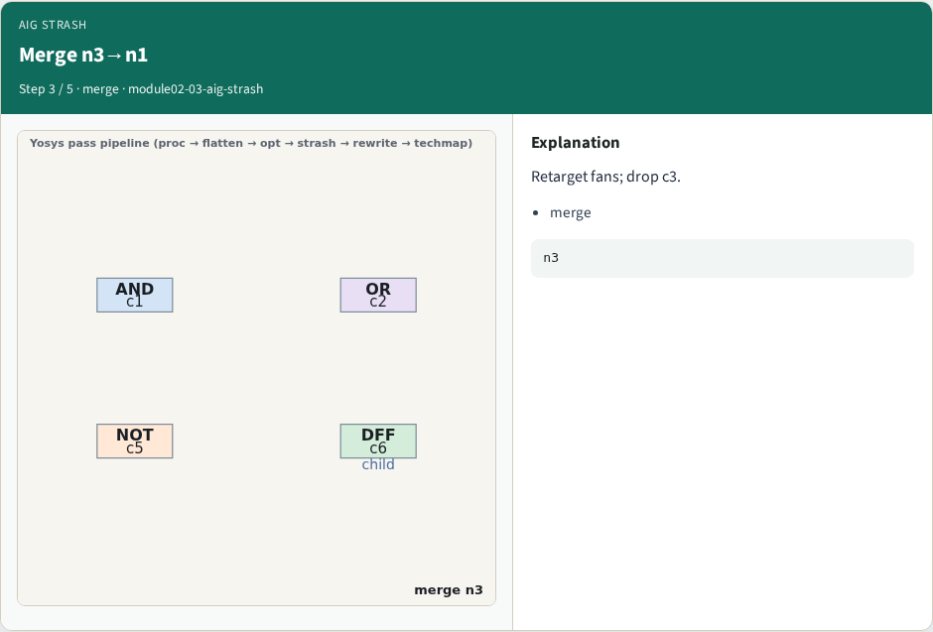
Merge n3→n1
Merge n3→n1
learn_yosys — 03 aig strash
Notes:
Retarget fans; drop c3.

Slide 6
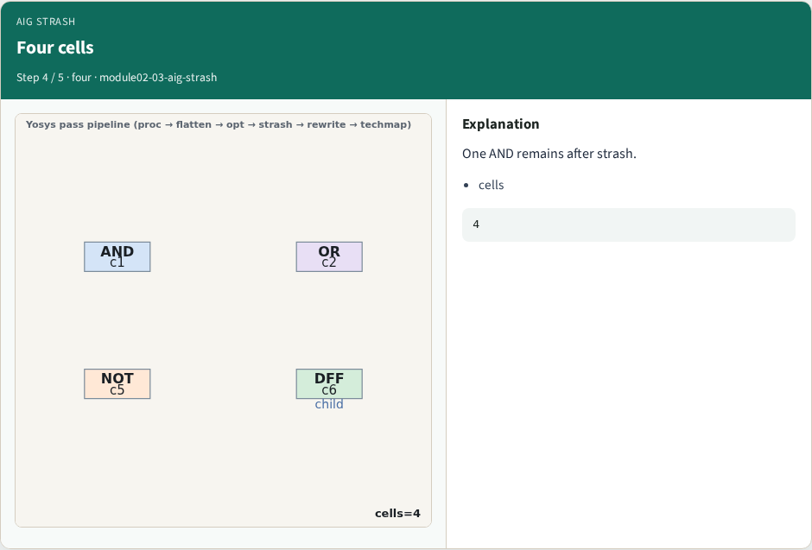
Four cells
Four cells
learn_yosys — 03 aig strash
Notes:
One AND remains after strash.

Slide 7
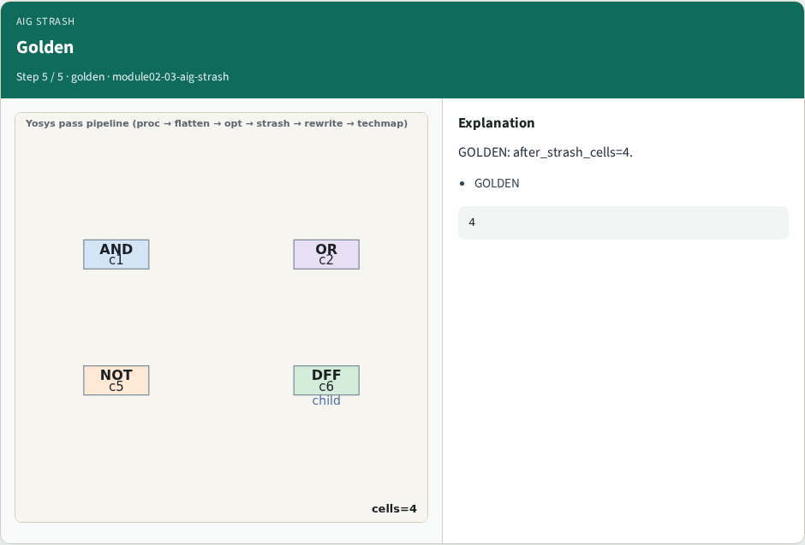
Golden
Golden
learn_yosys — 03 aig strash
Notes:
GOLDEN: after_strash_cells=4.

Slide 8

Browser lab track
Browser lab starter
learn_yosys — 03 aig strash
Notes:
Open **aig-strash**. Confirm cells=4 and n3 merged.

Slide 9
Implement track
Call pass_aig_strash(); assert cell_count==4
learn_yosys — 03 aig strash
Notes:
Call pass_aig_strash(); assert cell_count==4.

Slide 10
Pitfalls
Merging unlike cells
Forgetting fan retarget
learn_yosys — 03 aig strash
Notes:
Merging unlike cells. Forgetting fan retarget.

Slide 11
Your turn
Next: rewrite
learn_yosys — 03 aig strash
Notes:
Next: rewrite.

