Slide 1
Why rewrite
Rewrite absorbs OR followed by NOT into a single NOR cell
learn_yosys — 01 rewrite balance
Notes:
rewrite absorbs OR followed by NOT into a single NOR cell.

Slide 2
The idea
GOLDEN: after_rewrite_cells=3, comb=2, seq=1
learn_yosys — 01 rewrite balance
Notes:
GOLDEN: after_rewrite_cells=3, comb=2, seq=1.

Slide 3
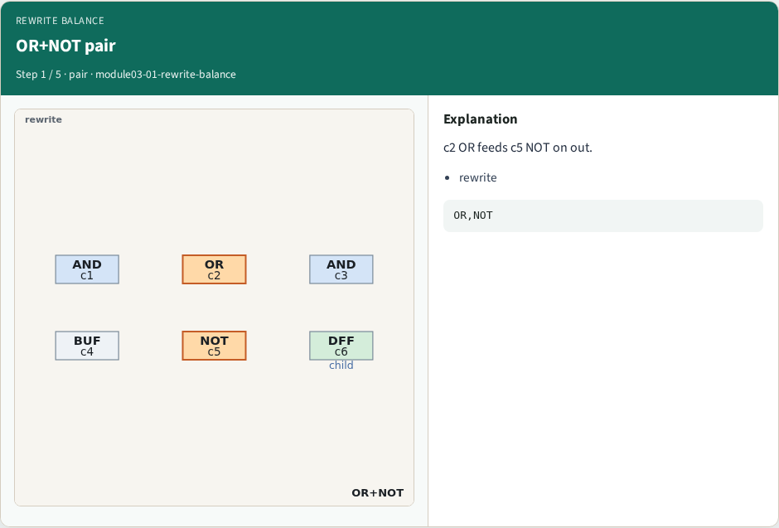
OR+NOT pair
OR+NOT pair
learn_yosys — 01 rewrite balance
Notes:
c2 OR feeds c5 NOT on out.

Slide 4
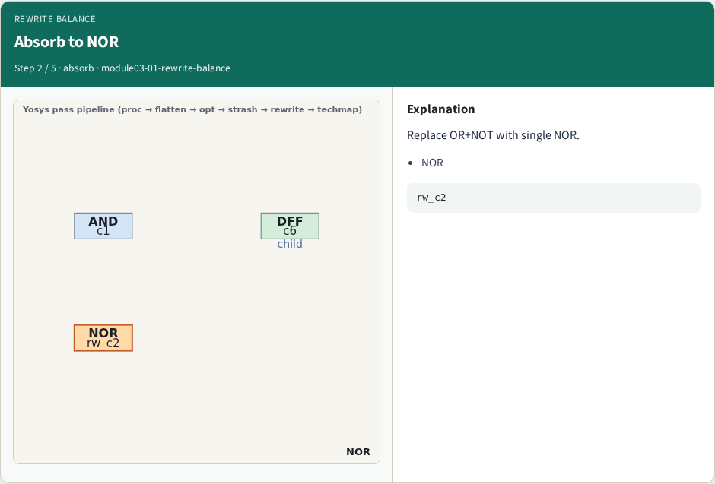
Absorb to NOR
Absorb to NOR
learn_yosys — 01 rewrite balance
Notes:
Replace OR+NOT with single NOR.

Slide 5
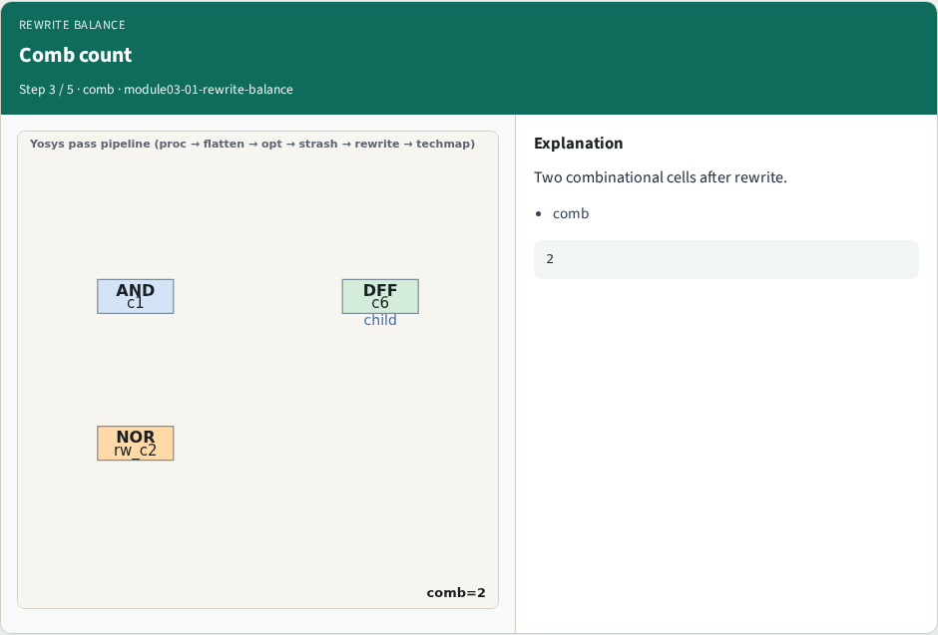
Comb count
Comb count
learn_yosys — 01 rewrite balance
Notes:
Two combinational cells after rewrite.

Slide 6
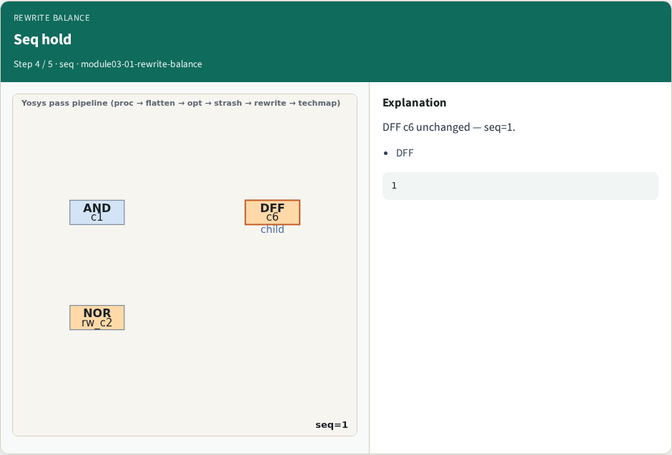
Seq hold
Seq hold
learn_yosys — 01 rewrite balance
Notes:
DFF c6 unchanged — seq=1.

Slide 7
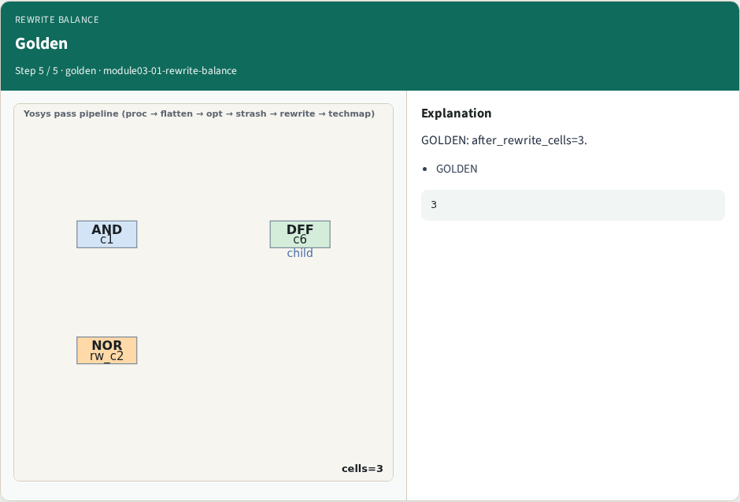
Golden
Golden
learn_yosys — 01 rewrite balance
Notes:
GOLDEN: after_rewrite_cells=3.

Slide 8
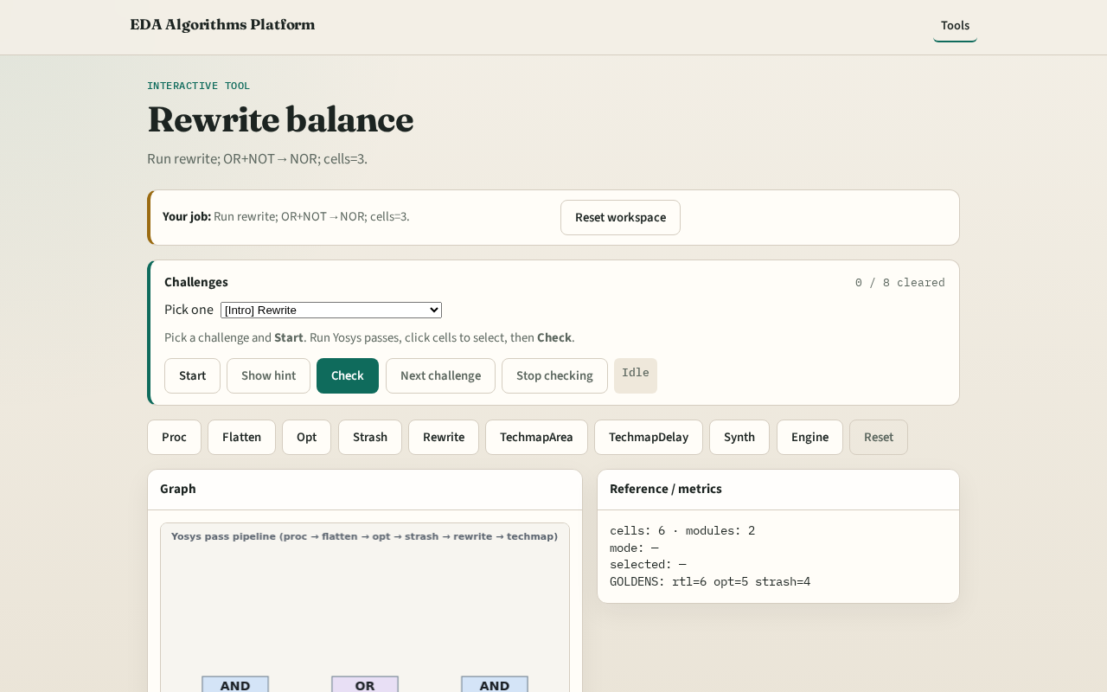
Browser lab track
Browser lab starter
learn_yosys — 01 rewrite balance
Notes:
Open **rewrite-balance**. Confirm cells=3 and NOR present.

Slide 9
Implement track
Call pass_rewrite(); assert cell_count==3 and comb_count==2
learn_yosys — 01 rewrite balance
Notes:
Call pass_rewrite(); assert cell_count==3 and comb_count==2.

Slide 10
Pitfalls
Rewriting DFF
Missing OR+NOT pattern
learn_yosys — 01 rewrite balance
Notes:
Rewriting DFF. Missing OR+NOT pattern.

Slide 11
Your turn
Next: techmap area
learn_yosys — 01 rewrite balance
Notes:
Next: techmap area.

