Slide 1
Why area map
Techmap maps AND/NOR to a NAND2 library minimizing cell count
learn_yosys — 03 techmap area
Notes:
techmap maps AND/NOR to a NAND2 library minimizing cell count.

Slide 2
The idea
GOLDEN: techmap_nand_count_area=6
learn_yosys — 03 techmap area
Notes:
GOLDEN: techmap_nand_count_area=6.

Slide 3
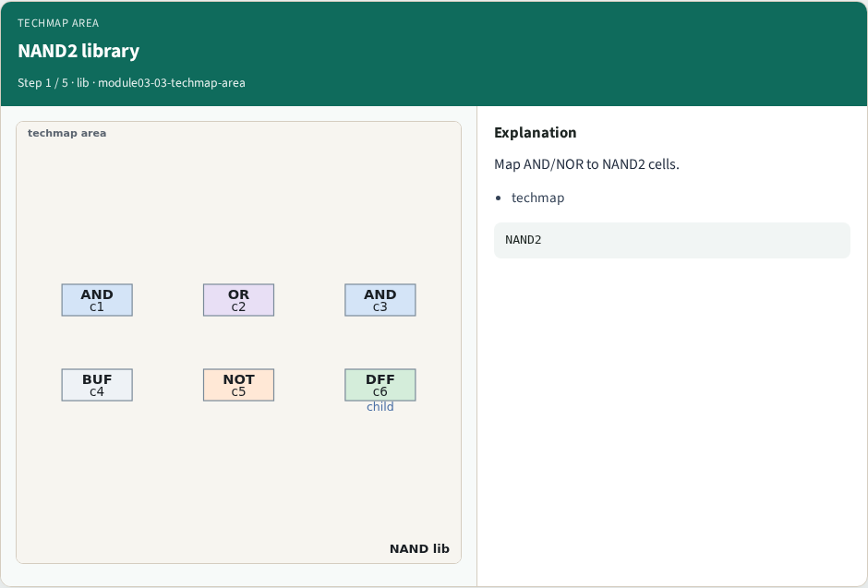
NAND2 library
NAND2 library
learn_yosys — 03 techmap area
Notes:
Map AND/NOR to NAND2 cells.

Slide 4
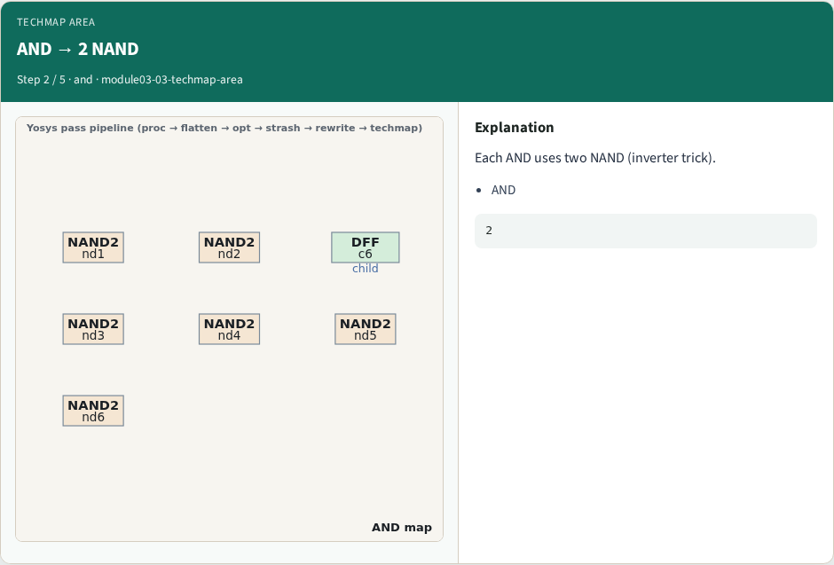
AND → 2 NAND
AND → 2 NAND
learn_yosys — 03 techmap area
Notes:
Each AND uses two NAND (inverter trick).

Slide 5
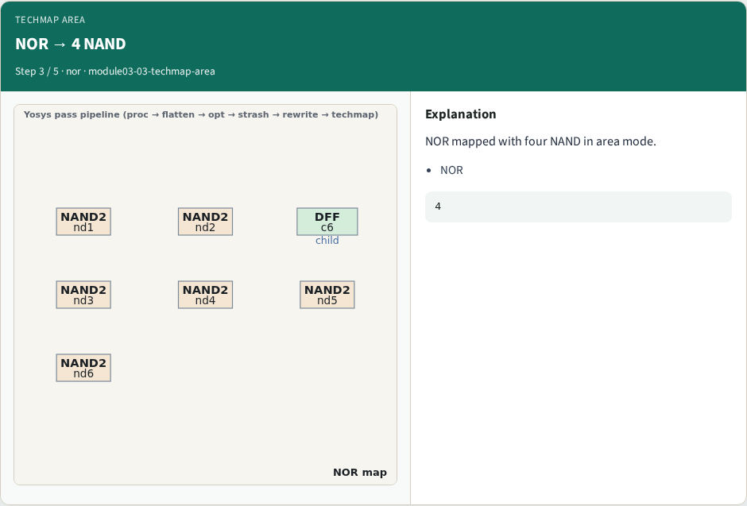
NOR → 4 NAND
NOR → 4 NAND
learn_yosys — 03 techmap area
Notes:
NOR mapped with four NAND in area mode.

Slide 6
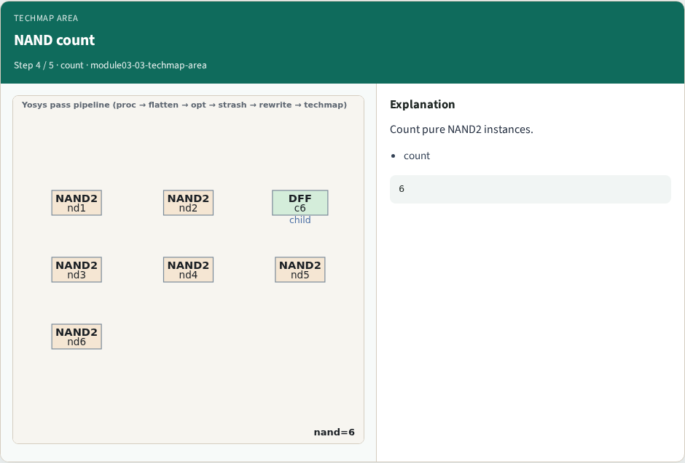
NAND count
NAND count
learn_yosys — 03 techmap area
Notes:
Count pure NAND2 instances.

Slide 7
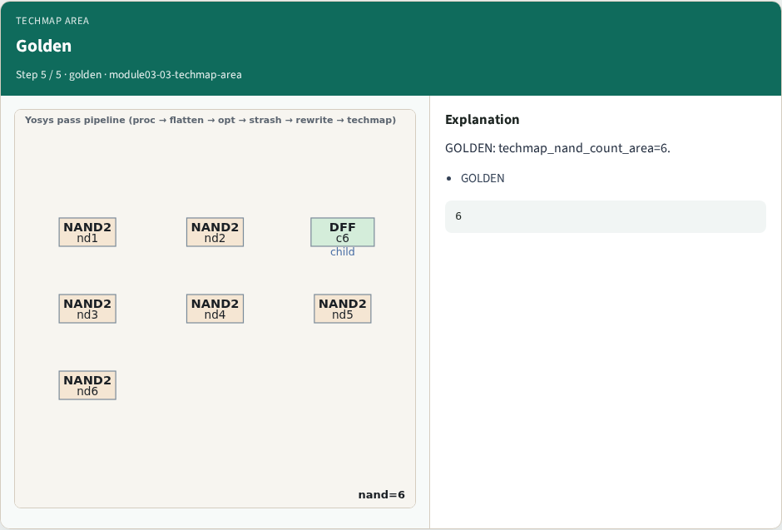
Golden
Golden
learn_yosys — 03 techmap area
Notes:
GOLDEN: techmap_nand_count_area=6.

Slide 8
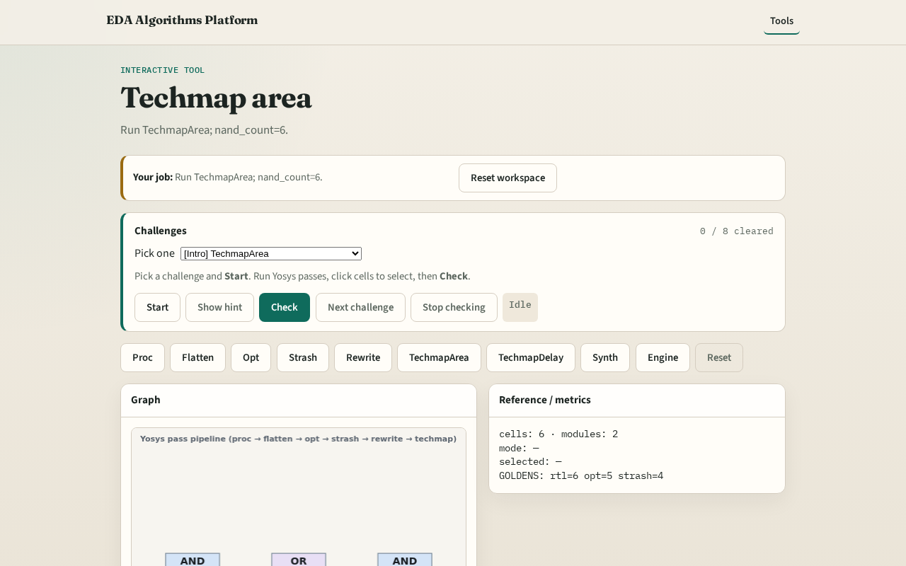
Browser lab track
Browser lab starter
learn_yosys — 03 techmap area
Notes:
Open **techmap-area**. Confirm nand_count=6.

Slide 9
Implement track
Call pass_techmap(mode='area'); assert nand_count==6
learn_yosys — 03 techmap area
Notes:
Call pass_techmap(mode='area'); assert nand_count==6.

Slide 10
Pitfalls
Counting DFF as NAND
Using delay mapping
learn_yosys — 03 techmap area
Notes:
Counting DFF as NAND. Using delay mapping.

Slide 11
Your turn
Next: techmap delay
learn_yosys — 03 techmap area
Notes:
Next: techmap delay.

