Slide 1
Why delay map
Delay-oriented techmap adds buffer NAND for timing literacy
learn_yosys — 01 techmap delay
Notes:
Delay-oriented techmap adds buffer NAND for timing literacy.

Slide 2
The idea
GOLDEN: techmap_nand_count_delay=7
learn_yosys — 01 techmap delay
Notes:
GOLDEN: techmap_nand_count_delay=7.

Slide 3
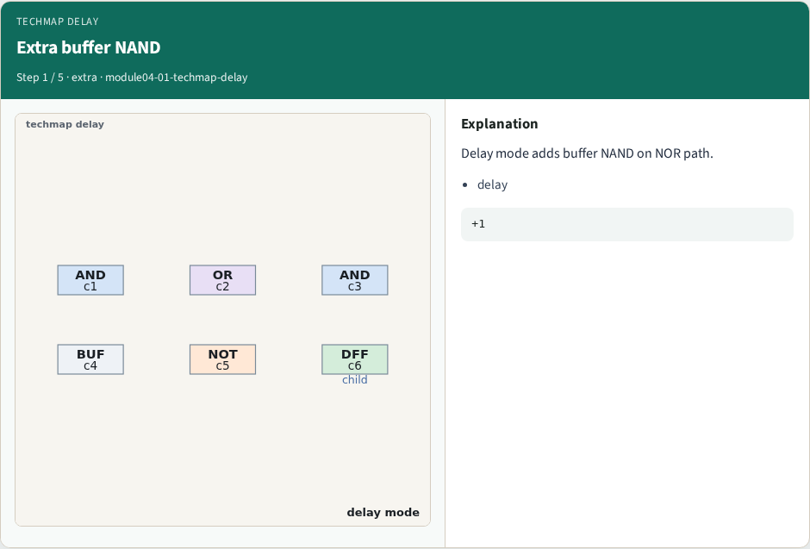
Extra buffer NAND
Extra buffer NAND
learn_yosys — 01 techmap delay
Notes:
Delay mode adds buffer NAND on NOR path.

Slide 4
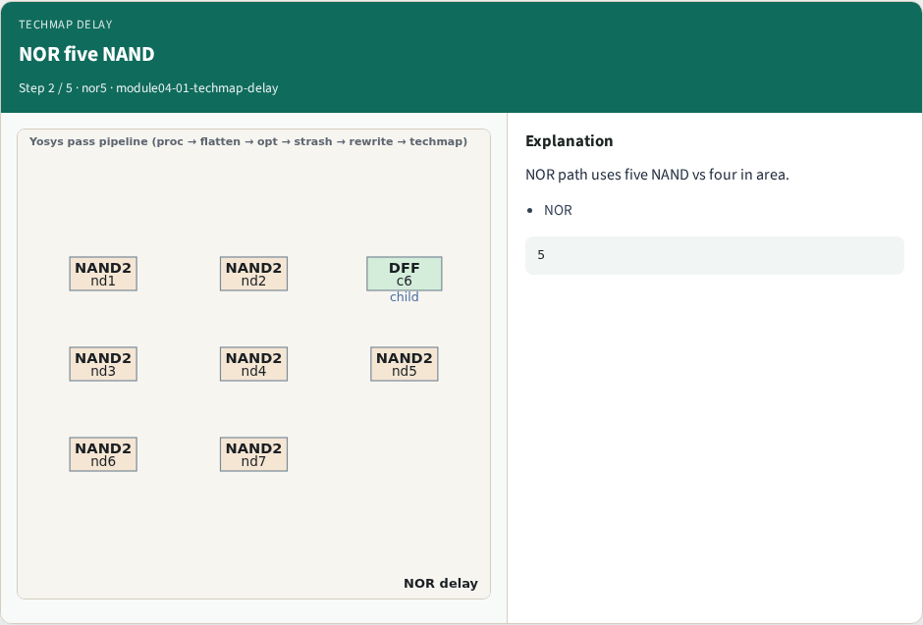
NOR five NAND
NOR five NAND
learn_yosys — 01 techmap delay
Notes:
NOR path uses five NAND vs four in area.

Slide 5
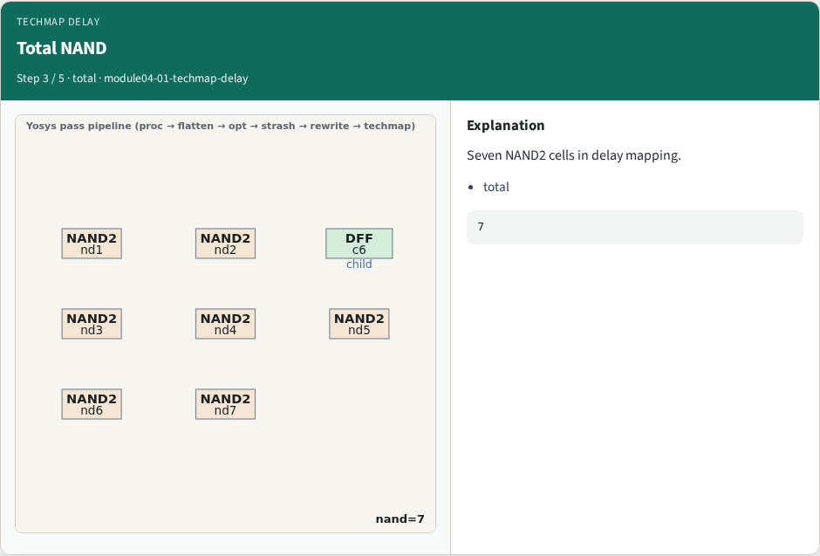
Total NAND
Total NAND
learn_yosys — 01 techmap delay
Notes:
Seven NAND2 cells in delay mapping.

Slide 6
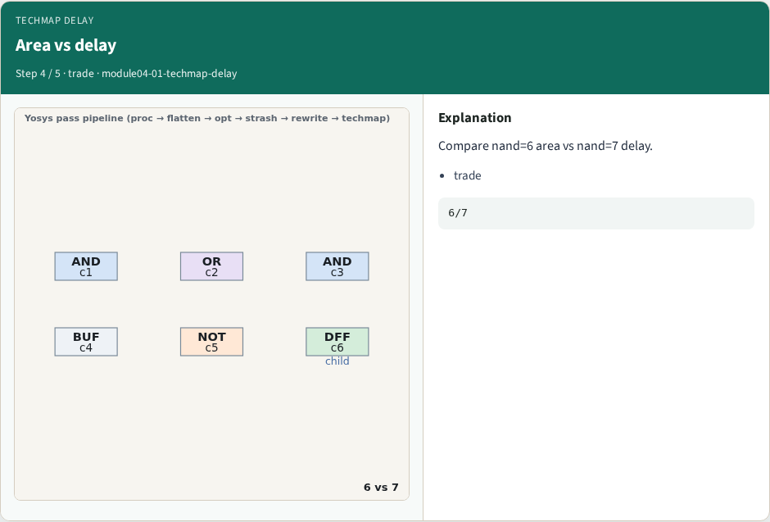
Area vs delay
Area vs delay
learn_yosys — 01 techmap delay
Notes:
Compare nand=6 area vs nand=7 delay.

Slide 7
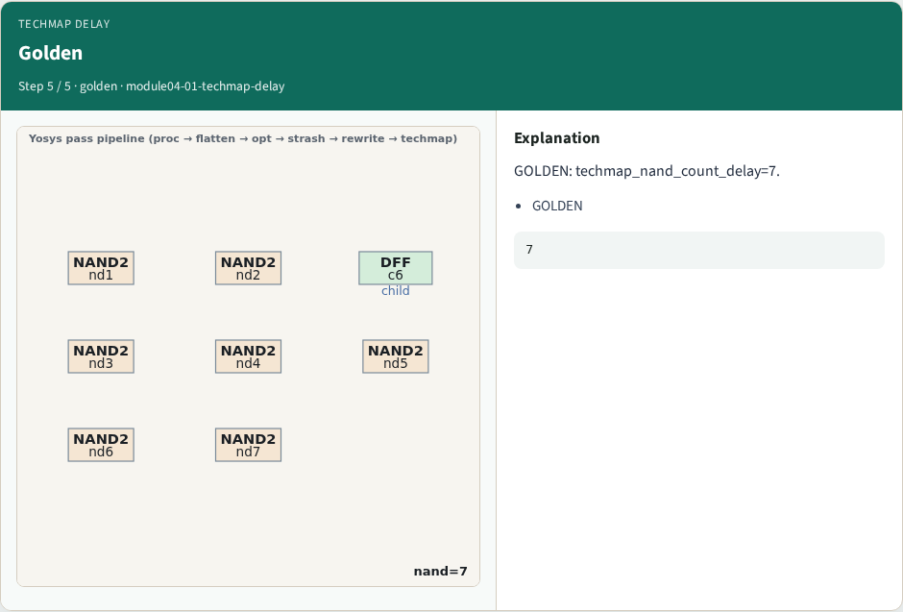
Golden
Golden
learn_yosys — 01 techmap delay
Notes:
GOLDEN: techmap_nand_count_delay=7.

Slide 8
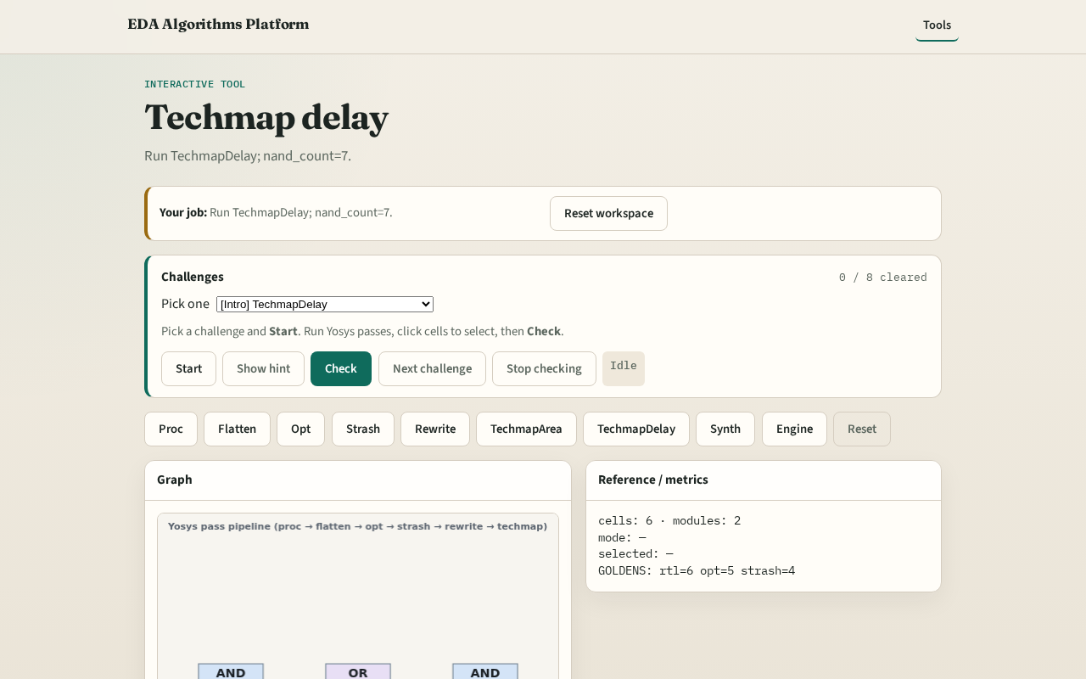
Browser lab track
Browser lab starter
learn_yosys — 01 techmap delay
Notes:
Open **techmap-delay**. Confirm nand_count=7.

Slide 9
Implement track
Call pass_techmap(mode='delay'); assert nand_count==7
learn_yosys — 01 techmap delay
Notes:
Call pass_techmap(mode='delay'); assert nand_count==7.

Slide 10
Pitfalls
Expecting same count as area
Ignoring DFF passthrough
learn_yosys — 01 techmap delay
Notes:
Expecting same count as area. Ignoring DFF passthrough.

Slide 11
Your turn
Next: synth script
learn_yosys — 01 techmap delay
Notes:
Next: synth script.

