Slide 1
Why synth
A Yosys synth script chains named passes into one recipe
learn_yosys — 03 synth script
Notes:
A Yosys synth script chains named passes into one recipe.

Slide 2
The idea
GOLDEN: full chain completes with nand area mapping
learn_yosys — 03 synth script
Notes:
GOLDEN: full chain completes with nand area mapping.

Slide 3
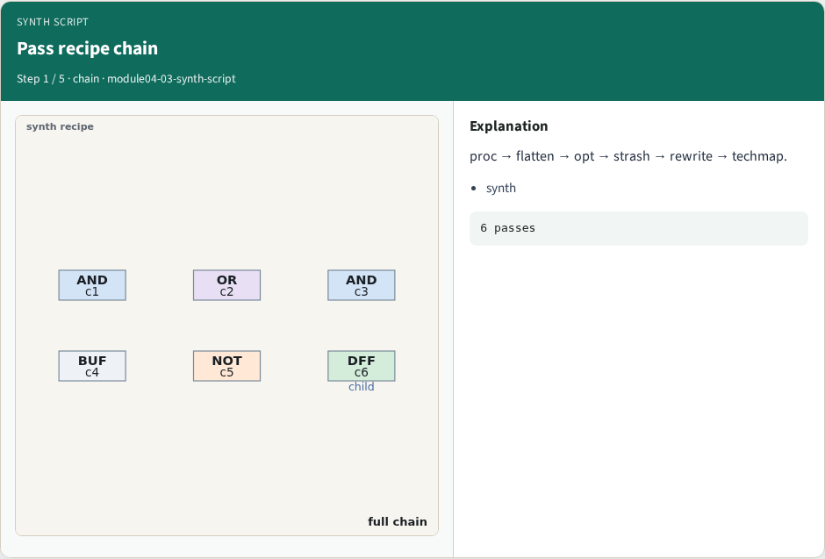
Pass recipe chain
Pass recipe chain
learn_yosys — 03 synth script
Notes:
proc → flatten → opt → strash → rewrite → techmap.

Slide 4
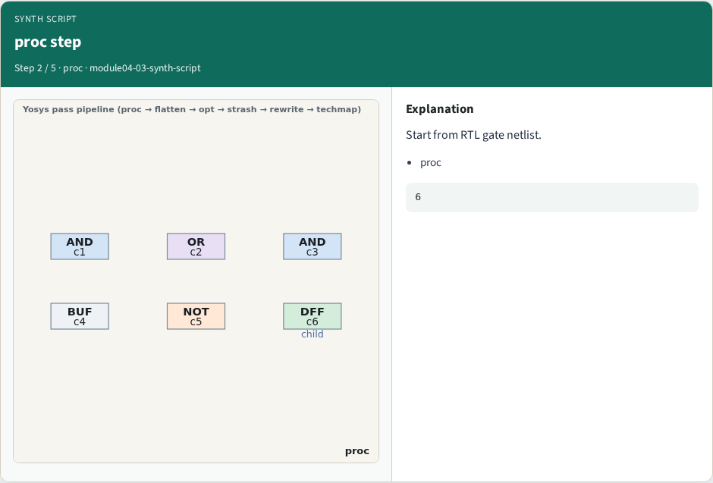
proc step
proc step
learn_yosys — 03 synth script
Notes:
Start from RTL gate netlist.

Slide 5
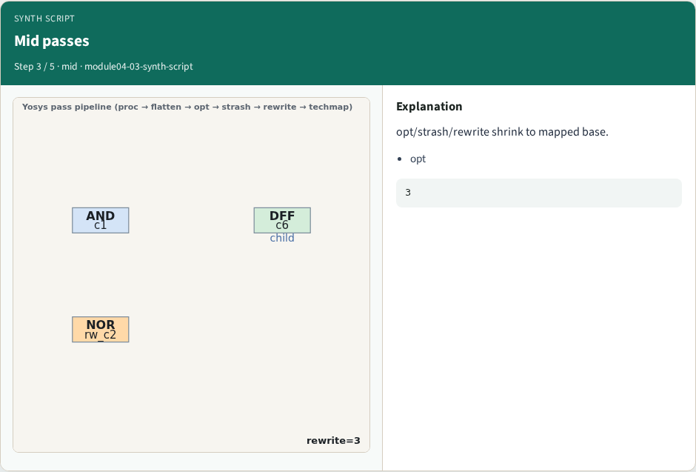
Mid passes
Mid passes
learn_yosys — 03 synth script
Notes:
opt/strash/rewrite shrink to mapped base.

Slide 6
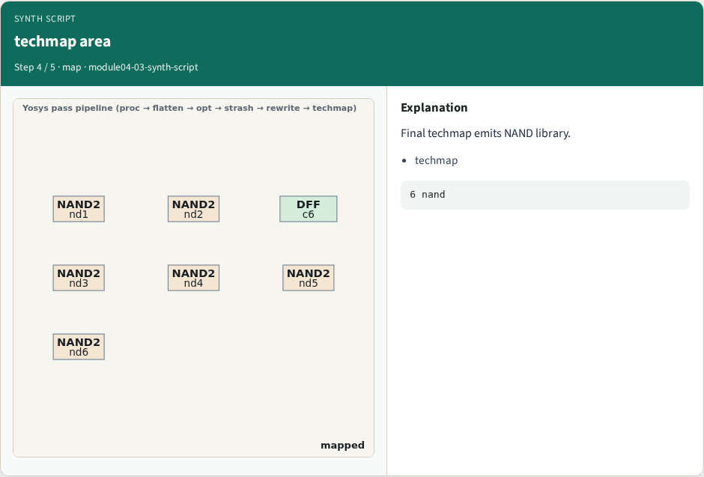
techmap area
techmap area
learn_yosys — 03 synth script
Notes:
Final techmap emits NAND library.

Slide 7
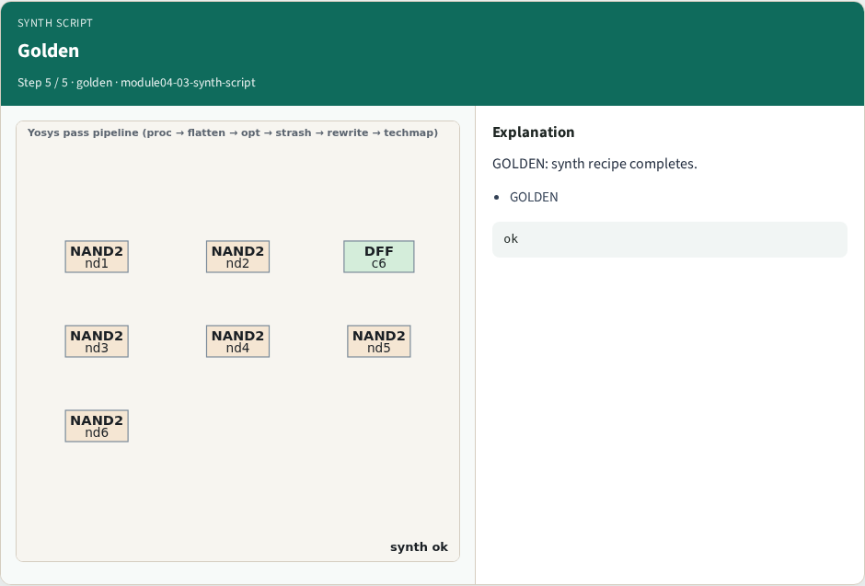
Golden
Golden
learn_yosys — 03 synth script
Notes:
GOLDEN: synth recipe completes.

Slide 8

Browser lab track
Browser lab starter
learn_yosys — 03 synth script
Notes:
Open **synth-script**. Run synth; confirm mapped netlist.

Slide 9
Implement track
Call pass_synth_script(); assert nand_count==6
learn_yosys — 03 synth script
Notes:
Call pass_synth_script(); assert nand_count==6.

Slide 10
Pitfalls
Skipping flatten
Wrong pass order
learn_yosys — 03 synth script
Notes:
Skipping flatten. Wrong pass order.

Slide 11
Your turn
Next: yosys engine
learn_yosys — 03 synth script
Notes:
Next: yosys engine.

