Slide 1
Engine
A tiny engine chains all passes and compares report stats to goldens
learn_yosys — 01 yosys engine
Notes:
A tiny engine chains all passes and compares report stats to goldens.

Slide 2
The idea
GOLDEN: engine_ok=True, report_cells=7, report_wires=11
learn_yosys — 01 yosys engine
Notes:
GOLDEN: engine_ok=True, report_cells=7, report_wires=11.

Slide 3
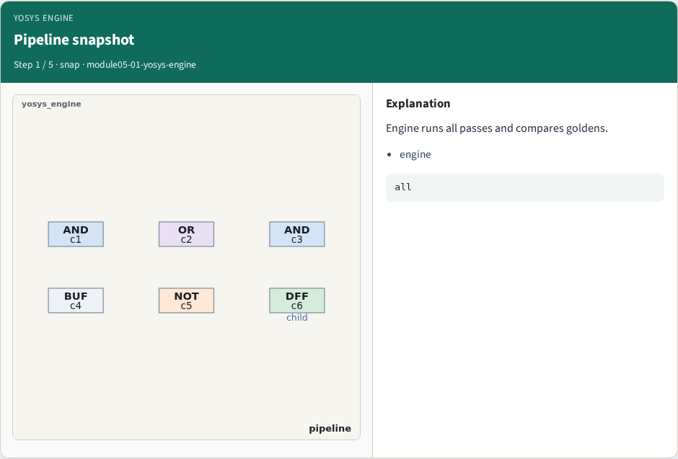
Pipeline snapshot
Pipeline snapshot
learn_yosys — 01 yosys engine
Notes:
Engine runs all passes and compares goldens.

Slide 4
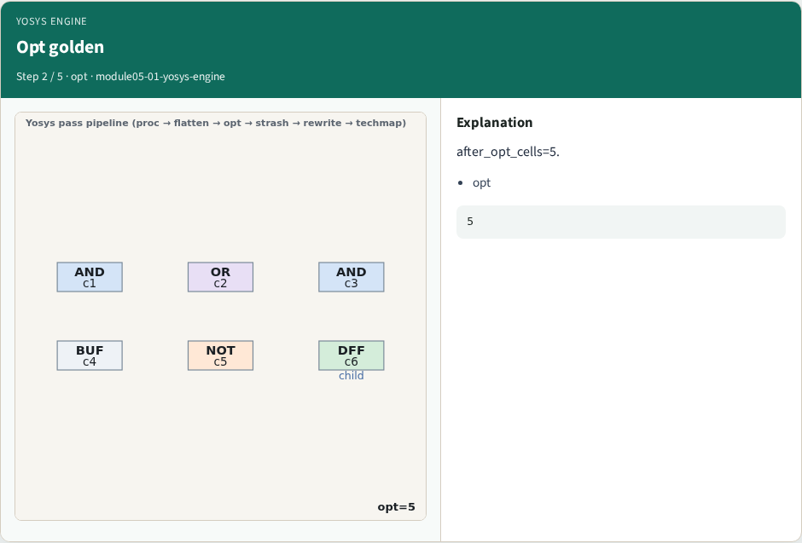
Opt golden
Opt golden
learn_yosys — 01 yosys engine
Notes:
after_opt_cells=5.

Slide 5

Strash golden
Strash golden
learn_yosys — 01 yosys engine
Notes:
after_strash_cells=4.

Slide 6
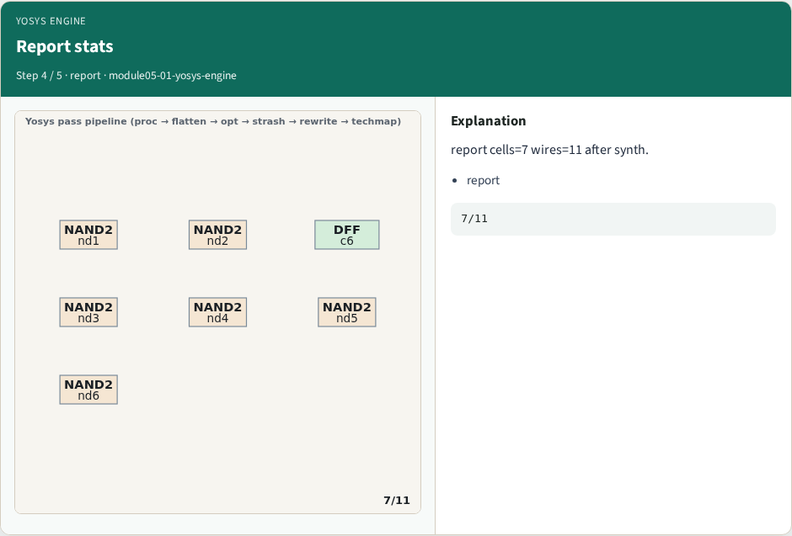
Report stats
Report stats
learn_yosys — 01 yosys engine
Notes:
report cells=7 wires=11 after synth.

Slide 7
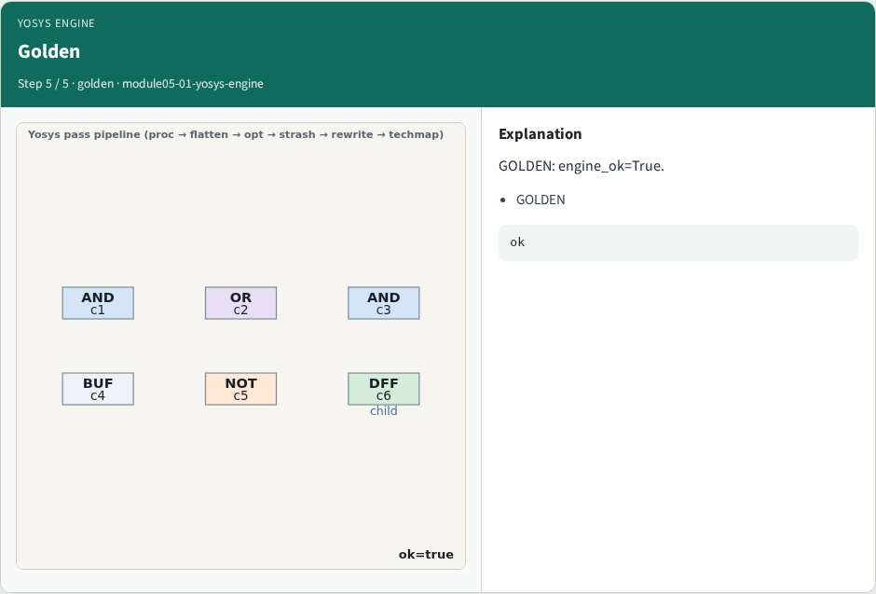
Golden
Golden
learn_yosys — 01 yosys engine
Notes:
GOLDEN: engine_ok=True.

Slide 8

Browser lab track
Browser lab starter
learn_yosys — 01 yosys engine
Notes:
Open **yosys-engine**. Run engine; confirm ok and report 7/11.

Slide 9
Implement track
Call yosys_engine(); assert ok and report cell/wire counts
learn_yosys — 01 yosys engine
Notes:
Call yosys_engine(); assert ok and report cell/wire counts.

Slide 10
Pitfalls
Reporting partial passes
Changing toy without updating goldens
learn_yosys — 01 yosys engine
Notes:
Reporting partial passes. Changing toy without updating goldens.

Slide 11
Your turn
Next: offline compare, then wrap
learn_yosys — 01 yosys engine
Notes:
Next: offline compare, then wrap.

