Slide 1
Why yosys
Real Yosys is a pass engine you drive with a .ys script or an interactive shell , not a toy button
learn_yosys — 01 yosys cli
Notes:
Real Yosys is a pass engine you drive with a .ys script or an interactive shell — not a toy button.

Slide 2
The idea
GOLDEN: first three cmds = read_verilog, hierarchy, proc; invoke with yosys -s script.ys
learn_yosys — 01 yosys cli
Notes:
GOLDEN: first three cmds = read_verilog, hierarchy, proc; invoke with yosys -s script.ys.

Slide 3
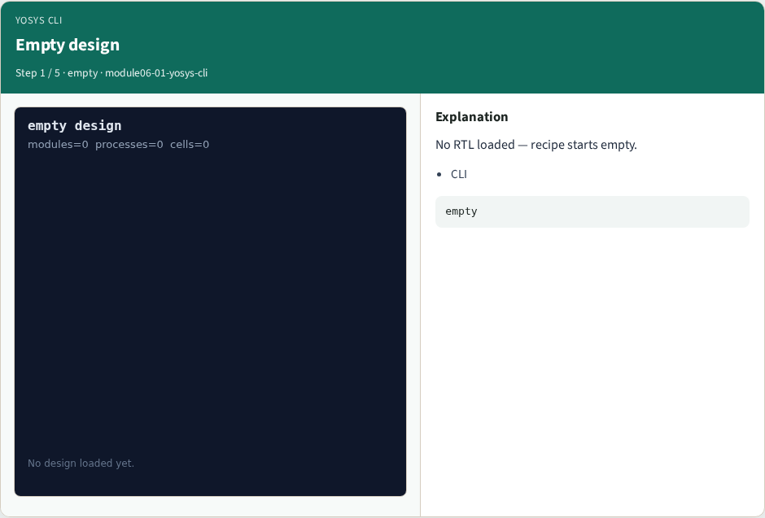
Empty design
Empty design
learn_yosys — 01 yosys cli
Notes:
No RTL loaded — recipe starts empty.

Slide 4

read_verilog
read_verilog
learn_yosys — 01 yosys cli
Notes:
Load rtl/tiny_and_or.v into Yosys.

Slide 5
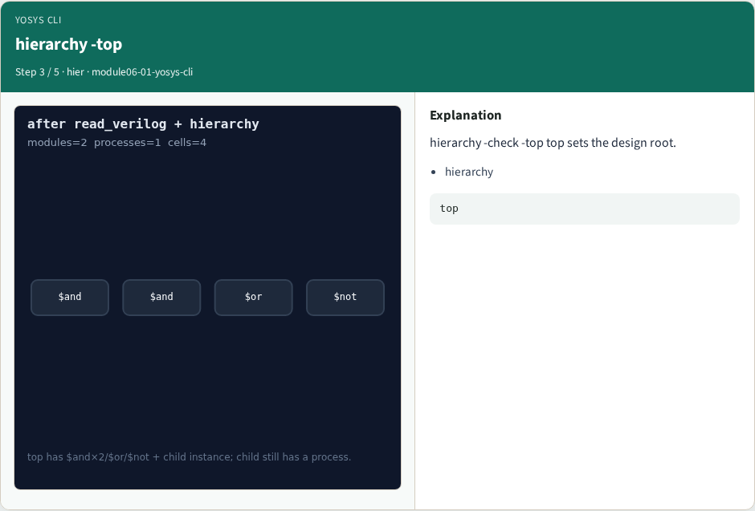
hierarchy -top
hierarchy -top
learn_yosys — 01 yosys cli
Notes:
hierarchy -check -top top sets the design root.

Slide 6

proc next
proc next
learn_yosys — 01 yosys cli
Notes:
Third command is proc — processes become cells.

Slide 7

Golden order
Golden order
learn_yosys — 01 yosys cli
Notes:
GOLDEN: read → hierarchy → proc.

Slide 8
Browser lab track
Open yosys-cli
Open yosys-cli
Append read_verilog, hierarchy, proc in order
learn_yosys — 01 yosys cli
Notes:
Open **yosys-cli**. Open **yosys-cli**. Append read_verilog, hierarchy, proc in order.

Slide 9
Implement track
Call pass_cli_check(['read_verilog','hierarchy','proc']); assert ok
learn_yosys — 01 yosys cli
Notes:
Call pass_cli_check(['read_verilog','hierarchy','proc']); assert ok.

Slide 10
Pitfalls
Starting with proc
Skipping hierarchy -top
learn_yosys — 01 yosys cli
Notes:
Starting with proc. Skipping hierarchy -top.

Slide 11
Try these
learn_yosys — 01 yosys cli

Slide 12
Try these — try these
cd courses/learn_yosys/common
python3 -c "from real_solvers import pass_cli_check;
print(pass_cli_check())"
learn_yosys — 01 yosys cli

Slide 13
Pseudocode
learn_yosys — 01 yosys cli

Slide 14
Pseudocode — try these
recipe ← []; append read_verilog; hierarchy; proc; ok ← prefix
matches golden
learn_yosys — 01 yosys cli

Slide 15
Next
Complete the quiz for this part
Next: RTLIL vocabulary
learn_yosys — 01 yosys cli
Notes:
Next: RTLIL vocabulary.

