Slide 1
Seq graph
Retiming starts from a sequential circuit graph , not just a Boolean network
learn_retiming — 01 sequential graph
Notes:
Retiming starts from a sequential circuit graph — not just a Boolean network.

Slide 2
The idea
Nodes carry combinational delay; edges carry register counts w
Our toy has five nodes and five edges
learn_retiming — 01 sequential graph
Notes:
Nodes carry combinational delay; edges carry register counts w. Our toy has five nodes and five edges.

Slide 3
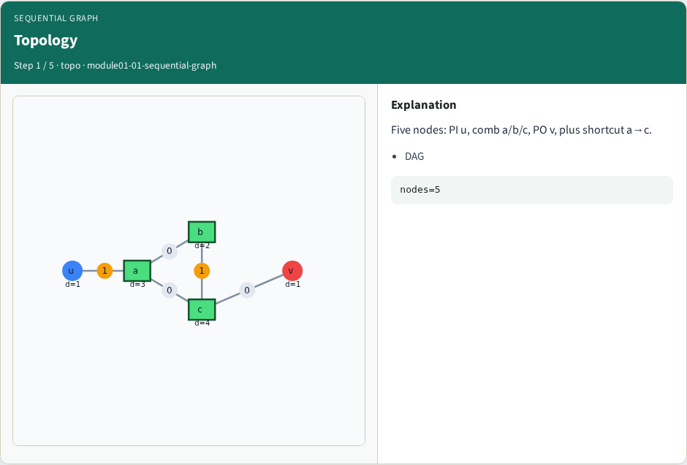
Topology
Topology
learn_retiming — 01 sequential graph
Notes:
Five nodes: PI u, comb a/b/c, PO v, plus shortcut a→c.

Slide 4
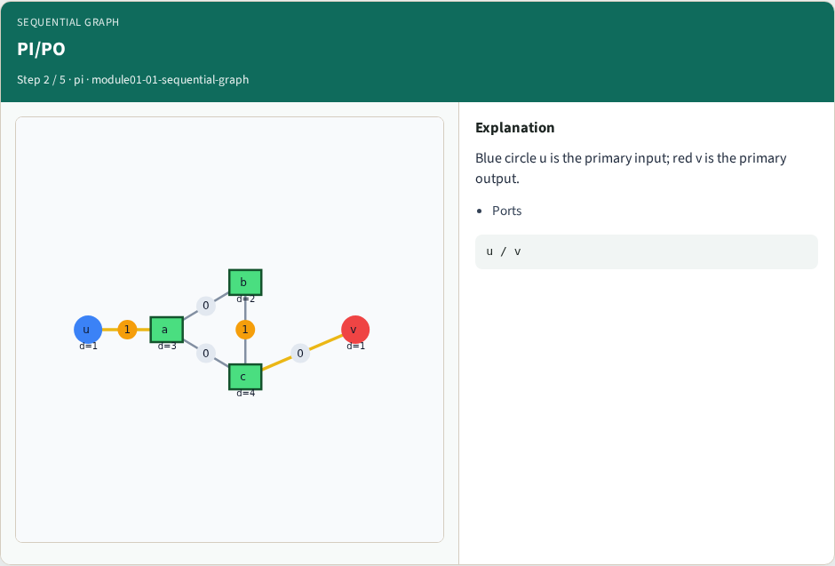
PI/PO
PI/PO
learn_retiming — 01 sequential graph
Notes:
Blue circle u is the primary input; red v is the primary output.

Slide 5
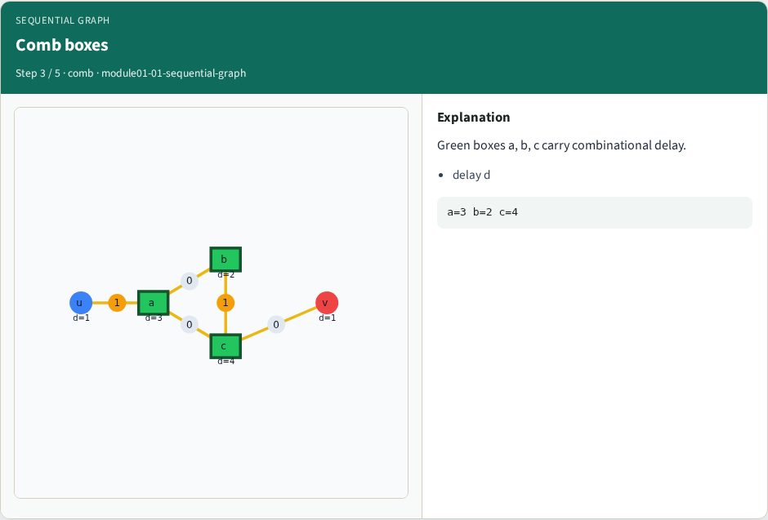
Comb boxes
Comb boxes
learn_retiming — 01 sequential graph
Notes:
Green boxes a, b, c carry combinational delay.

Slide 6
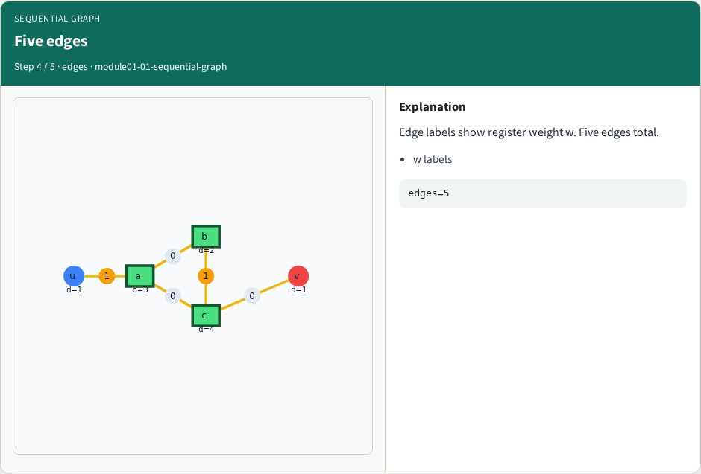
Five edges
Five edges
learn_retiming — 01 sequential graph
Notes:
Edge labels show register weight w. Five edges total.

Slide 7
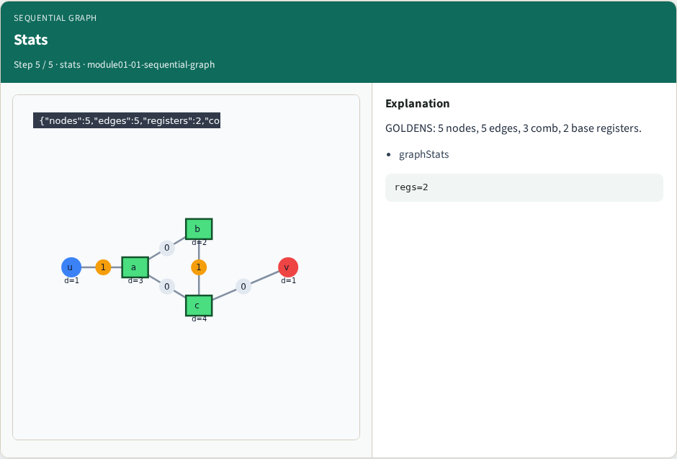
Stats
Stats
learn_retiming — 01 sequential graph
Notes:
GOLDENS: 5 nodes, 5 edges, 3 comb, 2 base registers.

Slide 8
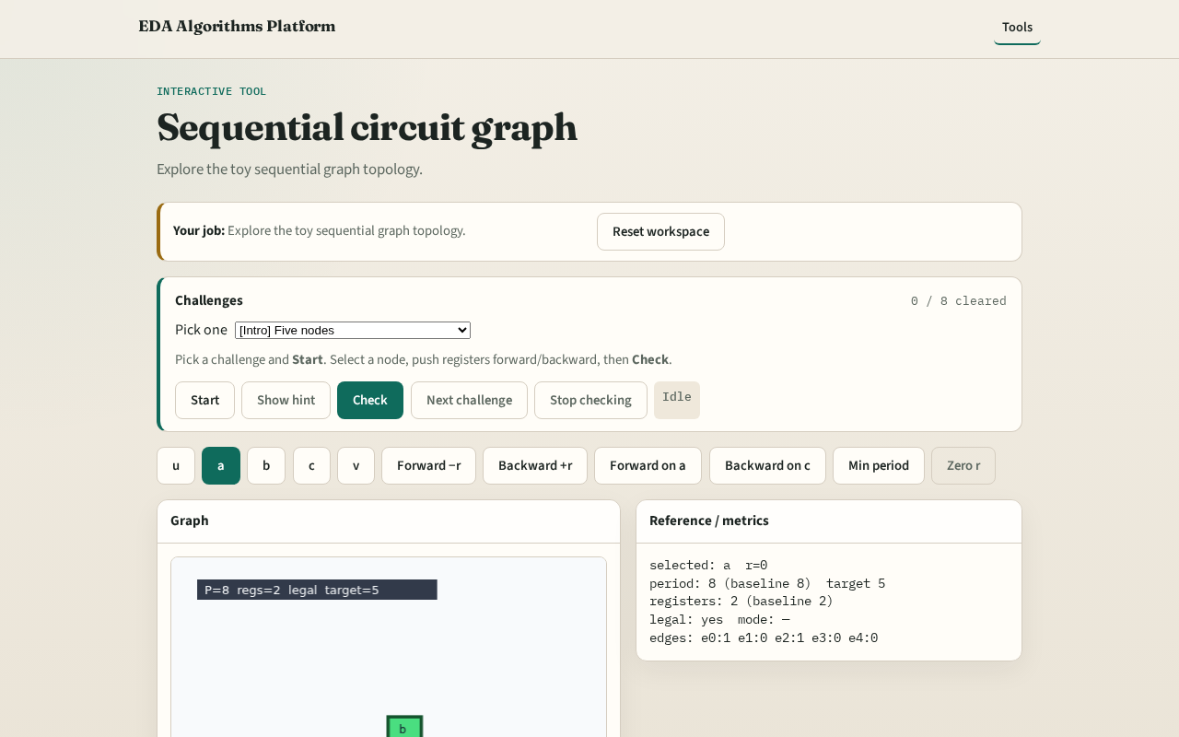
Browser lab track
Browser lab starter
learn_retiming — 01 sequential graph
Notes:
Open **sequential-graph**. Click nodes; read delay labels and edge ids.

Slide 9
Implement track
Load tiny_retime.json; call graph_stats , expect 5 nodes, 5 edges
learn_retiming — 01 sequential graph
Notes:
Load tiny_retime.json; call graph_stats — expect 5 nodes, 5 edges.

Slide 10
Pitfalls
Treating edge w as delay
Confusing PO v with a comb node
learn_retiming — 01 sequential graph
Notes:
Treating edge w as delay. Confusing PO v with a comb node.

Slide 11
Your turn
Next: edge register counts in detail
learn_retiming — 01 sequential graph
Notes:
Next: edge register counts in detail.

