Slide 1
Registers
In Leiserson–Saxe form, each edge weight w is how many registers sit on that wire
learn_retiming — 03 register count
Notes:
In Leiserson–Saxe form, each edge weight w is how many registers sit on that wire.

Slide 2
The idea
E0 u→a has w=1; e2 b→c has w=1; zero-weight edges are combinational
learn_retiming — 03 register count
Notes:
e0 u→a has w=1; e2 b→c has w=1; zero-weight edges are combinational.

Slide 3
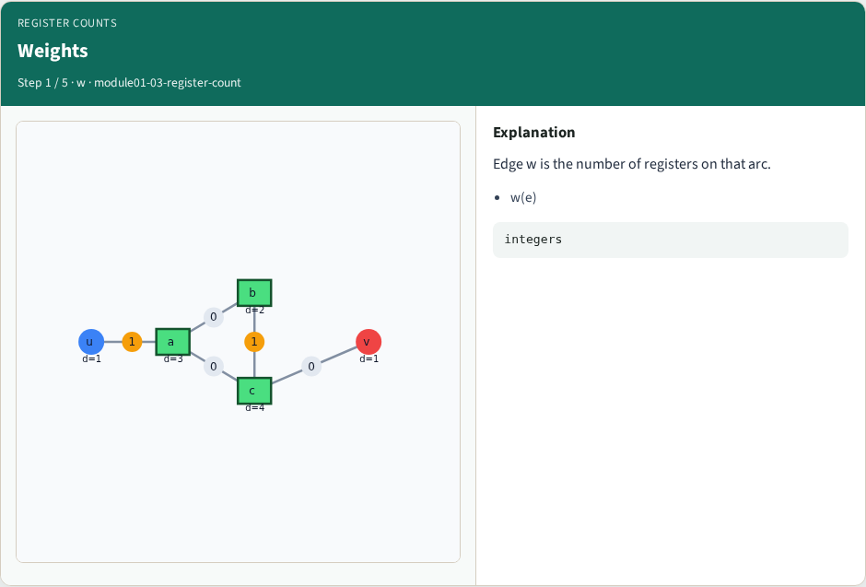
Weights
Weights
learn_retiming — 03 register count
Notes:
Edge w is the number of registers on that arc.

Slide 4
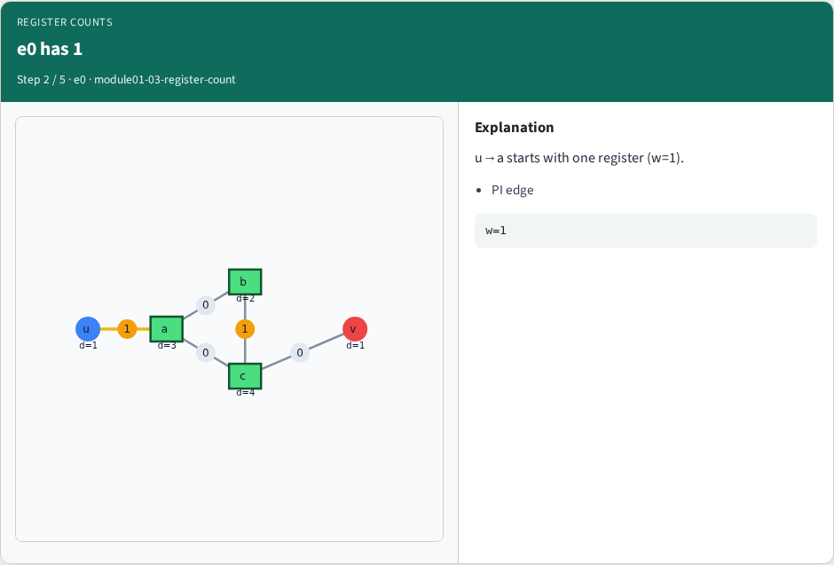
e0 has 1
e0 has 1
learn_retiming — 03 register count
Notes:
u→a starts with one register (w=1).

Slide 5
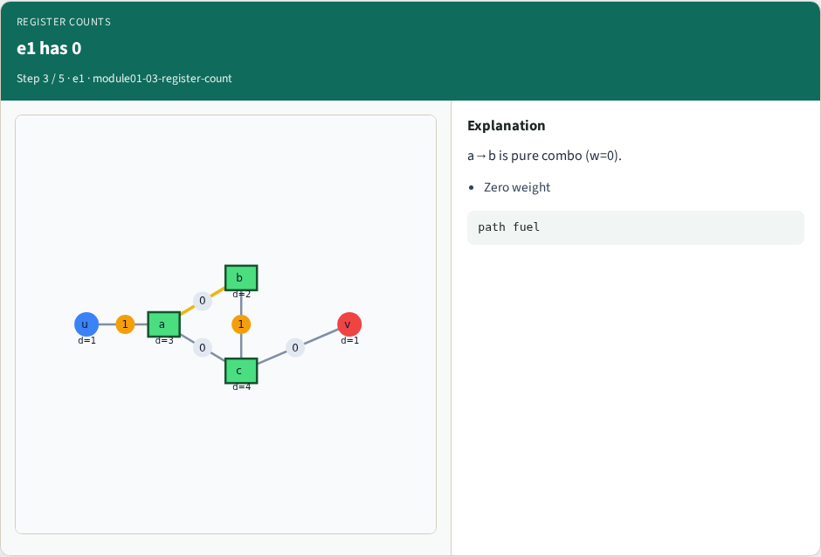
e1 has 0
e1 has 0
learn_retiming — 03 register count
Notes:
a→b is pure combo (w=0).

Slide 6
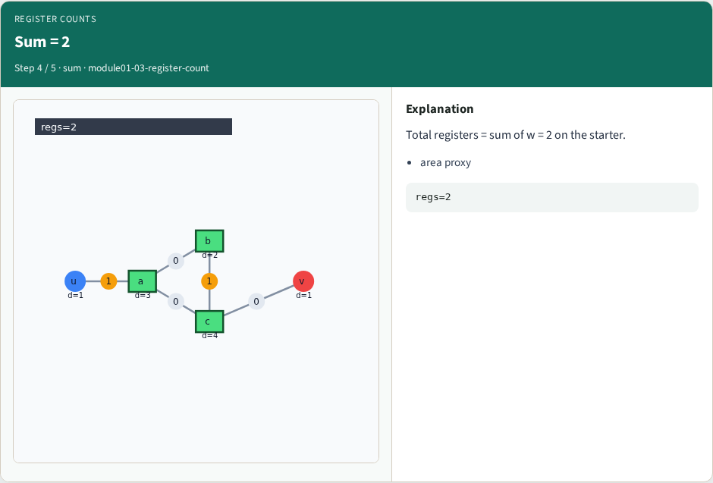
Sum = 2
Sum = 2
learn_retiming — 03 register count
Notes:
Total registers = sum of w = 2 on the starter.

Slide 7
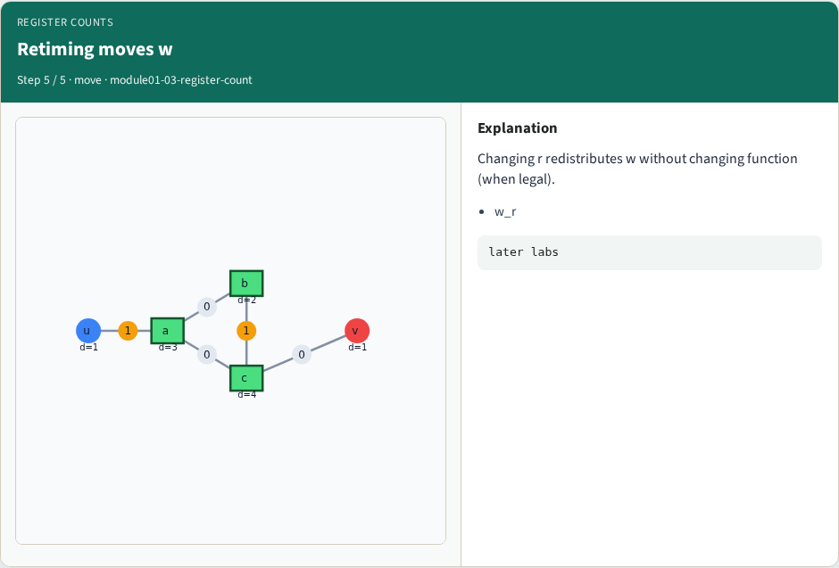
Retiming moves w
Retiming moves w
learn_retiming — 03 register count
Notes:
Changing r redistributes w without changing function (when legal).

Slide 8
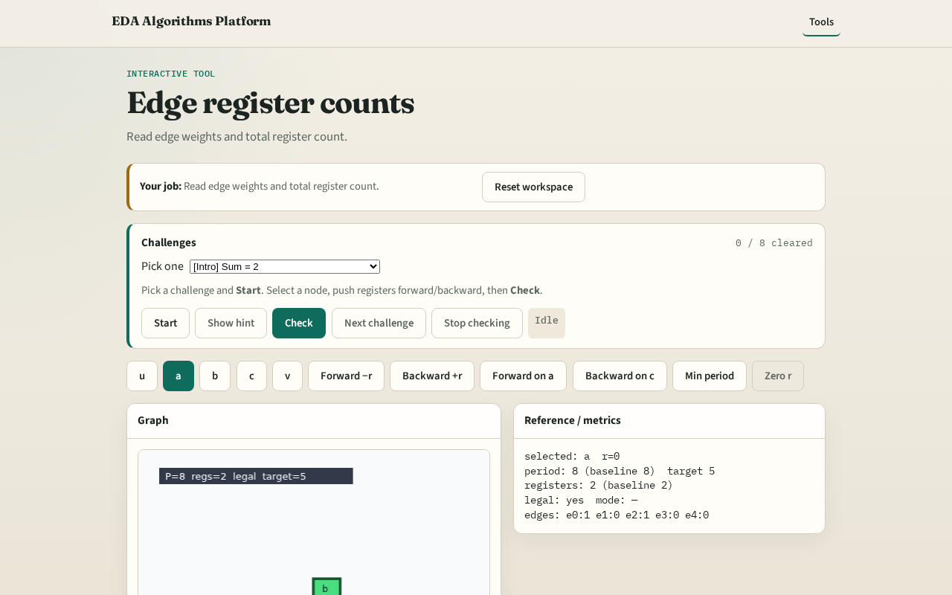
Browser lab track
Browser lab starter
learn_retiming — 03 register count
Notes:
Open **register-count**. Highlight e0 and e2; confirm total 2.

Slide 9
Implement track
Call total_registers(edges); assert sum == 2
learn_retiming — 03 register count
Notes:
Call total_registers(edges); assert sum == 2.

Slide 10
Pitfalls
Counting nodes instead of edges
Forgetting w on u→a
learn_retiming — 03 register count
Notes:
Counting nodes instead of edges. Forgetting w on u→a.

Slide 11
Your turn
Next: zero-weight path delay / clock period
learn_retiming — 03 register count
Notes:
Next: zero-weight path delay / clock period.

