Slide 1
Path delay
Clock period is the longest delay along paths that use only w=0 edges (registers break paths)
learn_retiming — 01 path delay
Notes:
Clock period is the longest delay along paths that use only w=0 edges (registers break paths).

Slide 2
The idea
Zero edges e1, e3, e4 form comb segments; longest chain a→b→c hits delays 3+2+4 → period 8
learn_retiming — 01 path delay
Notes:
Zero edges e1, e3, e4 form comb segments; longest chain a→b→c hits delays 3+2+4 → period 8.

Slide 3
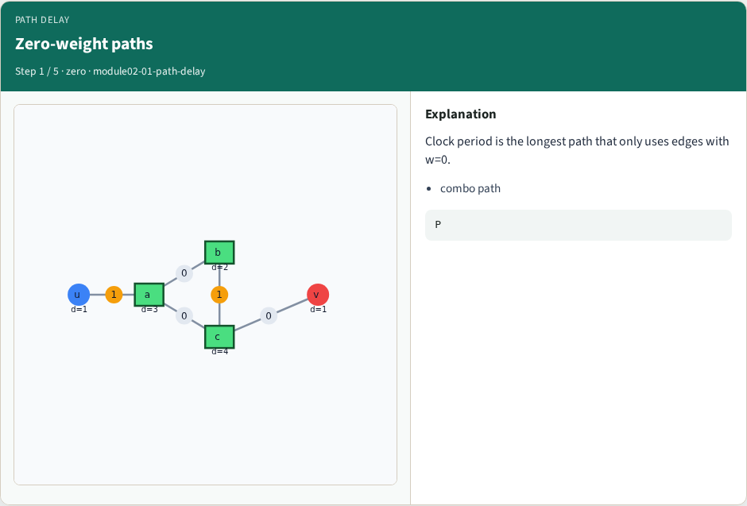
Zero-weight paths
Zero-weight paths
learn_retiming — 01 path delay
Notes:
Clock period is the longest path that only uses edges with w=0.

Slide 4
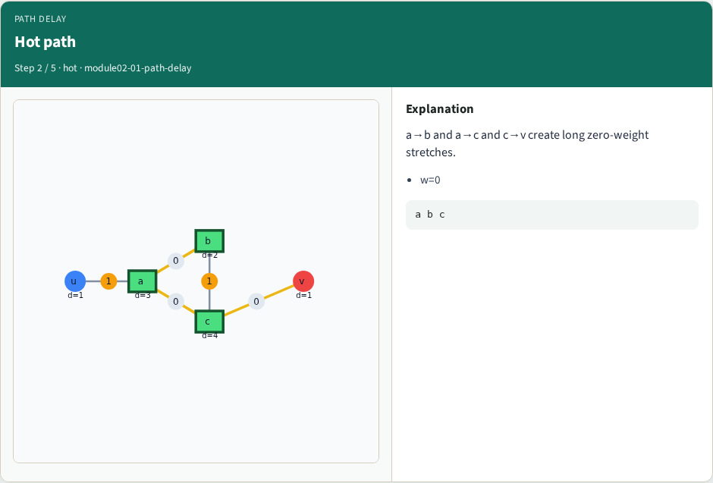
Hot path
Hot path
learn_retiming — 01 path delay
Notes:
a→b and a→c and c→v create long zero-weight stretches.

Slide 5
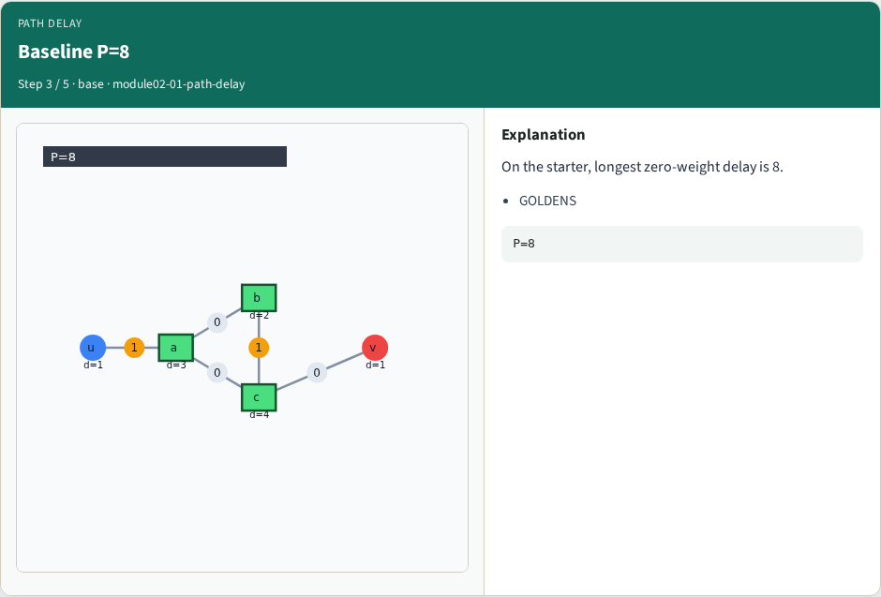
Baseline P=8
Baseline P=8
learn_retiming — 01 path delay
Notes:
On the starter, longest zero-weight delay is 8.

Slide 6
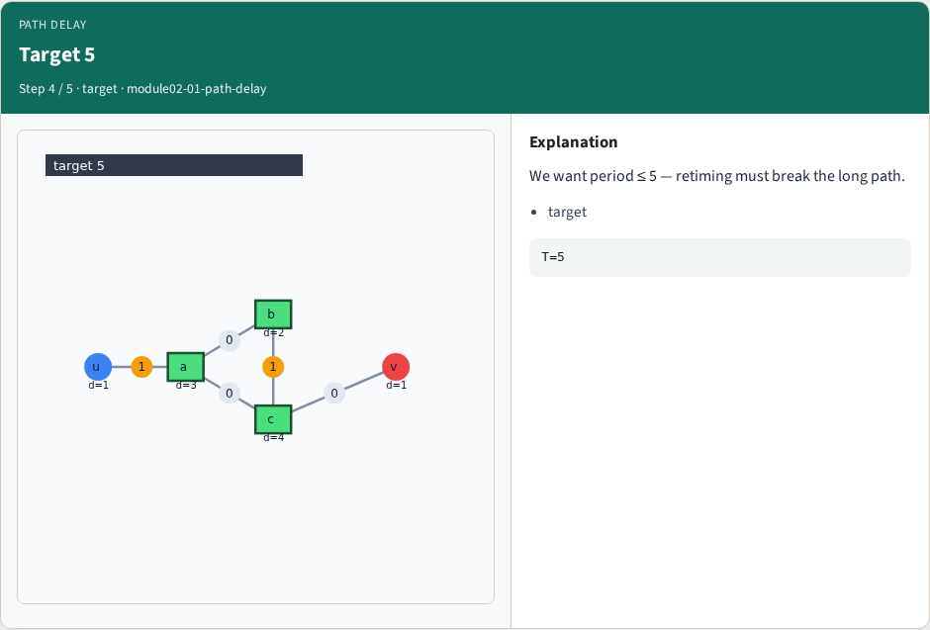
Target 5
Target 5
learn_retiming — 01 path delay
Notes:
We want period ≤ 5 — retiming must break the long path.

Slide 7
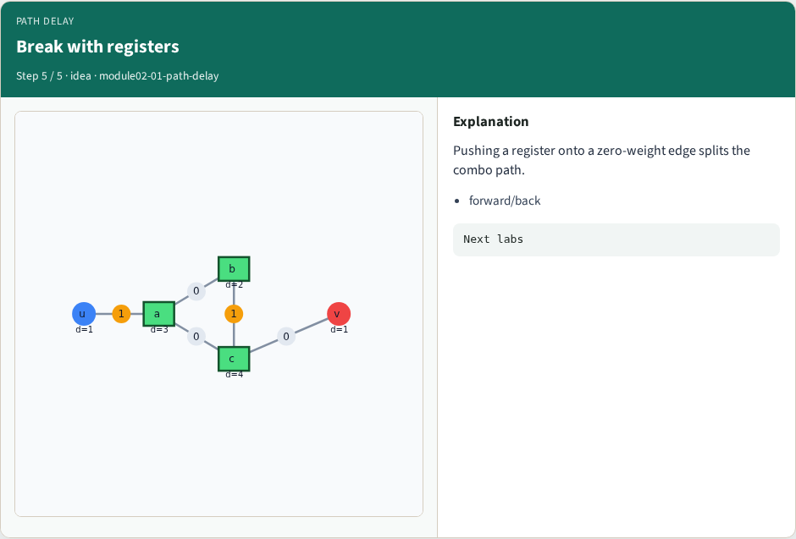
Break with registers
Break with registers
learn_retiming — 01 path delay
Notes:
Pushing a register onto a zero-weight edge splits the combo path.

Slide 8
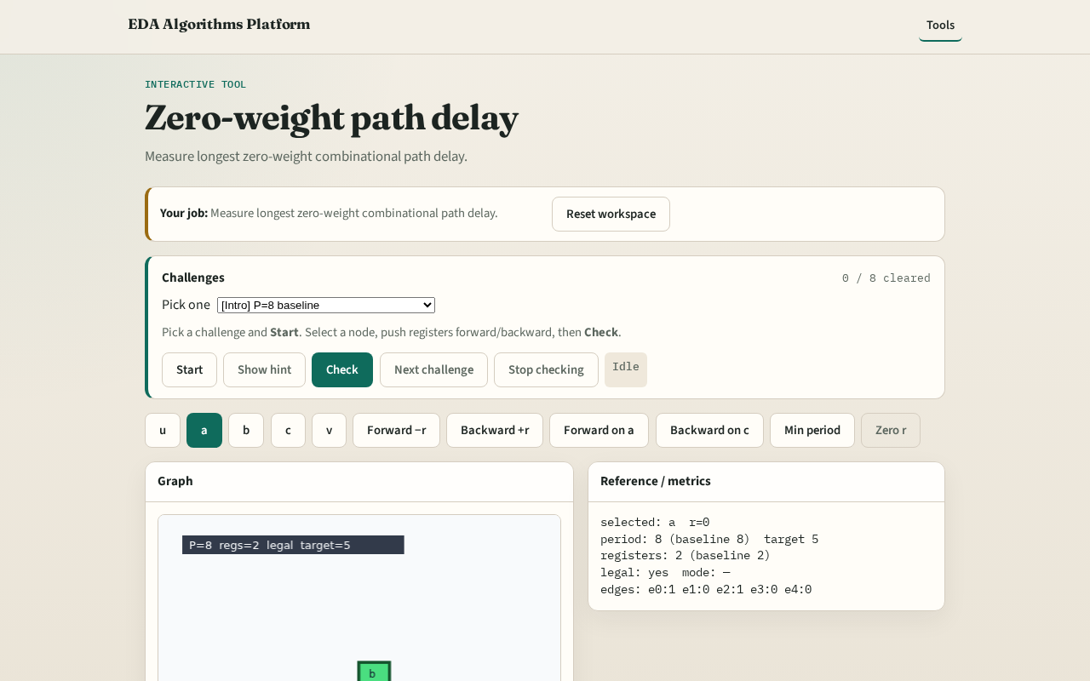
Browser lab track
Browser lab starter
learn_retiming — 01 path delay
Notes:
Open **path-delay**. Trace the critical zero-weight path; read period 8.

Slide 9
Implement track
Call clock_period(data, zero_retime(data)); assert ≈ 8
learn_retiming — 01 path delay
Notes:
Call clock_period(data, zero_retime(data)); assert ≈ 8.

Slide 10
Pitfalls
Including w=1 edges in the critical path
Summing edge delays instead of node delays
learn_retiming — 01 path delay
Notes:
Including w=1 edges in the critical path. Summing edge delays instead of node delays.

Slide 11
Your turn
Next: forward retiming on node a
learn_retiming — 01 path delay
Notes:
Next: forward retiming on node a.

