Slide 1
Forward
Forward retiming pulls registers toward outputs , decrease r(v) on the chosen node
learn_retiming — 03 forward retime
Notes:
Forward retiming pulls registers toward outputs — decrease r(v) on the chosen node.

Slide 2
The idea
Forward_retime('a', r, 1) sets r(a)=−1; e0 w_r becomes 0; e1/e4 gain registers
learn_retiming — 03 forward retime
Notes:
forward_retime('a', r, 1) sets r(a)=−1; e0 w_r becomes 0; e1/e4 gain registers.

Slide 3
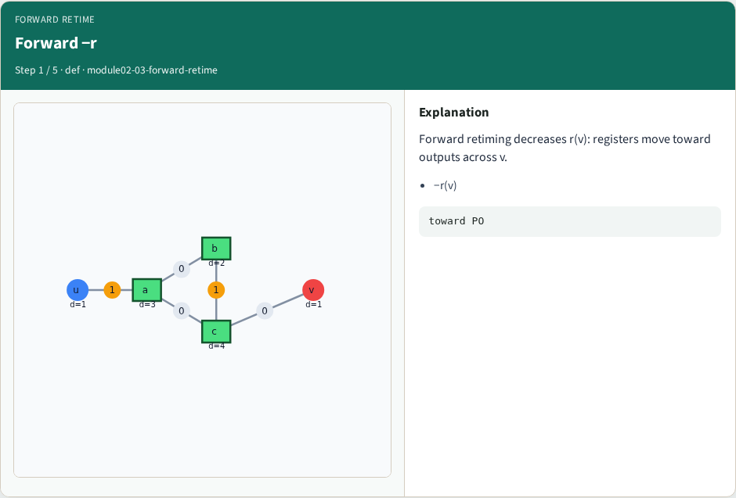
Forward −r
Forward −r
learn_retiming — 03 forward retime
Notes:
Forward retiming decreases r(v): registers move toward outputs across v.

Slide 4
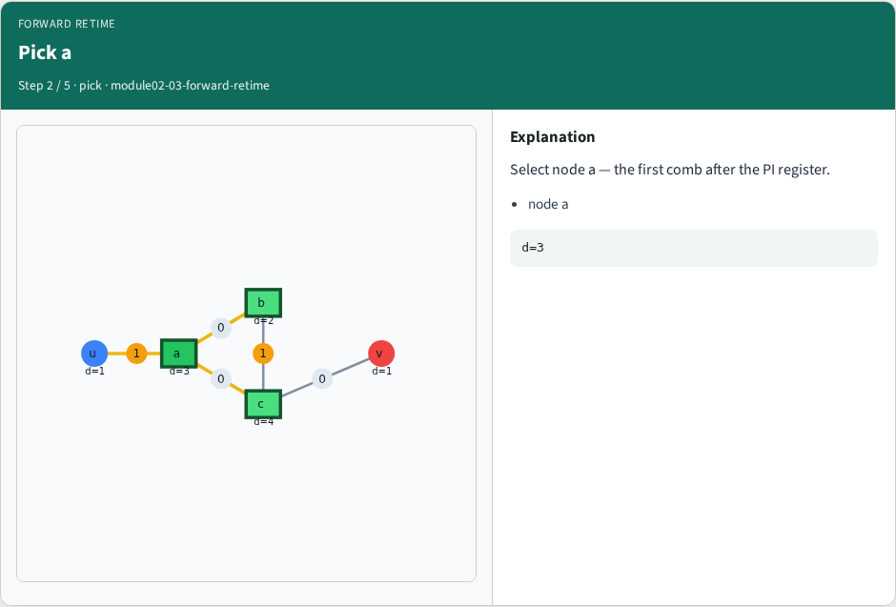
Pick a
Pick a
learn_retiming — 03 forward retime
Notes:
Select node a — the first comb after the PI register.

Slide 5
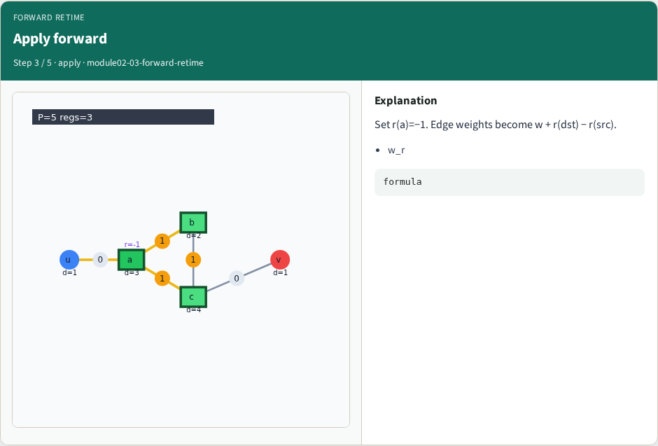
Apply forward
Apply forward
learn_retiming — 03 forward retime
Notes:
Set r(a)=−1. Edge weights become w + r(dst) − r(src).

Slide 6
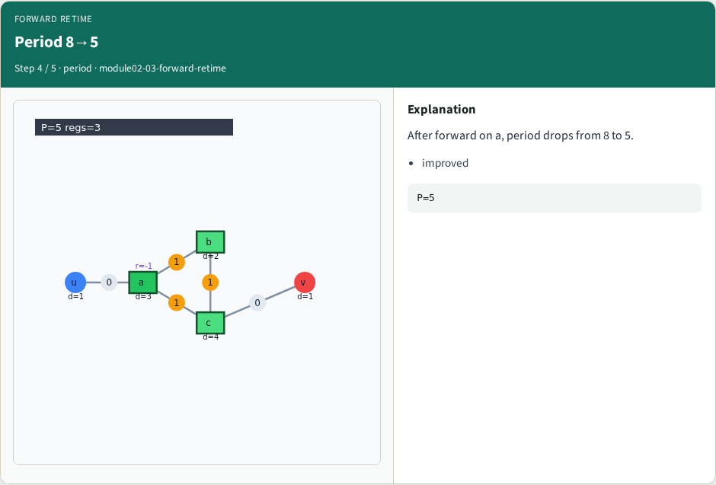
Period 8→5
Period 8→5
learn_retiming — 03 forward retime
Notes:
After forward on a, period drops from 8 to 5.

Slide 7

Registers 2→3
Registers 2→3
learn_retiming — 03 forward retime
Notes:
Register count rises to 3 — timing vs area tradeoff.

Slide 8
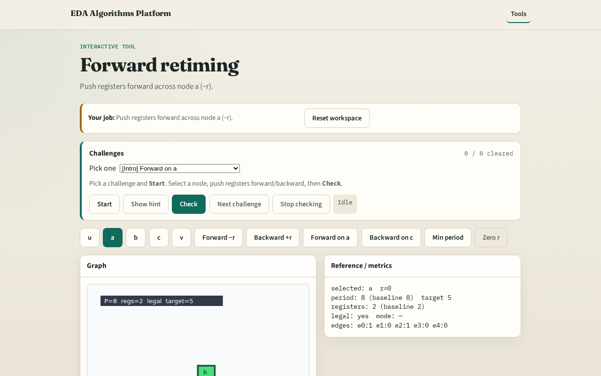
Browser lab track
Browser lab starter
learn_retiming — 03 forward retime
Notes:
Open **forward-retime**. Click Forward on a; read w_r labels and period 5.

Slide 9
Implement track
Call forward_retime('a', r, 1); print apply_retime edges and clock_period
learn_retiming — 03 forward retime
Notes:
Call forward_retime('a', r, 1); print apply_retime edges and clock_period.

Slide 10
Pitfalls
Decreasing r on PI/PO
Applying forward on c first and breaking legality
learn_retiming — 03 forward retime
Notes:
Decreasing r on PI/PO. Applying forward on c first and breaking legality.

Slide 11
Your turn
Next: backward retiming on c
learn_retiming — 03 forward retime
Notes:
Next: backward retiming on c.

