Slide 1
Backward
Backward retiming pushes registers toward inputs , increase r(v) on the chosen node
learn_retiming — 05 backward retime
Notes:
Backward retiming pushes registers toward inputs — increase r(v) on the chosen node.

Slide 2
The idea
Backward_retime('c', r, 1) sets r(c)=+1; e3 w_r = 0+0−1 = −1 violates w_r ≥ 0
learn_retiming — 05 backward retime
Notes:
backward_retime('c', r, 1) sets r(c)=+1; e3 w_r = 0+0−1 = −1 violates w_r ≥ 0.

Slide 3
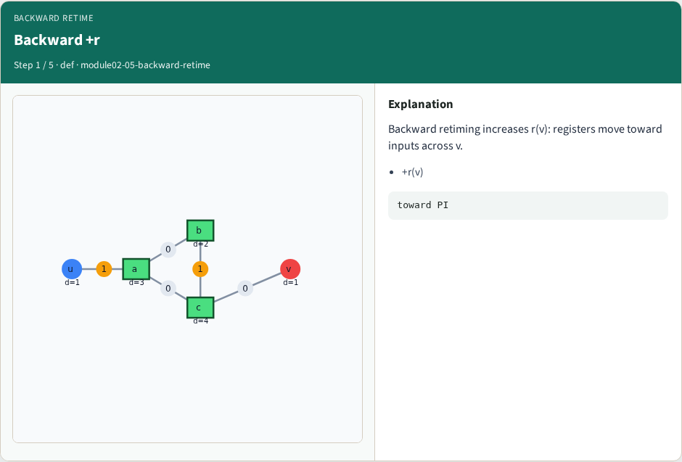
Backward +r
Backward +r
learn_retiming — 05 backward retime
Notes:
Backward retiming increases r(v): registers move toward inputs across v.

Slide 4
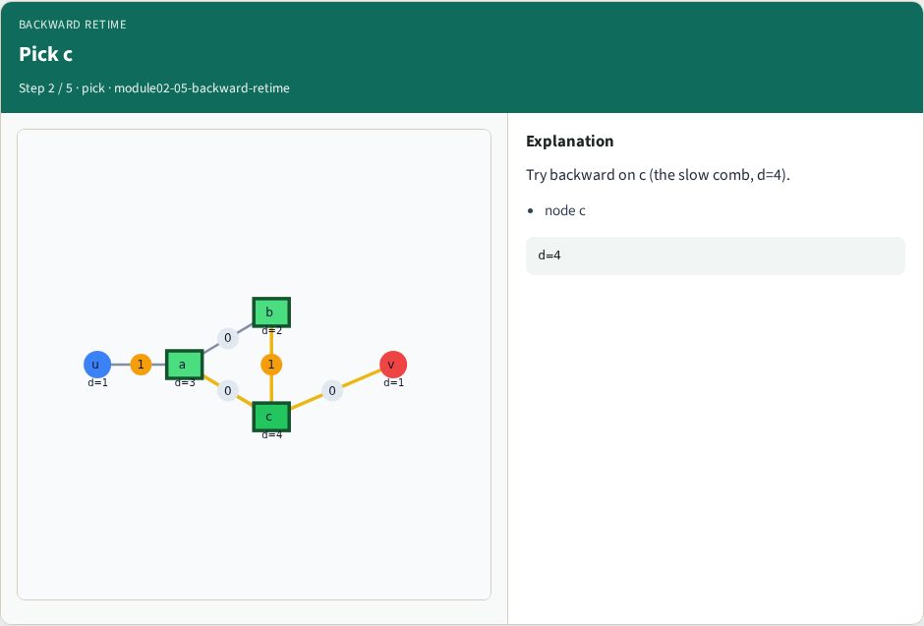
Pick c
Pick c
learn_retiming — 05 backward retime
Notes:
Try backward on c (the slow comb, d=4).

Slide 5
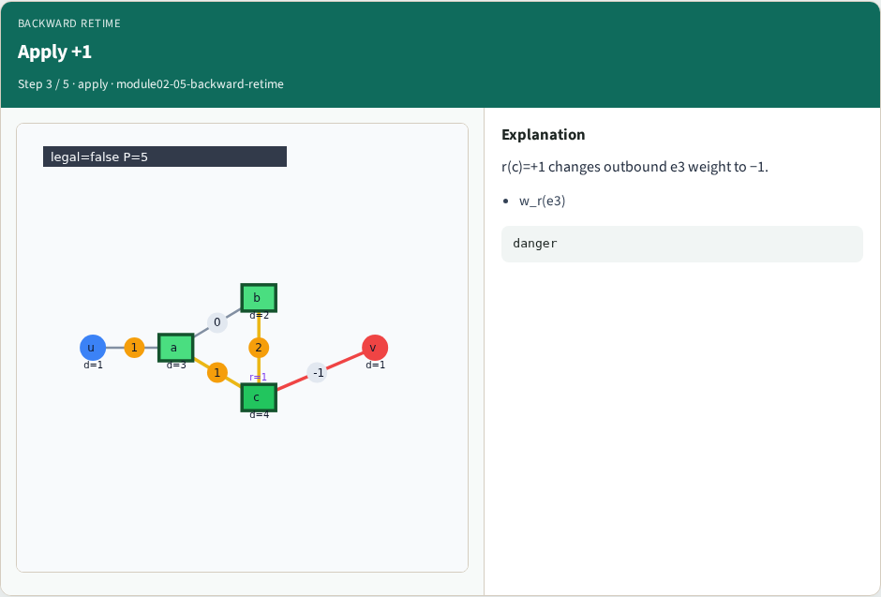
Apply +1
Apply +1
learn_retiming — 05 backward retime
Notes:
r(c)=+1 changes outbound e3 weight to −1.

Slide 6
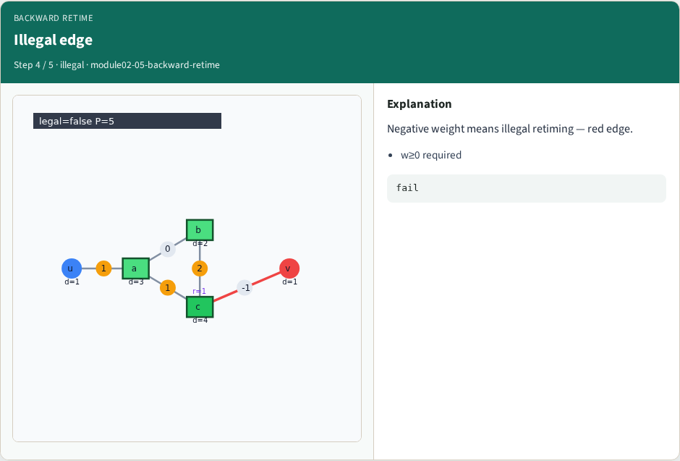
Illegal edge
Illegal edge
learn_retiming — 05 backward retime
Notes:
Negative weight means illegal retiming — red edge.

Slide 7
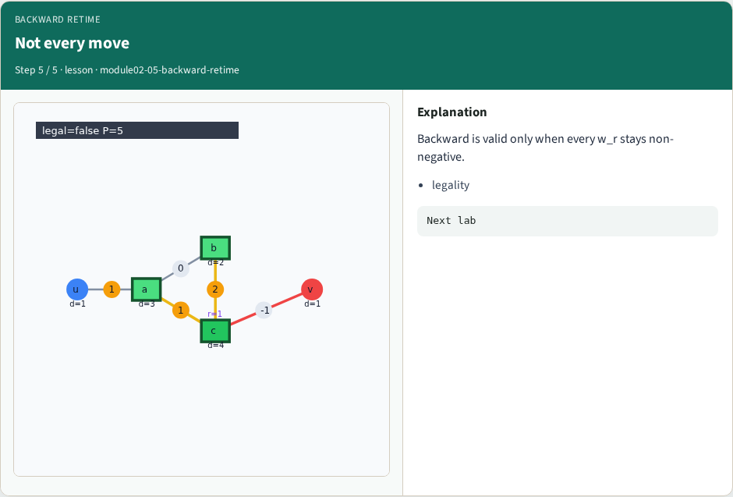
Not every move
Not every move
learn_retiming — 05 backward retime
Notes:
Backward is valid only when every w_r stays non-negative.

Slide 8
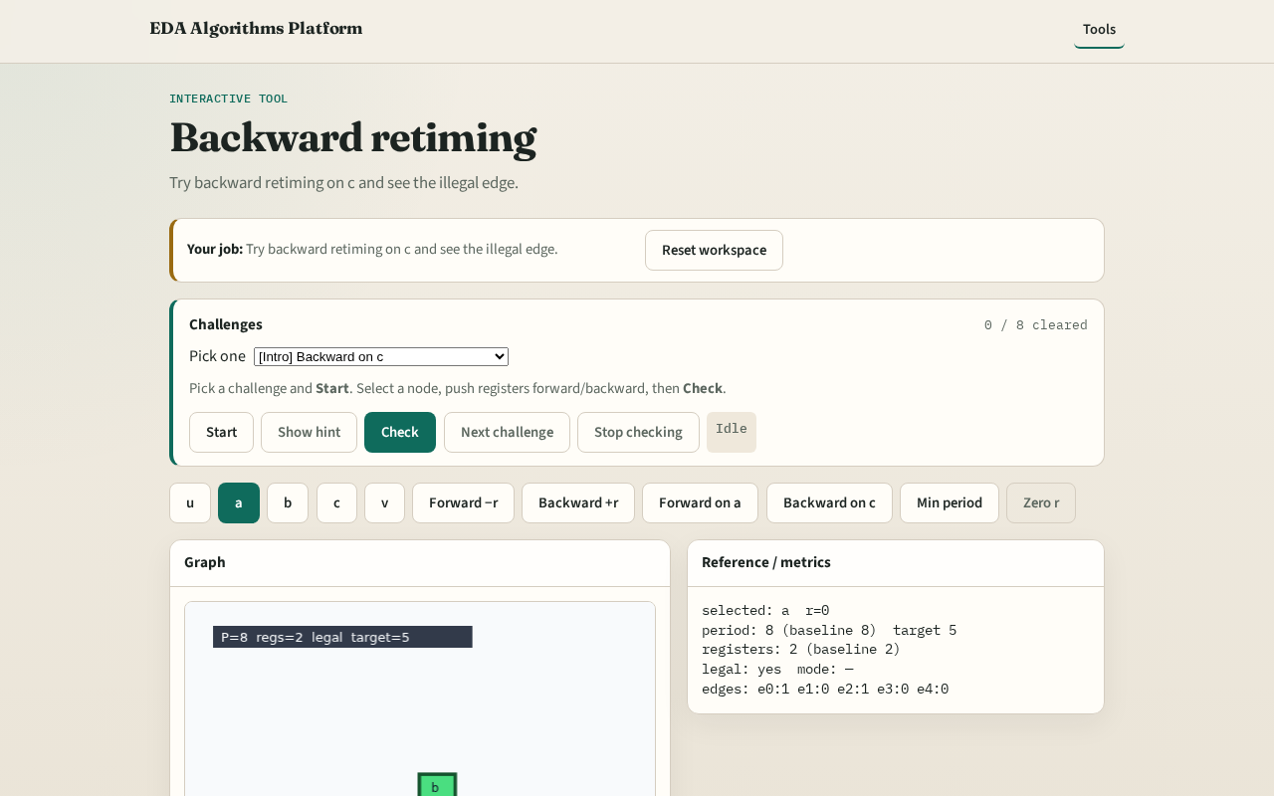
Browser lab track
Browser lab starter
learn_retiming — 05 backward retime
Notes:
Open **backward-retime**. Try Backward on c; see illegal flag on e3.

Slide 9
Implement track
Call backward_retime('c', r, 1); assert not is_legal(edges, r)
learn_retiming — 05 backward retime
Notes:
Call backward_retime('c', r, 1); assert not is_legal(edges, r).

Slide 10
Pitfalls
Assuming backward is always safe
Ignoring PO-adjacent edges
learn_retiming — 05 backward retime
Notes:
Assuming backward is always safe. Ignoring PO-adjacent edges.

Slide 11
Your turn
Next: legal retiming check for all edges
learn_retiming — 05 backward retime
Notes:
Next: legal retiming check for all edges.

