Slide 1
Legal
A retiming lag assignment r is legal only if every edge keeps a non-negative register count
learn_retiming — 07 legal retime
Notes:
A retiming lag assignment r is legal only if every edge keeps a non-negative register count.

Slide 2
The idea
Check w_r = w + r(dst) − r(src) for e0…e4; one negative edge breaks legality
learn_retiming — 07 legal retime
Notes:
Check w_r = w + r(dst) − r(src) for e0…e4; one negative edge breaks legality.

Slide 3
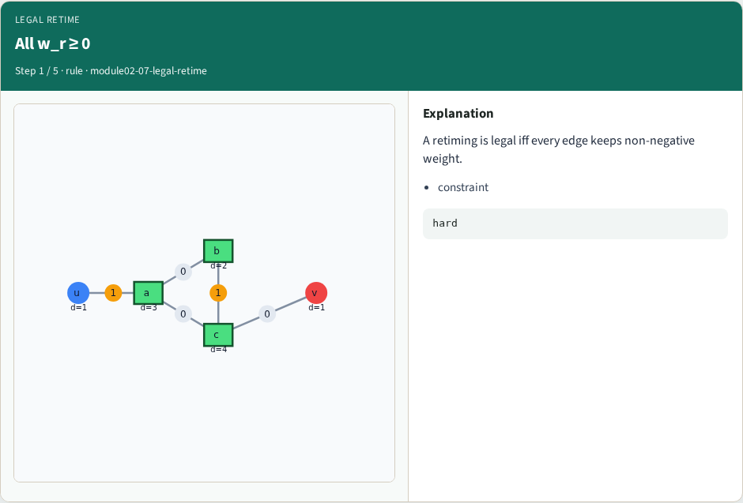
All w_r ≥ 0
All w_r ≥ 0
learn_retiming — 07 legal retime
Notes:
A retiming is legal iff every edge keeps non-negative weight.

Slide 4
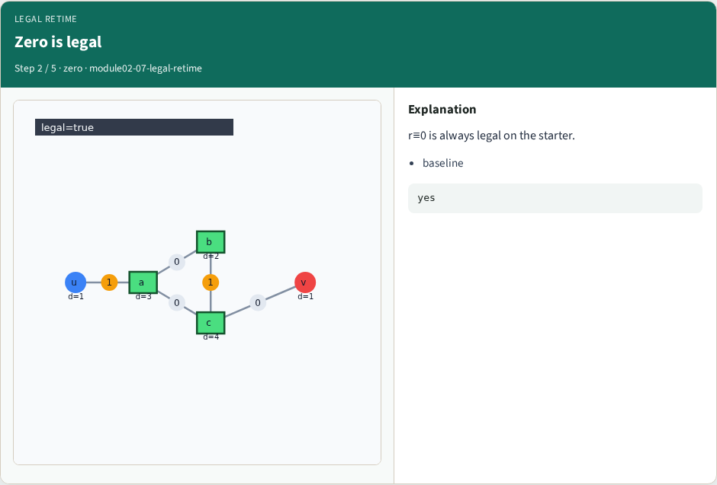
Zero is legal
Zero is legal
learn_retiming — 07 legal retime
Notes:
r≡0 is always legal on the starter.

Slide 5
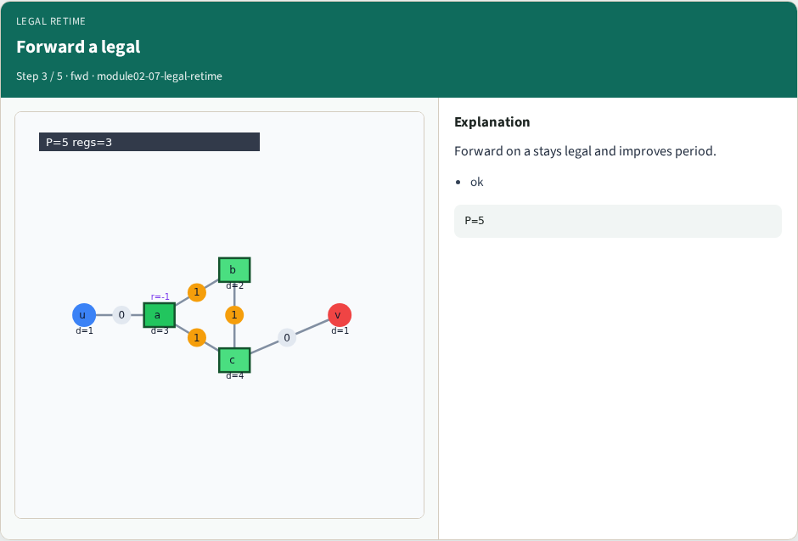
Forward a legal
Forward a legal
learn_retiming — 07 legal retime
Notes:
Forward on a stays legal and improves period.

Slide 6
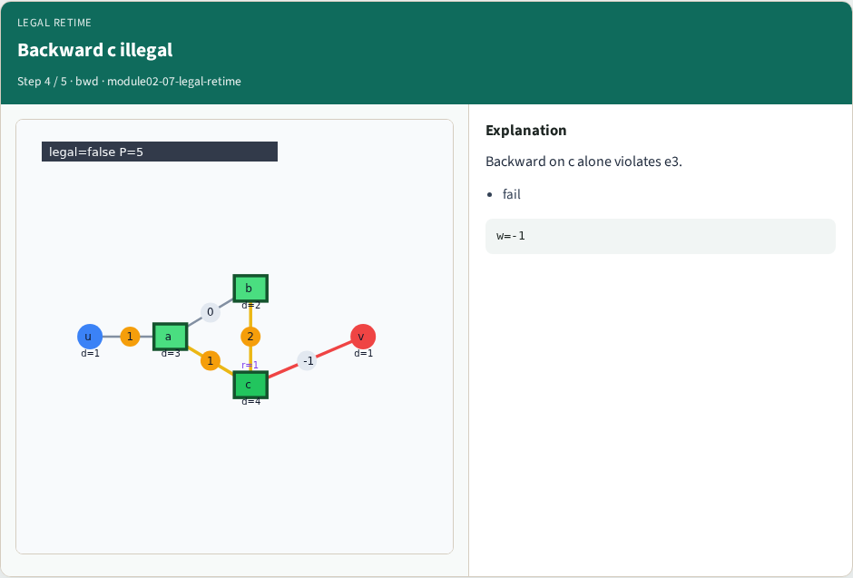
Backward c illegal
Backward c illegal
learn_retiming — 07 legal retime
Notes:
Backward on c alone violates e3.

Slide 7
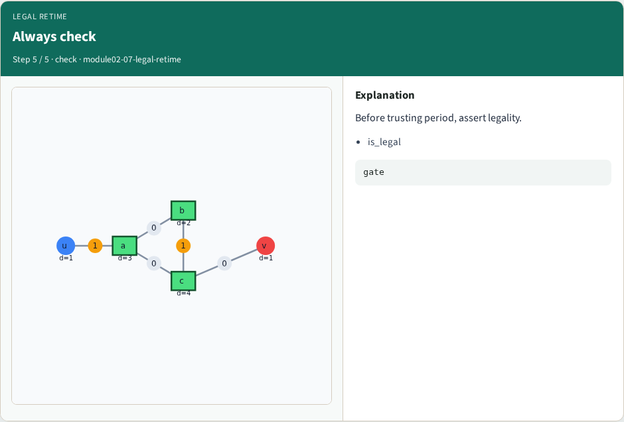
Always check
Always check
learn_retiming — 07 legal retime
Notes:
Before trusting period, assert legality.

Slide 8
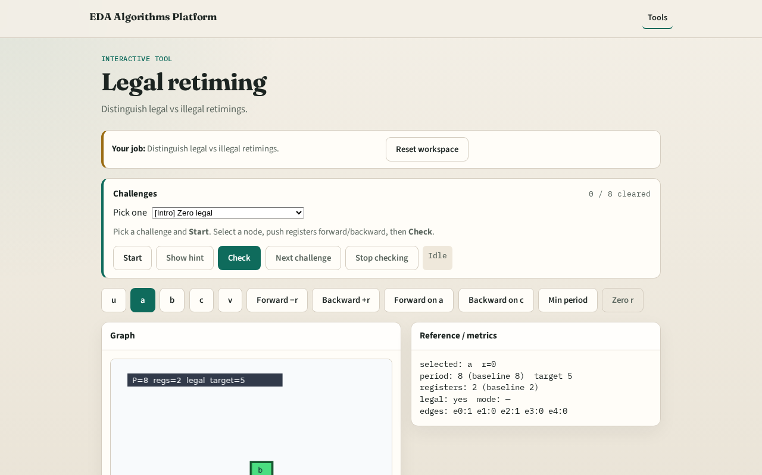
Browser lab track
Browser lab starter
learn_retiming — 07 legal retime
Notes:
Open **legal-retime**. Toggle moves; green only when is_legal is true.

Slide 9
Implement track
Test is_legal after forward on a (True) and backward on c (False)
learn_retiming — 07 legal retime
Notes:
Test is_legal after forward on a (True) and backward on c (False).

Slide 10
Pitfalls
Checking only one edge
Allowing fractional or negative w in the UI
learn_retiming — 07 legal retime
Notes:
Checking only one edge. Allowing fractional or negative w in the UI.

Slide 11
Your turn
Next: period bound / FEAS lite
learn_retiming — 07 legal retime
Notes:
Next: period bound / FEAS lite.

