Slide 1
Period bound
Given target period φ, a retiming is feasible if it is legal and the clock period is at most φ
learn_retiming — 01 period bound
Notes:
Given target period φ, a retiming is feasible if it is legal and the clock period is at most φ.

Slide 2
The idea
Feas_check(data, 5, r) after forward on a: period 5 ≤ target 5 , passes
learn_retiming — 01 period bound
Notes:
feas_check(data, 5, r) after forward on a: period 5 ≤ target 5 — passes.

Slide 3
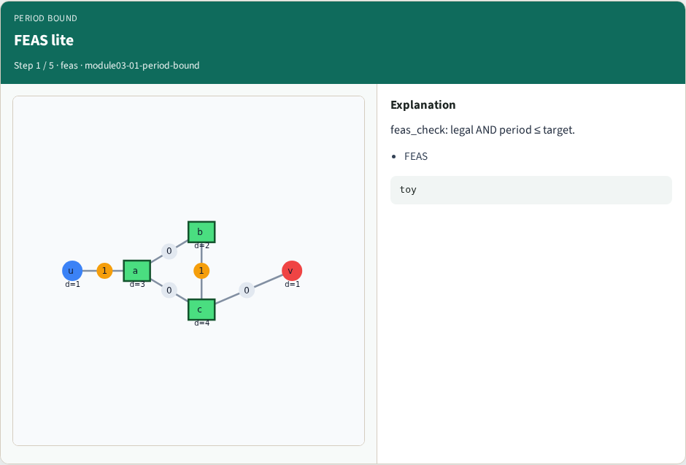
FEAS lite
FEAS lite
learn_retiming — 01 period bound
Notes:
feas_check: legal AND period ≤ target.

Slide 4
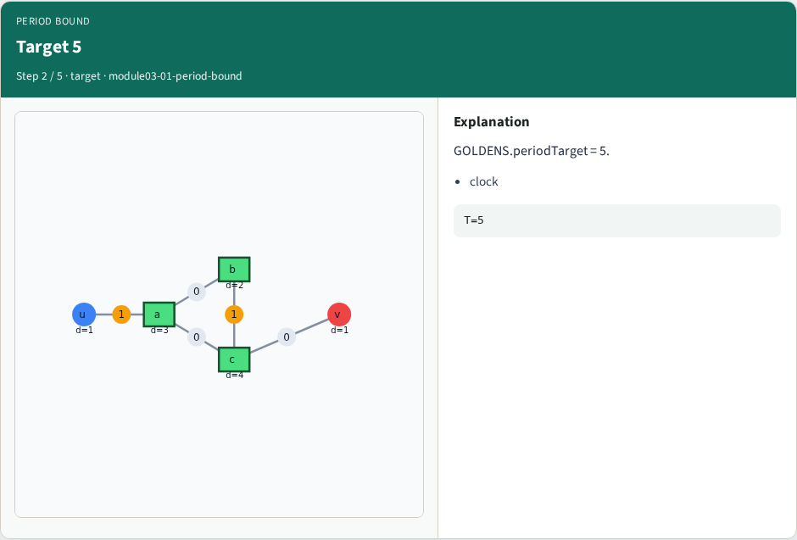
Target 5
Target 5
learn_retiming — 01 period bound
Notes:
GOLDENS.periodTarget = 5.

Slide 5
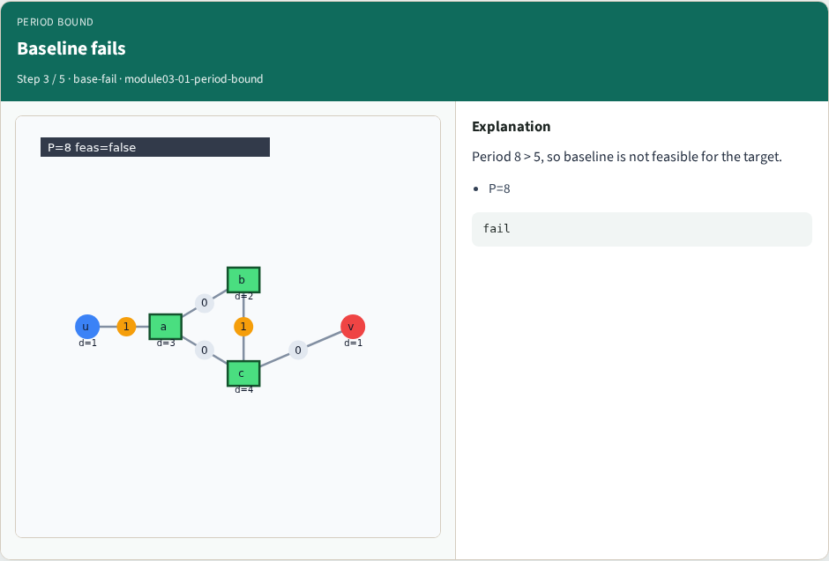
Baseline fails
Baseline fails
learn_retiming — 01 period bound
Notes:
Period 8 > 5, so baseline is not feasible for the target.

Slide 6

Forward passes
Forward passes
learn_retiming — 01 period bound
Notes:
Forward on a: legal and P=5 ≤ 5 — feasible.

Slide 7
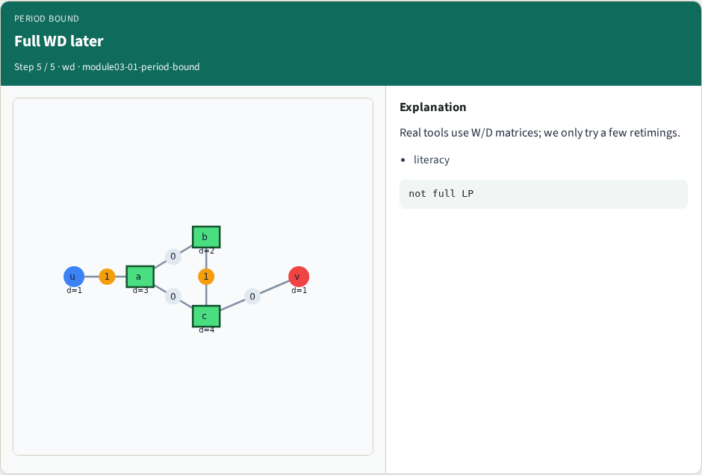
Full WD later
Full WD later
learn_retiming — 01 period bound
Notes:
Real tools use W/D matrices; we only try a few retimings.

Slide 8
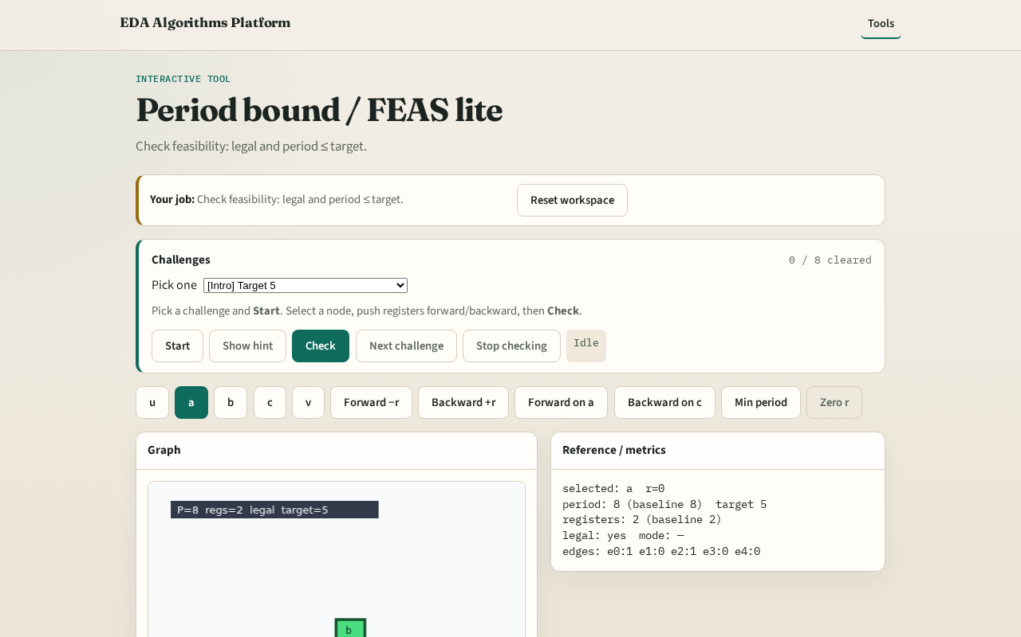
Browser lab track
Browser lab starter
learn_retiming — 01 period bound
Notes:
Open **period-bound**. Set target 5; run Check after forward on a.

Slide 9
Implement track
Call feas_check(DATA, 5, r) with forward-on-a r; expect True
learn_retiming — 01 period bound
Notes:
Call feas_check(DATA, 5, r) with forward-on-a r; expect True.

Slide 10
Pitfalls
Forgetting legality in FEAS
Comparing to target 8 instead of 5
learn_retiming — 01 period bound
Notes:
Forgetting legality in FEAS. Comparing to target 8 instead of 5.

Slide 11
Your turn
Next: min-period search across candidate retimings
learn_retiming — 01 period bound
Notes:
Next: min-period search across candidate retimings.

