Slide 1
Min period
Search a small candidate set of retimings , not full WD/FEAS , and pick the smallest legal period
learn_retiming — 03 min period
Notes:
Search a small candidate set of retimings — not full WD/FEAS — and pick the smallest legal period.

Slide 2
The idea
Candidates include r=0, forward on a/b, backward on c; best is forward on a with period 5
learn_retiming — 03 min period
Notes:
Candidates include r=0, forward on a/b, backward on c; best is forward on a with period 5.

Slide 3
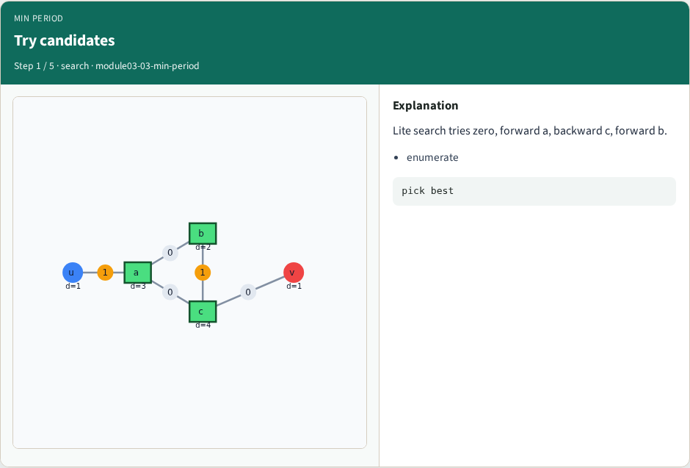
Try candidates
Try candidates
learn_retiming — 03 min period
Notes:
Lite search tries zero, forward a, backward c, forward b.

Slide 4
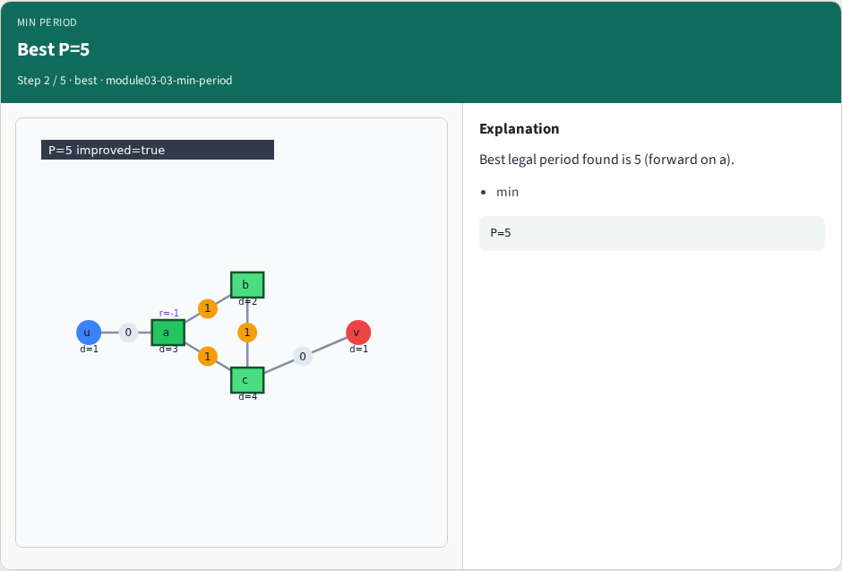
Best P=5
Best P=5
learn_retiming — 03 min period
Notes:
Best legal period found is 5 (forward on a).

Slide 5
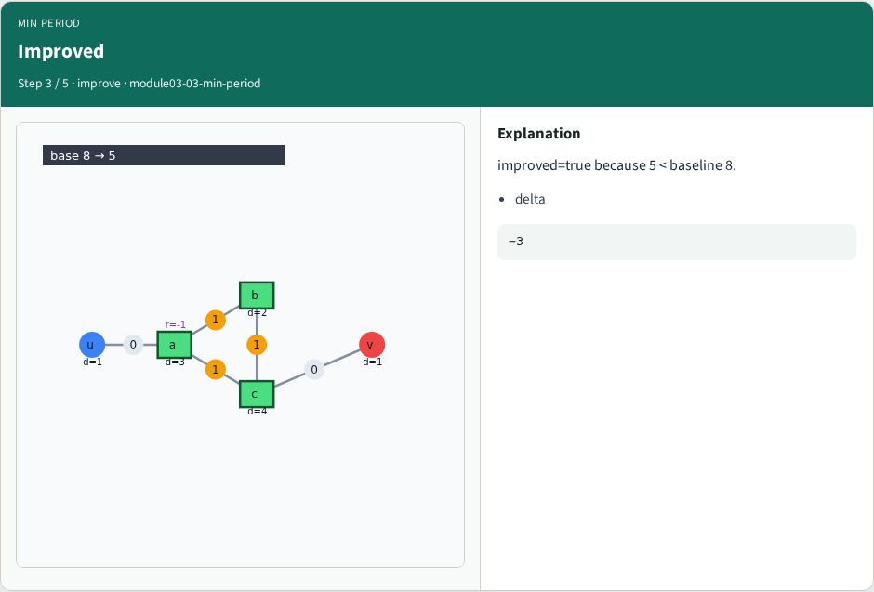
Improved
Improved
learn_retiming — 03 min period
Notes:
improved=true because 5 < baseline 8.

Slide 6

Cost registers
Cost registers
learn_retiming — 03 min period
Notes:
Best solution uses 3 registers vs 2 baseline.

Slide 7

Sequential API
Sequential API
learn_retiming — 03 min period
Notes:
sequential_retime(min_period) wraps the same search.

Slide 8
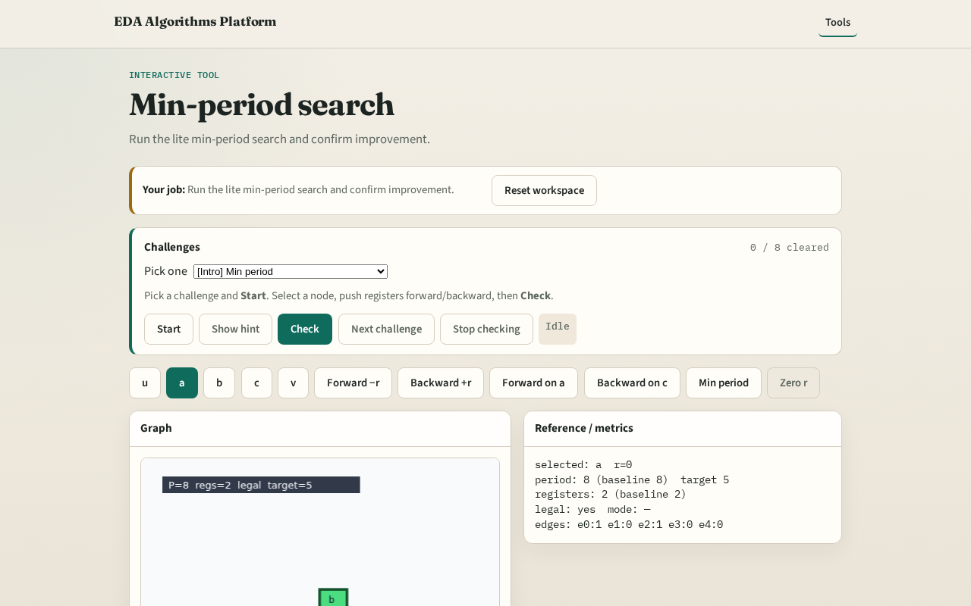
Browser lab track
Browser lab starter
learn_retiming — 03 min period
Notes:
Open **min-period**. Run search; confirm best period 5 and r(a)=−1.

Slide 9
Implement track
Call min_period_binary_search(DATA); assert period==5 and legal
learn_retiming — 03 min period
Notes:
Call min_period_binary_search(DATA); assert period==5 and legal.

Slide 10
Pitfalls
Assuming backward on c helps
Expecting full LP optimality
learn_retiming — 03 min period
Notes:
Assuming backward on c helps. Expecting full LP optimality.

Slide 11
Your turn
Next: register/area tradeoff
learn_retiming — 03 min period
Notes:
Next: register/area tradeoff.

