Slide 1
Area/regs
Retiming trades register area for shorter clock period , same function, different register placement
learn_retiming — 05 area registers
Notes:
Retiming trades register area for shorter clock period — same function, different register placement.

Slide 2
The idea
Forward on a
learn_retiming — 05 area registers
Notes:
forward on a: registers 2→3 (+1) but period 8→5; zero retiming keeps 2 registers at period 8.

Slide 3
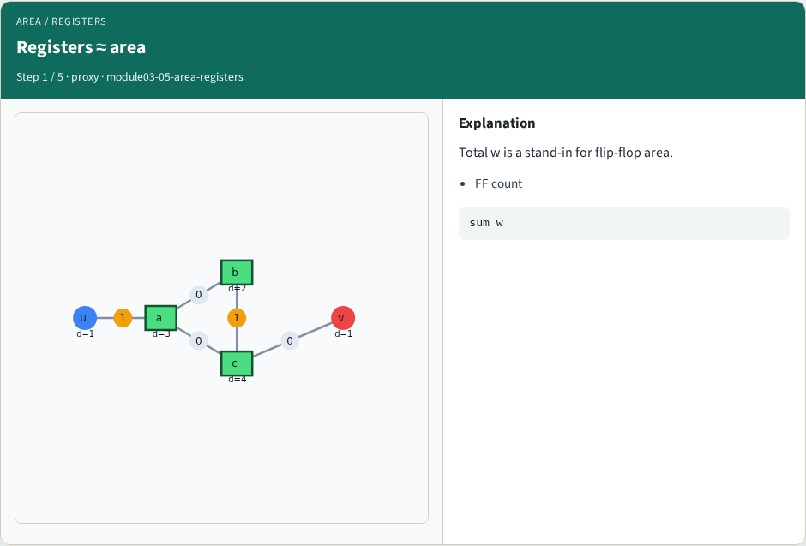
Registers ≈ area
Registers ≈ area
learn_retiming — 05 area registers
Notes:
Total w is a stand-in for flip-flop area.

Slide 4
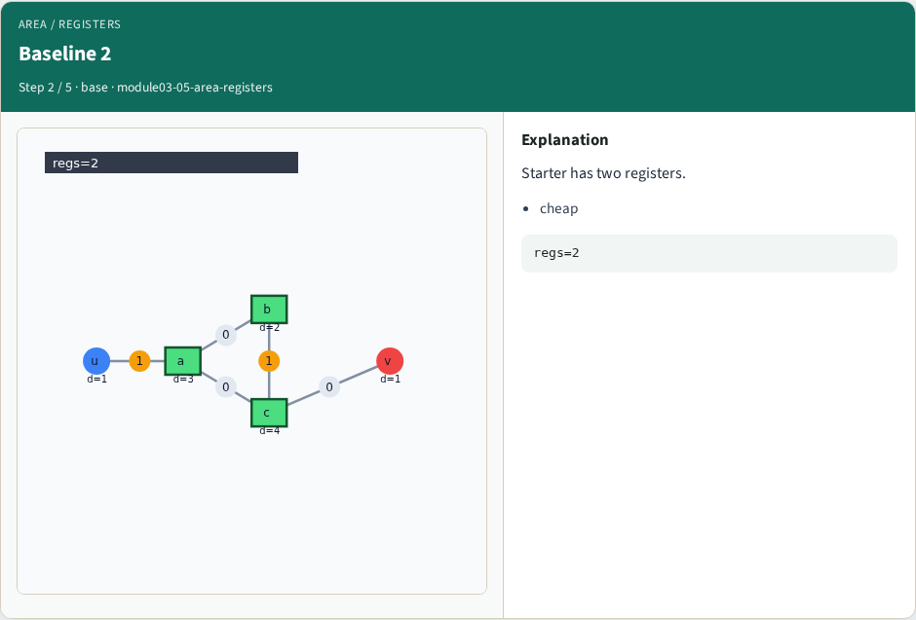
Baseline 2
Baseline 2
learn_retiming — 05 area registers
Notes:
Starter has two registers.

Slide 5
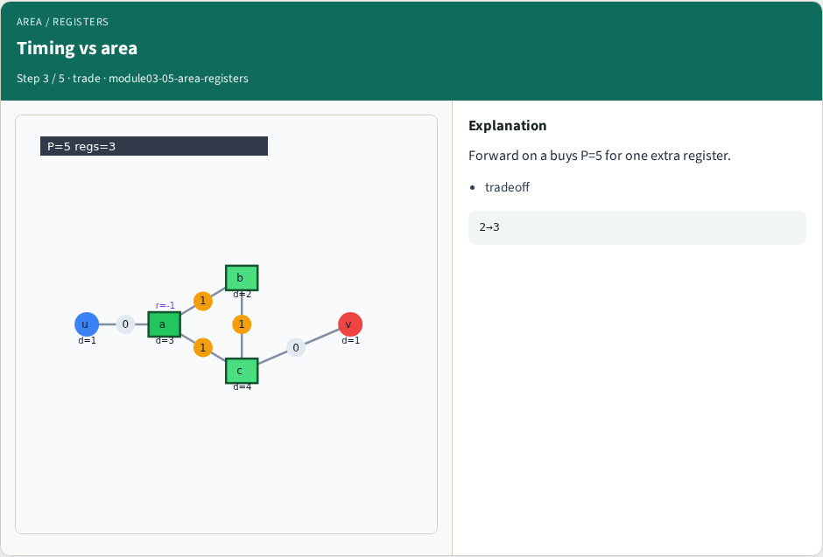
Timing vs area
Timing vs area
learn_retiming — 05 area registers
Notes:
Forward on a buys P=5 for one extra register.

Slide 6
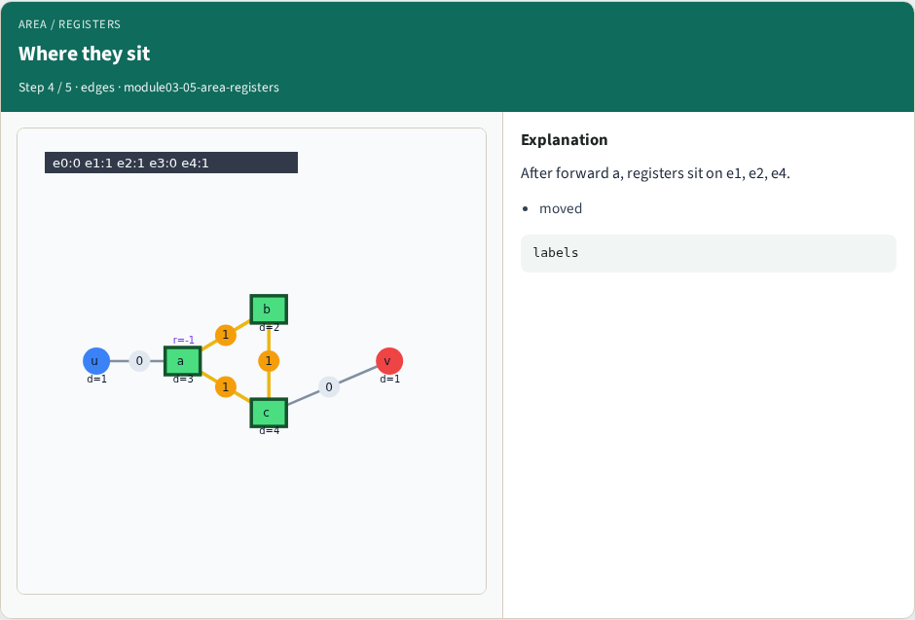
Where they sit
Where they sit
learn_retiming — 05 area registers
Notes:
After forward a, registers sit on e1, e2, e4.

Slide 7
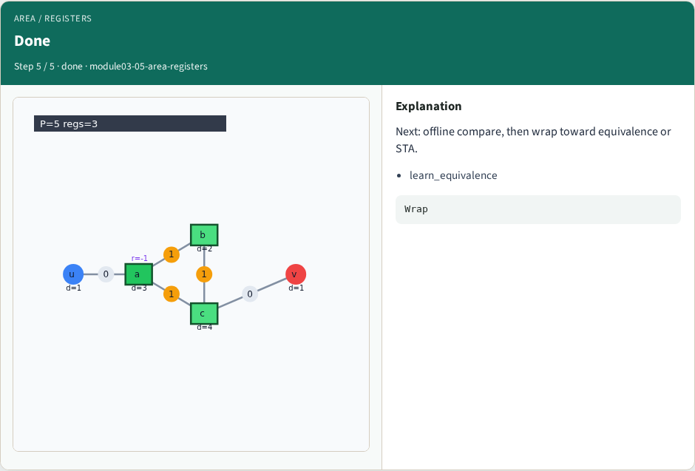
Done
Done
learn_retiming — 05 area registers
Notes:
Next: offline compare, then wrap toward equivalence or STA.

Slide 8
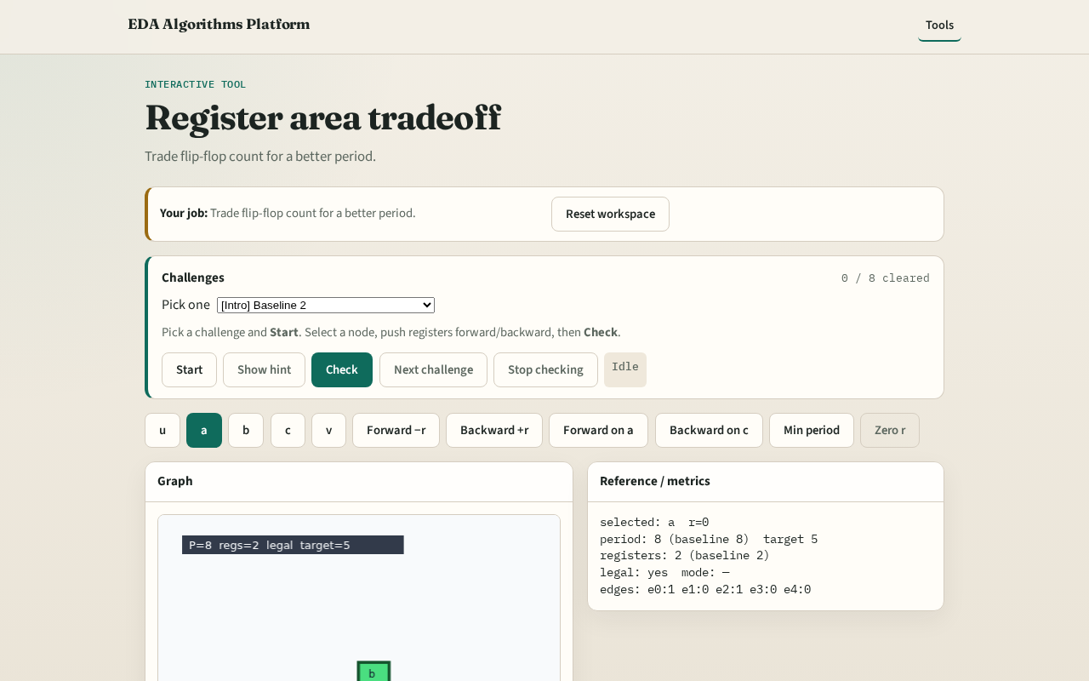
Browser lab track
Browser lab starter
learn_retiming — 05 area registers
Notes:
Open **area-registers**. Compare baseline vs forward-on-a register totals.

Slide 9
Implement track
Print register_count at r=0 and after forward on a (2 vs 3)
learn_retiming — 05 area registers
Notes:
Print register_count at r=0 and after forward on a (2 vs 3).

Slide 10
Pitfalls
Assuming retiming always reduces registers
Ignoring period when counting area
learn_retiming — 05 area registers
Notes:
Assuming retiming always reduces registers. Ignoring period when counting area.

Slide 11
Your turn
Next: offline benchmark, then wrap
learn_retiming — 05 area registers
Notes:
Next: offline benchmark, then wrap.

