Slide 1
Wire RC
Every buffering decision starts from how much resistance and capacitance a wire segment carries
learn_buffering — 01 wire rc
Notes:
Every buffering decision starts from how much resistance and capacitance a wire segment carries.

Slide 2
The idea
Wire_rc of length L returns R equals L times r_per and C equals L times c_per
Elmore delay uses R times C_self over two plus C_load
learn_buffering — 01 wire rc
Notes:
wire_rc of length L returns R equals L times r_per and C equals L times c_per. Elmore delay uses R times C_self over two plus C_load.

Slide 3
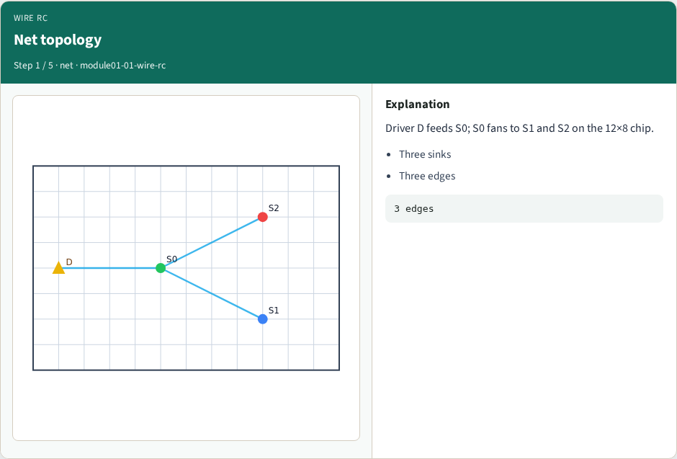
Net topology
Net topology
learn_buffering — 01 wire rc
Notes:
Driver D feeds S0; S0 fans to S1 and S2 on the 12×8 chip.

Slide 4
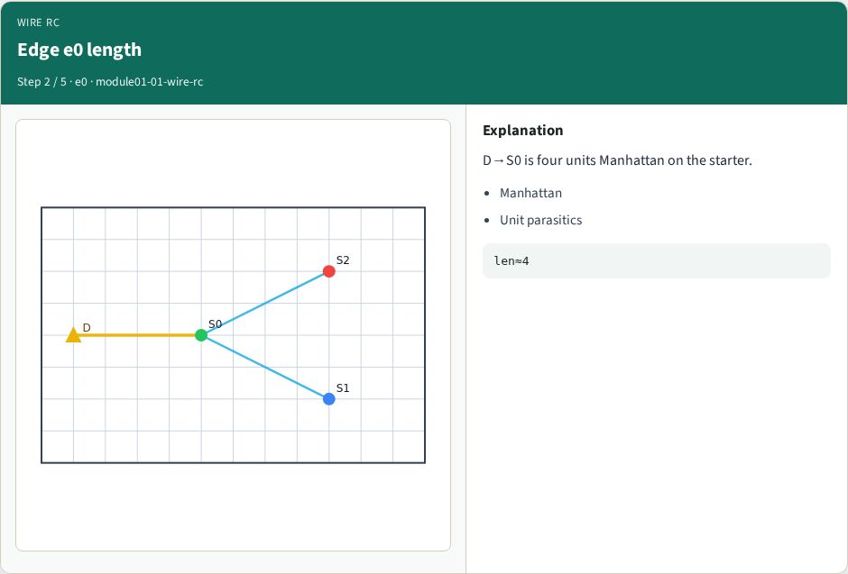
Edge e0 length
Edge e0 length
learn_buffering — 01 wire rc
Notes:
D→S0 is four units Manhattan on the starter.

Slide 5
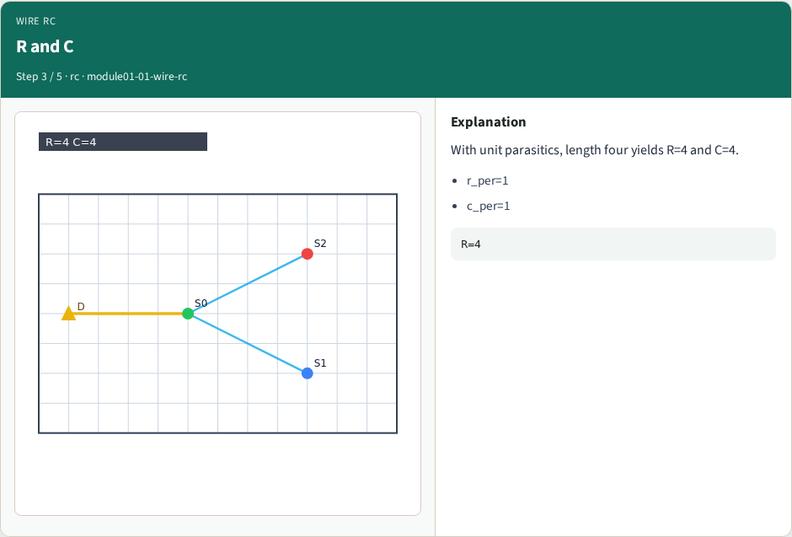
R and C
R and C
learn_buffering — 01 wire rc
Notes:
With unit parasitics, length four yields R=4 and C=4.

Slide 6
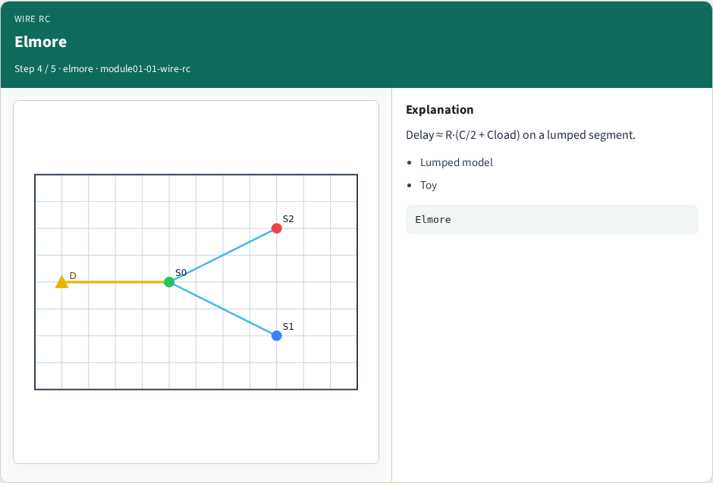
Elmore
Elmore
learn_buffering — 01 wire rc
Notes:
Delay ≈ R·(C/2 + Cload) on a lumped segment.

Slide 7
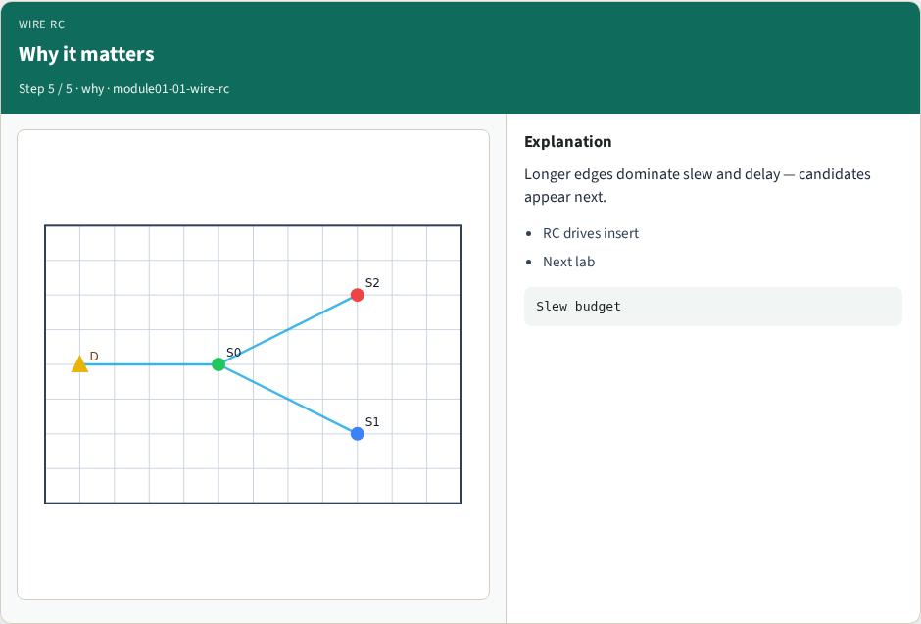
Why it matters
Why it matters
learn_buffering — 01 wire rc
Notes:
Longer edges dominate slew and delay — candidates appear next.

Slide 8
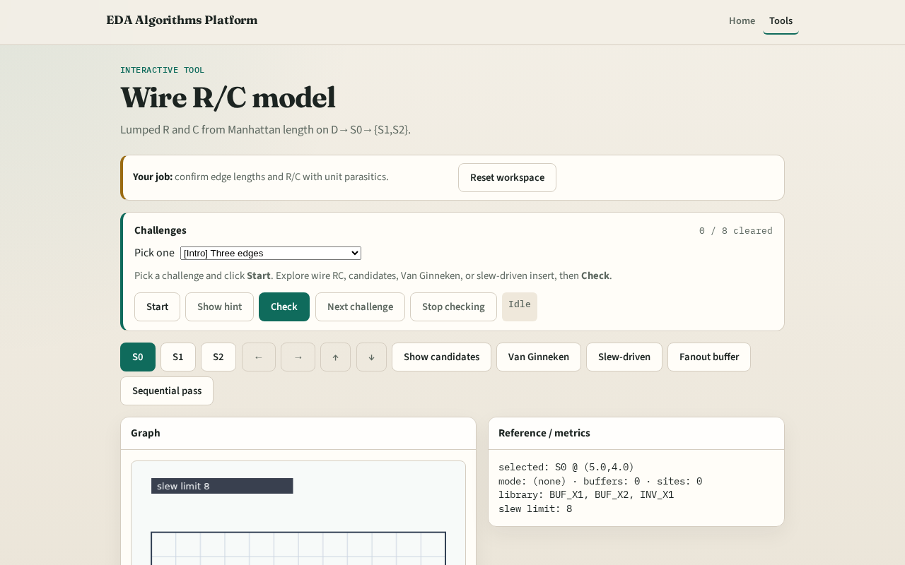
Browser lab track
Browser lab starter
learn_buffering — 01 wire rc
Notes:
Open **wire-rc**. Inspect edges e0–e2. Confirm length-four e0 maps to R=4, C=4 with unit parasitics.

Slide 9
Implement track
Call `wire_rc(length)` and `elmore_delay` in `common/`
Match GOLDENS.wireRcLen4R
learn_buffering — 01 wire rc
Notes:
Call `wire_rc(length)` and `elmore_delay` in `common/`. Match GOLDENS.wireRcLen4R.

Slide 10
Pitfalls
Using Euclidean length
Forgetting C_load in Elmore
Mixing per-unit R with total R
learn_buffering — 01 wire rc
Notes:
Using Euclidean length. Forgetting C_load in Elmore. Mixing per-unit R with total R.

Slide 11
Your turn
Next: slew budgets on those RC segments
learn_buffering — 01 wire rc
Notes:
Next: slew budgets on those RC segments.

