Slide 1
Slew budget
Slew (transition) is what library cells require; long RC violates the budget
learn_buffering — 03 slew budget
Notes:
Slew (transition) is what library cells require; long RC violates the budget.

Slide 2
The idea
Estimate_slew equals k times R times C_total with k about 2.2
Slew_ok is true when slew is at most the limit, eight on the toy
learn_buffering — 03 slew budget
Notes:
estimate_slew equals k times R times C_total with k about 2.2. slew_ok is true when slew is at most the limit—eight on the toy.

Slide 3
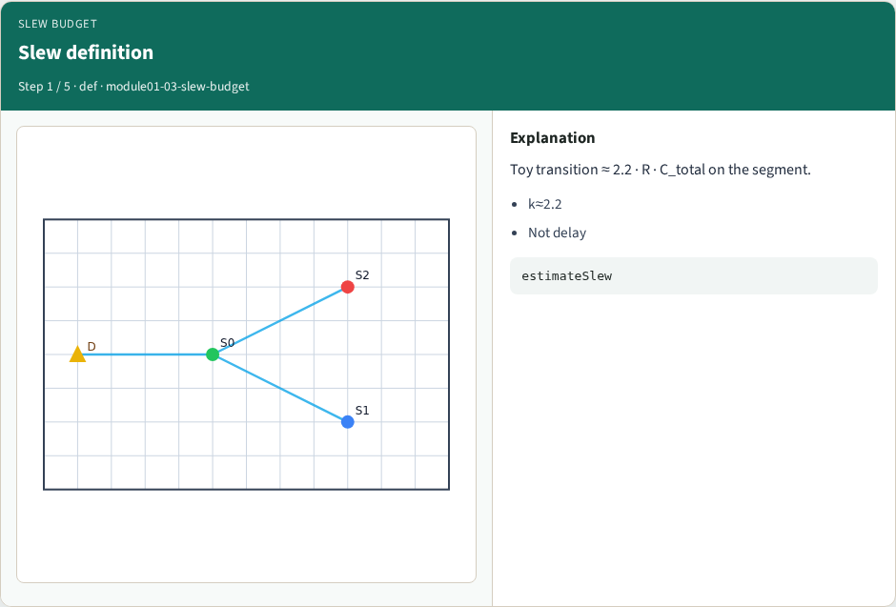
Slew definition
Slew definition
learn_buffering — 03 slew budget
Notes:
Toy transition ≈ 2.2 · R · C_total on the segment.

Slide 4
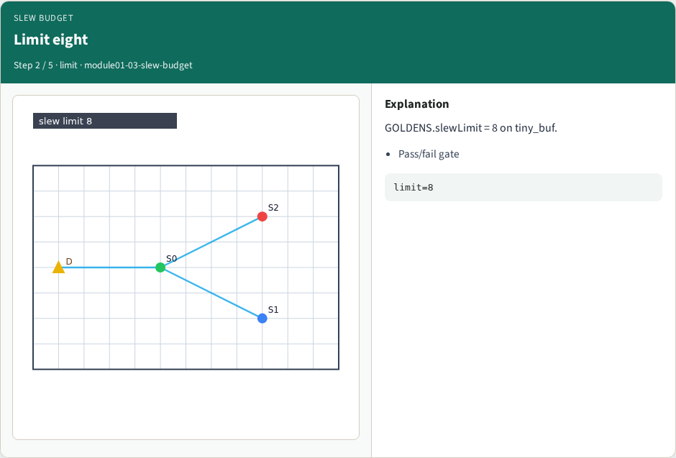
Limit eight
Limit eight
learn_buffering — 03 slew budget
Notes:
GOLDENS.slewLimit = 8 on tiny_buf.

Slide 5
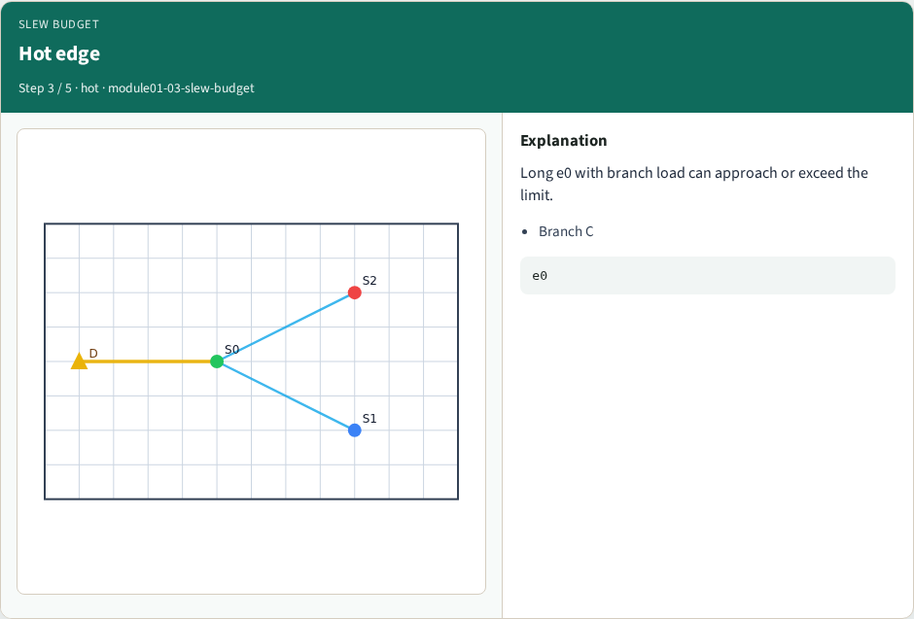
Hot edge
Hot edge
learn_buffering — 03 slew budget
Notes:
Long e0 with branch load can approach or exceed the limit.

Slide 6
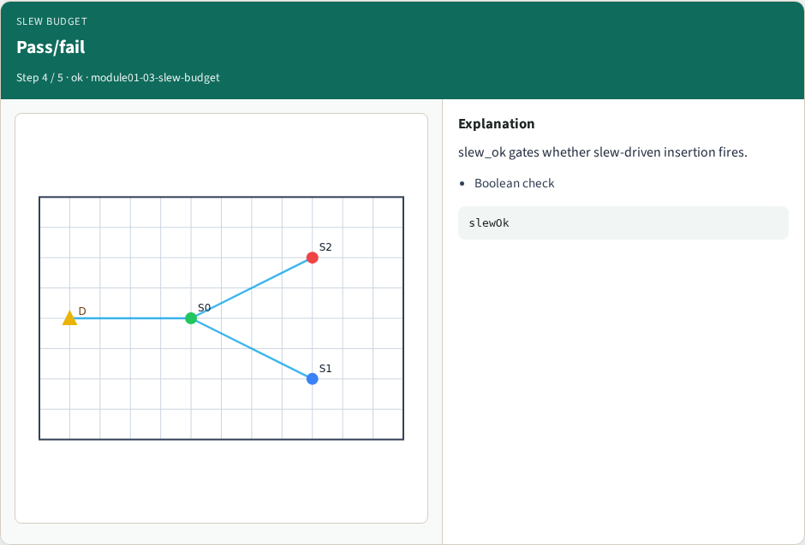
Pass/fail
Pass/fail
learn_buffering — 03 slew budget
Notes:
slew_ok gates whether slew-driven insertion fires.

Slide 7
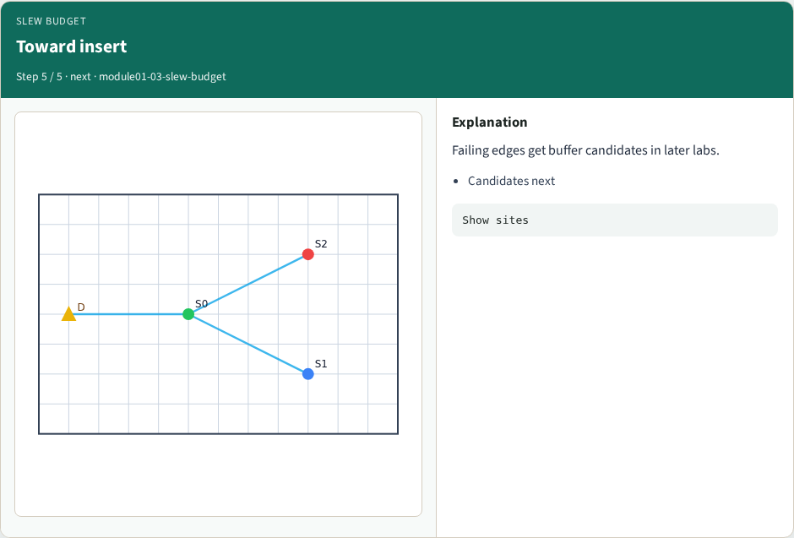
Toward insert
Toward insert
learn_buffering — 03 slew budget
Notes:
Failing edges get buffer candidates in later labs.

Slide 8
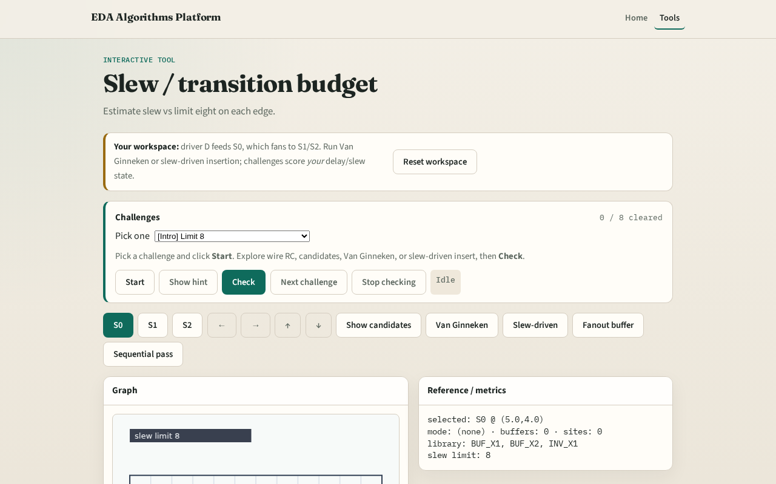
Browser lab track
Browser lab starter
learn_buffering — 03 slew budget
Notes:
Open **slew-budget**. Read edge slews vs limit eight. Stretch a sink to worsen e1 slew.

Slide 9
Implement track
Call `estimate_slew` and `slew_ok` in solvers
Assert limit from tiny_buf.json
learn_buffering — 03 slew budget
Notes:
Call `estimate_slew` and `slew_ok` in solvers. Assert limit from tiny_buf.json.

Slide 10
Pitfalls
Using delay as slew
Ignoring C_load
Hard-coding pass without measuring
learn_buffering — 03 slew budget
Notes:
Using delay as slew. Ignoring C_load. Hard-coding pass without measuring.

Slide 11
Your turn
Next: place candidate buffer sites along edges
learn_buffering — 03 slew budget
Notes:
Next: place candidate buffer sites along edges.

