Slide 1
Candidates
Van Ginneken and slew-driven flows only insert where candidates exist
learn_buffering — 01 candidate sites
Notes:
Van Ginneken and slew-driven flows only insert where candidates exist.

Slide 2
The idea
Walk each edge; every candidate_step units place a site excluding endpoints
Gray dots mark legal insert points
learn_buffering — 01 candidate sites
Notes:
Walk each edge; every candidate_step units place a site excluding endpoints. Gray dots mark legal insert points.

Slide 3
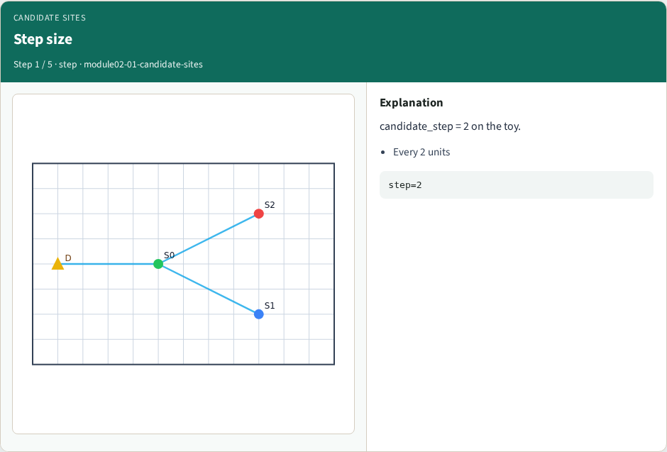
Step size
Step size
learn_buffering — 01 candidate sites
Notes:
candidate_step = 2 on the toy.

Slide 4
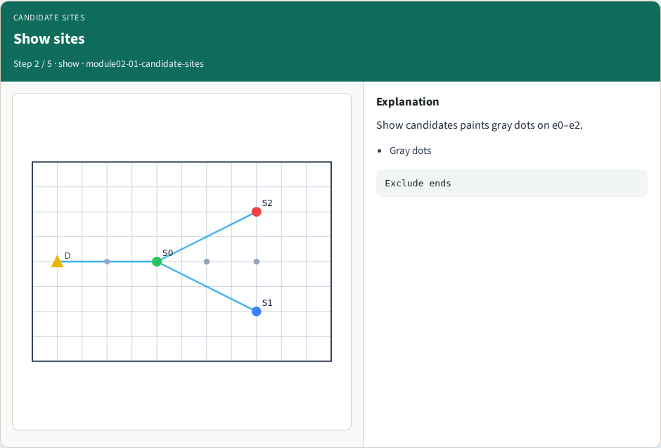
Show sites
Show sites
learn_buffering — 01 candidate sites
Notes:
Show candidates paints gray dots on e0–e2.

Slide 5

Count
Count
learn_buffering — 01 candidate sites
Notes:
Longer edges yield more sites.

Slide 6
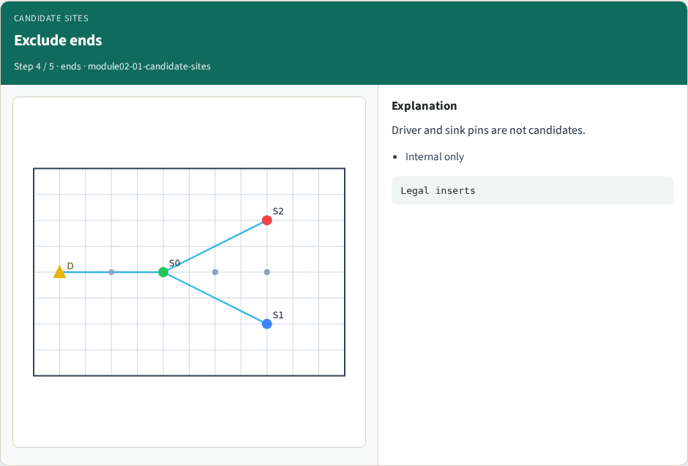
Exclude ends
Exclude ends
learn_buffering — 01 candidate sites
Notes:
Driver and sink pins are not candidates.

Slide 7
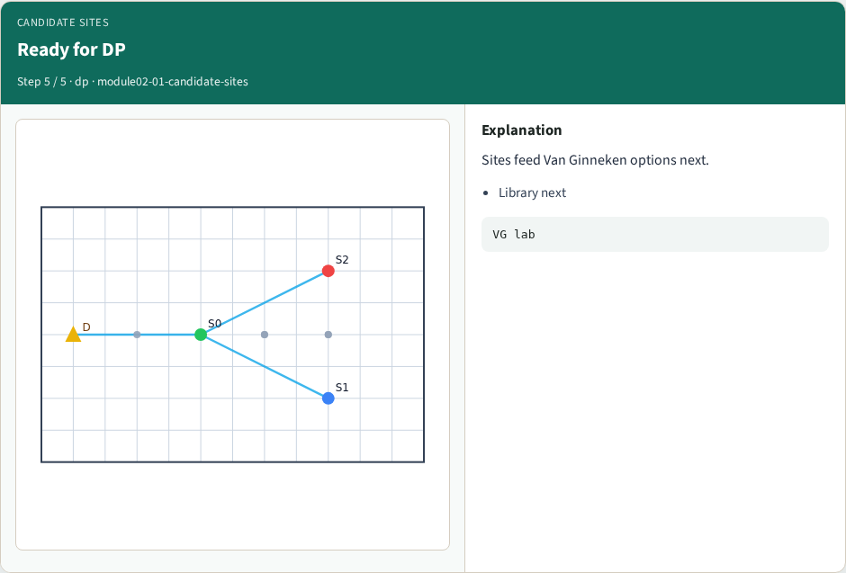
Ready for DP
Ready for DP
learn_buffering — 01 candidate sites
Notes:
Sites feed Van Ginneken options next.

Slide 8
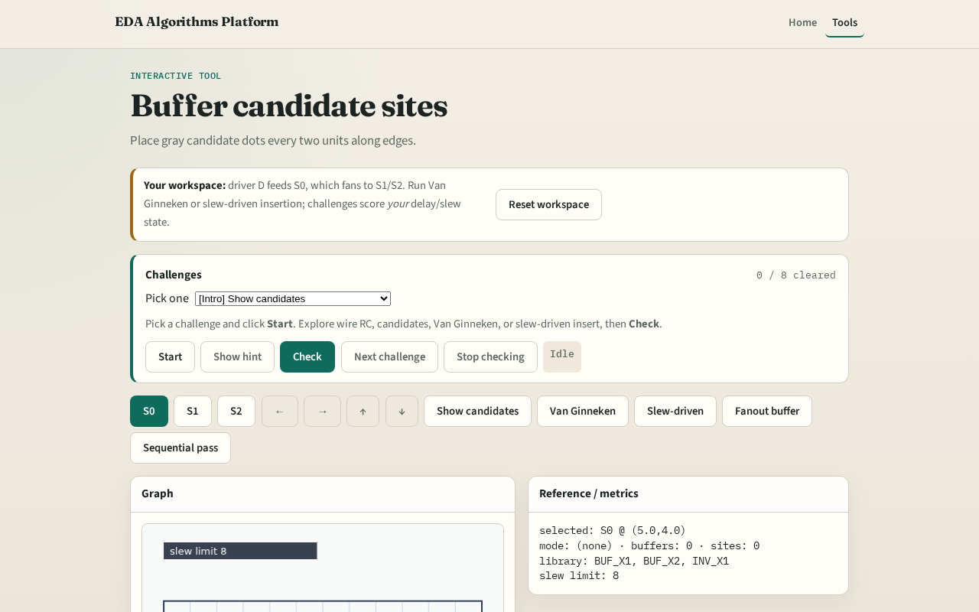
Browser lab track
Browser lab starter
learn_buffering — 01 candidate sites
Notes:
Open **candidate-sites**. Click Show candidates. Count gray dots on e0.

Slide 9
Implement track
Call `candidate_sites(data)`
Assert length > 0 for tiny_buf
learn_buffering — 01 candidate sites
Notes:
Call `candidate_sites(data)`. Assert length > 0 for tiny_buf.

Slide 10
Pitfalls
Placing sites past the far endpoint
Using step zero
Forgetting diagonal HV walk
learn_buffering — 01 candidate sites
Notes:
Placing sites past the far endpoint. Using step zero. Forgetting diagonal HV walk.

Slide 11
Your turn
Next: the buffer library cells you can instantiate
learn_buffering — 01 candidate sites
Notes:
Next: the buffer library cells you can instantiate.

