Slide 1
Library
Stronger buffers cost input cap but drive with lower resistance
learn_buffering — 03 buffer library
Notes:
Stronger buffers cost input cap but drive with lower resistance.

Slide 2
The idea
BUF_X1, BUF_X2, INV_X1 each publish cin, rout, delay, invert
Van Ginneken tries each non-inverting cell unless polarity mode allows INV
learn_buffering — 03 buffer library
Notes:
BUF_X1, BUF_X2, INV_X1 each publish cin, rout, delay, invert. Van Ginneken tries each non-inverting cell unless polarity mode allows INV.

Slide 3
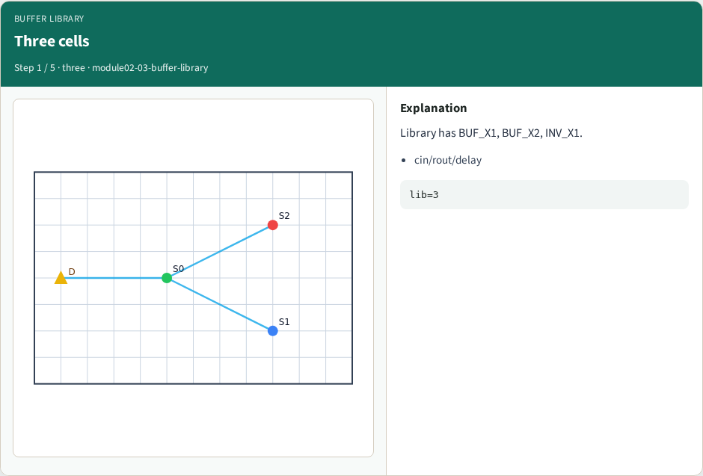
Three cells
Three cells
learn_buffering — 03 buffer library
Notes:
Library has BUF_X1, BUF_X2, INV_X1.

Slide 4
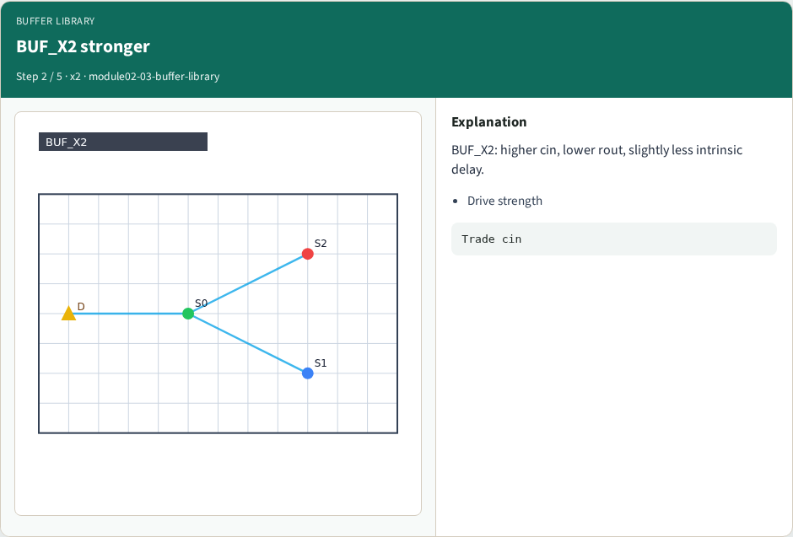
BUF_X2 stronger
BUF_X2 stronger
learn_buffering — 03 buffer library
Notes:
BUF_X2: higher cin, lower rout, slightly less intrinsic delay.

Slide 5
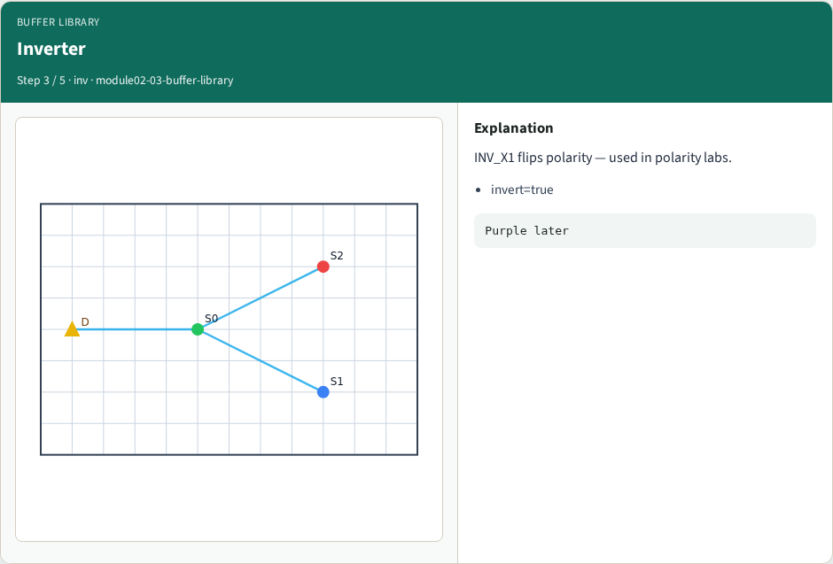
Inverter
Inverter
learn_buffering — 03 buffer library
Notes:
INV_X1 flips polarity — used in polarity labs.

Slide 6
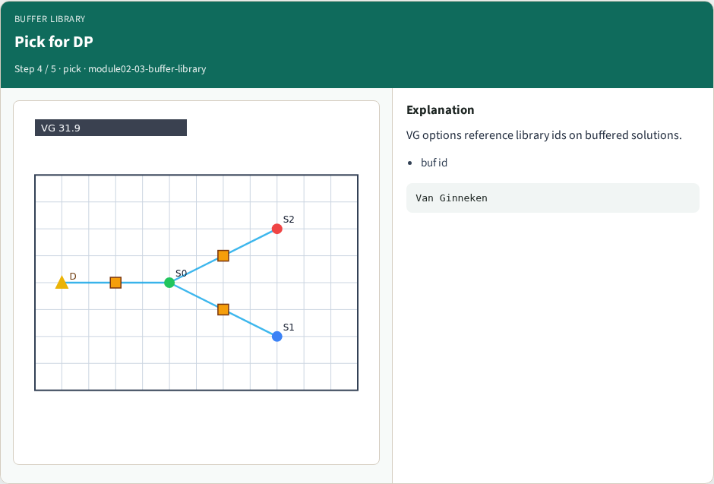
Pick for DP
Pick for DP
learn_buffering — 03 buffer library
Notes:
VG options reference library ids on buffered solutions.

Slide 7
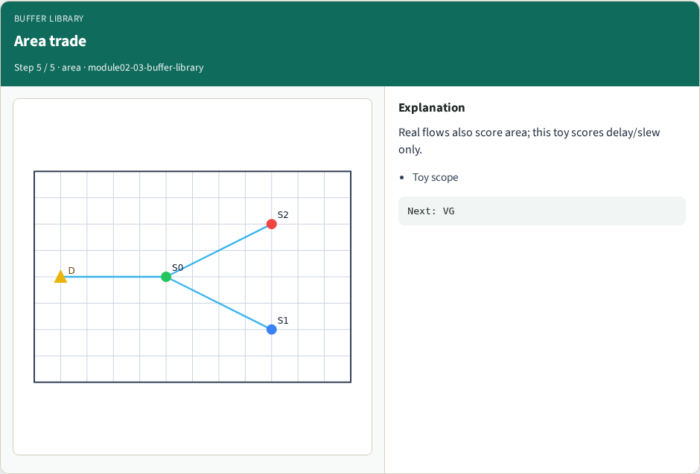
Area trade
Area trade
learn_buffering — 03 buffer library
Notes:
Real flows also score area; this toy scores delay/slew only.

Slide 8
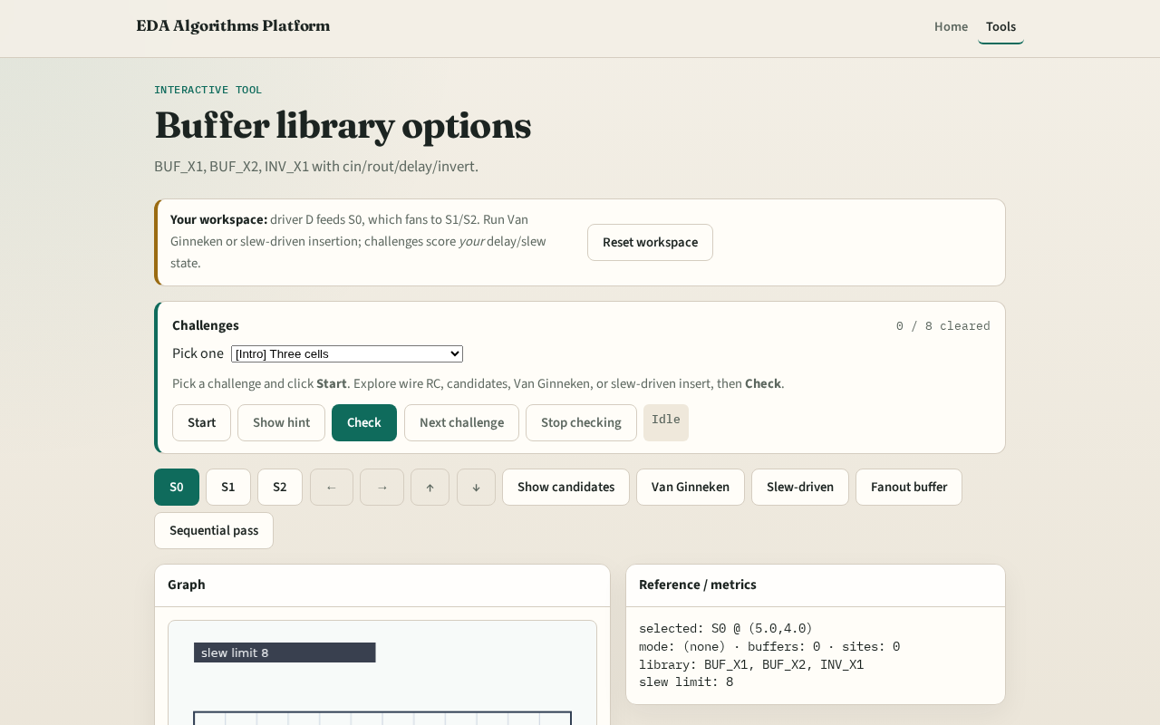
Browser lab track
Browser lab starter
learn_buffering — 03 buffer library
Notes:
Open **buffer-library**. Confirm three cells. Run Van Ginneken and see which buf ids appear.

Slide 9
Implement track
Print `data['buffer_library']`
Assert GOLDENS.libCount == 3
learn_buffering — 03 buffer library
Notes:
Print `data['buffer_library']`. Assert GOLDENS.libCount == 3.

Slide 10
Pitfalls
Ignoring invert flag
Treating rout as delay
Using cells not in the library
learn_buffering — 03 buffer library
Notes:
Ignoring invert flag. Treating rout as delay. Using cells not in the library.

Slide 11
Your turn
Next: Van Ginneken dynamic programming lite
learn_buffering — 03 buffer library
Notes:
Next: Van Ginneken dynamic programming lite.

