Slide 1
Van Ginneken
Van Ginneken is the classic DP for buffer insertion on trees
learn_buffering — 05 van ginneken
Notes:
Van Ginneken is the classic DP for buffer insertion on trees.

Slide 2
The idea
For each edge build wire-only and mid-buffer options as (c,d) pairs
Dominate_prune keeps non-dominated fronts
Pick minimum delay
Sum along the toy tree
learn_buffering — 05 van ginneken
Notes:
For each edge build wire-only and mid-buffer options as (c,d) pairs. dominate_prune keeps non-dominated fronts. Pick minimum delay. Sum along the toy tree.

Slide 3
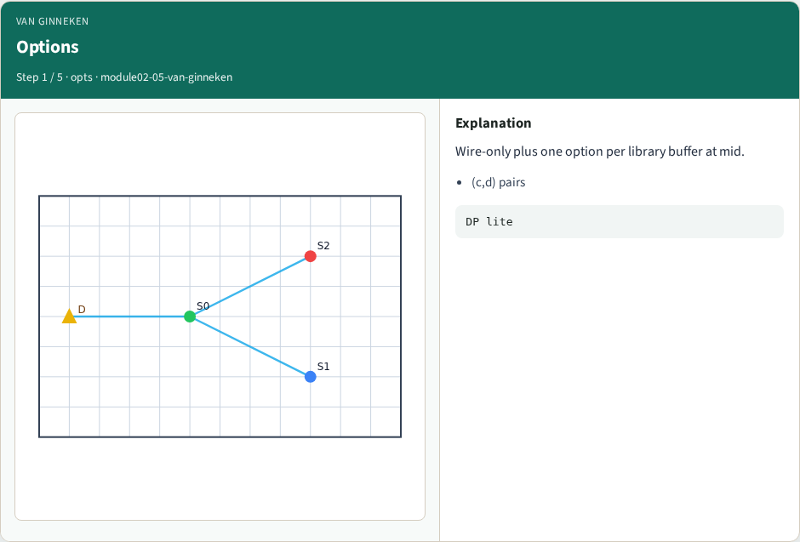
Options
Options
learn_buffering — 05 van ginneken
Notes:
Wire-only plus one option per library buffer at mid.

Slide 4
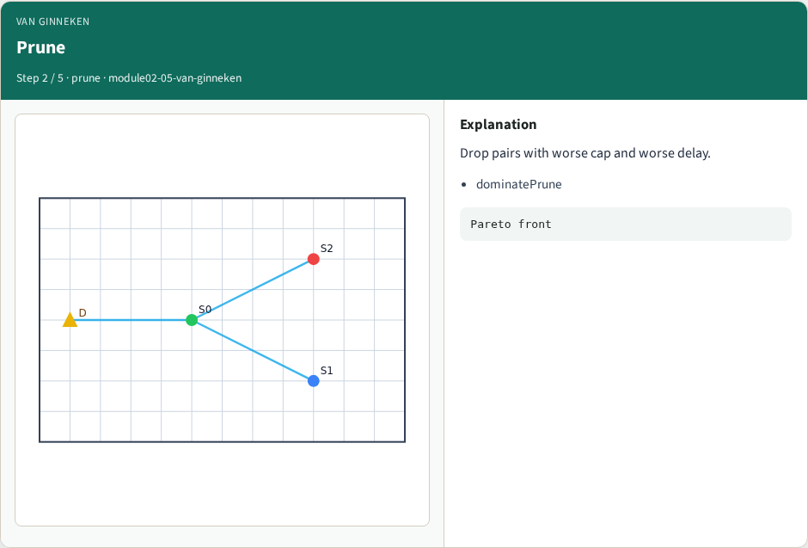
Prune
Prune
learn_buffering — 05 van ginneken
Notes:
Drop pairs with worse cap and worse delay.

Slide 5
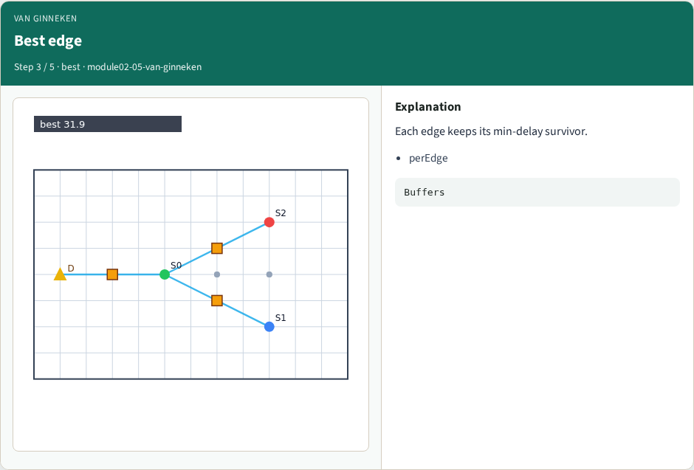
Best edge
Best edge
learn_buffering — 05 van ginneken
Notes:
Each edge keeps its min-delay survivor.

Slide 6
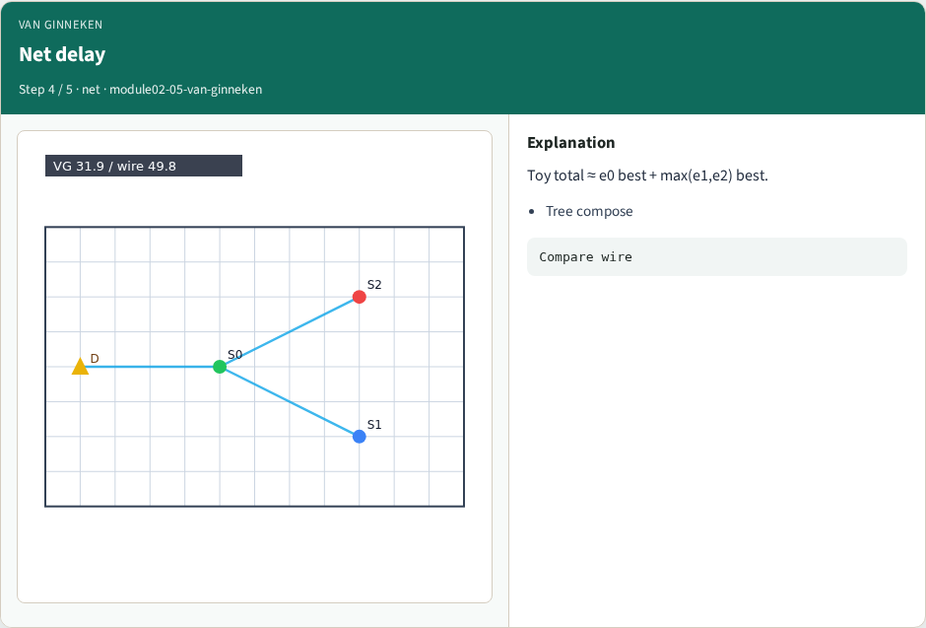
Net delay
Net delay
learn_buffering — 05 van ginneken
Notes:
Toy total ≈ e0 best + max(e1,e2) best.

Slide 7
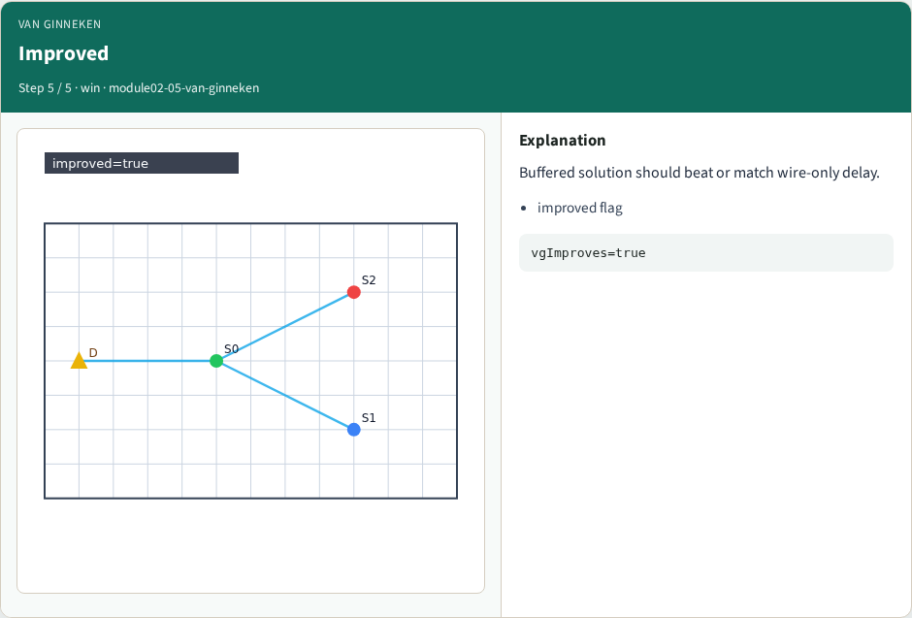
Improved
Improved
learn_buffering — 05 van ginneken
Notes:
Buffered solution should beat or match wire-only delay.

Slide 8
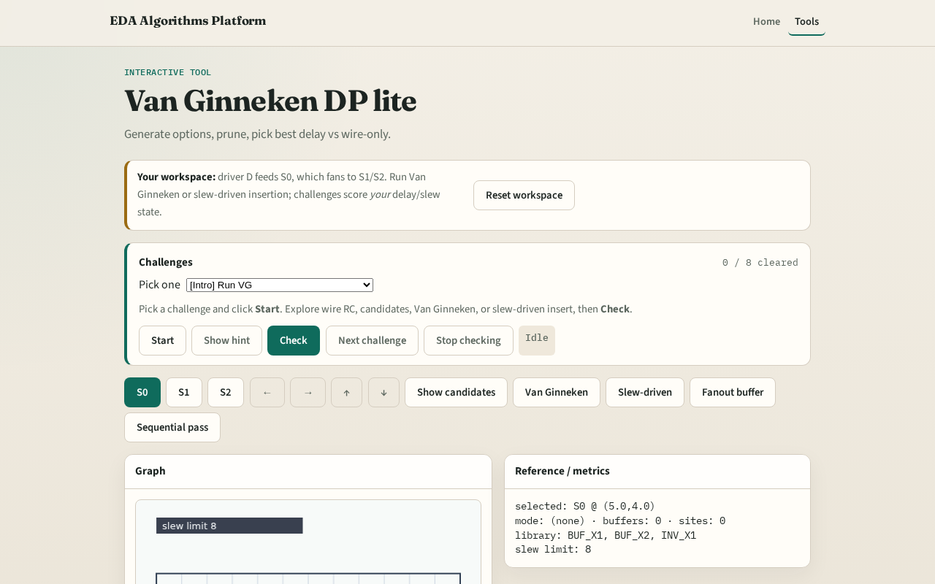
Browser lab track
Browser lab starter
learn_buffering — 05 van ginneken
Notes:
Open **van-ginneken**. Click Van Ginneken. Confirm improved delay vs wire and orange buffers where chosen.

Slide 9
Implement track
Call `van_ginneken_net(data)`
Assert best_delay ≤ wire_delay
learn_buffering — 05 van ginneken
Notes:
Call `van_ginneken_net(data)`. Assert best_delay ≤ wire_delay.

Slide 10
Pitfalls
Keeping dominated options
Double-counting branch loads
Forgetting wire-only option
learn_buffering — 05 van ginneken
Notes:
Keeping dominated options. Double-counting branch loads. Forgetting wire-only option.

Slide 11
Your turn
Next: slew-driven greedy insertion
learn_buffering — 05 van ginneken
Notes:
Next: slew-driven greedy insertion.

