Slide 1
Slew-driven
When DP is heavy, a slew check plus mid-edge buffer is a fast practical heuristic
learn_buffering — 07 slew driven
Notes:
When DP is heavy, a slew check plus mid-edge buffer is a fast practical heuristic.

Slide 2
The idea
For each edge compute slew; if above limit, insert BUF_X1 at the midpoint
Lowering the limit forces more insertions
learn_buffering — 07 slew driven
Notes:
For each edge compute slew; if above limit, insert BUF_X1 at the midpoint. Lowering the limit forces more insertions.

Slide 3
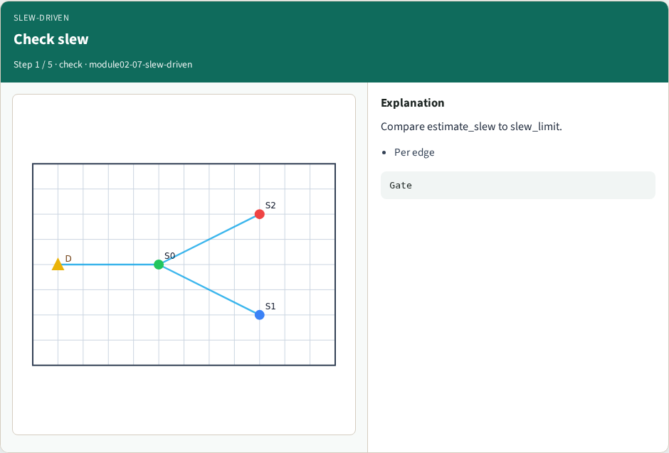
Check slew
Check slew
learn_buffering — 07 slew driven
Notes:
Compare estimate_slew to slew_limit.

Slide 4
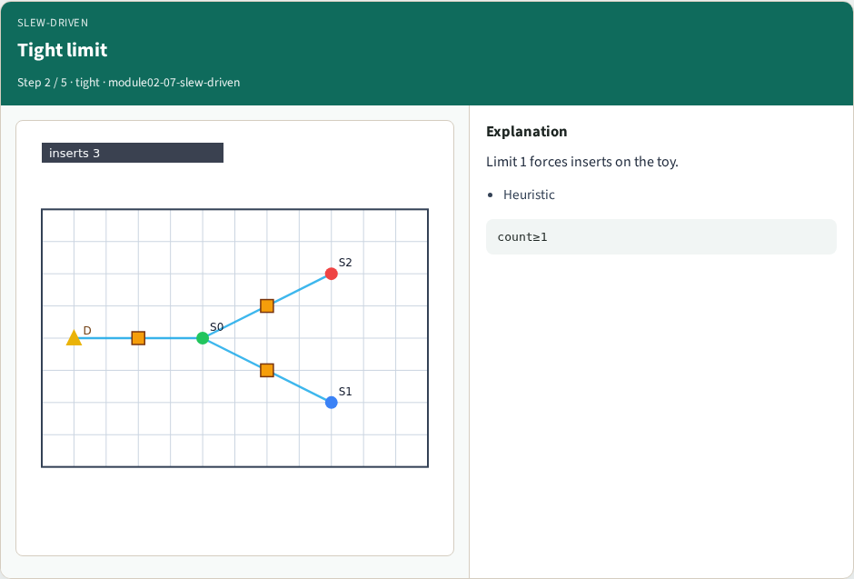
Tight limit
Tight limit
learn_buffering — 07 slew driven
Notes:
Limit 1 forces inserts on the toy.

Slide 5
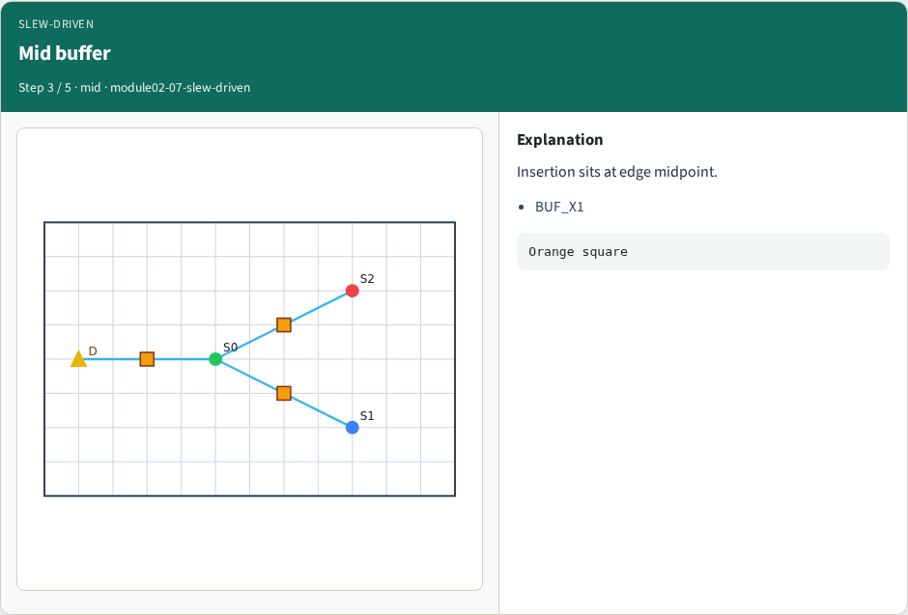
Mid buffer
Mid buffer
learn_buffering — 07 slew driven
Notes:
Insertion sits at edge midpoint.

Slide 6
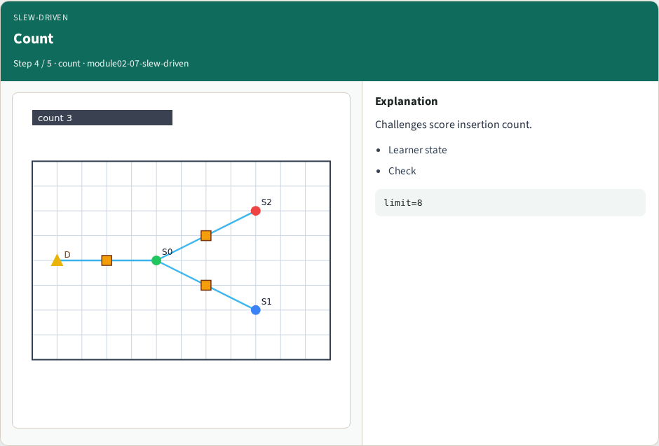
Count
Count
learn_buffering — 07 slew driven
Notes:
Challenges score insertion count.

Slide 7
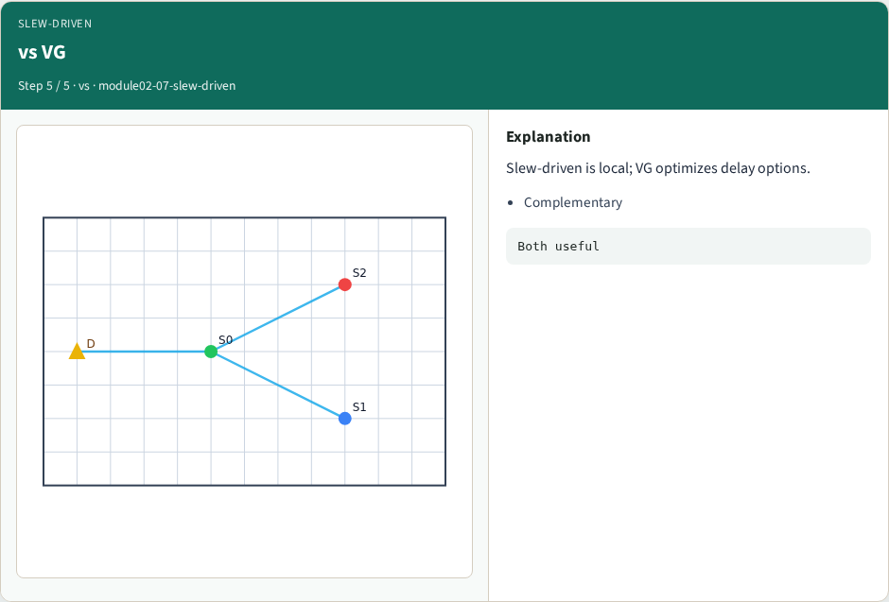
vs VG
vs VG
learn_buffering — 07 slew driven
Notes:
Slew-driven is local; VG optimizes delay options.

Slide 8
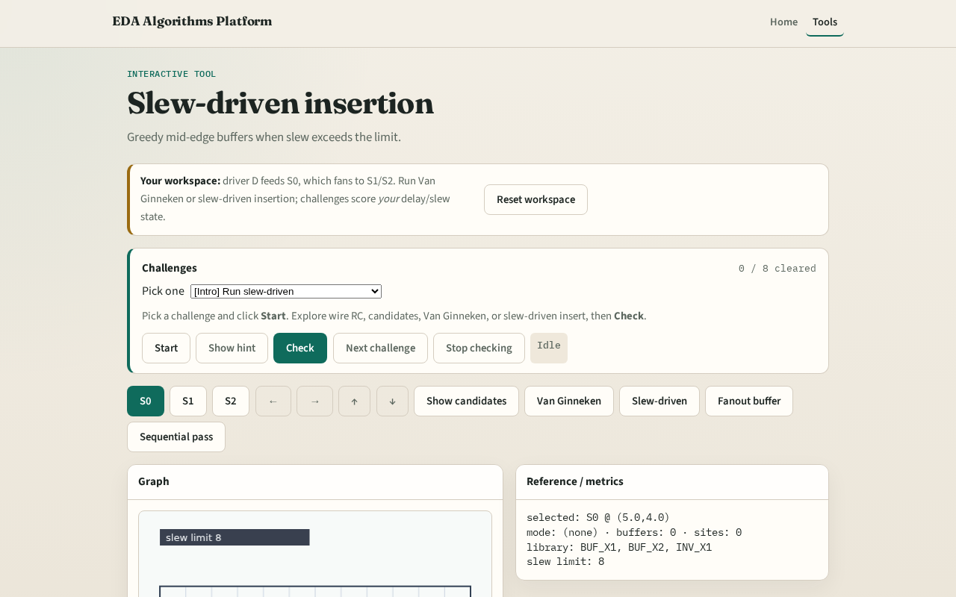
Browser lab track
Browser lab starter
learn_buffering — 07 slew driven
Notes:
Open **slew-driven**. Click Slew-driven. With default limit, note count; mentally compare to Van Ginneken.

Slide 9
Implement track
Call `slew_driven_insert` with slew_limit=1; assert count ≥ 1
learn_buffering — 07 slew driven
Notes:
Call `slew_driven_insert` with slew_limit=1; assert count ≥ 1.

Slide 10
Pitfalls
Inserting without measuring slew
Stacking infinite buffers
Ignoring branch load
learn_buffering — 07 slew driven
Notes:
Inserting without measuring slew. Stacking infinite buffers. Ignoring branch load.

Slide 11
Your turn
Next: polarity and inverters
learn_buffering — 07 slew driven
Notes:
Next: polarity and inverters.

