Slide 1
Polarity
Inverters are useful buffers but flip the signal; odd counts need a fix
learn_buffering — 01 polarity invert
Notes:
Inverters are useful buffers but flip the signal; odd counts need a fix.

Slide 2
The idea
Each INV_X1 flips polarity
Polarity_fix reports flips and whether the path is still positive
learn_buffering — 01 polarity invert
Notes:
Each INV_X1 flips polarity. polarity_fix reports flips and whether the path is still positive.

Slide 3
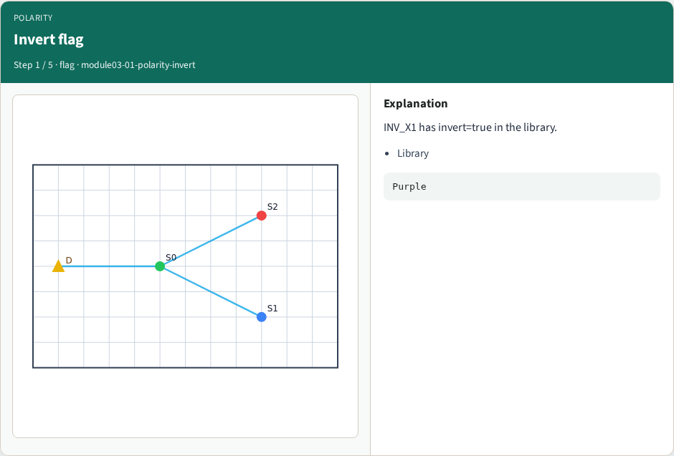
Invert flag
Invert flag
learn_buffering — 01 polarity invert
Notes:
INV_X1 has invert=true in the library.

Slide 4
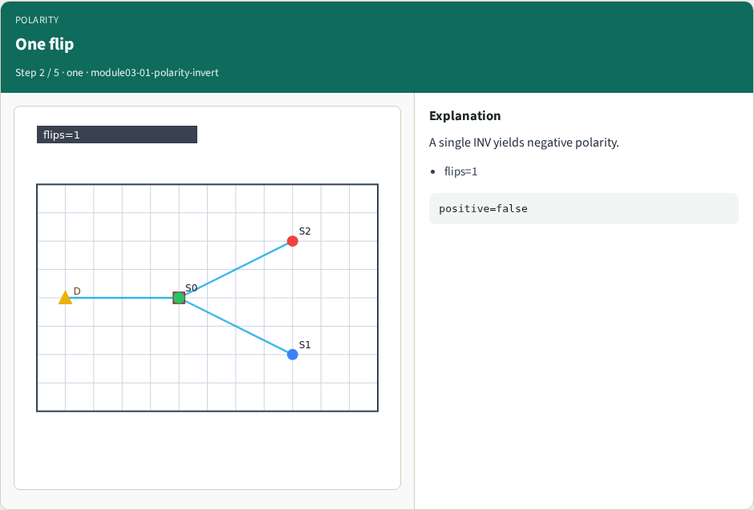
One flip
One flip
learn_buffering — 01 polarity invert
Notes:
A single INV yields negative polarity.

Slide 5

Two flips
Two flips
learn_buffering — 01 polarity invert
Notes:
Two INVs restore positive sense.

Slide 6
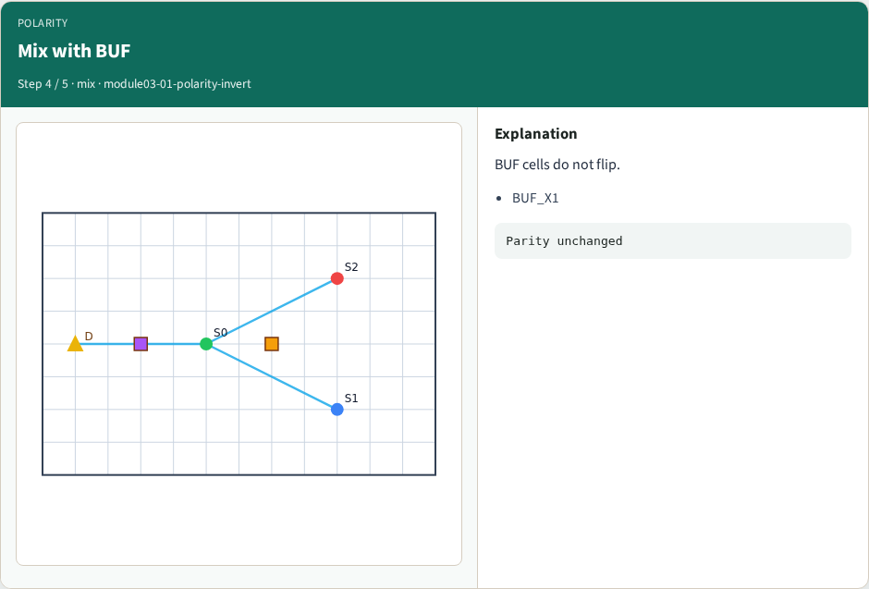
Mix with BUF
Mix with BUF
learn_buffering — 01 polarity invert
Notes:
BUF cells do not flip.

Slide 7
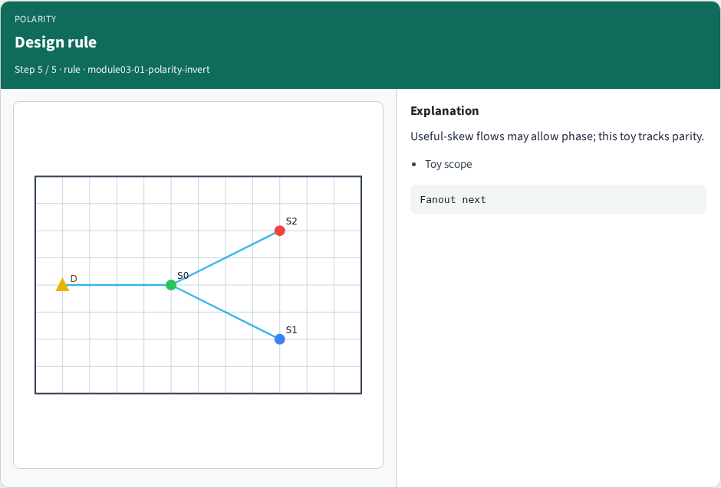
Design rule
Design rule
learn_buffering — 01 polarity invert
Notes:
Useful-skew flows may allow phase; this toy tracks parity.

Slide 8
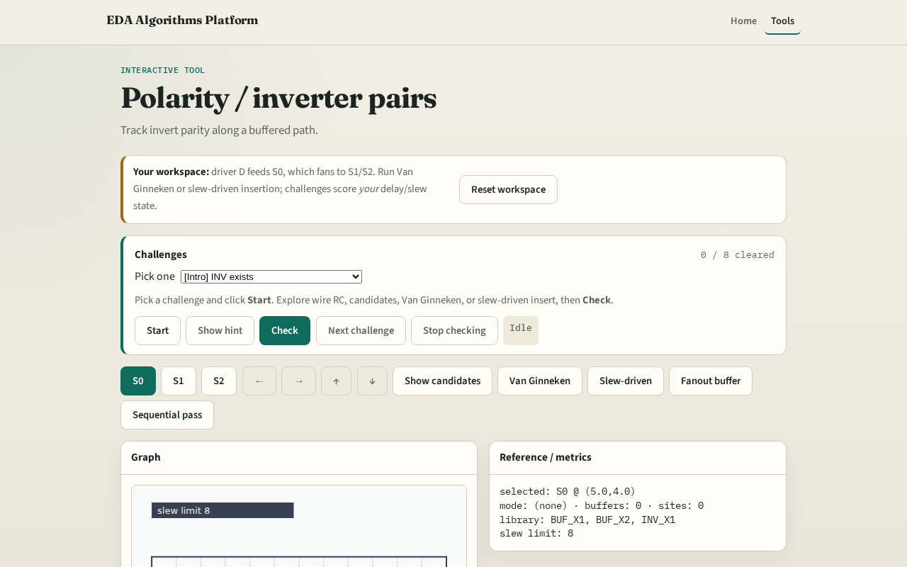
Browser lab track
Browser lab starter
learn_buffering — 01 polarity invert
Notes:
Open **polarity-invert**. Place an INV on a path mentally; Check polarity challenges.

Slide 9
Implement track
Call `polarity_fix([INV],[BUF])`
Assert flips and positive flags
learn_buffering — 01 polarity invert
Notes:
Call `polarity_fix([INV],[BUF])`. Assert flips and positive flags.

Slide 10
Pitfalls
Counting BUF as invert
Forgetting parity
Using INV in VG when allow_invert is false
learn_buffering — 01 polarity invert
Notes:
Counting BUF as invert. Forgetting parity. Using INV in VG when allow_invert is false.

Slide 11
Your turn
Next: fanout buffering at the junction
learn_buffering — 01 polarity invert
Notes:
Next: fanout buffering at the junction.

