Slide 1
Fanout
One driver cannot feed too many sinks without a buffer tree stage
learn_buffering — 03 fanout tree
Notes:
One driver cannot feed too many sinks without a buffer tree stage.

Slide 2
The idea
If sink count exceeds max_fanout (two on the toy), insert BUF_X2 at S0
Three sinks therefore force an insert
learn_buffering — 03 fanout tree
Notes:
If sink count exceeds max_fanout (two on the toy), insert BUF_X2 at S0. Three sinks therefore force an insert.

Slide 3
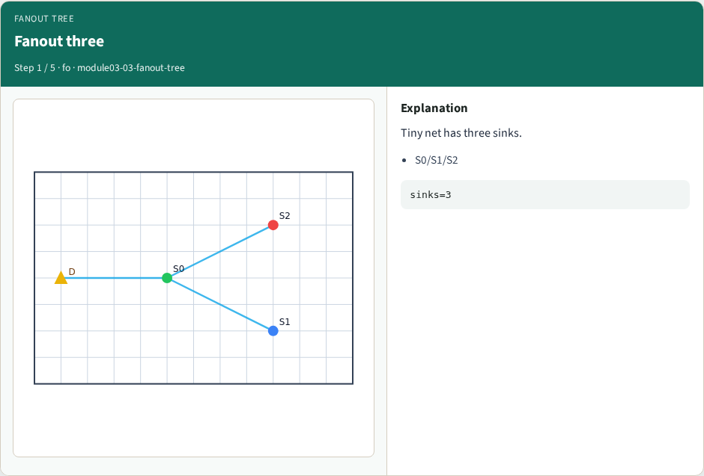
Fanout three
Fanout three
learn_buffering — 03 fanout tree
Notes:
Tiny net has three sinks.

Slide 4
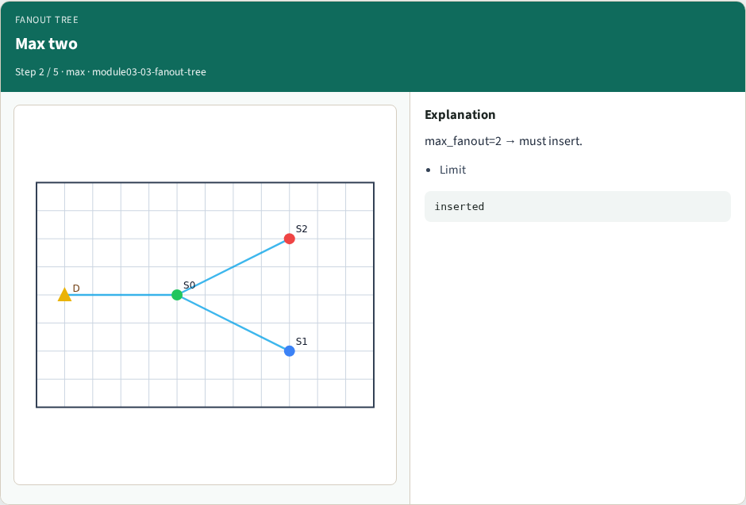
Max two
Max two
learn_buffering — 03 fanout tree
Notes:
max_fanout=2 → must insert.

Slide 5
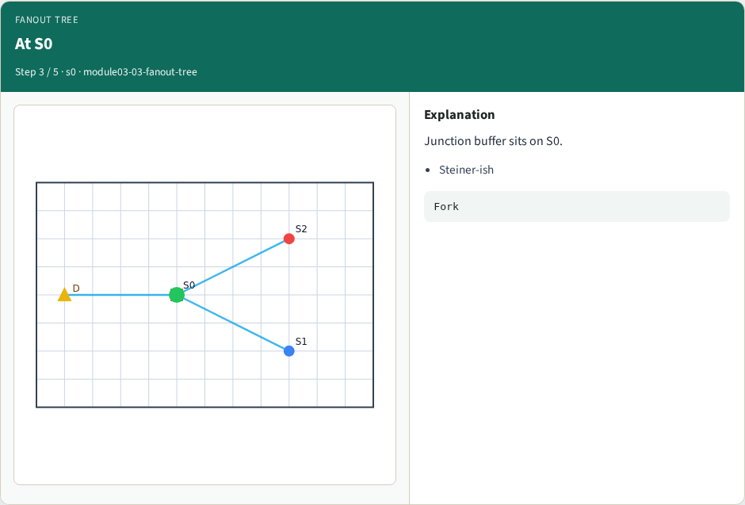
At S0
At S0
learn_buffering — 03 fanout tree
Notes:
Junction buffer sits on S0.

Slide 6

BUF_X2
BUF_X2
learn_buffering — 03 fanout tree
Notes:
Stronger cell for the fork.

Slide 7
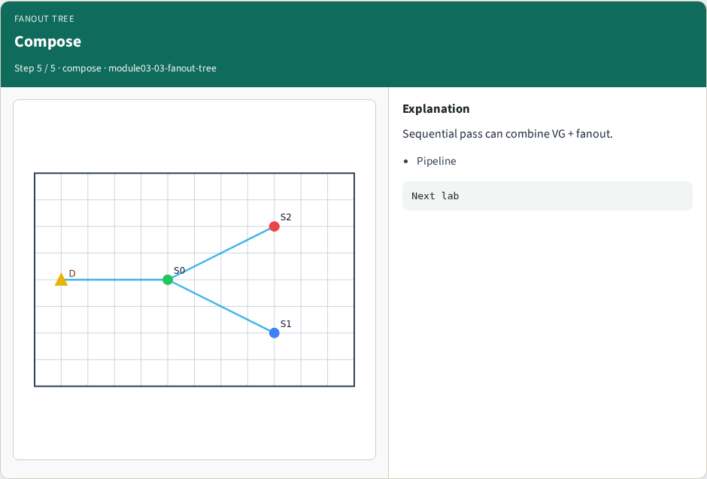
Compose
Compose
learn_buffering — 03 fanout tree
Notes:
Sequential pass can combine VG + fanout.

Slide 8
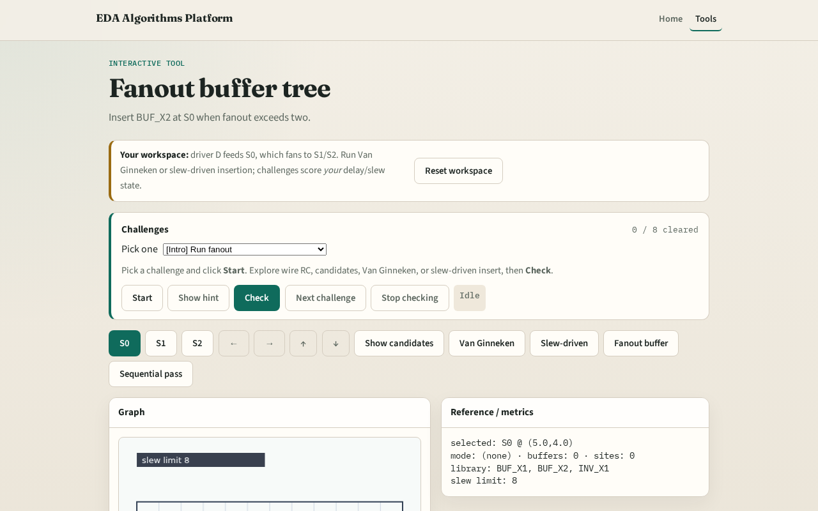
Browser lab track
Browser lab starter
learn_buffering — 03 fanout tree
Notes:
Open **fanout-tree**. Click Fanout buffer. Confirm a buffer appears at S0.

Slide 9
Implement track
Call `fanout_buffer_tree(data, max_fanout=2)`
Assert inserted is true
learn_buffering — 03 fanout tree
Notes:
Call `fanout_buffer_tree(data, max_fanout=2)`. Assert inserted is true.

Slide 10
Pitfalls
Buffering at the driver only
Using max_fanout ≥ sink count
Forgetting S0 coordinates
learn_buffering — 03 fanout tree
Notes:
Buffering at the driver only. Using max_fanout ≥ sink count. Forgetting S0 coordinates.

Slide 11
Your turn
Next: full sequential buffering pass
learn_buffering — 03 fanout tree
Notes:
Next: full sequential buffering pass.

