Slide 1
Sequential
Production flows chain heuristics; this lab is the toy pipeline
learn_buffering — 01 sequential buffer
Notes:
Production flows chain heuristics; this lab is the toy pipeline.

Slide 2
The idea
Sequential_buffer builds sites, runs Van Ginneken, optionally adds fanout buffers
learn_buffering — 01 sequential buffer
Notes:
sequential_buffer builds sites, runs Van Ginneken, optionally adds fanout buffers, and reports primary metrics.

Slide 3
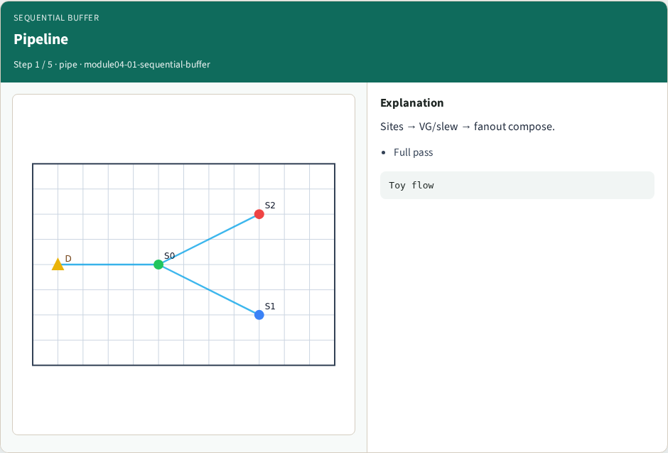
Pipeline
Pipeline
learn_buffering — 01 sequential buffer
Notes:
Sites → VG/slew → fanout compose.

Slide 4
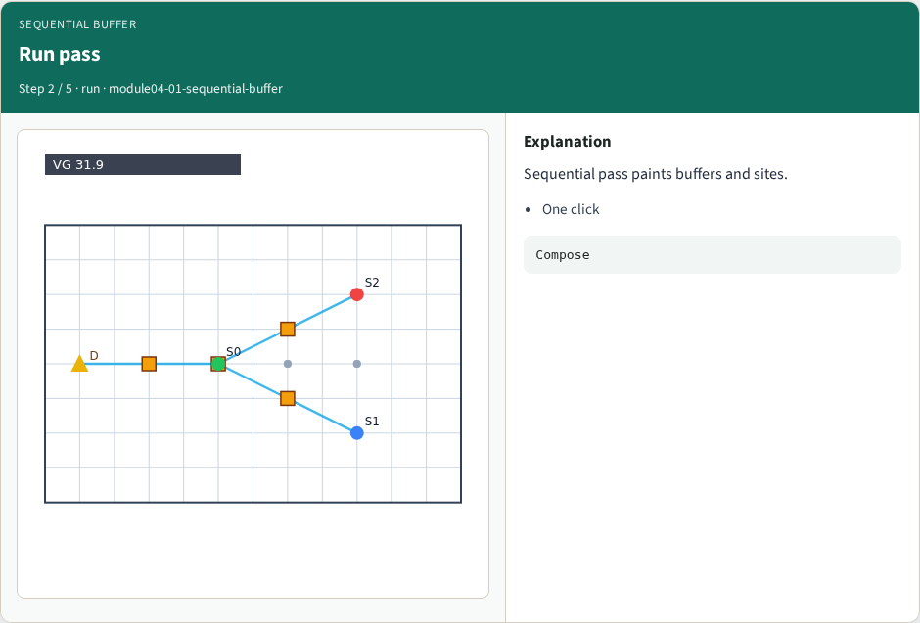
Run pass
Run pass
learn_buffering — 01 sequential buffer
Notes:
Sequential pass paints buffers and sites.

Slide 5
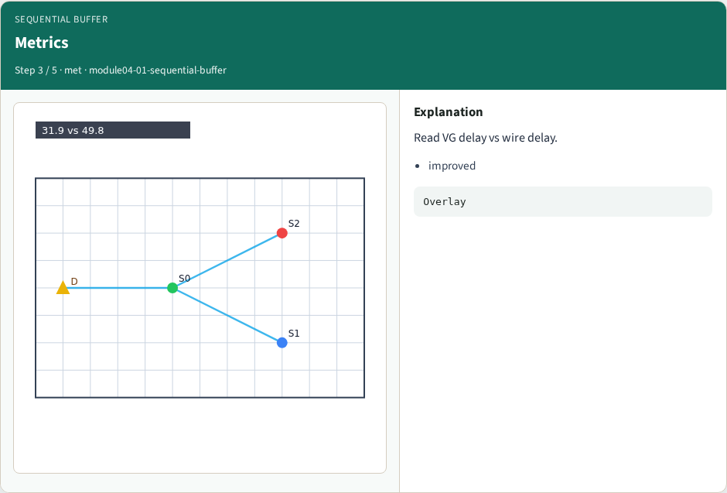
Metrics
Metrics
learn_buffering — 01 sequential buffer
Notes:
Read VG delay vs wire delay.

Slide 6
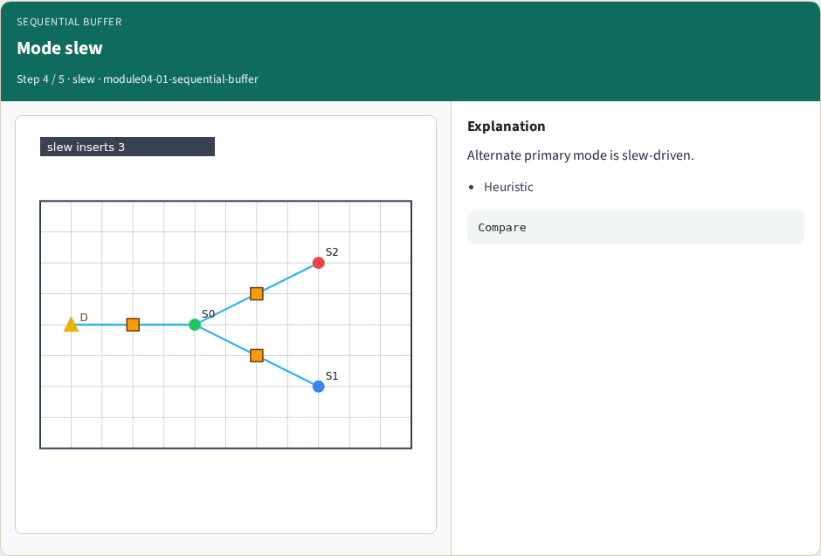
Mode slew
Mode slew
learn_buffering — 01 sequential buffer
Notes:
Alternate primary mode is slew-driven.

Slide 7
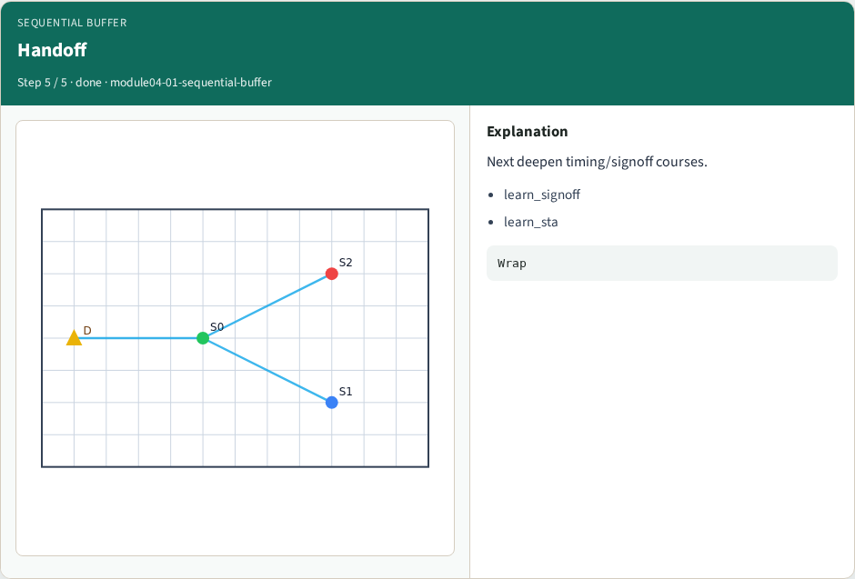
Handoff
Handoff
learn_buffering — 01 sequential buffer
Notes:
Next deepen timing/signoff courses.

Slide 8
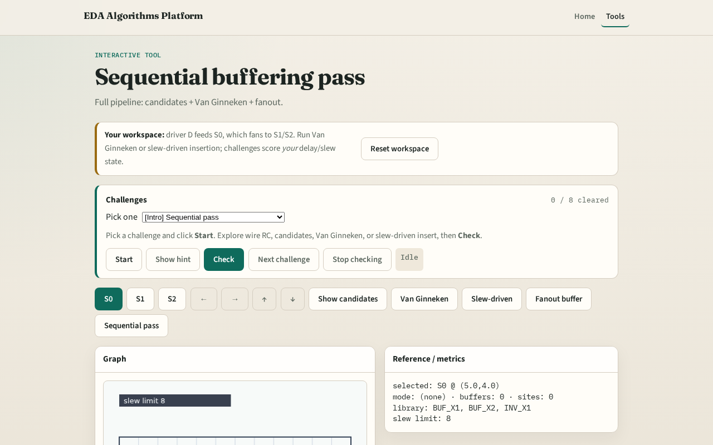
Browser lab track
Browser lab starter
learn_buffering — 01 sequential buffer
Notes:
Open **sequential-buffer**. Click Sequential pass. Confirm buffers and improved VG delay.

Slide 9
Implement track
Call `sequential_buffer(data)`
Assert sites and van_ginneken keys exist
learn_buffering — 01 sequential buffer
Notes:
Call `sequential_buffer(data)`. Assert sites and van_ginneken keys exist.

Slide 10
Pitfalls
Skipping prune
Mixing modes without clearing buffers
Ignoring fanout stage
learn_buffering — 01 sequential buffer
Notes:
Skipping prune. Mixing modes without clearing buffers. Ignoring fanout stage.

Slide 11
Your turn
Next: offline compare, then wrap
learn_buffering — 01 sequential buffer
Notes:
Next: offline compare, then wrap.

