Slide 1
Boolean net
Synthesis starts from a technology-independent subject graph
learn_synthesis — 01 boolean network
Notes:
Synthesis starts from a technology-independent subject graph.

Slide 2
The idea
Our subject graph is an And-Inverter Graph: AND nodes with optional complemented edges
learn_synthesis — 01 boolean network
Notes:
Our subject graph is an And-Inverter Graph: AND nodes with optional complemented edges.

Slide 3
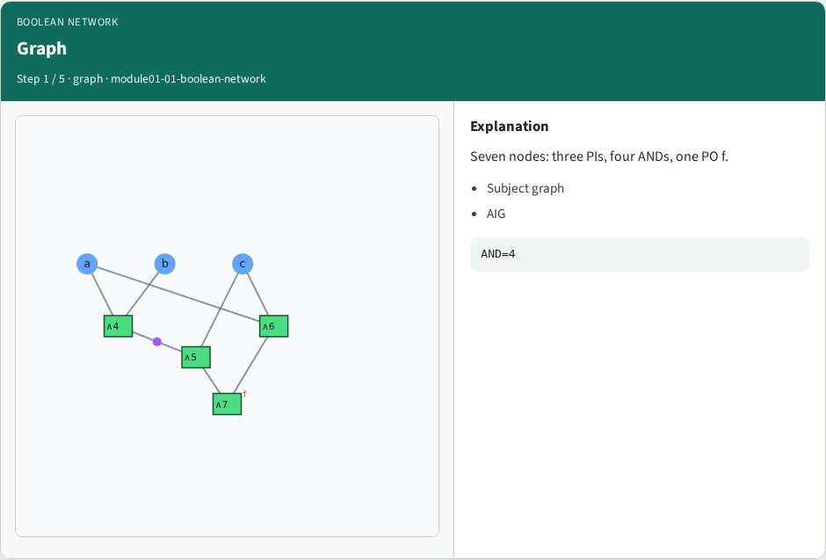
Graph
Graph
learn_synthesis — 01 boolean network
Notes:
Seven nodes: three PIs, four ANDs, one PO f.

Slide 4
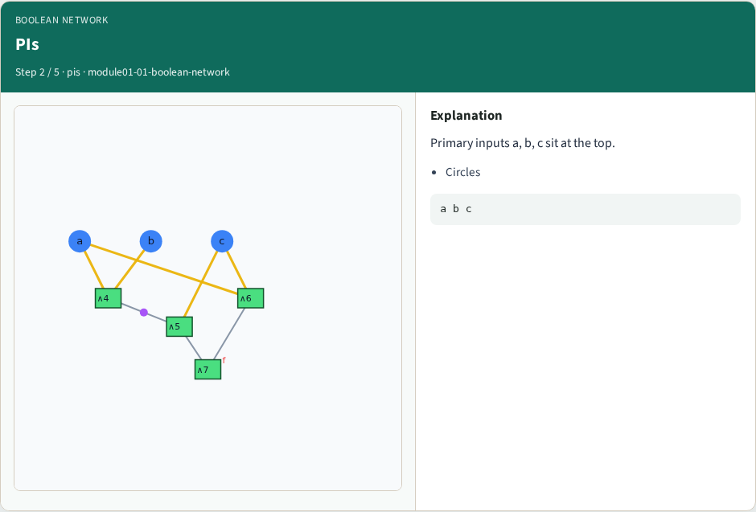
PIs
PIs
learn_synthesis — 01 boolean network
Notes:
Primary inputs a, b, c sit at the top.

Slide 5
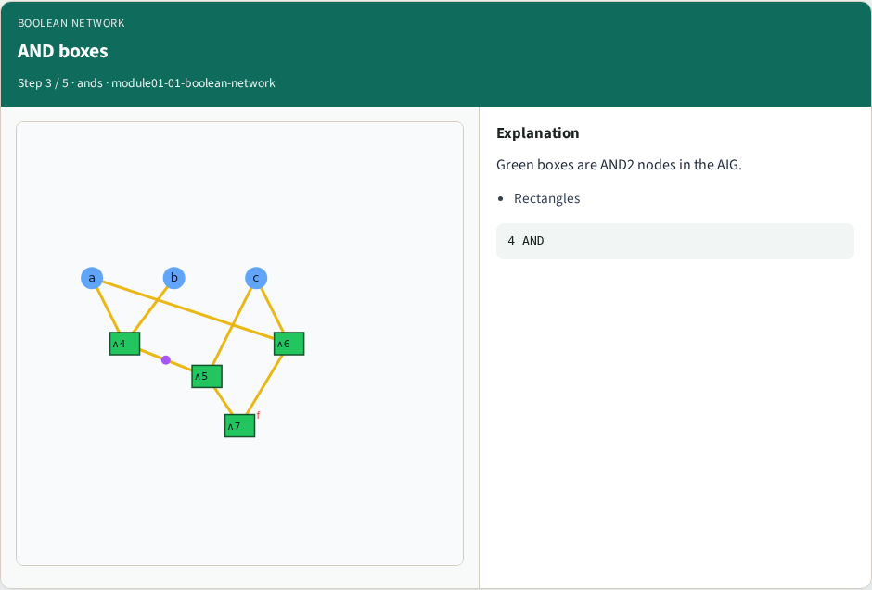
AND boxes
AND boxes
learn_synthesis — 01 boolean network
Notes:
Green boxes are AND2 nodes in the AIG.

Slide 6
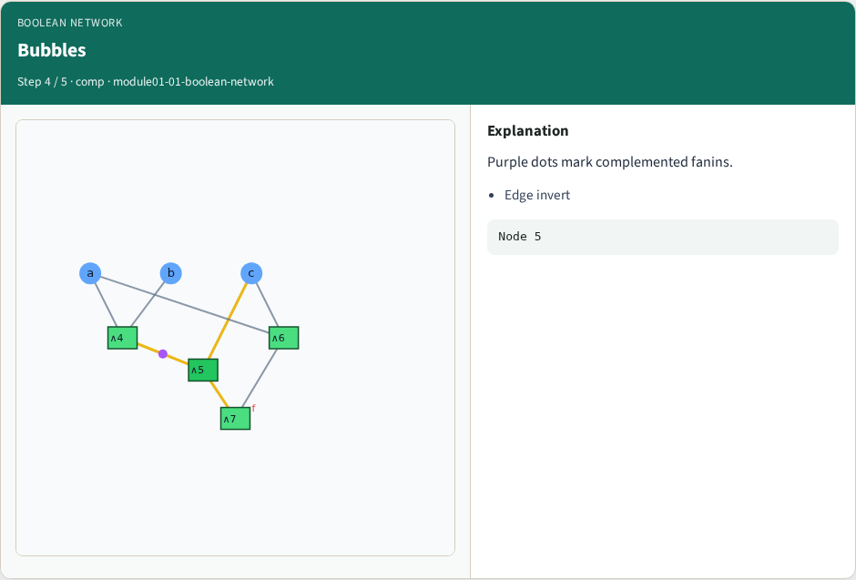
Bubbles
Bubbles
learn_synthesis — 01 boolean network
Notes:
Purple dots mark complemented fanins.

Slide 7
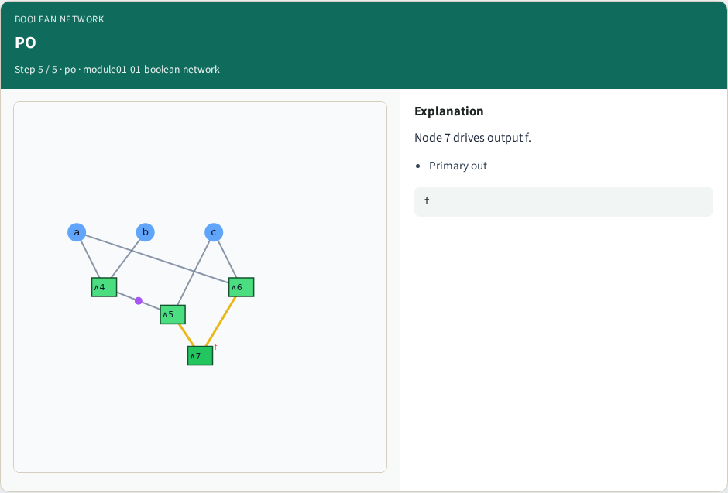
PO
PO
learn_synthesis — 01 boolean network
Notes:
Node 7 drives output f.

Slide 8
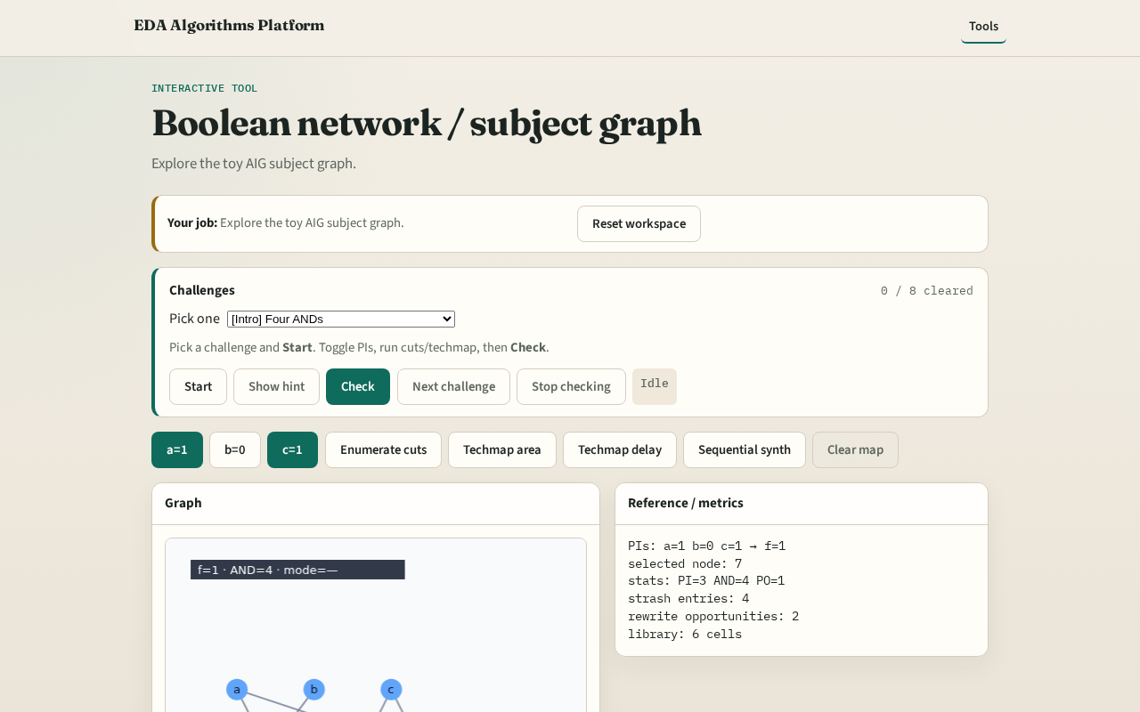
Browser lab track
Browser lab starter
learn_synthesis — 01 boolean network
Notes:
Open **boolean-network**. Click nodes; toggle PIs and watch f.

Slide 9
Implement track
Load tiny_synth.json; print aig_stats
learn_synthesis — 01 boolean network
Notes:
Load tiny_synth.json; print aig_stats.

Slide 10
Pitfalls
Treating INV as a separate AIG node type
Ignoring complement bubbles
learn_synthesis — 01 boolean network
Notes:
Treating INV as a separate AIG node type. Ignoring complement bubbles.

Slide 11
Your turn
Next: AIG node types in detail
learn_synthesis — 01 boolean network
Notes:
Next: AIG node types in detail.

