Slide 1
AIG nodes
AIGs use only AND + optional edge complement , not arbitrary gates yet
learn_synthesis — 03 aig nodes
Notes:
AIGs use only AND + optional edge complement — not arbitrary gates yet.

Slide 2
The idea
Each AND has two fanins (id, complemented)
Evaluate bottom-up with bitwise AND
learn_synthesis — 03 aig nodes
Notes:
Each AND has two fanins (id, complemented). Evaluate bottom-up with bitwise AND.

Slide 3
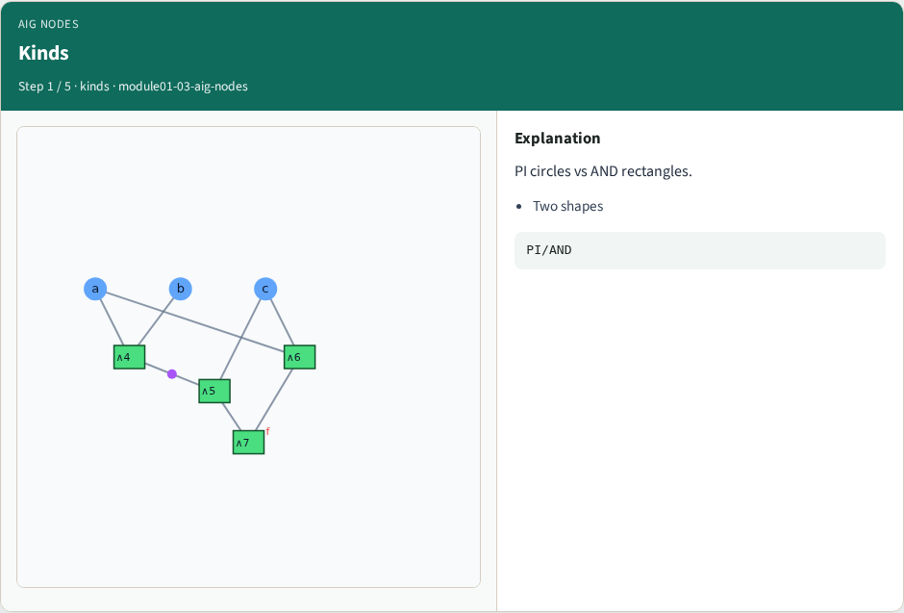
Kinds
Kinds
learn_synthesis — 03 aig nodes
Notes:
PI circles vs AND rectangles.

Slide 4
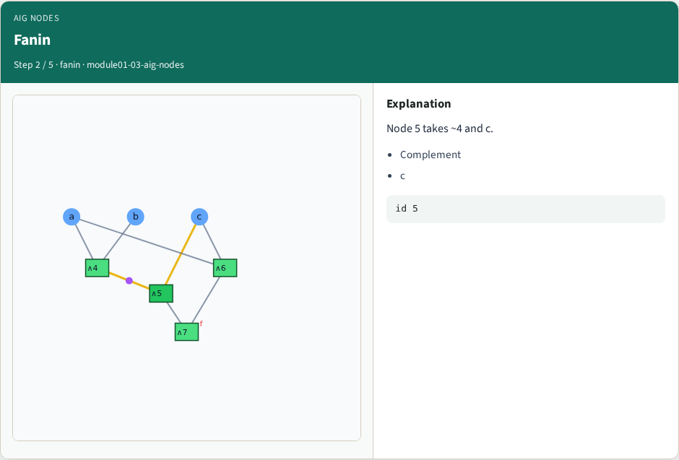
Fanin
Fanin
learn_synthesis — 03 aig nodes
Notes:
Node 5 takes ~4 and c.

Slide 5
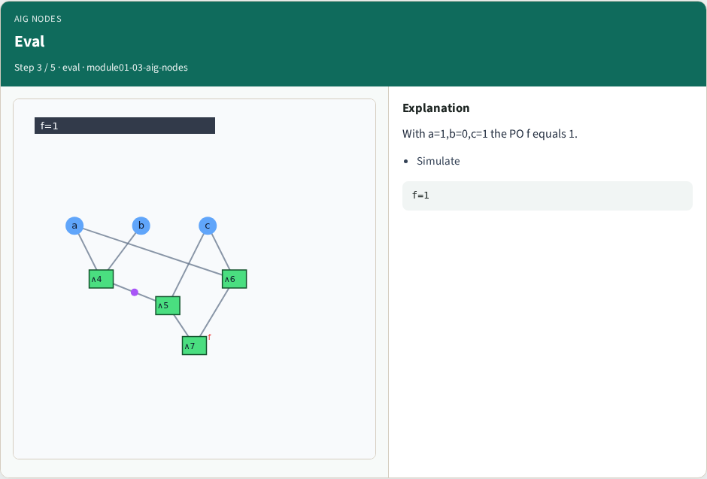
Eval
Eval
learn_synthesis — 03 aig nodes
Notes:
With a=1,b=0,c=1 the PO f equals 1.

Slide 6
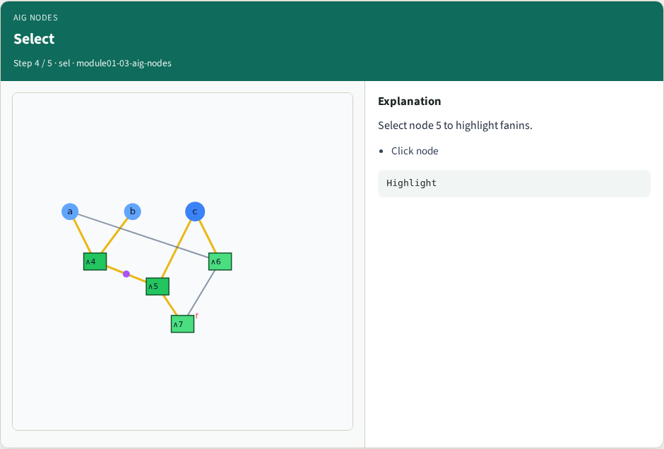
Select
Select
learn_synthesis — 03 aig nodes
Notes:
Select node 5 to highlight fanins.

Slide 7
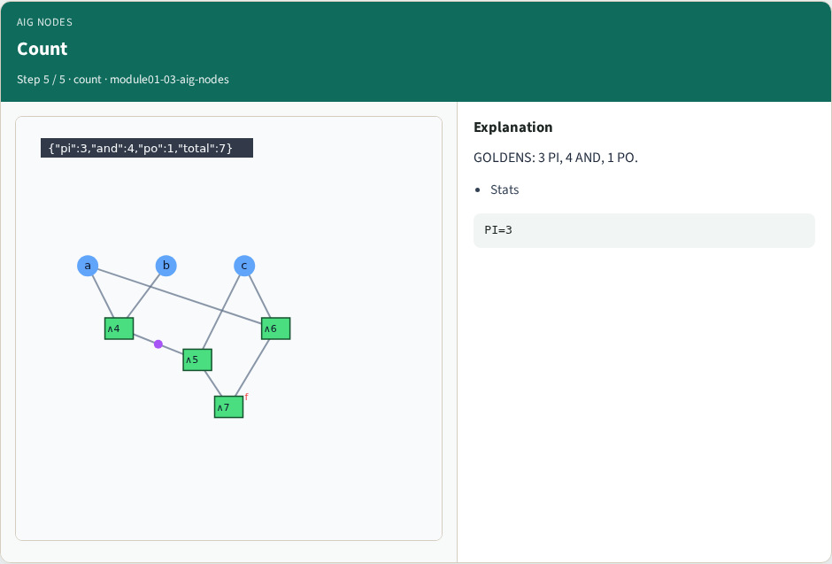
Count
Count
learn_synthesis — 03 aig nodes
Notes:
GOLDENS: 3 PI, 4 AND, 1 PO.

Slide 8
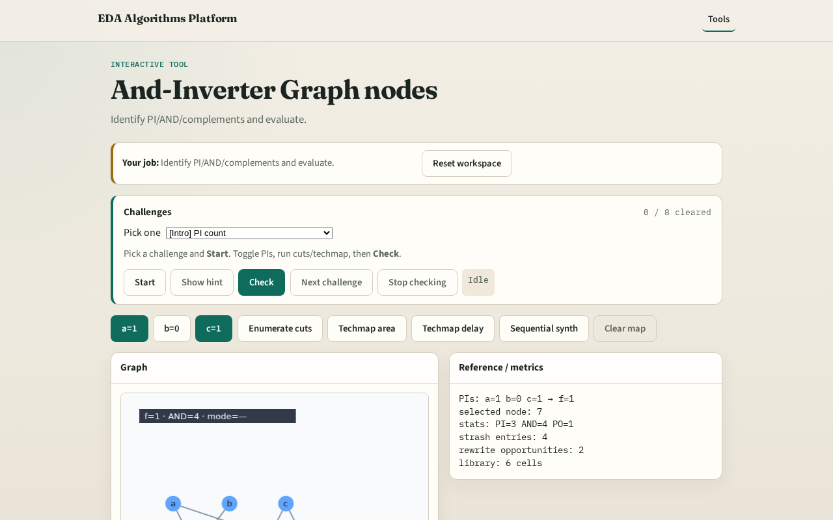
Browser lab track
Browser lab starter
learn_synthesis — 03 aig nodes
Notes:
Open **aig-nodes**. Toggle to a=1,b=1,c=1 and confirm f=0.

Slide 9
Implement track
Call output_value for assignments (1,0,1) and (1,1,1)
learn_synthesis — 03 aig nodes
Notes:
Call output_value for assignments (1,0,1) and (1,1,1).

Slide 10
Pitfalls
Evaluating complemented edges wrongly
Mixing PI names with ids
learn_synthesis — 03 aig nodes
Notes:
Evaluating complemented edges wrongly. Mixing PI names with ids.

Slide 11
Your turn
Next: structural hashing
learn_synthesis — 03 aig nodes
Notes:
Next: structural hashing.

