Slide 1
Strash
Strash reuses identical AND structures so the graph stays compact
learn_synthesis — 01 aig strash
Notes:
Strash reuses identical AND structures so the graph stays compact.

Slide 2
The idea
Canonical key sorts the two literals; table maps key → node id
learn_synthesis — 01 aig strash
Notes:
Canonical key sorts the two literals; table maps key → node id.

Slide 3
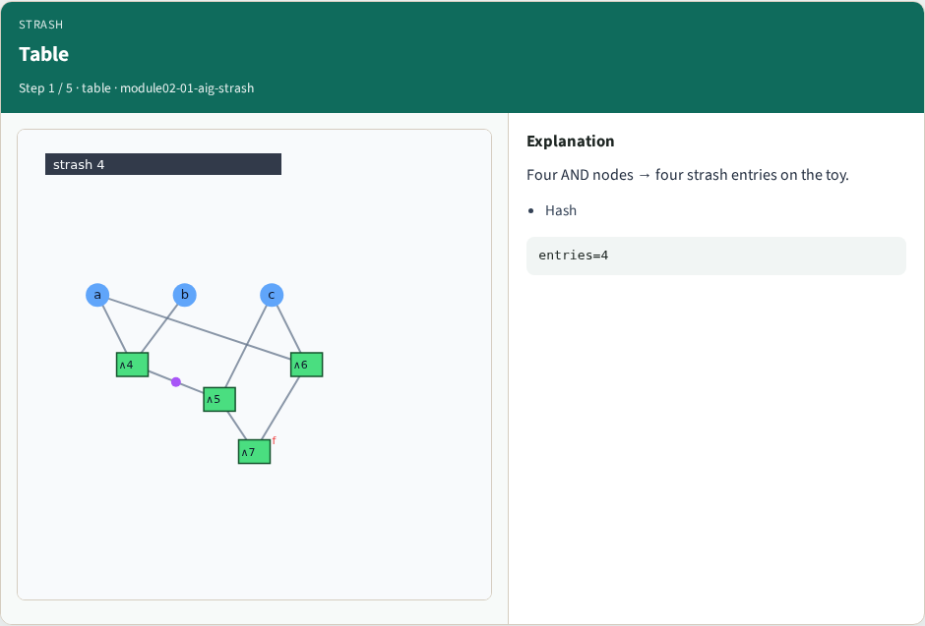
Table
Table
learn_synthesis — 01 aig strash
Notes:
Four AND nodes → four strash entries on the toy.

Slide 4
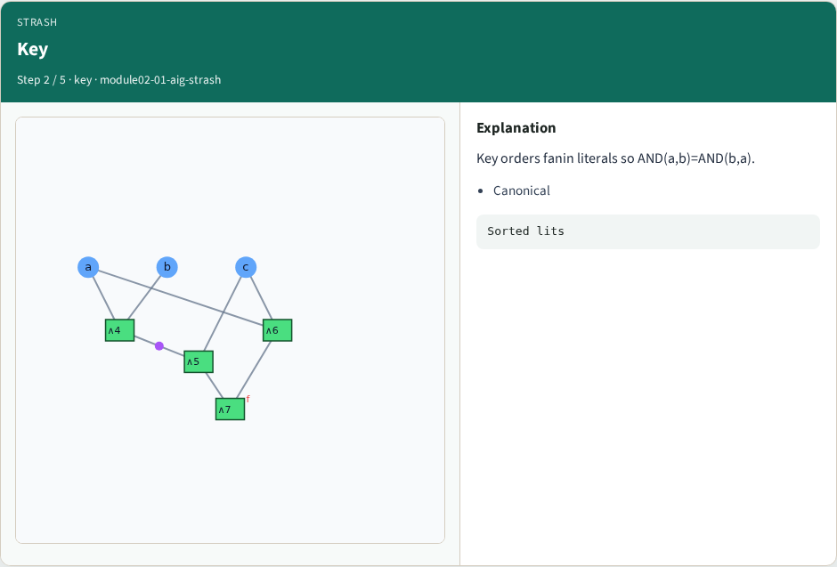
Key
Key
learn_synthesis — 01 aig strash
Notes:
Key orders fanin literals so AND(a,b)=AND(b,a).

Slide 5
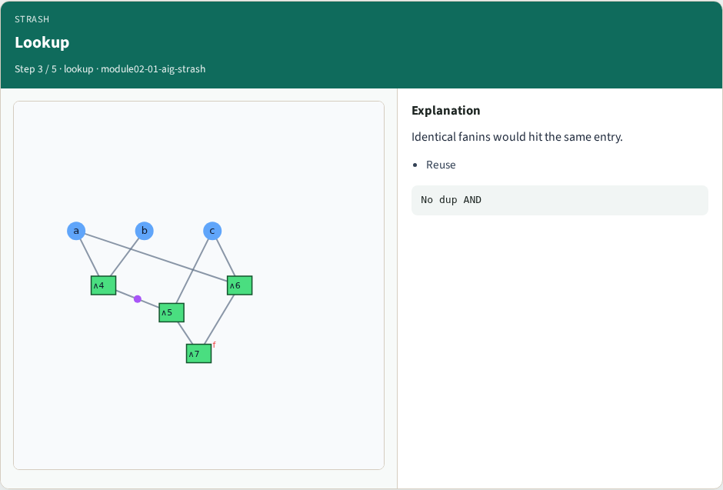
Lookup
Lookup
learn_synthesis — 01 aig strash
Notes:
Identical fanins would hit the same entry.

Slide 6
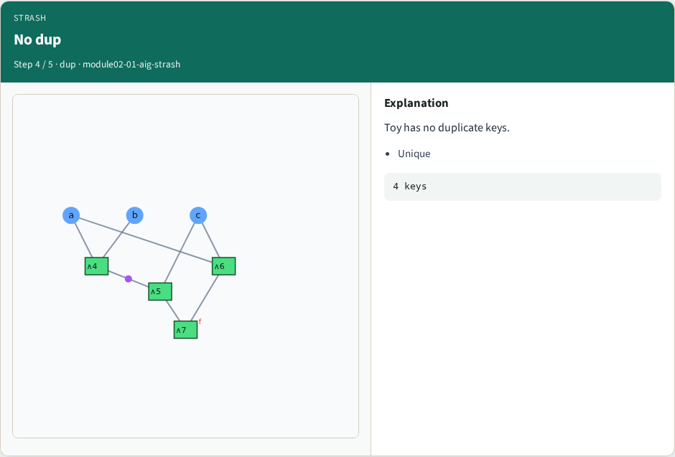
No dup
No dup
learn_synthesis — 01 aig strash
Notes:
Toy has no duplicate keys.

Slide 7
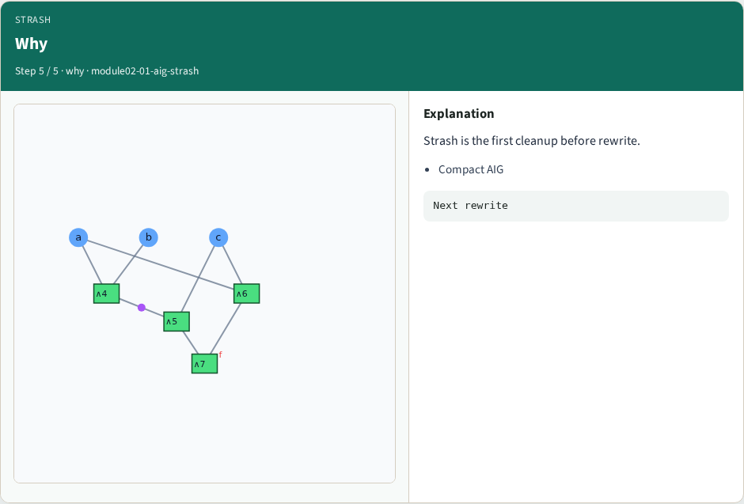
Why
Why
learn_synthesis — 01 aig strash
Notes:
Strash is the first cleanup before rewrite.

Slide 8
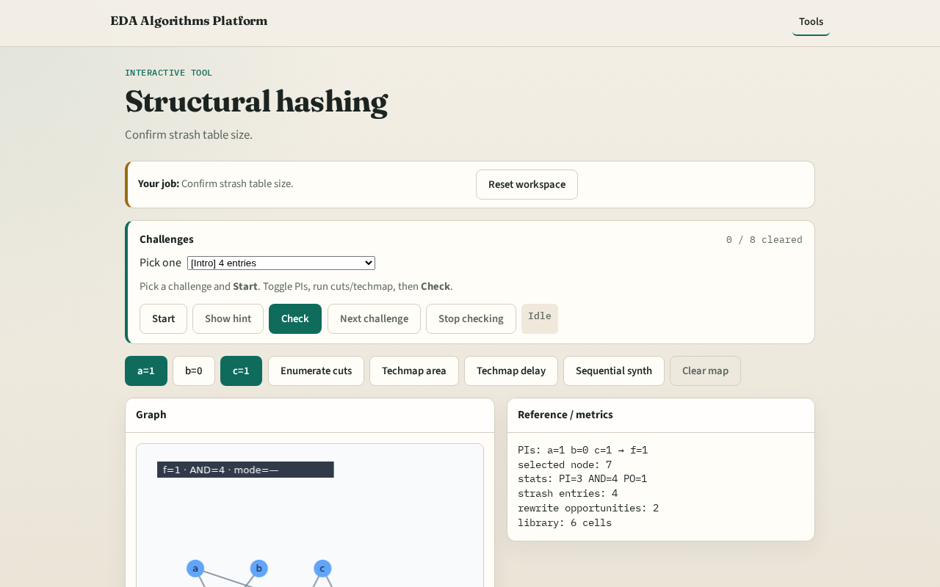
Browser lab track
Browser lab starter
learn_synthesis — 01 aig strash
Notes:
Open **aig-strash**. Confirm strash entries = 4.

Slide 9
Implement track
Call build_strash_table; assert len==4
learn_synthesis — 01 aig strash
Notes:
Call build_strash_table; assert len==4.

Slide 10
Pitfalls
Forgetting to sort fanins
Hashing node id instead of literals
learn_synthesis — 01 aig strash
Notes:
Forgetting to sort fanins. Hashing node id instead of literals.

Slide 11
Your turn
Next: local rewrite opportunities
learn_synthesis — 01 aig strash
Notes:
Next: local rewrite opportunities.

