Slide 1
Rewrite
Rewriting reshapes the AIG before mapping without changing function
learn_synthesis — 03 rewrite local
Notes:
Rewriting reshapes the AIG before mapping without changing function.

Slide 2
The idea
Count nodes with complemented edges or AND children; flag AND(~x,~y) as NOR-friendly
learn_synthesis — 03 rewrite local
Notes:
Count nodes with complemented edges or AND children; flag AND(~x,~y) as NOR-friendly.

Slide 3
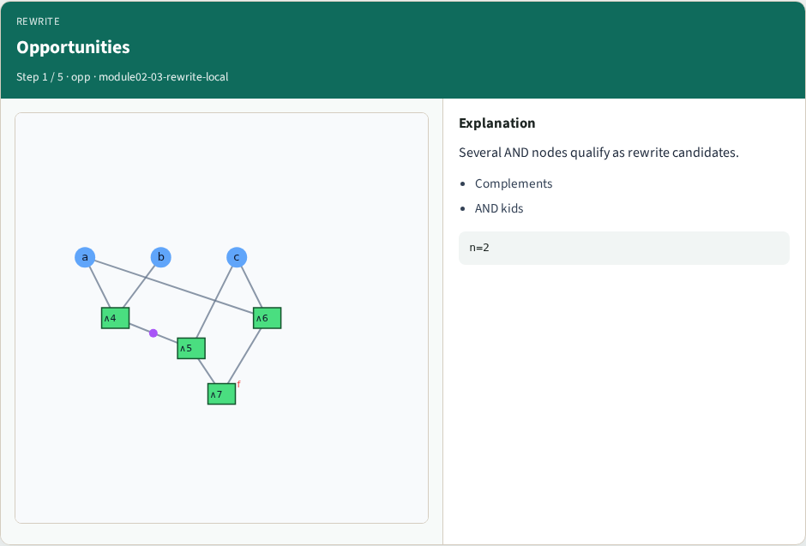
Opportunities
Opportunities
learn_synthesis — 03 rewrite local
Notes:
Several AND nodes qualify as rewrite candidates.

Slide 4
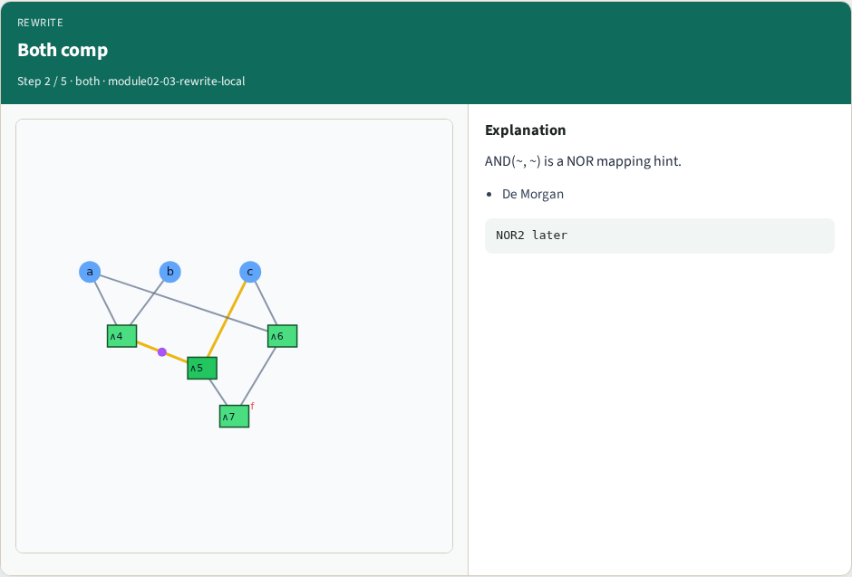
Both comp
Both comp
learn_synthesis — 03 rewrite local
Notes:
AND(~, ~) is a NOR mapping hint.

Slide 5
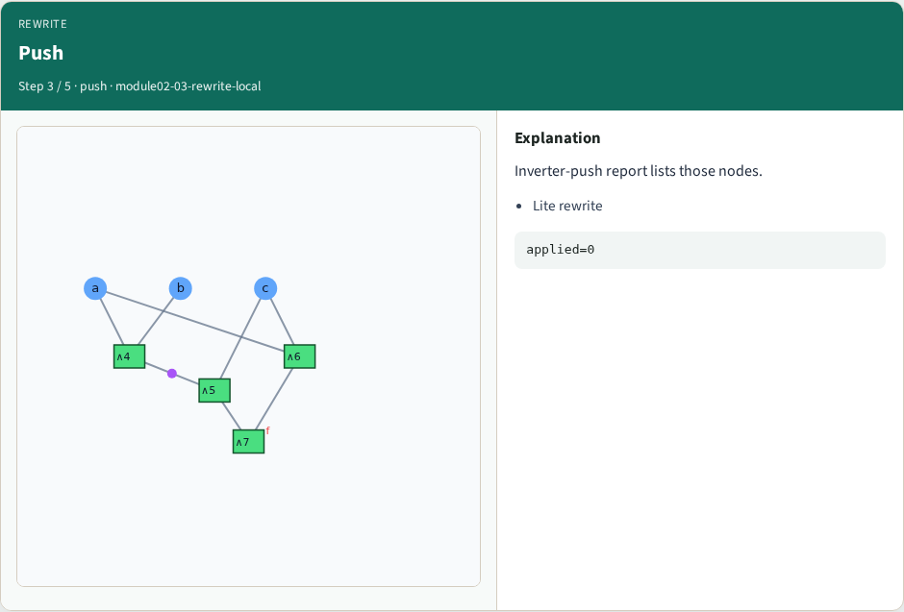
Push
Push
learn_synthesis — 03 rewrite local
Notes:
Inverter-push report lists those nodes.

Slide 6
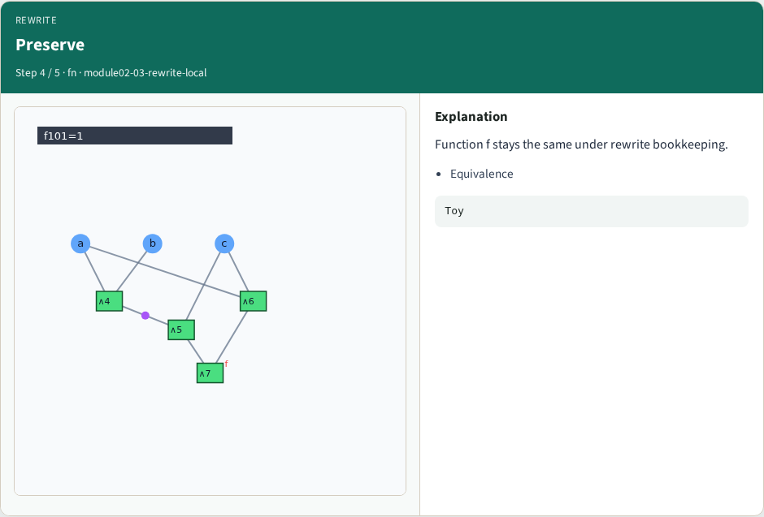
Preserve
Preserve
learn_synthesis — 03 rewrite local
Notes:
Function f stays the same under rewrite bookkeeping.

Slide 7
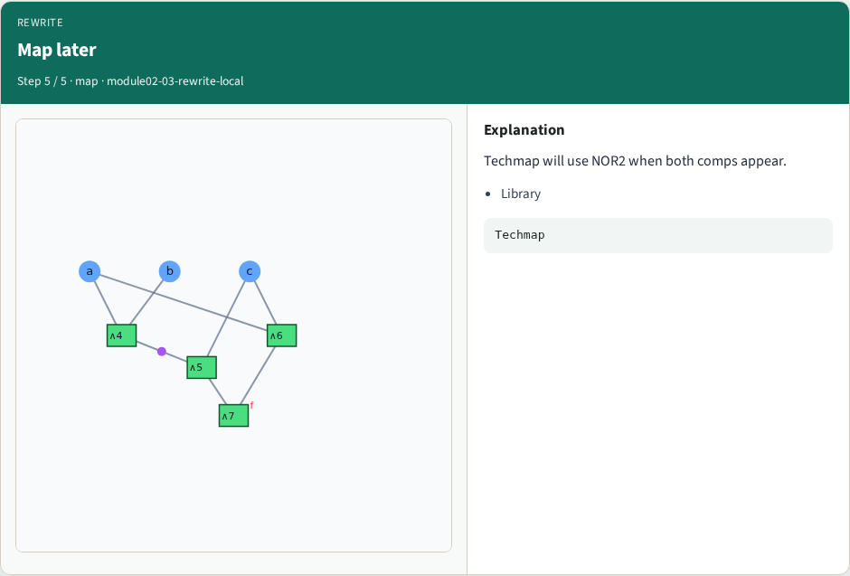
Map later
Map later
learn_synthesis — 03 rewrite local
Notes:
Techmap will use NOR2 when both comps appear.

Slide 8
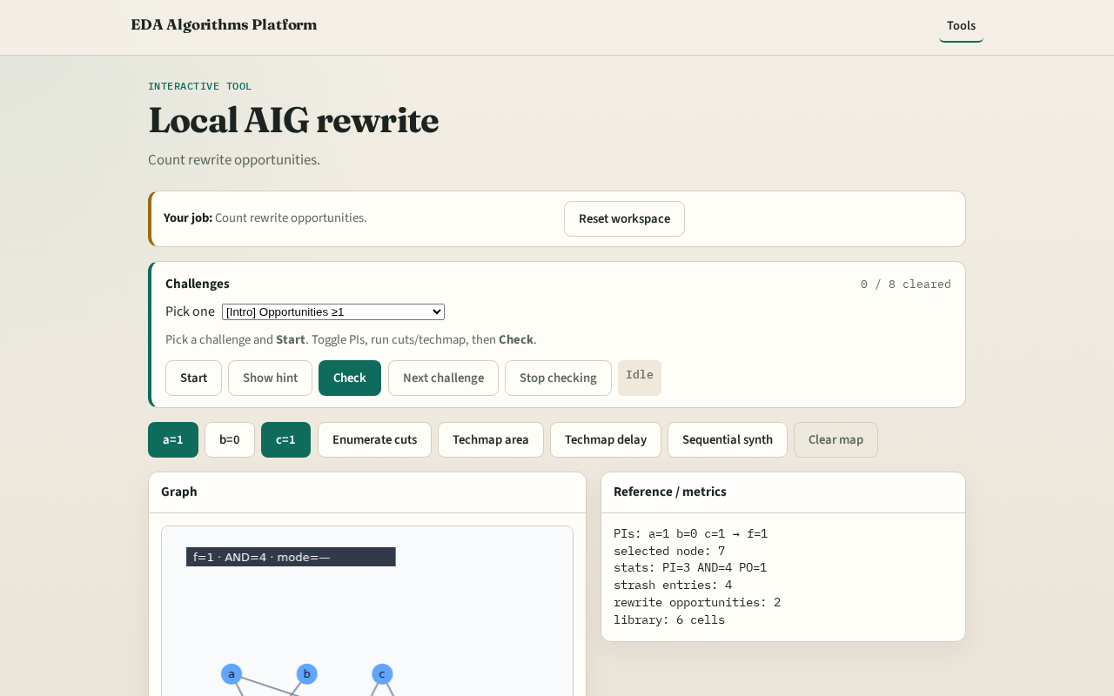
Browser lab track
Browser lab starter
learn_synthesis — 03 rewrite local
Notes:
Open **rewrite-local**. Read rewrite opportunity count.

Slide 9
Implement track
Call local_rewrite_count and apply_inverter_push
learn_synthesis — 03 rewrite local
Notes:
Call local_rewrite_count and apply_inverter_push.

Slide 10
Pitfalls
Mutating function accidentally
Counting PIs as rewrite targets
learn_synthesis — 03 rewrite local
Notes:
Mutating function accidentally. Counting PIs as rewrite targets.

Slide 11
Your turn
Next: k-feasible cuts
learn_synthesis — 03 rewrite local
Notes:
Next: k-feasible cuts.

