Slide 1
Cuts
Cuts describe which leaves a subgraph may stand on for techmapping
learn_synthesis — 05 cut enumeration
Notes:
Cuts describe which leaves a subgraph may stand on for techmapping.

Slide 2
The idea
PI cut={self}
AND cuts = unions of fanin cuts with size ≤ k, plus trivial {self}
learn_synthesis — 05 cut enumeration
Notes:
PI cut={self}. AND cuts = unions of fanin cuts with size ≤ k, plus trivial {self}.

Slide 3
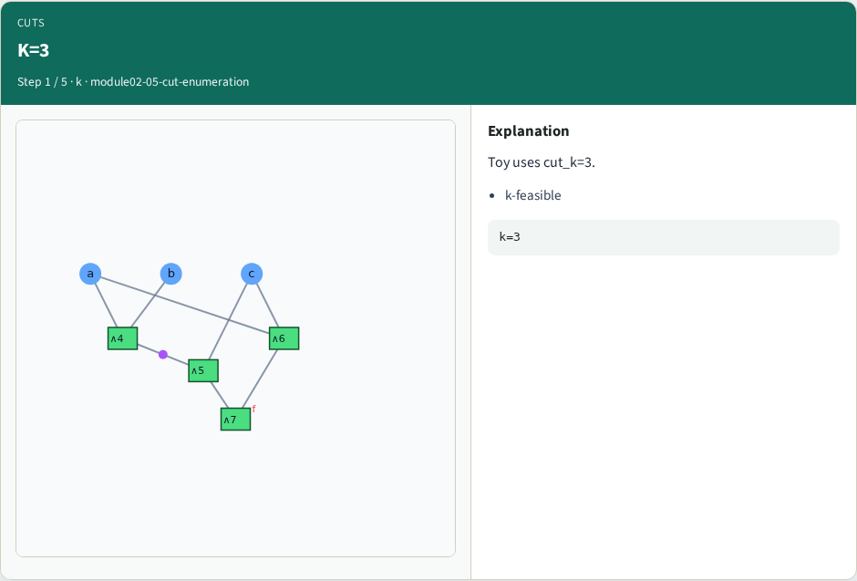
K=3
K=3
learn_synthesis — 05 cut enumeration
Notes:
Toy uses cut_k=3.

Slide 4
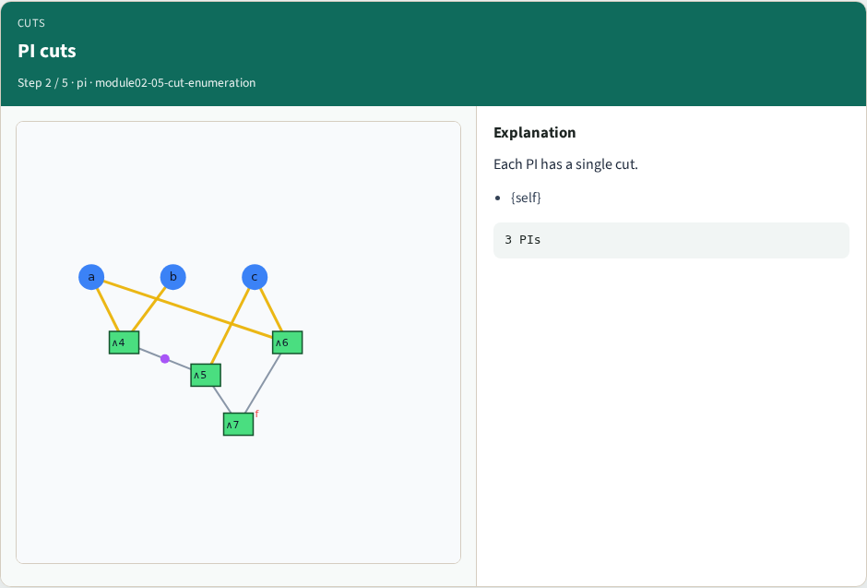
PI cuts
PI cuts
learn_synthesis — 05 cut enumeration
Notes:
Each PI has a single cut.

Slide 5
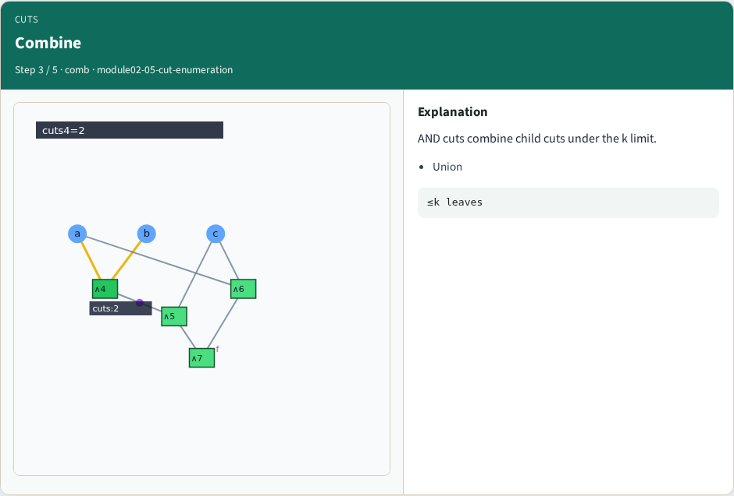
Combine
Combine
learn_synthesis — 05 cut enumeration
Notes:
AND cuts combine child cuts under the k limit.

Slide 6
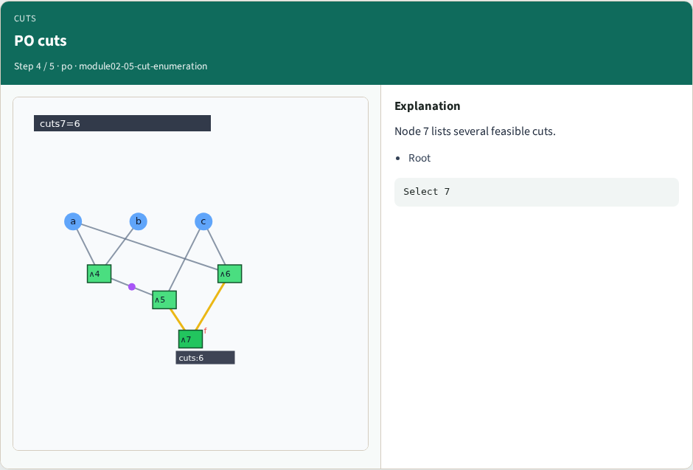
PO cuts
PO cuts
learn_synthesis — 05 cut enumeration
Notes:
Node 7 lists several feasible cuts.

Slide 7
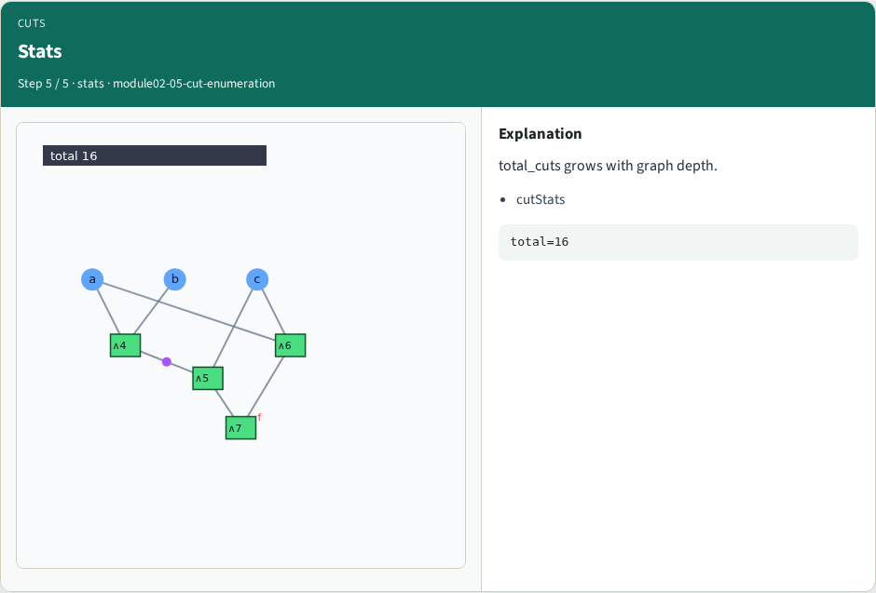
Stats
Stats
learn_synthesis — 05 cut enumeration
Notes:
total_cuts grows with graph depth.

Slide 8
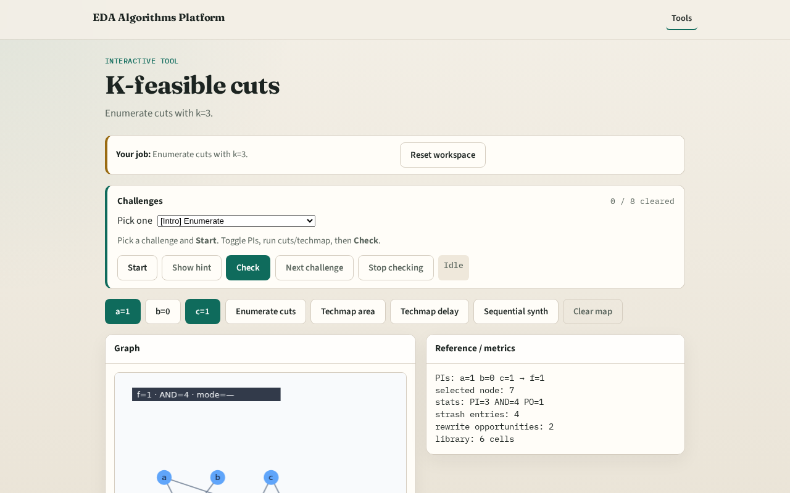
Browser lab track
Browser lab starter
learn_synthesis — 05 cut enumeration
Notes:
Open **cut-enumeration**. Click Enumerate cuts; select node 7.

Slide 9
Implement track
Call enumerate_cuts(k=3); assert all |cut|≤3
learn_synthesis — 05 cut enumeration
Notes:
Call enumerate_cuts(k=3); assert all |cut|≤3.

Slide 10
Pitfalls
Allowing cuts larger than k
Forgetting the trivial cut
learn_synthesis — 05 cut enumeration
Notes:
Allowing cuts larger than k. Forgetting the trivial cut.

Slide 11
Your turn
Next: the cell library
learn_synthesis — 05 cut enumeration
Notes:
Next: the cell library.

