Slide 1
Library
Techmapping chooses library cells that cover AIG cuts
learn_synthesis — 07 library cells
Notes:
Techmapping chooses library cells that cover AIG cuts.

Slide 2
The idea
Six cells: area and delay costs; INV for complemented edges
learn_synthesis — 07 library cells
Notes:
Six cells: area and delay costs; INV for complemented edges.

Slide 3
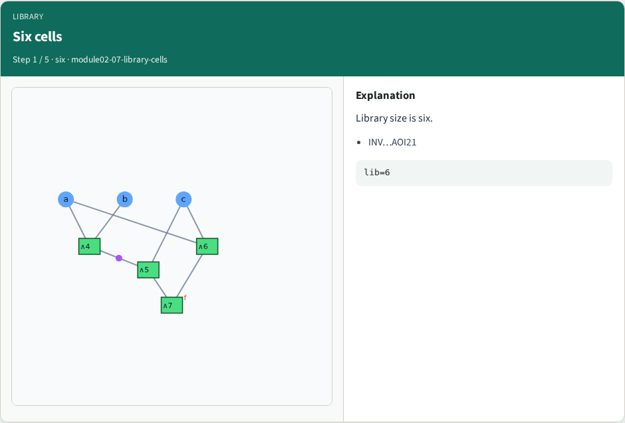
Six cells
Six cells
learn_synthesis — 07 library cells
Notes:
Library size is six.

Slide 4
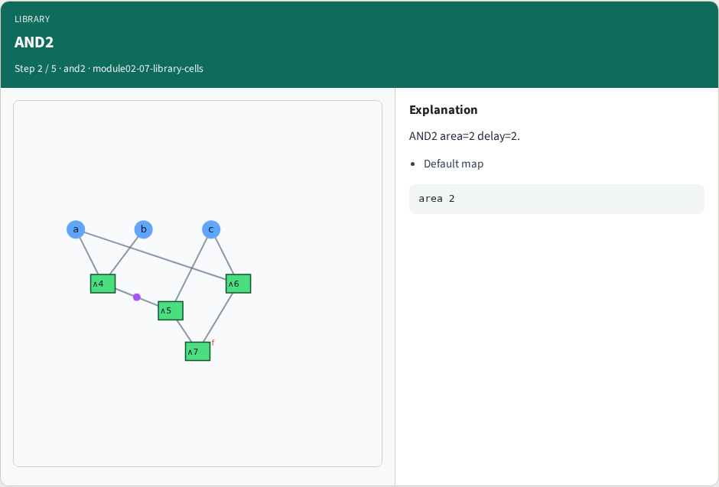
AND2
AND2
learn_synthesis — 07 library cells
Notes:
AND2 area=2 delay=2.

Slide 5
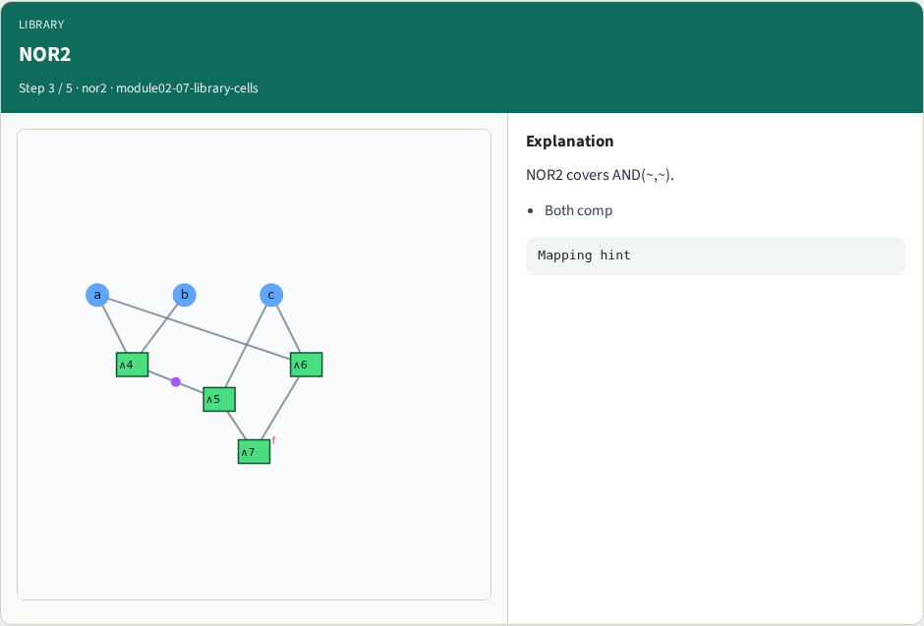
NOR2
NOR2
learn_synthesis — 07 library cells
Notes:
NOR2 covers AND(~,~).

Slide 6
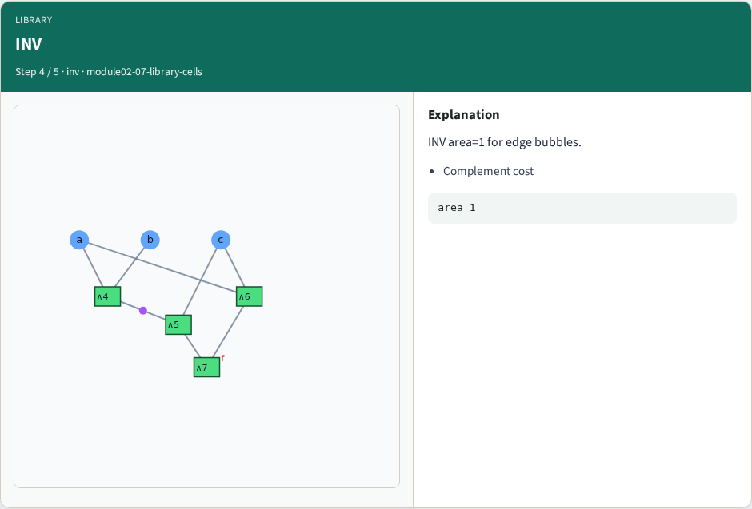
INV
INV
learn_synthesis — 07 library cells
Notes:
INV area=1 for edge bubbles.

Slide 7
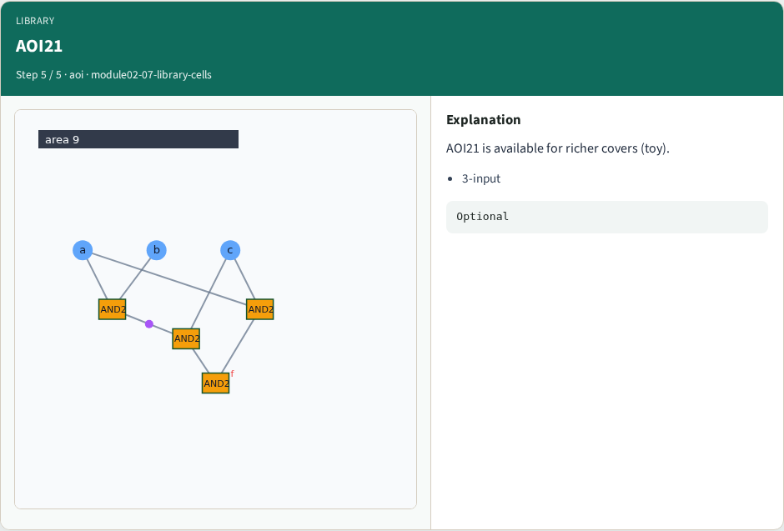
AOI21
AOI21
learn_synthesis — 07 library cells
Notes:
AOI21 is available for richer covers (toy).

Slide 8
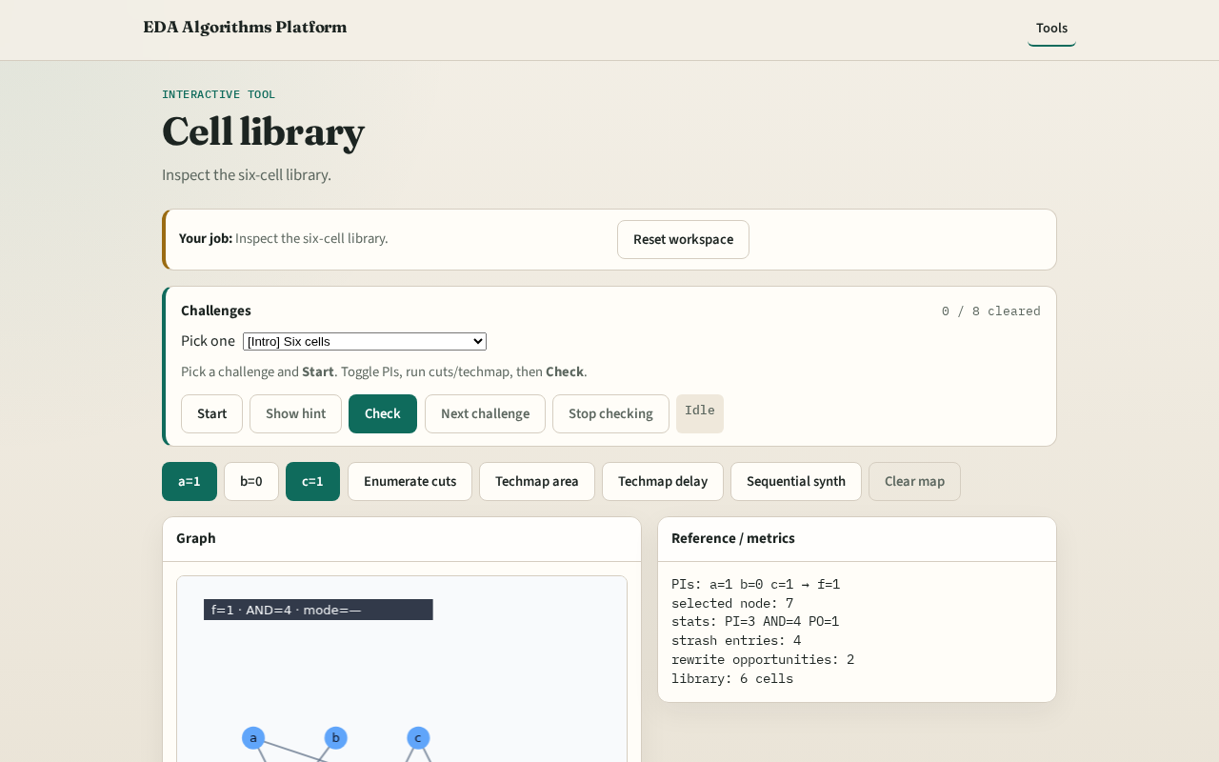
Browser lab track
Browser lab starter
learn_synthesis — 07 library cells
Notes:
Open **library-cells**. Confirm six cells; run techmap and see cell ids.

Slide 9
Implement track
Print data['library']; assert len==6
learn_synthesis — 07 library cells
Notes:
Print data['library']; assert len==6.

Slide 10
Pitfalls
Ignoring area when comparing
Mapping without INV cost
learn_synthesis — 07 library cells
Notes:
Ignoring area when comparing. Mapping without INV cost.

Slide 11
Your turn
Next: area-oriented techmap cover
learn_synthesis — 07 library cells
Notes:
Next: area-oriented techmap cover.

