Slide 1
Techmap
A cover assigns a library cell to each subject node (or cut)
learn_synthesis — 01 techmap cover
Notes:
A cover assigns a library cell to each subject node (or cut).

Slide 2
The idea
Greedy: AND→AND2, AND(~,~)→NOR2, plus INV per complemented edge; sum areas
learn_synthesis — 01 techmap cover
Notes:
Greedy: AND→AND2, AND(~,~)→NOR2, plus INV per complemented edge; sum areas.

Slide 3
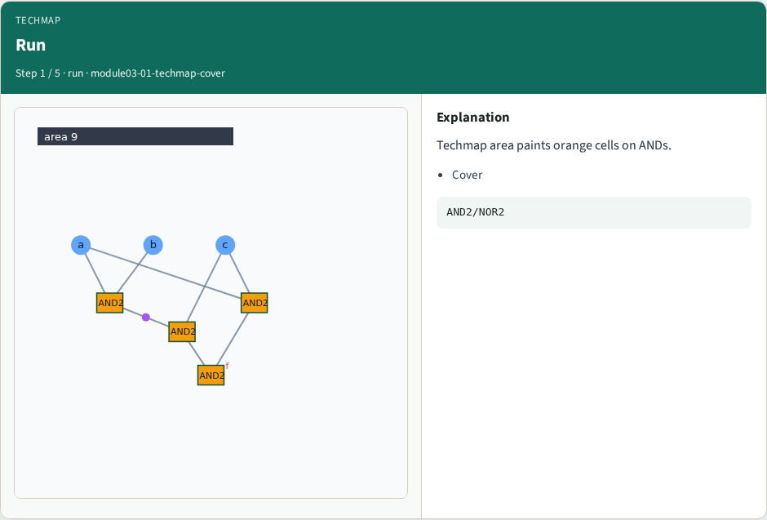
Run
Run
learn_synthesis — 01 techmap cover
Notes:
Techmap area paints orange cells on ANDs.

Slide 4
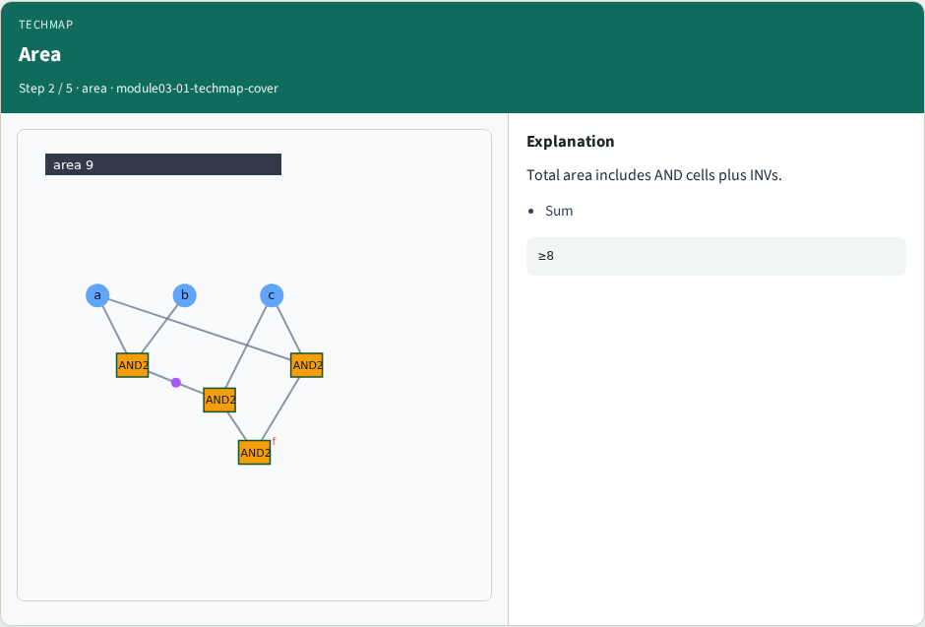
Area
Area
learn_synthesis — 01 techmap cover
Notes:
Total area includes AND cells plus INVs.

Slide 5
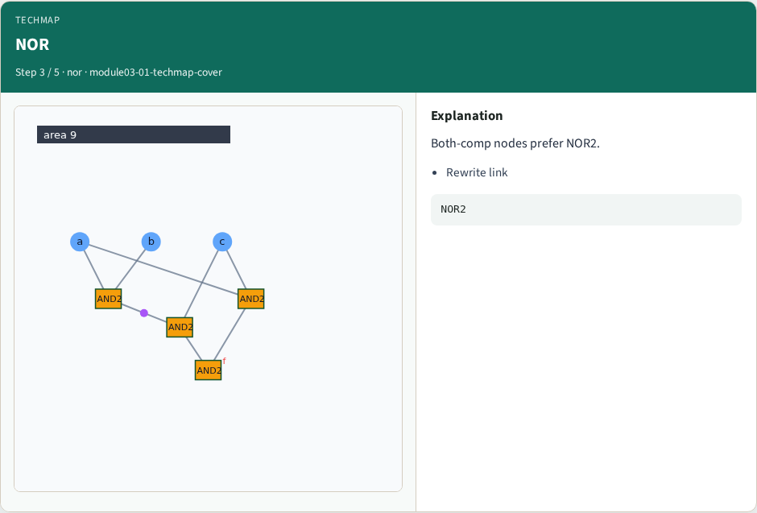
NOR
NOR
learn_synthesis — 01 techmap cover
Notes:
Both-comp nodes prefer NOR2.

Slide 6

Inv
Inv
learn_synthesis — 01 techmap cover
Notes:
Complement bubbles add INV area.

Slide 7
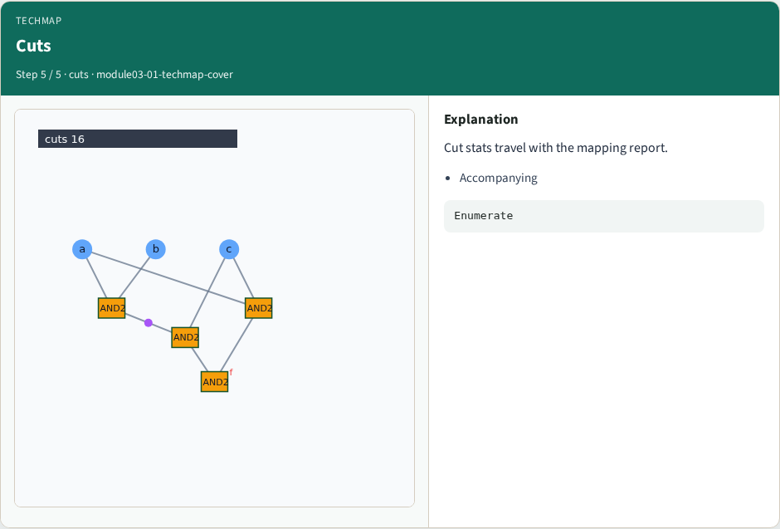
Cuts
Cuts
learn_synthesis — 01 techmap cover
Notes:
Cut stats travel with the mapping report.

Slide 8
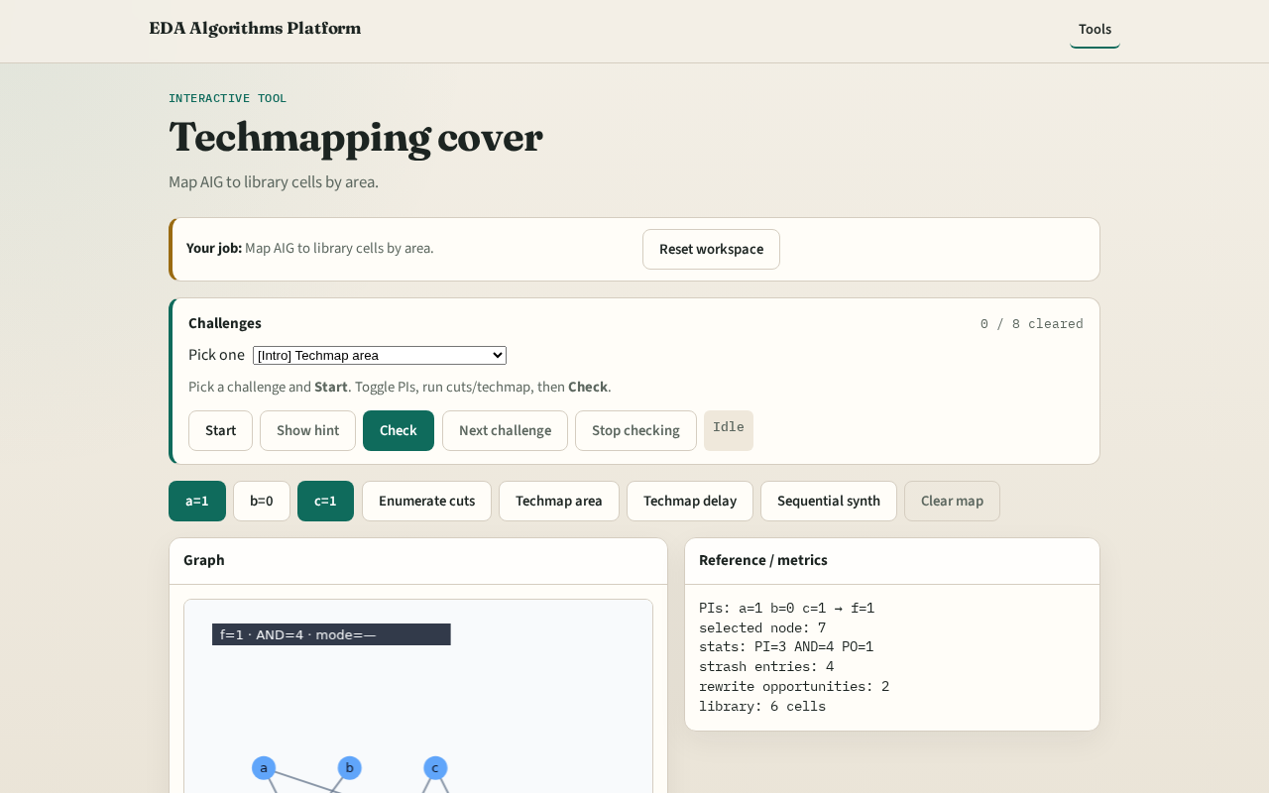
Browser lab track
Browser lab starter
learn_synthesis — 01 techmap cover
Notes:
Open **techmap-cover**. Click Techmap area; read total area.

Slide 9
Implement track
Call techmap_area; assert area ≥ mapAreaMin
learn_synthesis — 01 techmap cover
Notes:
Call techmap_area; assert area ≥ mapAreaMin.

Slide 10
Pitfalls
Forgetting INV cost
Mapping PIs to gates
learn_synthesis — 01 techmap cover
Notes:
Forgetting INV cost. Mapping PIs to gates.

Slide 11
Your turn
Next: area vs delay tradeoff
learn_synthesis — 01 techmap cover
Notes:
Next: area vs delay tradeoff.

