Slide 1
Area/delay
Mappers optimize different objectives: area, delay, or a blend
learn_synthesis — 03 area delay
Notes:
Mappers optimize different objectives: area, delay, or a blend.

Slide 2
The idea
Area_mode reports area + delay_sum; delay_mode reports depth×AND delay
learn_synthesis — 03 area delay
Notes:
area_mode reports area + delay_sum; delay_mode reports depth×AND delay.

Slide 3
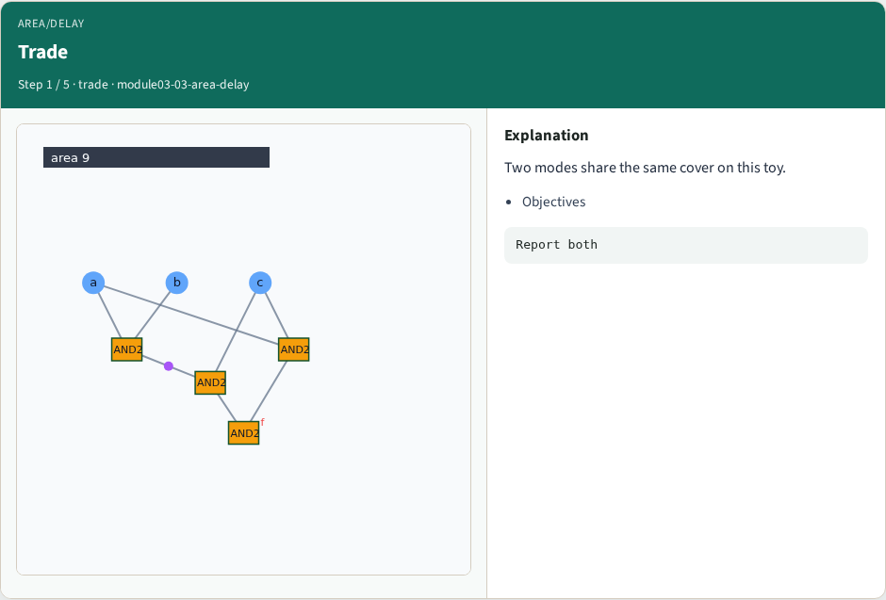
Trade
Trade
learn_synthesis — 03 area delay
Notes:
Two modes share the same cover on this toy.

Slide 4
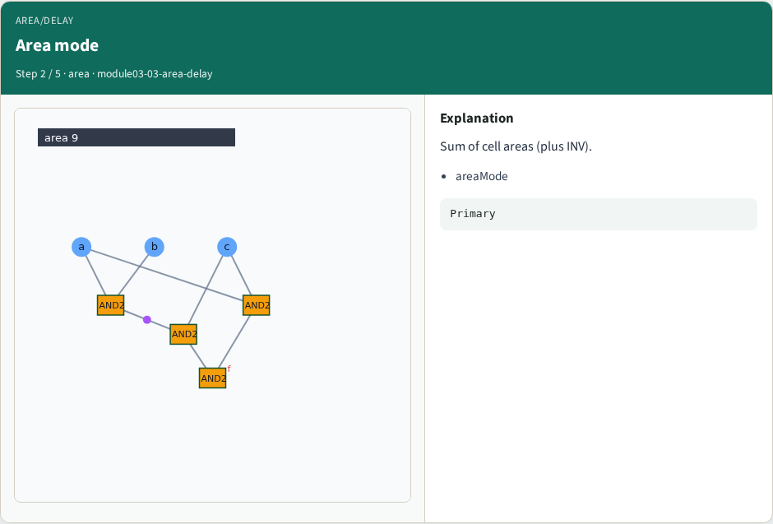
Area mode
Area mode
learn_synthesis — 03 area delay
Notes:
Sum of cell areas (plus INV).

Slide 5

Delay mode
Delay mode
learn_synthesis — 03 area delay
Notes:
Depth proxy = #AND × AND2 delay.

Slide 6
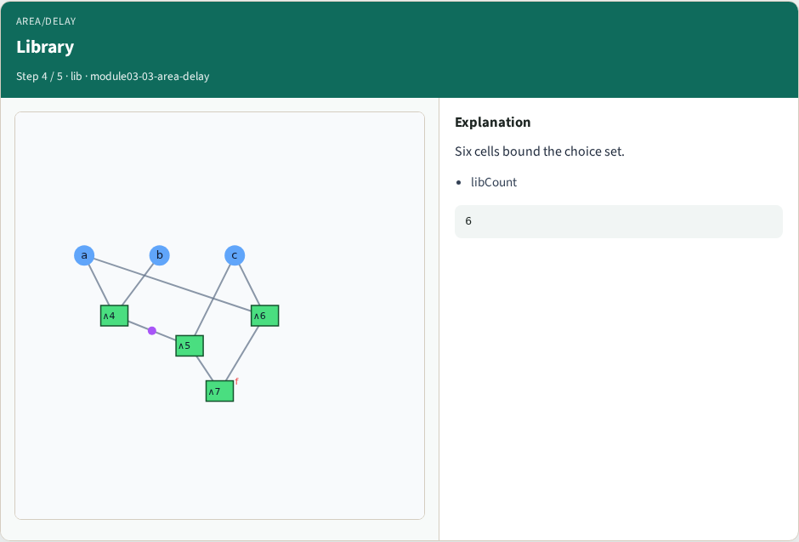
Library
Library
learn_synthesis — 03 area delay
Notes:
Six cells bound the choice set.

Slide 7
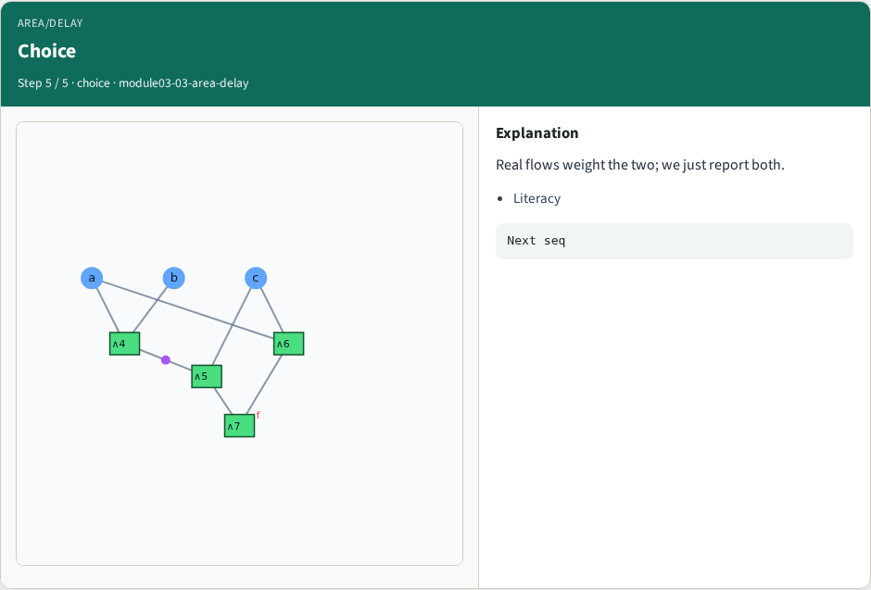
Choice
Choice
learn_synthesis — 03 area delay
Notes:
Real flows weight the two; we just report both.

Slide 8
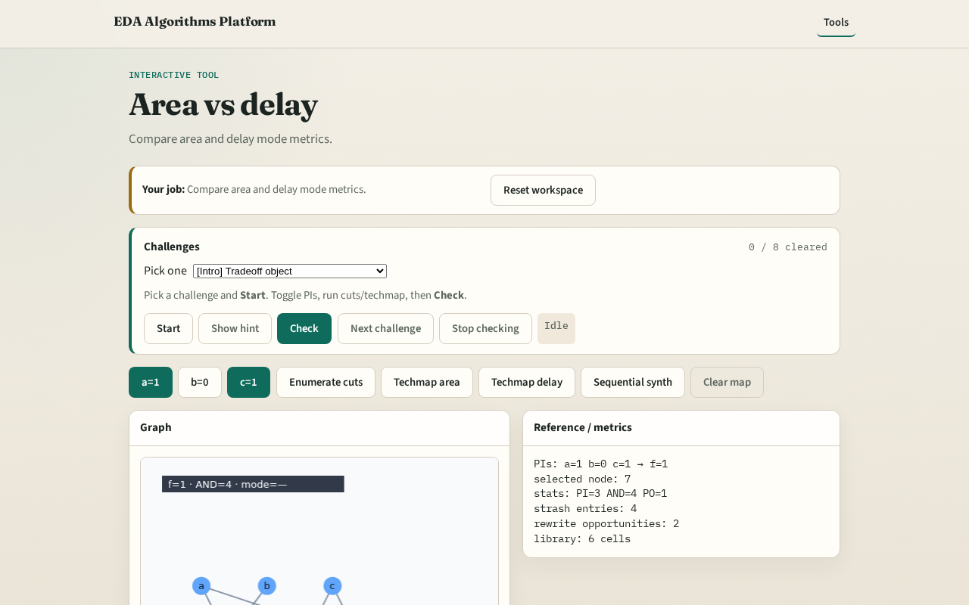
Browser lab track
Browser lab starter
learn_synthesis — 03 area delay
Notes:
Open **area-delay**. Run both techmap buttons; compare metrics.

Slide 9
Implement track
Call area_delay_tradeoff; print both modes
learn_synthesis — 03 area delay
Notes:
Call area_delay_tradeoff; print both modes.

Slide 10
Pitfalls
Treating delay_sum as critical path blindly
Ignoring depth
learn_synthesis — 03 area delay
Notes:
Treating delay_sum as critical path blindly. Ignoring depth.

Slide 11
Your turn
Next: full sequential synth pass
learn_synthesis — 03 area delay
Notes:
Next: full sequential synth pass.

