Slide 1
Sequential
A full pass chains cleanup and mapping like a tiny ABC script
learn_synthesis — 01 sequential synth
Notes:
A full pass chains cleanup and mapping like a tiny ABC script.

Slide 2
The idea
Sequential_synth returns stats, strash size, rewrite, cuts, mapping, tradeoff
learn_synthesis — 01 sequential synth
Notes:
sequential_synth returns stats, strash size, rewrite, cuts, mapping, tradeoff.

Slide 3
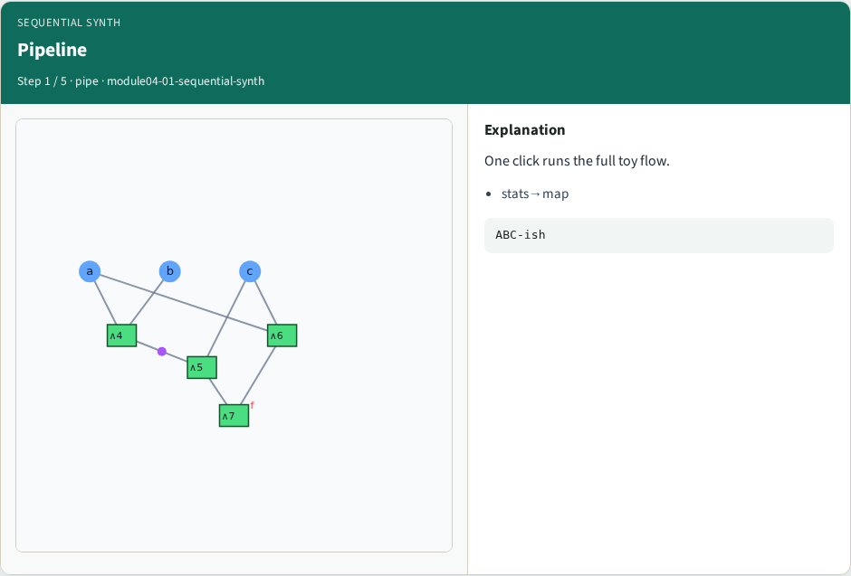
Pipeline
Pipeline
learn_synthesis — 01 sequential synth
Notes:
One click runs the full toy flow.

Slide 4
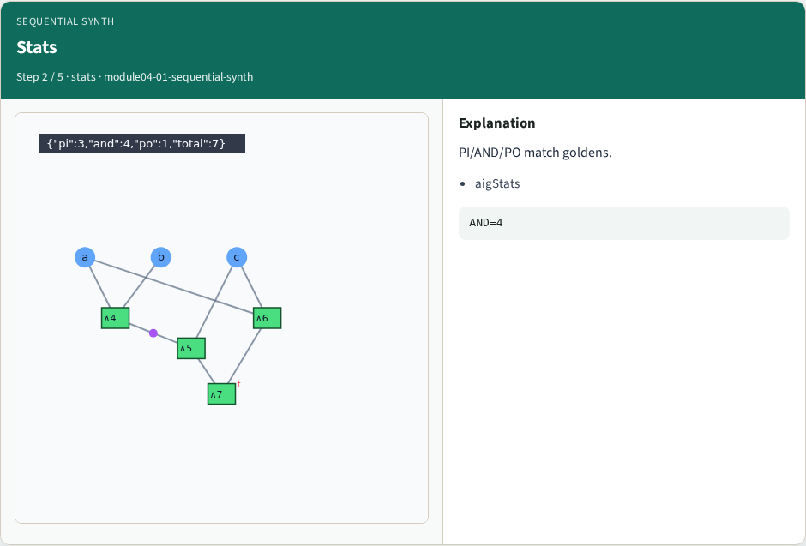
Stats
Stats
learn_synthesis — 01 sequential synth
Notes:
PI/AND/PO match goldens.

Slide 5
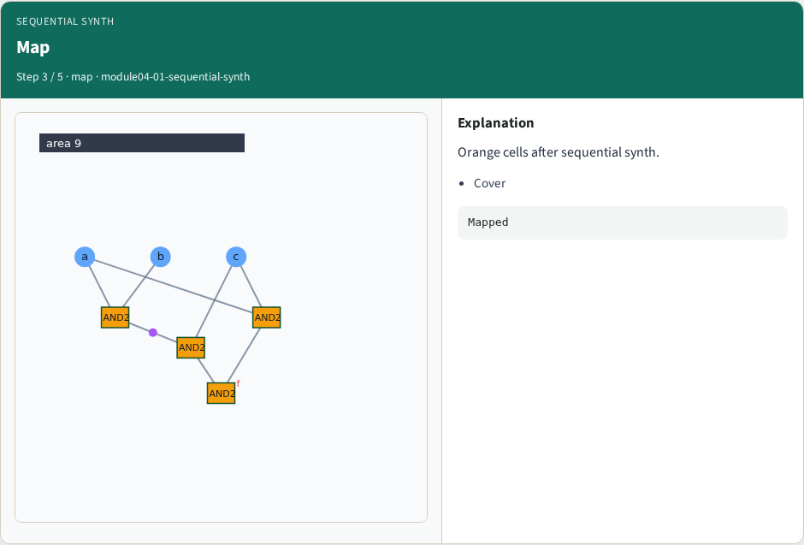
Map
Map
learn_synthesis — 01 sequential synth
Notes:
Orange cells after sequential synth.

Slide 6
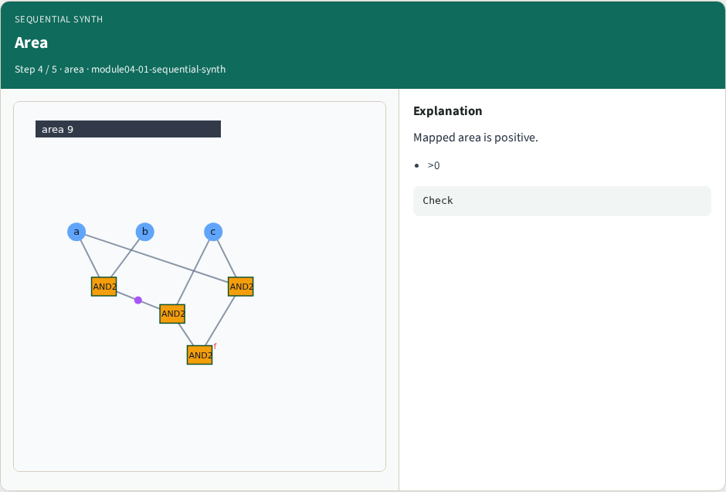
Area
Area
learn_synthesis — 01 sequential synth
Notes:
Mapped area is positive.

Slide 7
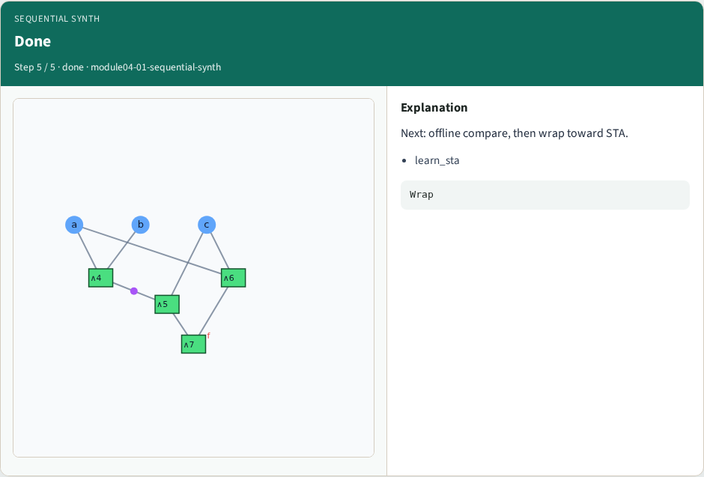
Done
Done
learn_synthesis — 01 sequential synth
Notes:
Next: offline compare, then wrap toward STA.

Slide 8
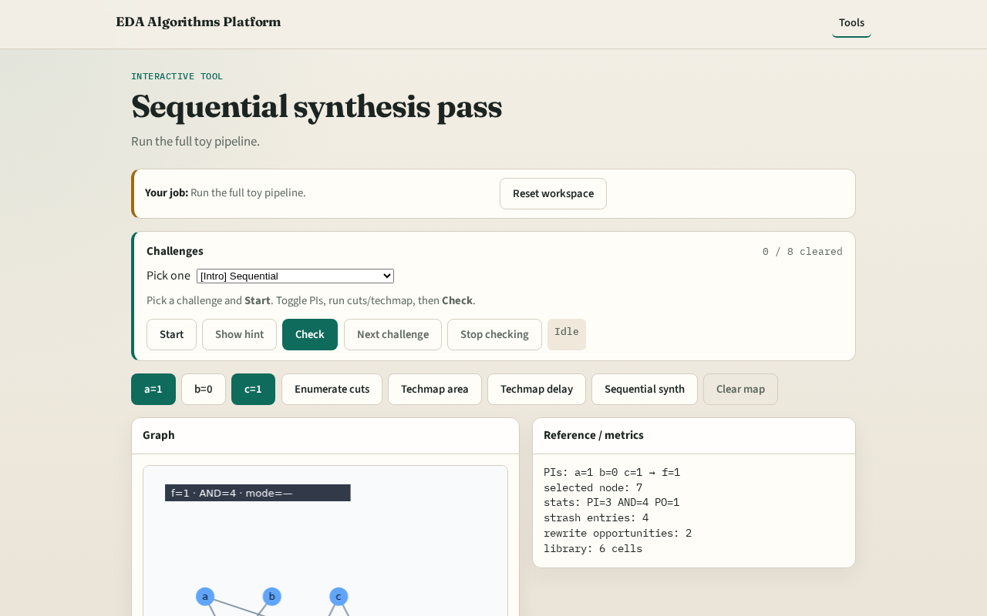
Browser lab track
Browser lab starter
learn_synthesis — 01 sequential synth
Notes:
Open **sequential-synth**. Click Sequential synth; confirm area and cuts.

Slide 9
Implement track
Call sequential_synth(data); assert mapping.area > 0
learn_synthesis — 01 sequential synth
Notes:
Call sequential_synth(data); assert mapping.area > 0.

Slide 10
Pitfalls
Skipping strash
Mixing delay and area covers without clearing
learn_synthesis — 01 sequential synth
Notes:
Skipping strash. Mixing delay and area covers without clearing.

Slide 11
Your turn
Next: offline benchmark, then wrap
learn_synthesis — 01 sequential synth
Notes:
Next: offline benchmark, then wrap.

