Slide 1
Rule deck
DRC starts from a rule deck , typed rules with limits on each layer
learn_drc — 01 rule deck
Notes:
DRC starts from a rule deck — typed rules with limits on each layer.

Slide 2
The idea
GOLDEN: rule_count=8
learn_drc — 01 rule deck
Notes:
GOLDEN: rule_count=8.

Slide 3
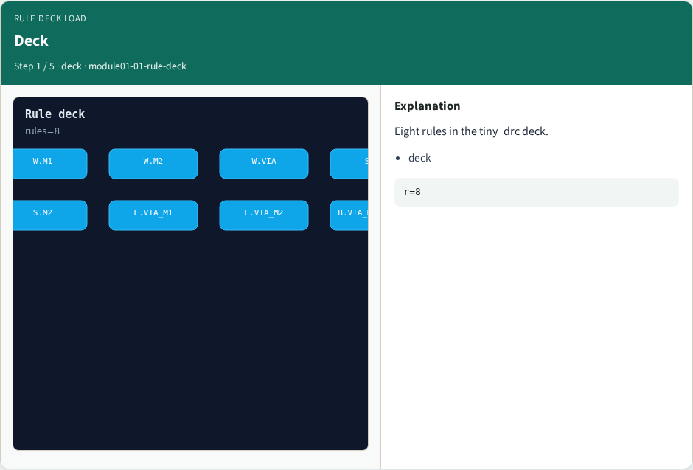
Deck
Deck
learn_drc — 01 rule deck
Notes:
Eight rules in the tiny_drc deck.

Slide 4
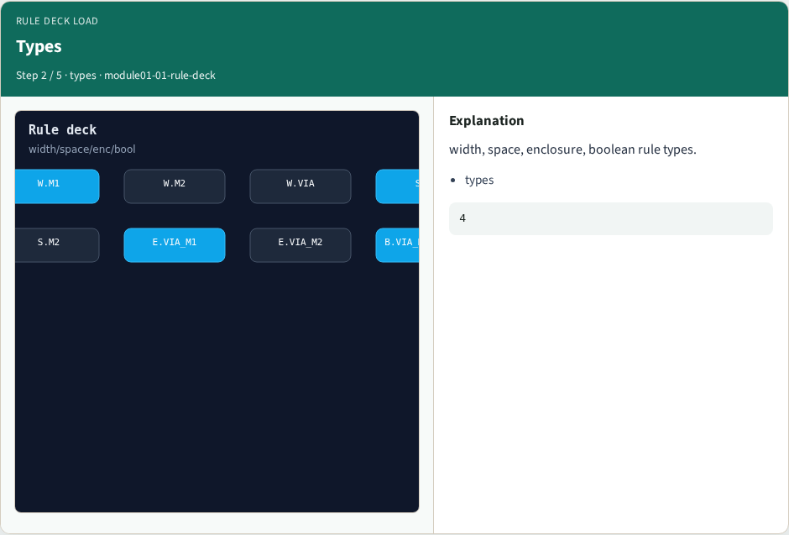
Types
Types
learn_drc — 01 rule deck
Notes:
width, space, enclosure, boolean rule types.

Slide 5
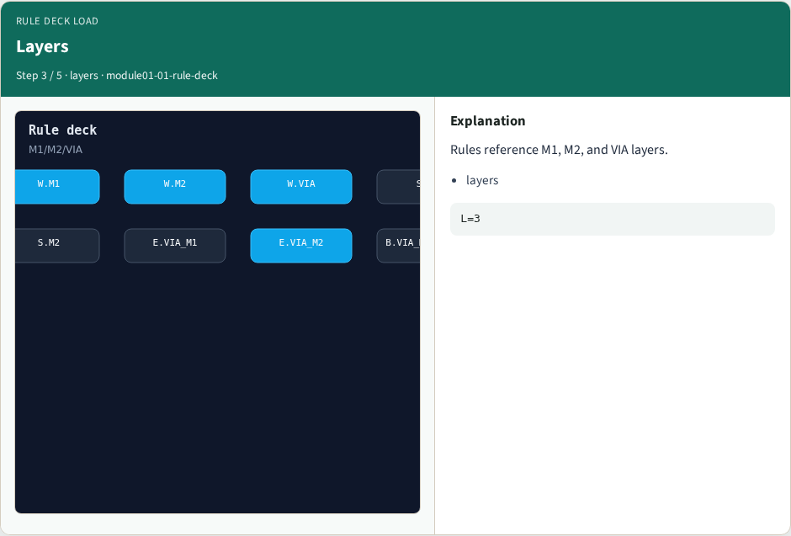
Layers
Layers
learn_drc — 01 rule deck
Notes:
Rules reference M1, M2, and VIA layers.

Slide 6
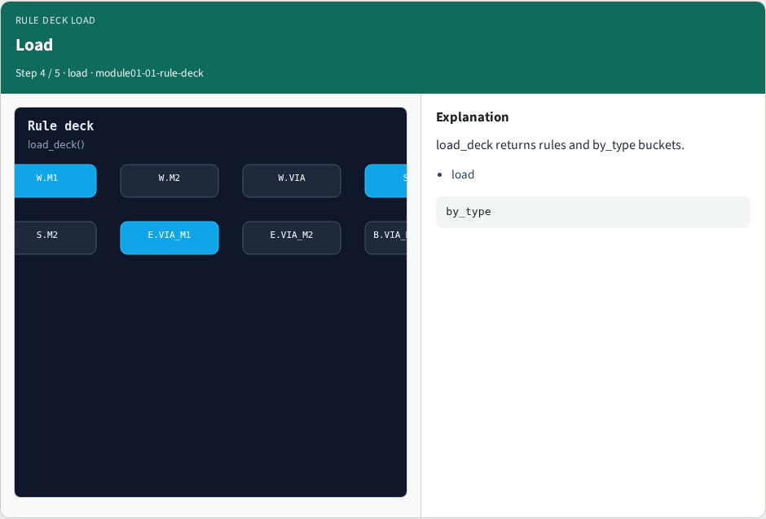
Load
Load
learn_drc — 01 rule deck
Notes:
load_deck returns rules and by_type buckets.

Slide 7
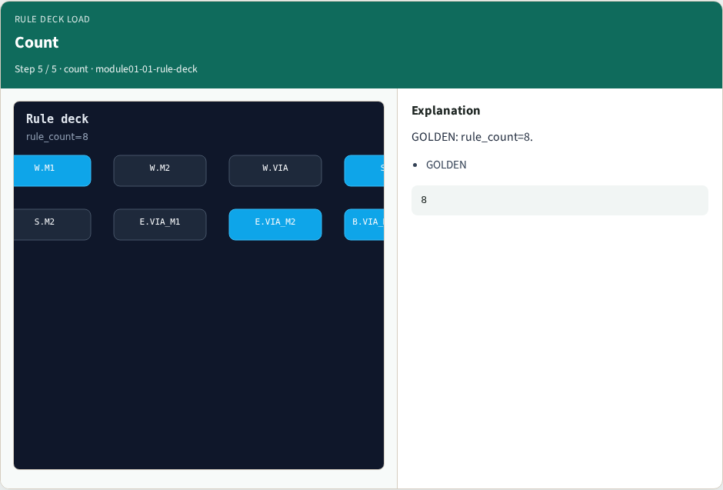
Count
Count
learn_drc — 01 rule deck
Notes:
GOLDEN: rule_count=8.

Slide 8
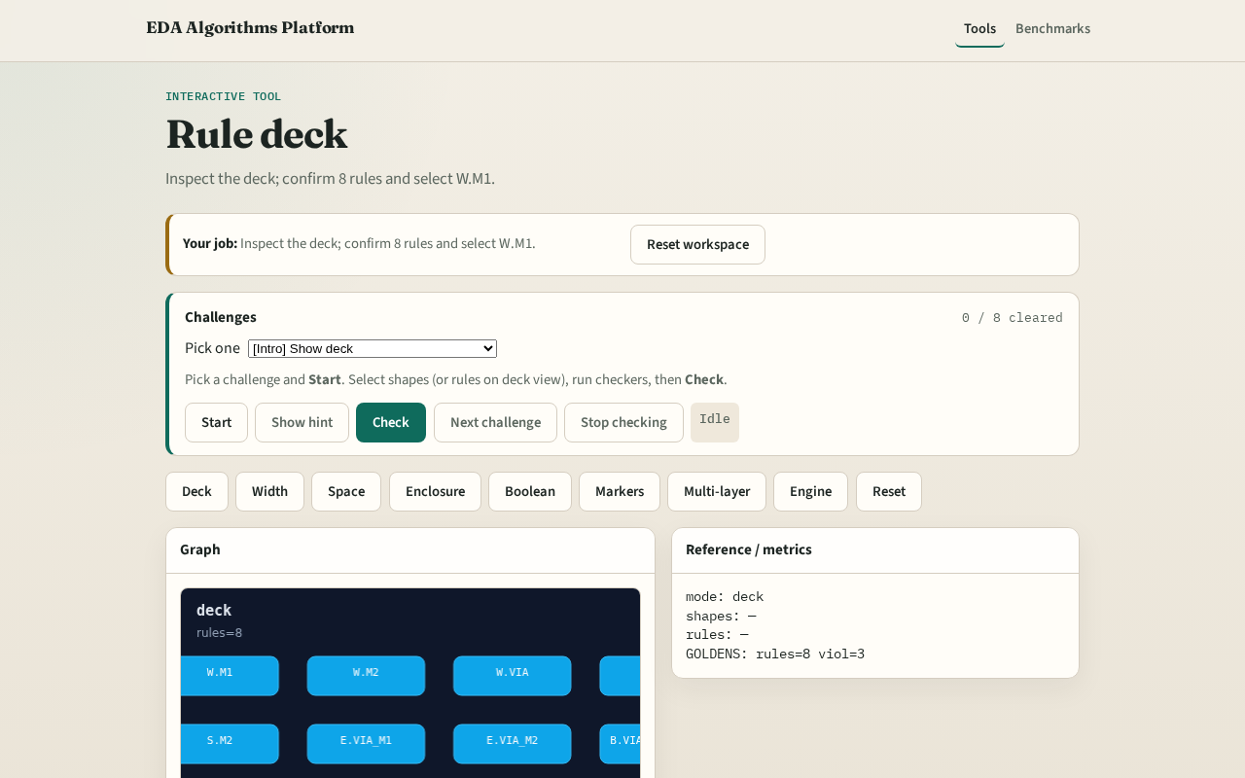
Browser lab track
Browser lab starter
learn_drc — 01 rule deck
Notes:
Open **rule-deck**. Inspect the deck; confirm 8 rules.

Slide 9
Implement track
Call load_deck(); assert rule_count==8
learn_drc — 01 rule deck
Notes:
Call load_deck(); assert rule_count==8.

Slide 10
Pitfalls
Counting shapes as rules
Ignoring boolean rules in the total
learn_drc — 01 rule deck
Notes:
Counting shapes as rules. Ignoring boolean rules in the total.

Slide 11
Your turn
Next: width checker
learn_drc — 01 rule deck
Notes:
Next: width checker.

