Slide 1
Width
Width rules flag shapes whose min(width,height) is below the deck limit
learn_drc — 03 width checker
Notes:
Width rules flag shapes whose min(width,height) is below the deck limit.

Slide 2
The idea
GOLDEN: width viol=1 on D, rule W.M1
learn_drc — 03 width checker
Notes:
GOLDEN: width viol=1 on D, rule W.M1.

Slide 3
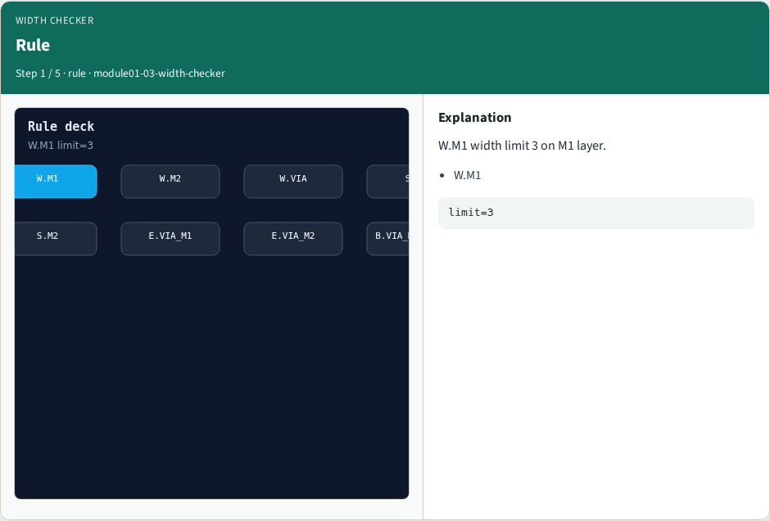
Rule
Rule
learn_drc — 03 width checker
Notes:
W.M1 width limit 3 on M1 layer.

Slide 4
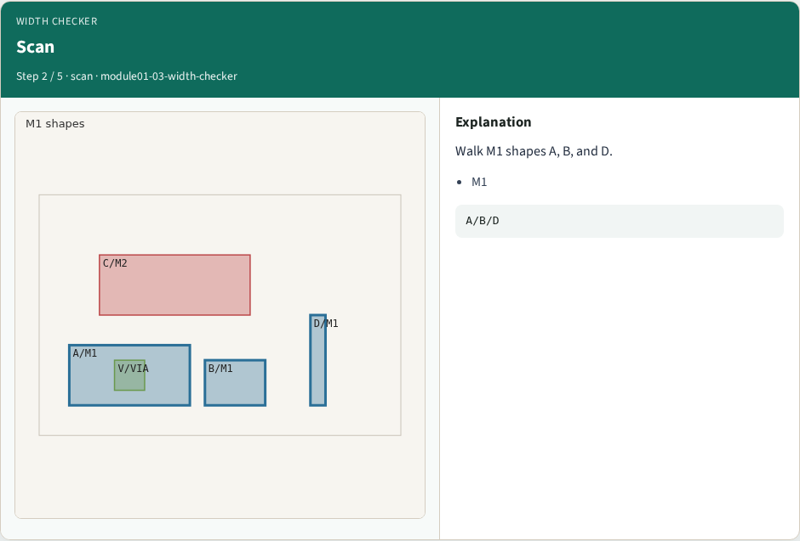
Scan
Scan
learn_drc — 03 width checker
Notes:
Walk M1 shapes A, B, and D.

Slide 5
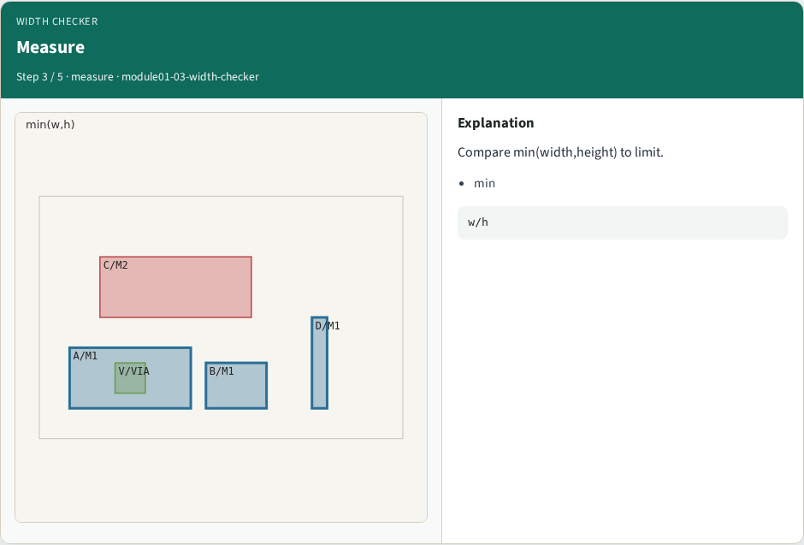
Measure
Measure
learn_drc — 03 width checker
Notes:
Compare min(width,height) to limit.

Slide 6
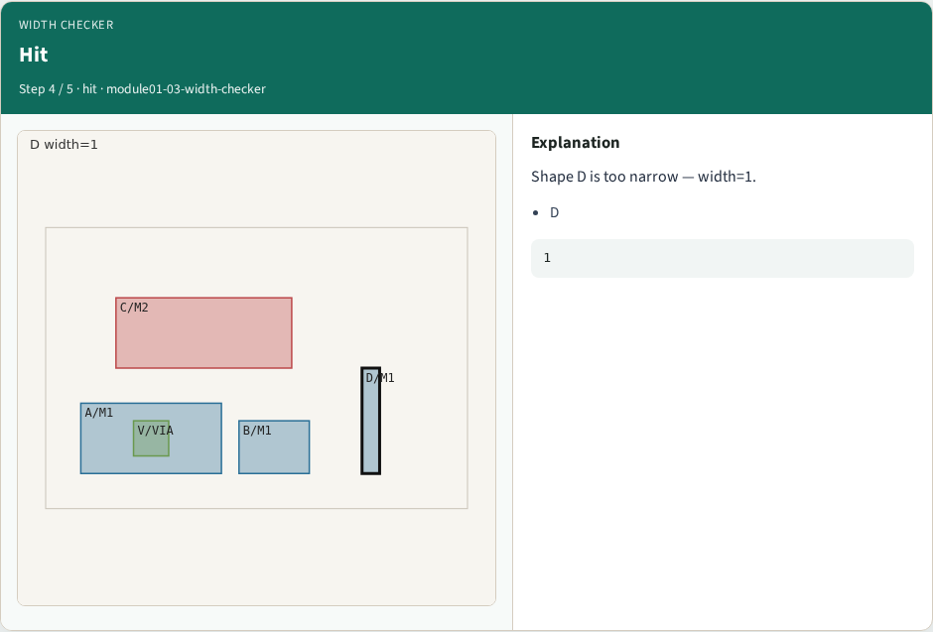
Hit
Hit
learn_drc — 03 width checker
Notes:
Shape D is too narrow — width=1.

Slide 7

Golden
Golden
learn_drc — 03 width checker
Notes:
GOLDEN: width viol=1, rule W.M1.

Slide 8
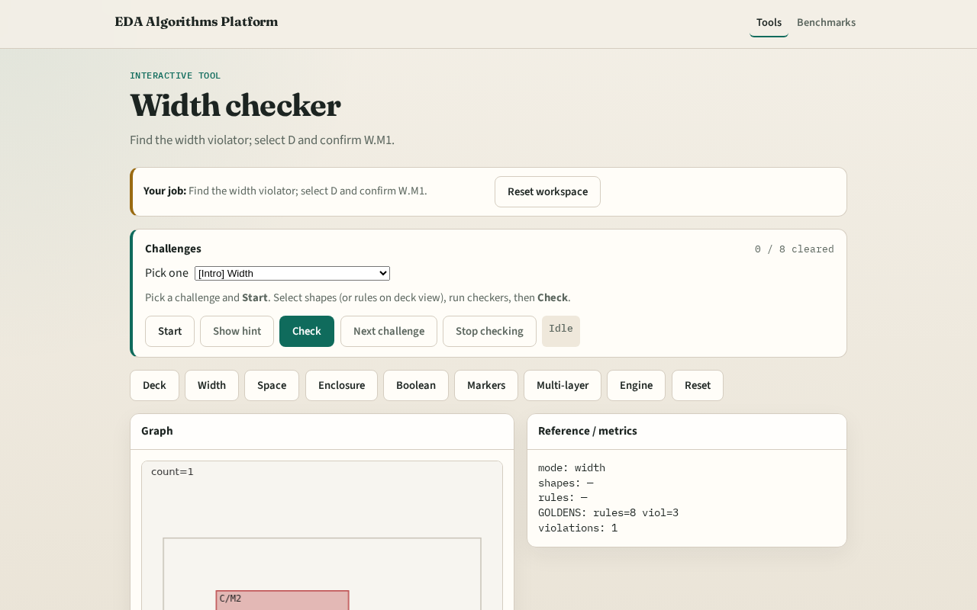
Browser lab track
Browser lab starter
learn_drc — 03 width checker
Notes:
Open **width-checker**. Select D; run width check.

Slide 9
Implement track
Call check_width(); assert count==1 and violations[0].shapes==['D']
learn_drc — 03 width checker
Notes:
Call check_width(); assert count==1 and violations[0].shapes==['D'].

Slide 10
Pitfalls
Using max edge instead of min dimension
Missing rule_id on violations
learn_drc — 03 width checker
Notes:
Using max edge instead of min dimension. Missing rule_id on violations.

Slide 11
Your turn
Next: spacing checker
learn_drc — 03 width checker
Notes:
Next: spacing checker.

